Slide 1
CSC422: Machine and Deep Learning
Module 1 – Supervised Learning
Robert Moseley (rmoseley@calbaptist.edu)
California Baptist University
Slides provided by

Slide 2
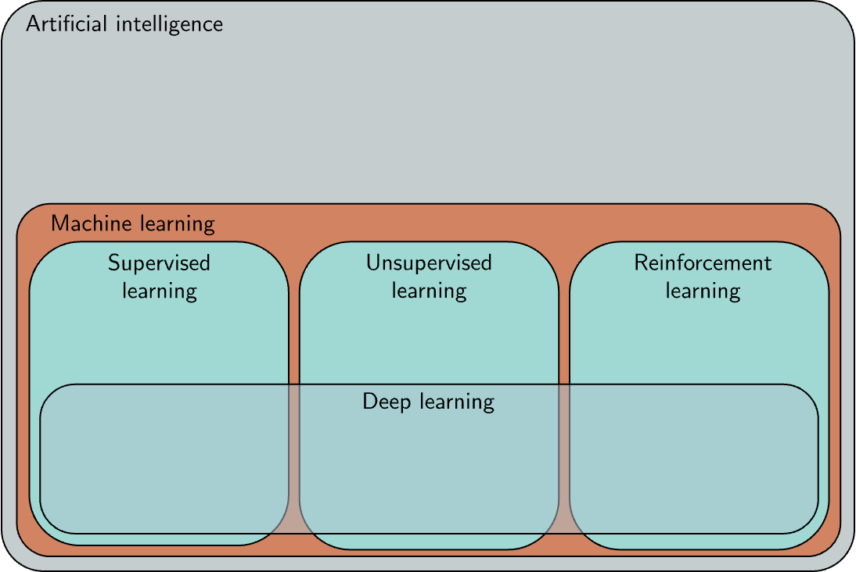

Slide 3
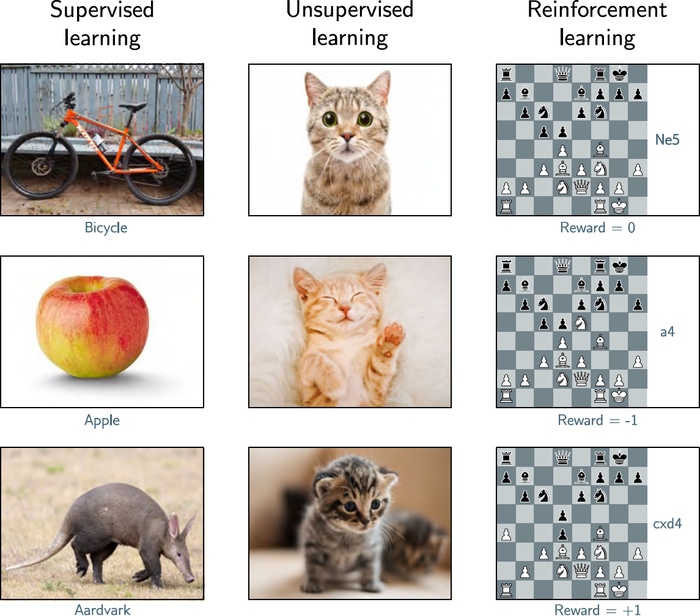

Slide 8
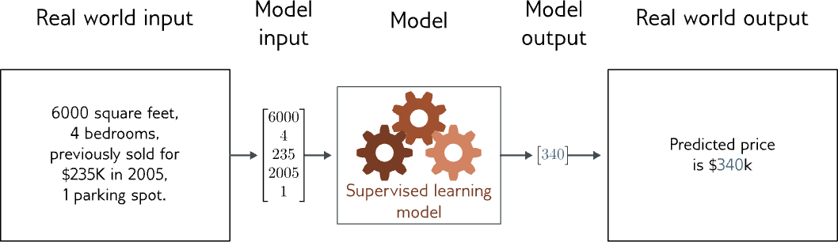
Regression
Univariate regression problem (one output, real value)

Slide 9
Supervised learning
Overview
Notation
  Model
  Loss function
  Training
  Testing
1D Linear regression example
  Model
  Loss function
  Training
  Testing
Where are we going?

Slide 10
Supervised learning
Overview
Notation
  Model
  Loss function
  Training
  Testing
1D Linear regression example
  Model
  Loss function
  Training
  Testing
Where are we going?

Slide 11
Supervised learning overview
Supervised learning model = mapping from one or more inputs to one or more outputs
Model is a mathematical equation
Computing the inputs from the outputs = inference

Slide 12
Supervised learning overview
Supervised learning model = mapping from one or more inputs to one or more outputs
Model is a mathematical equation
Computing the inputs from the outputs = inference
Example:
  Input is age and milage of secondhand Toyota Prius
  Output is estimated price of car

Slide 13
Supervised learning overview
Supervised learning model = mapping from one or more inputs to one or more outputs
Model is a mathematical equation
Computing the inputs from the outputs = inference

Slide 14
Supervised learning overview
Supervised learning model = mapping from one or more inputs to one or more outputs
Model is a mathematical equation
Computing the inputs from the outputs = inference
Model also includes parameters
Parameters affect outcome of equation

Slide 15
Supervised learning overview
Supervised learning model = mapping from one or more inputs to one or more outputs
Model is a mathematical equation
Model is a family of equations
Computing the inputs from the outputs = inference
Model also includes parameters
Parameters affect outcome of equation

Slide 16
Supervised learning overview
Supervised learning model = mapping from one or more inputs to one or more outputs
Model is a mathematical equation
Model is a family of equations
Computing the inputs from the outputs = inference
Model also includes parameters
Parameters affect outcome of equation

Slide 17
Supervised learning overview
Supervised learning model = mapping from one or more inputs to one or more outputs
Model is a family of equations
blank
Computing the inputs from the outputs = inference
Model also includes parameters
Parameters affect outcome of equation

Slide 18
Supervised learning overview
Supervised learning model = mapping from one or more inputs to one or more outputs
Model is a family of equations
Blank
Computing the inputs from the outputs = inference
Model also includes parameters
Parameters affect outcome of equation
Training a model = finding parameters that predict outputs “well” from inputs for a training dataset of input/output pairs

Slide 19
Supervised learning
Overview
Notation
  Model
  Loss function
  Training
  Testing
1D Linear regression example
  Model
  Loss function
  Training
  Testing
Where are we going?

Slide 20
Notation:
Input:
Output:
Model:
Variables always Roman letters
Normal = scalar
Bold = vector
Capital Bold = matrix
Functions always square brackets
Normal = returns scalar
Bold = returns vector
Capital Bold = returns matrix

Slide 21
Notation example:
Input:
Output:
Model:
Structured or tabular data

Slide 22
Model
Parameters:
Model :
Parameters always Greek letters (phi)

Slide 23
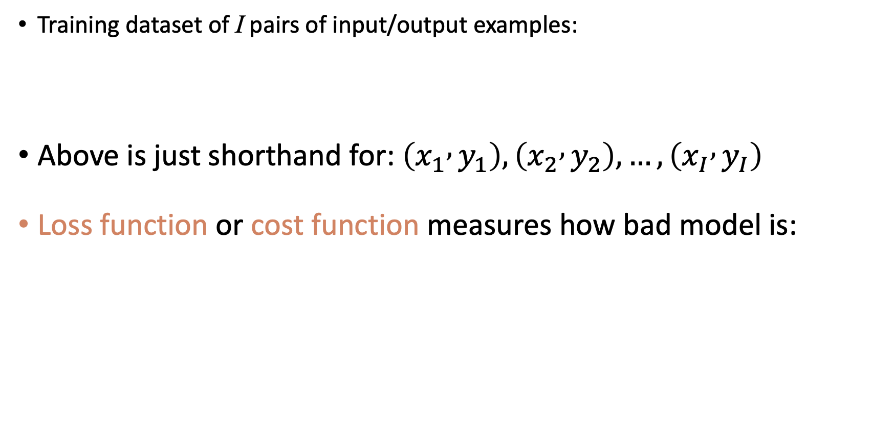
Loss function
Training dataset of I pairs of input/output examples:
Above is just shorthand for: $\left(x_{1} , y_{1}\right),\left(x_{2} , y_{2}\right),…,\left(x_{I} , y_{I}\right)$
Loss function or cost function measures how bad model is:
or for short:
Notes:
\begingroup\color{marginColor}
{\color{black}L\Bigl[\bfphi, }\underbrace{\color{black}\mystrut{2.0ex}\mbox{f}[\bfx,\bfphi]}_{\mbox{model}}, \underbrace{\color{black}\mystrut{2.0ex}\{\bfx_{i},\bfy_{i}\}}_{\mbox{data}}\Bigr]
\endgroup

Slide 24
Loss function
Training dataset of I pairs of input/output examples:
Loss function or cost function measures how bad model is:
or for short:
Returns a scalar that is smaller when model maps inputs to outputs better
Notes:
\begingroup\color{marginColor}
{\color{black}L\Bigl[\bfphi, }\underbrace{\color{black}\mystrut{2.0ex}\mbox{f}[\bfx,\bfphi]}_{\mbox{model}}, \underbrace{\color{black}\mystrut{2.0ex}\{\bfx_{i},\bfy_{i}\}_{i=1}^{I}}_{\mbox{train data}}\Bigr]
\endgroup

Slide 25
Training
Loss function:
Find the parameters that minimize the loss:
Returns a scalar that is smaller when model maps inputs to outputs better

Slide 26
Testing
To test the model, run on a separate test dataset of input / output pairs
See how well it generalizes to new data

Slide 27
Supervised learning
Overview
Notation
  Model
  Loss function
  Training
  Testing
1D Linear regression example
  Model
  Loss function
  Training
  Testing
Where are we going?

Slide 28
Example: 1D Linear regression model
Model:
Parameters
y-offset
slope

Slide 29
Example: 1D Linear regression model
Model:
Parameters
y-offset
slope

Slide 30
Example: 1D Linear regression model
Model:
Parameters
y-offset
slope

Slide 31
Example: 1D Linear regression model
Model:
Parameters
y-offset
slope

Slide 32
Example: 1D Linear regression training data

Slide 33
Example: 1D Linear regression training data
Loss function:
“Least squares loss function”

Slide 34
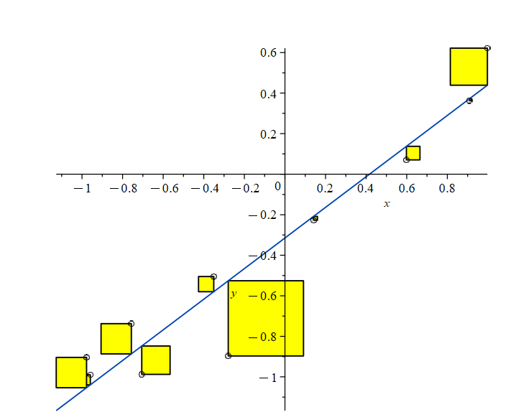
What is least squares error?

Slide 35
Example: 1D Linear regression loss function
Loss function:
“Least squares loss function”

Slide 36
Example: 1D Linear regression loss function
Loss function:
“Least squares loss function”

Slide 37
Example: 1D Linear regression loss function
Loss function:
“Least squares loss function”

Slide 38
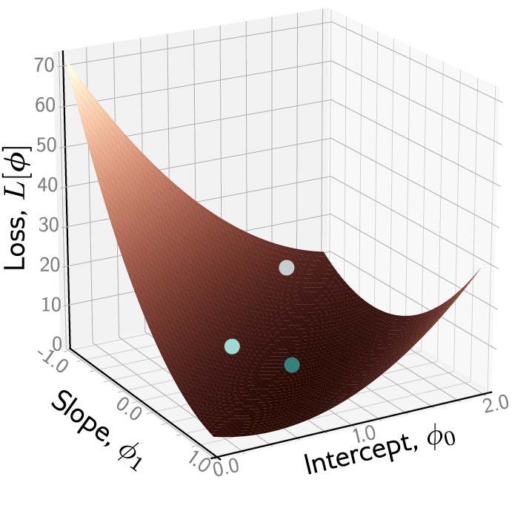
Example: 1D Linear regression loss function
Loss function:
“Least squares loss function”
Notes:
The loss function defines a landscape over the parameters.
Optimization algorithms adjust parameters step by step to move downhill on that landscape.
As parameters improve, the model’s predictions (the line) fit the data better.

Slide 39
Example: 1D Linear regression loss function
Notes:
The loss function defines a landscape over the parameters.
Optimization algorithms adjust parameters step by step to move downhill on that landscape.
As parameters improve, the model’s predictions (the line) fit the data better.

Slide 40
Example: 1D Linear regression loss function
Notes:
The loss function defines a landscape over the parameters.
Optimization algorithms adjust parameters step by step to move downhill on that landscape.
As parameters improve, the model’s predictions (the line) fit the data better.

Slide 41
Example: 1D Linear regression loss function
Notes:
The loss function defines a landscape over the parameters.
Optimization algorithms adjust parameters step by step to move downhill on that landscape.
As parameters improve, the model’s predictions (the line) fit the data better.

Slide 42
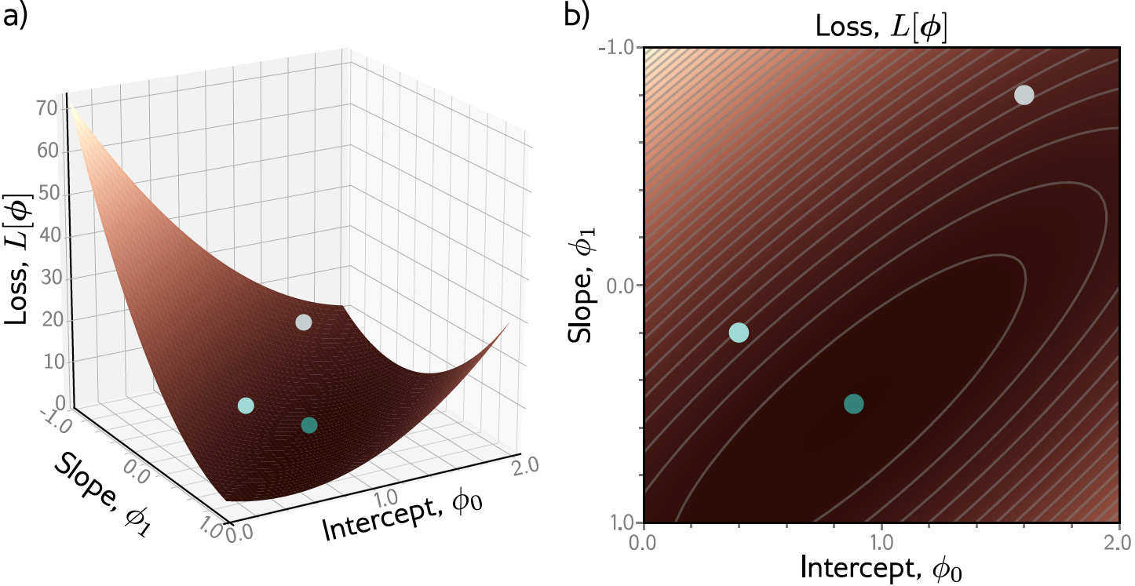
Example: 1D Linear regression loss function
Notes:
The loss function defines a landscape over the parameters.
Optimization algorithms adjust parameters step by step to move downhill on that landscape.
As parameters improve, the model’s predictions (the line) fit the data better.

Slide 43
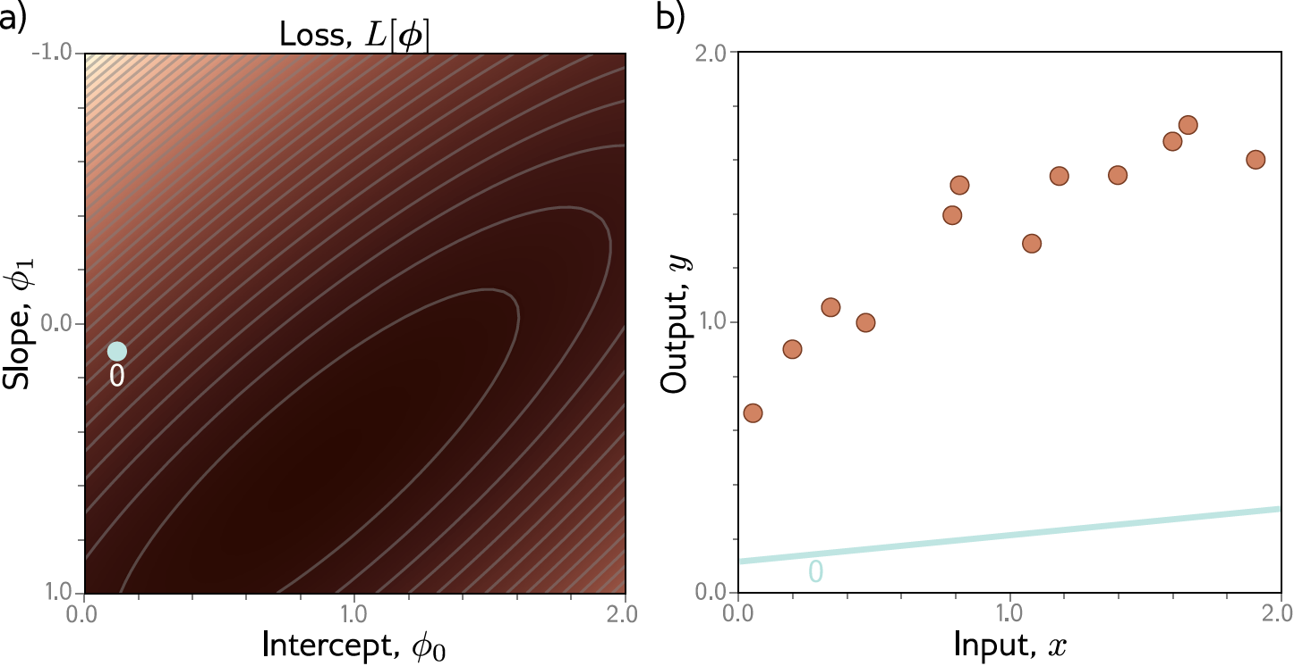
Example: 1D Linear regression training

Slide 44
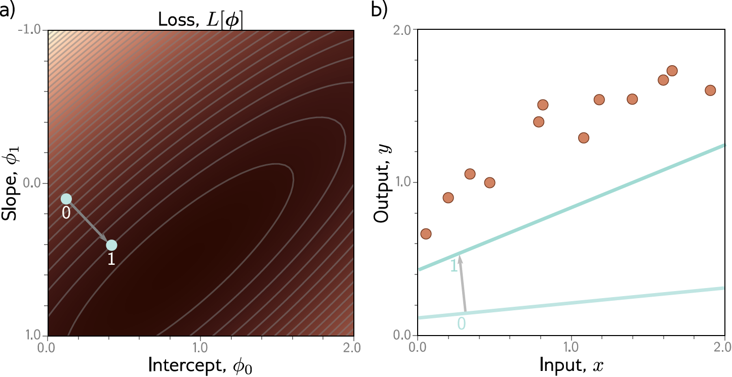
Example: 1D Linear regression training

Slide 45
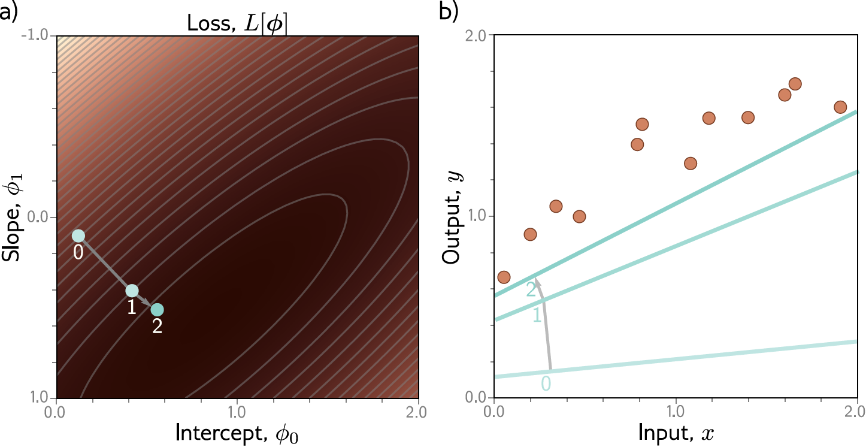
Example: 1D Linear regression training

Slide 46

Example: 1D Linear regression training

Slide 47
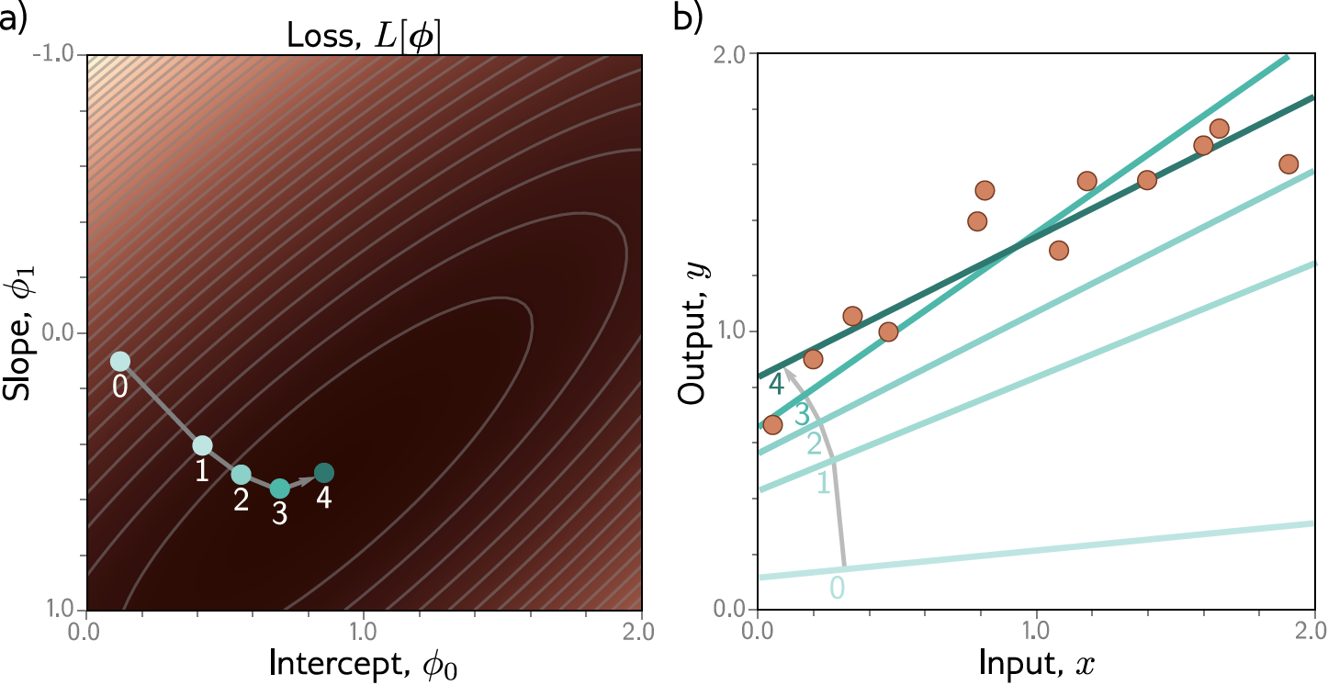
Example: 1D Linear regression training
This technique is known as gradient descent
Notes:
The loss function defines a landscape over the parameters.
Optimization algorithms adjust parameters step by step to move downhill on that landscape.
As parameters improve, the model’s predictions (the line) fit the data better.

Slide 48
Possible objections
But you can fit the line model in closed form!
  Yes – but we won’t be able to do this for more complex models
But we could exhaustively try every slope and intercept combo!
  Yes – but we won’t be able to do this when there are a million parameters

Slide 49
Example: 1D Linear regression testing
Test with different set of paired input/output data
  Measure performance
  Degree to which this is same as training = generalization
Might not generalize well because
  Model too simple
  Model too complex
    fits to statistical peculiarities of data
    this is known as overfitting

Slide 50
Supervised learning
Overview
Notation
  Model
  Loss function
  Training
  Testing
1D Linear regression example
  Model
  Loss function
  Training
  Testing
Where are we going?

