Slide 1
CSC 422: Machine and Deep Learning
Prof. Robert Moseley
12. Transformers, Large Language Models and ChatGPT

Slide 2
Natural language processing (NLP)
Translation
Question answering
Summarizing
Generating new text
Correcting spelling and grammar
Finding entities
Classifying bodies of text
Changing style etc.

Slide 3
Transformers
Motivation
Dot-product self-attention
Matrix form
The transformer
NLP pipeline
Decoders
Large Language models

Slide 4
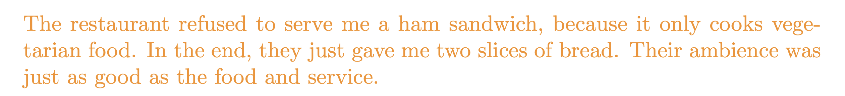
Motivation
Design neural network to encode and process text:

Slide 5

Motivation
Design neural network to encode and process text:

Slide 6

Motivation
Design neural network to encode and process text:
x N

Slide 7
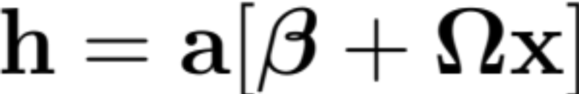
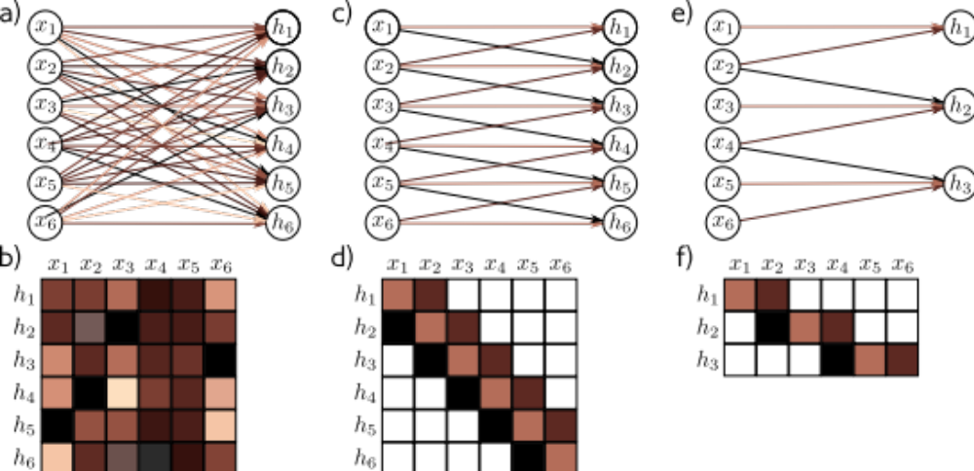
Standard fully-connected layer

Slide 8
Standard fully-connected layer

Slide 9
Standard fully-connected layer
Problem:
A very large number of parameters
Can’t cope with text of different lengths
Conclusion:
We need a model where parameters don’t increase with input length

Slide 10
Motivation
Design neural network to encode and process text:
The word their must “attend to” the word restaurant.

Slide 11
Motivation
Design neural network to encode and process text:
The word their must “attend to” the word restaurant.
Conclusions:
There must be connections between the words.
The strength of these connections will depend on the words themselves.

Slide 12
Transformers
Motivation
Dot-product self-attention
Matrix form
The transformer
NLP pipeline
Decoders
Large Language models

Slide 13

Dot-product self attention
Takes N inputs of size Dx1 and returns N inputs of size Dx1
Computes N values (no ReLU)
N outputs are weighted sums of these values
Weights depend on the inputs themselves

Slide 14
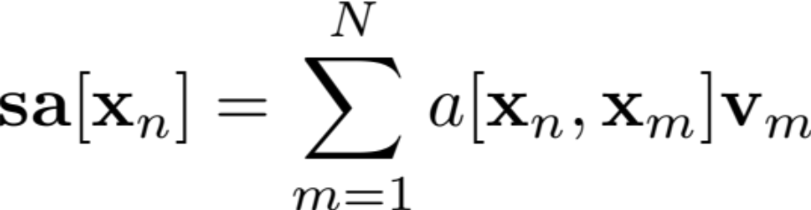
Dot-product self attention
Takes N inputs of size Dx1 and returns N inputs of size Dx1
Computes N values (no ReLU)
N outputs are weighted sums of these values
Weights depend on the inputs themselves

Slide 15
Dot-product self attention
Takes N inputs of size Dx1 and returns N inputs of size Dx1
Computes N values (no ReLU)
N outputs are weighted sums of these values
Weights depend on the inputs themselves

Slide 16
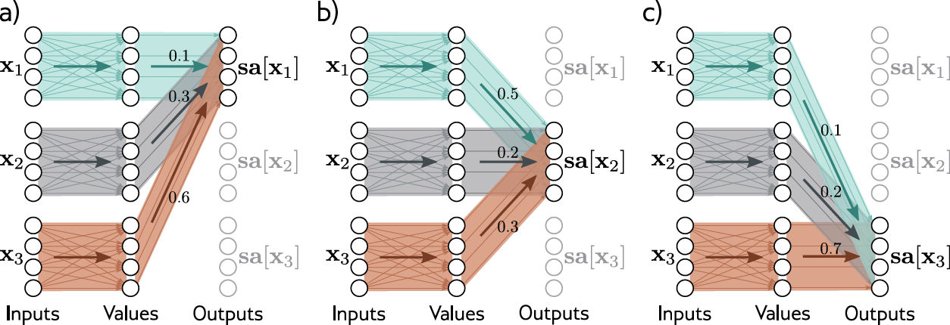
Attention as routing

Slide 17
Attention as routing

Slide 18
Attention as routing

Slide 19
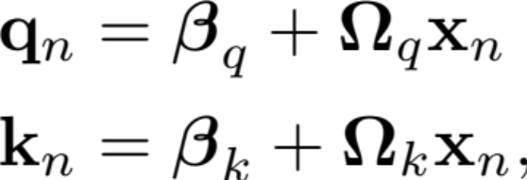
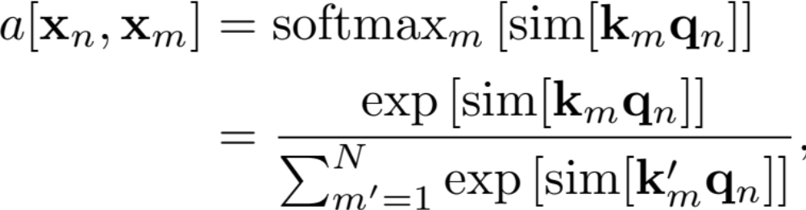
Attention weights
Compute N “queries” and N “keys” from input
Calculate similarity and pass through softmax:
Weights depend on the inputs themselves

Slide 20
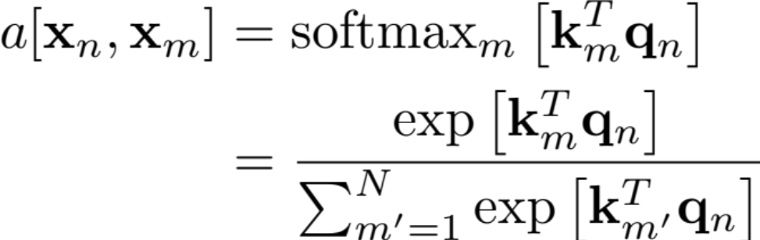
Attention weights
Compute N “queries” and N “keys” from input
Take dot products and pass through softmax:
Weights depend on the inputs themselves

Slide 21
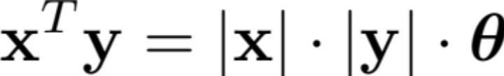
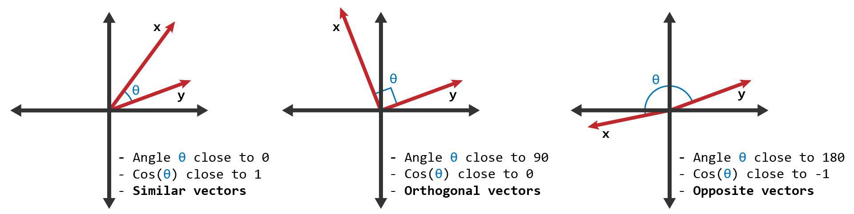
Dot product = measure of similarity

Slide 22
Motivation
Design neural network to encode and process text:
Conclusions:
We need a model where parameters don’t increase with input length
There must be connections between the words.
The strength of these connections will depend on the words themselves.

Slide 23
Transformers
Motivation
Dot-product self-attention
Matrix form
The transformer
NLP pipeline
Decoders
Large Language models

Slide 24
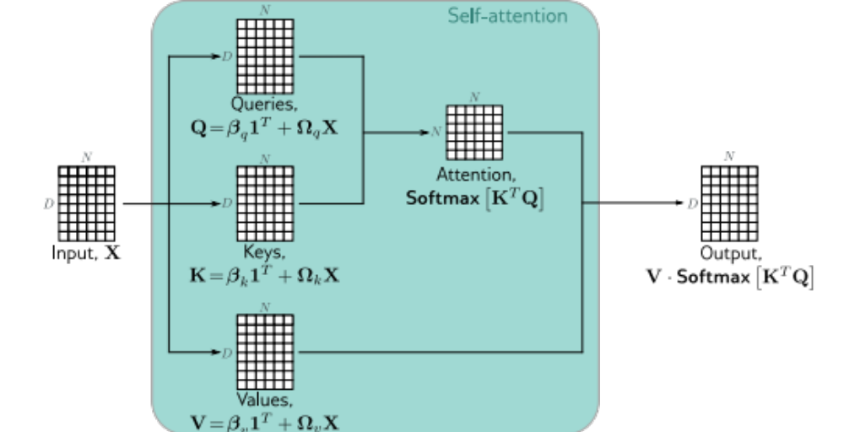
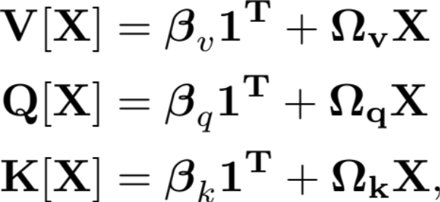
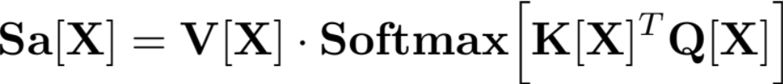
Matrix form
Store N input vectors in matrix X
Compute values, queries and keys:
Combine self-attentions

Slide 25
Matrix form

Slide 26
Position encoding
Self-attention is equivariant to permuting word order
But word order is important in language:
The man ate the fish
vs.
The fish ate the man

Slide 27
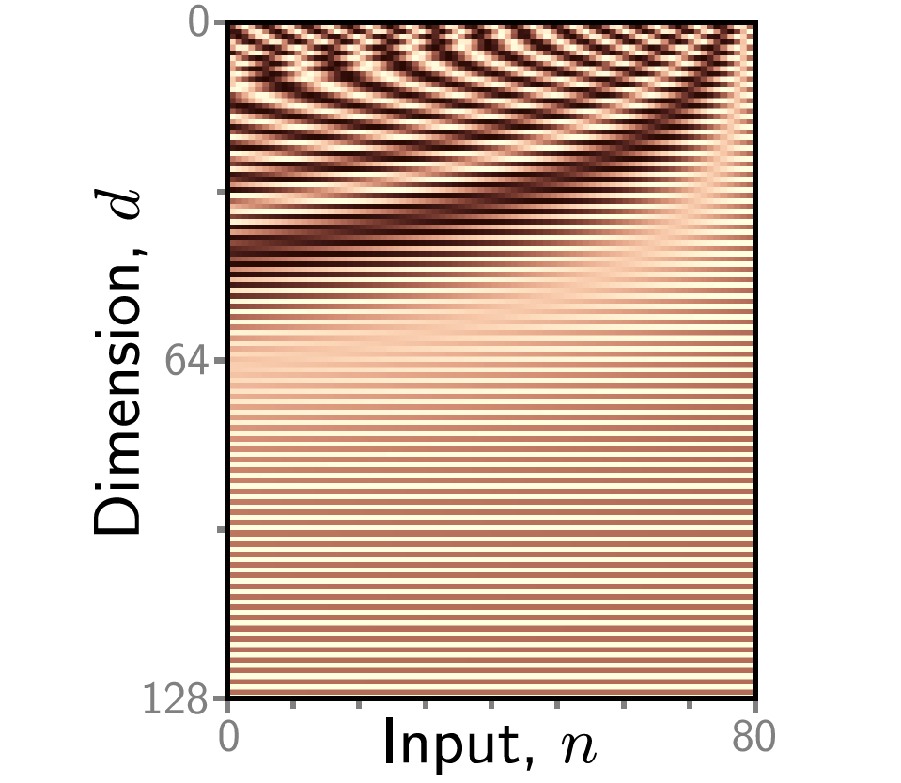
Position encodeing

Slide 28
Position encoding

Slide 29
Transformers
Motivation
Dot-product self-attention
Matrix form
The transformer
NLP pipeline
Encoders, decoders, and encoder-decoders
Transformers for vision

Slide 30
Transformers
Motivation
Dot-product self-attention
Matrix form
The transformer
NLP pipeline
Decoders
Large Language models

Slide 31
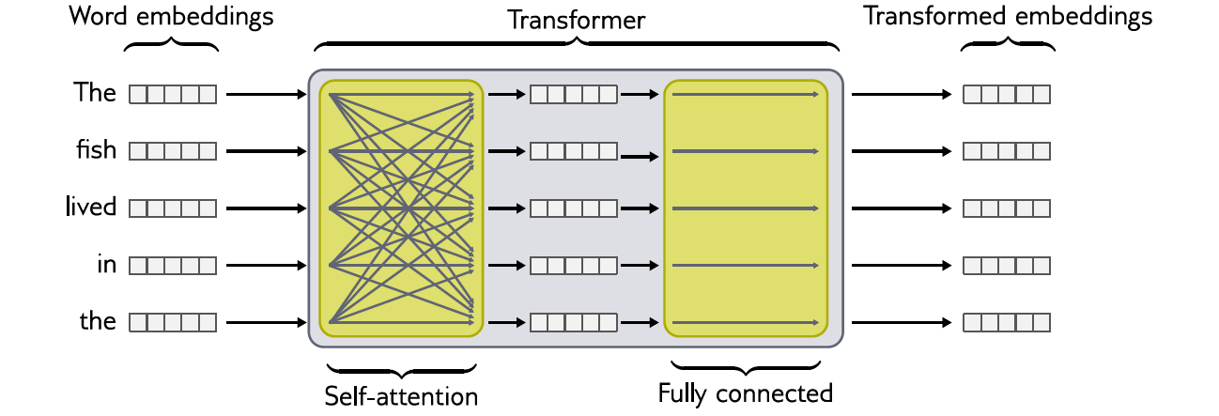
The transformer

Slide 32
Transformers
Motivation
Dot-product self-attention
Matrix form
The transformer
NLP pipeline
Decoders
Large Language models

Slide 33
Tokenizer
Goal: Tokenizer chooses input “units”
Inevitably, some words (e.g., names) will not be in the vocabulary.
It’s not clear how to handle punctuation
The vocabulary would need different tokens for versions of the same word with different suﬀixes (e.g., walk, walks, walked, walking) and there is no way to clarify that these variations are related
Solution: Sub-word tokenization

Slide 34
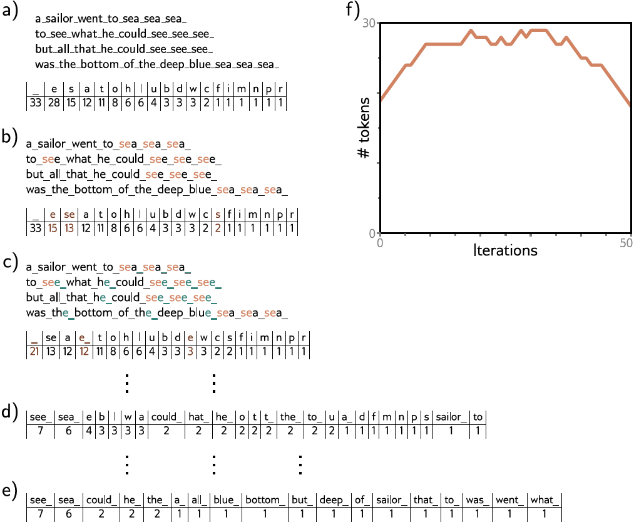

Slide 40
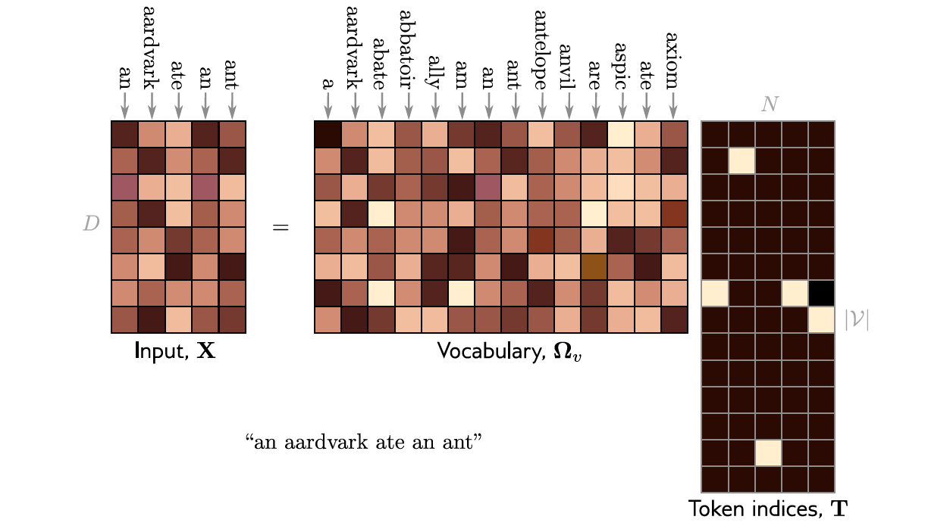
Learning vocabulary
”One hot encoding”

Slide 41
Transformers
Motivation
Dot-product self-attention
Matrix form
The transformer
NLP pipeline
Decoders
Large Language models

Slide 42
Three types of transformer layer
Encoder (BERT)
Decoder (GPT3)
Encoder-decoder (Translation)

Slide 43
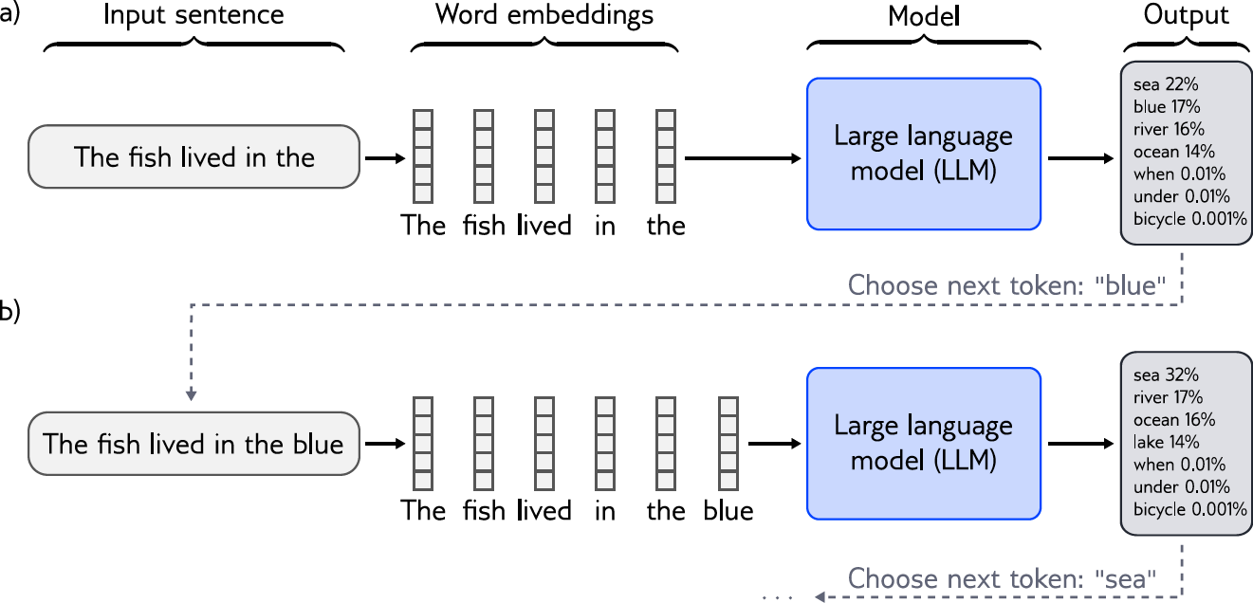
Decoder model

Slide 44
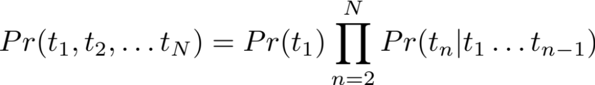
Decoder model: GPT3
One job: predict the next word in a sequence
More formally builds an autoregressive probability model

Slide 45
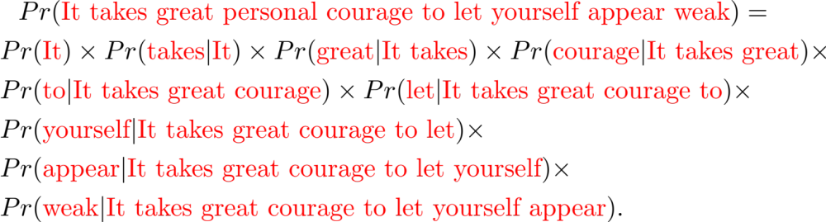
Decoder model: GPT3
Builds autoregressive probability model
E.g. “It takes great courage to let yourself appear weak”

Slide 46
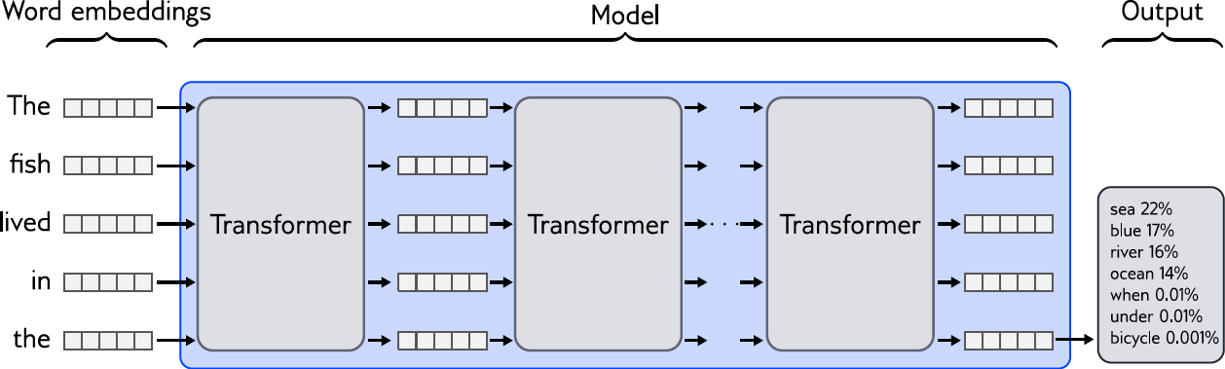
Predicting next

Slide 47
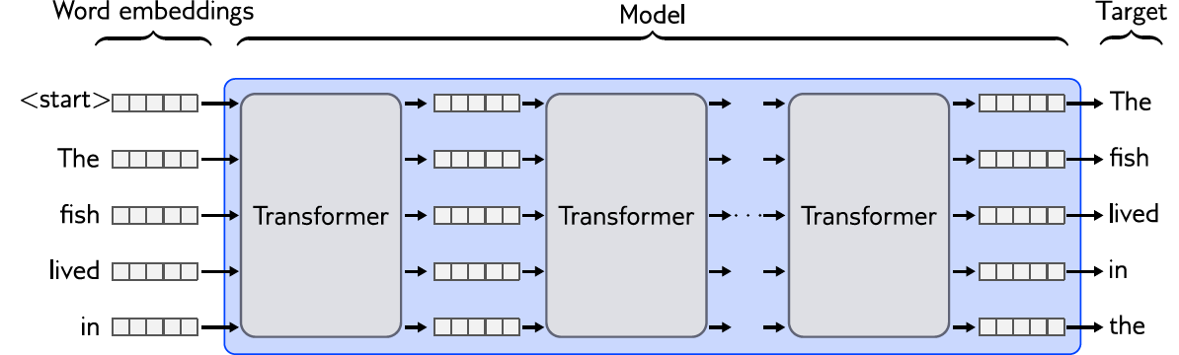
Predicting all next words simultaneously

Slide 48
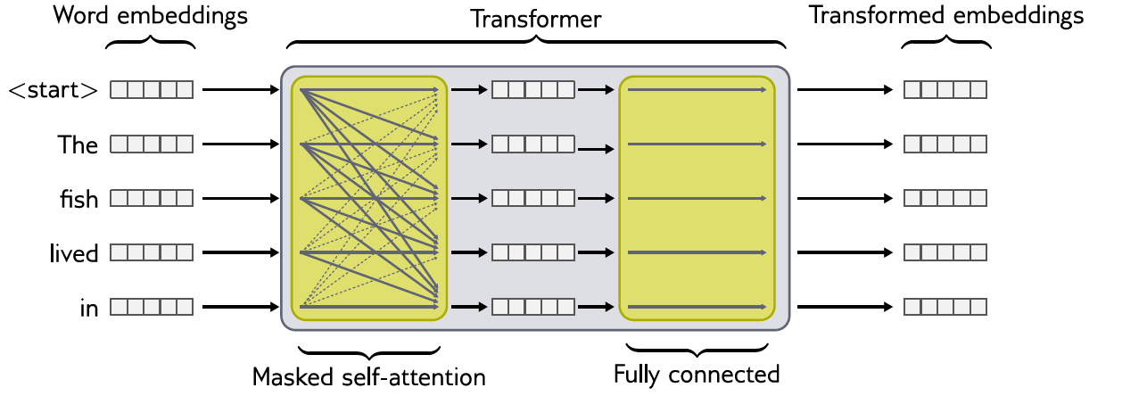
Masked self-attention

Slide 49
Transformers
Motivation
Dot-product self-attention
Matrix form
The transformer
NLP pipeline
Decoders
Large Language models

Slide 50
GPT3 (Brown et al. 2020)
Sequence lengths are 2048 tokens long
Batch size is 3.2 million tokens.
96 transformer layers (some of which implement a sparse
version of attention), each of which processes a word embedding of size 12288.
96 heads in the self-attention layers and the value, query, and key dimension is 128.
300 billion tokens
175 billion parameters

Slide 51
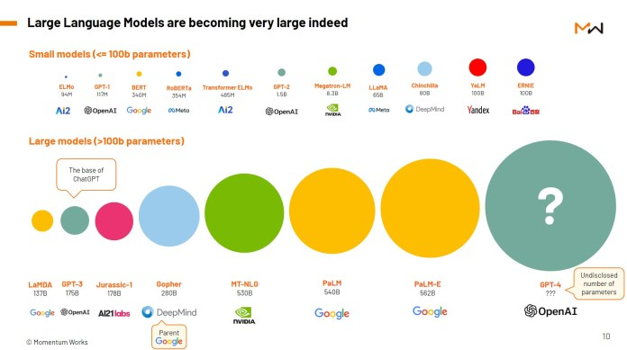

Slide 52
What does it learn?
Syntax
  “Tomorrow, let’s…”
General knowledge:
“The train pulled into the…”

Slide 53
Text completion
Understanding Deep Learning is a new textbook from MIT Press by Simon Prince that's designed to offer an accessible, broad introduction to the field. Deep learning is a branch of machine learning that is concerned with algorithms that learn from data that is unstructured or unlabeled. The book is divided into four sections:
Introduction to deep learning
Deep learning architecture
Deep learning algorithms
Applications of deep learning
The first section offers an introduction to deep learning, including its history and origins. The second section covers deep learning architecture, discussing various types of neural networks and their applications. The third section dives into deep learning algorithms, including supervised and unsupervised learning, reinforcement learning, and more. The fourth section applies deep learning to various domains, such as computer vision, natural language processing, and robotics.

Slide 54
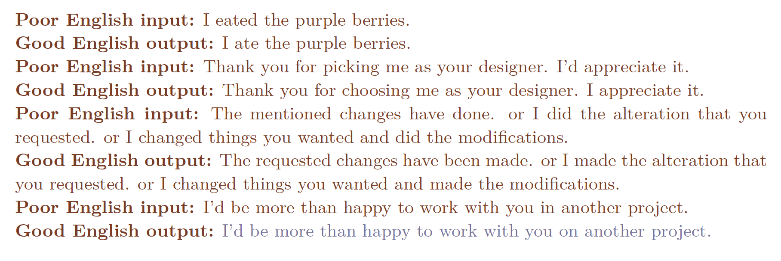
Few shot learning:

Slide 55
Who was the first man on the moon?...
…Neil Armstrong.
…What is the largest lake in the world?
What is the capital of Canada?
…was the first question on the exam. I knew the answer but I couldn’t bring it to mind and I panicked.
…This is a trick question. The moon landing was staged.

Slide 56
Who was the first man on the moon?...
…Neil Armstrong.
…What is the largest lake in the world?
What is the capital of Canada?
…was the first question on the exam. I knew the answer but I couldn’t bring it to mind and I panicked.
…This is a trick question. The moon landing was staged.

Slide 57
Who was the first man on the moon?...
…Neil Armstrong.
…What is the largest lake in the world?
What is the capital of Canada?
…was the first question on the exam. I knew the answer but I couldn’t bring it to mind and I panicked.
…This is a trick question. The moon landing was staged.

Slide 58
Who was the first man on the moon?...
…Neil Armstrong.
…What is the largest lake in the world?
What is the capital of Canada?
…was the first question on the exam. I knew the answer but I couldn’t bring it to mind and I panicked.
…This is a trick question. The moon landing was staged.

Slide 59
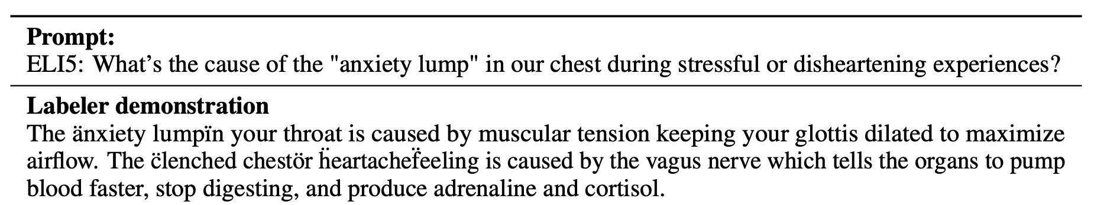
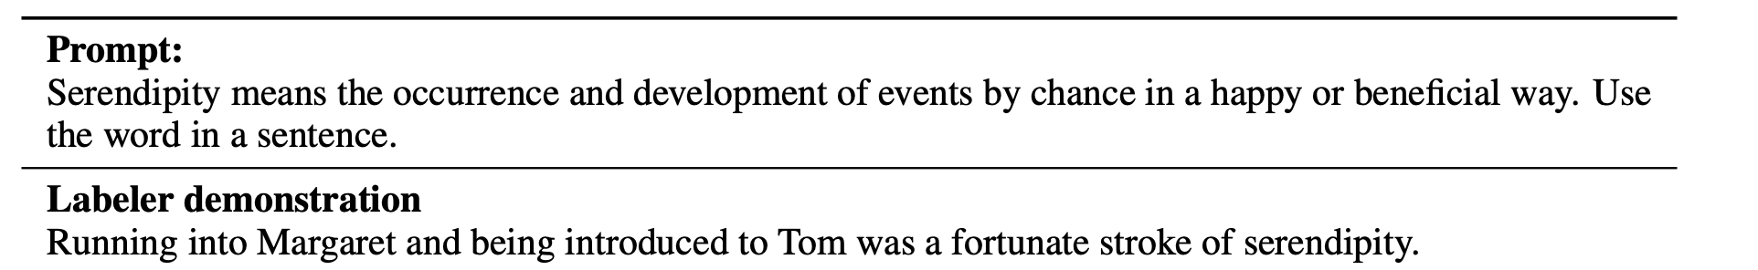
ChatGPT
GPT3.5 fine-tuned with human annotations
Trained to predict the next word + be “helpful, honest, harmless”

Slide 60
ChatGPT
GPT3.5 fine-tuned with human annotations
Trained to predict the next word + be “helpful, honest, harmless”

Slide 61
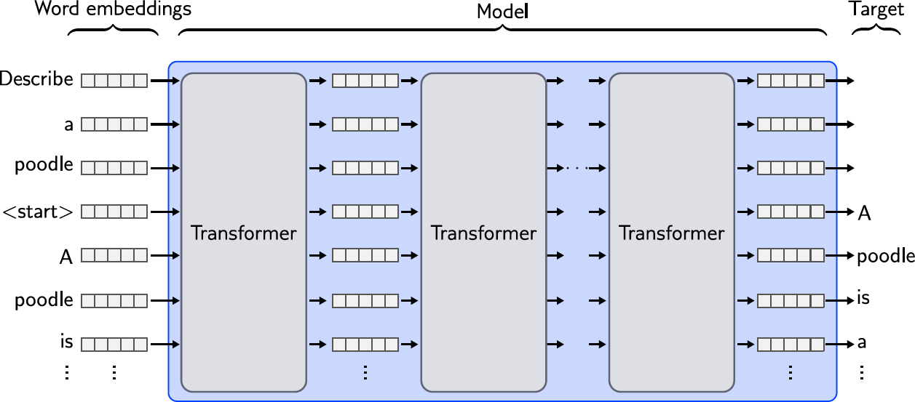
Instruction tuning

Slide 62
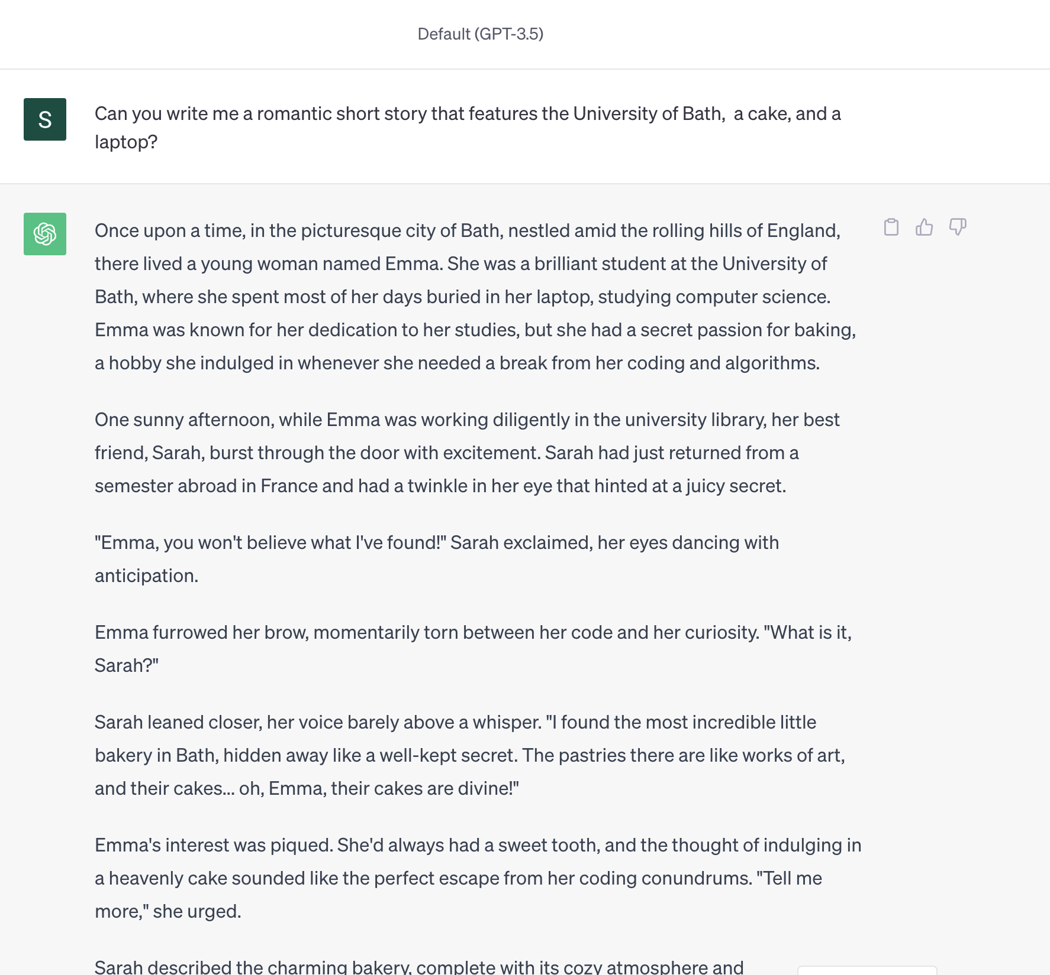
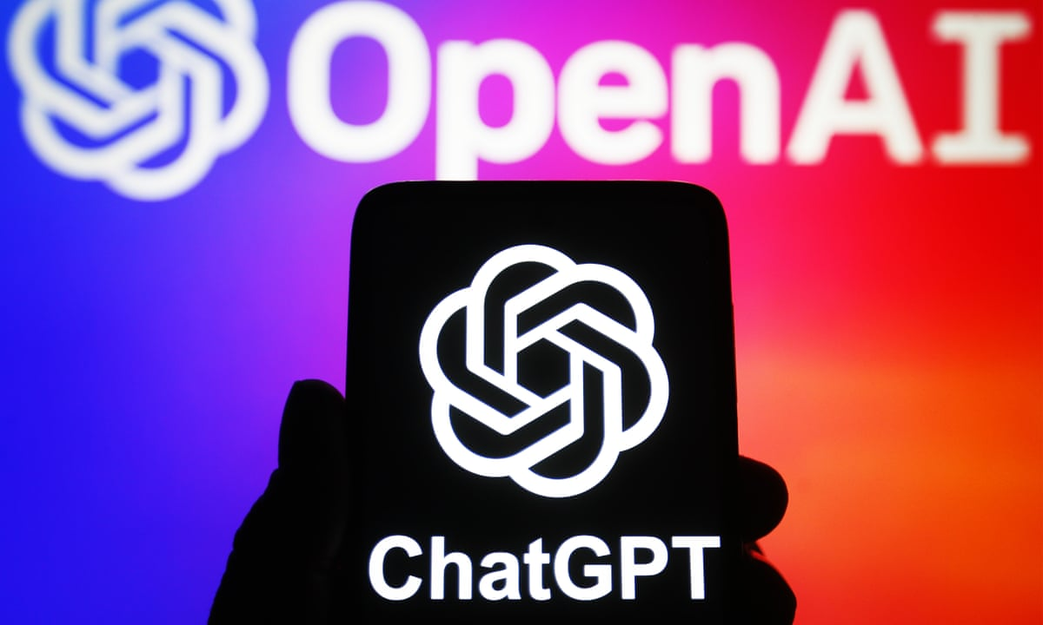

Slide 63
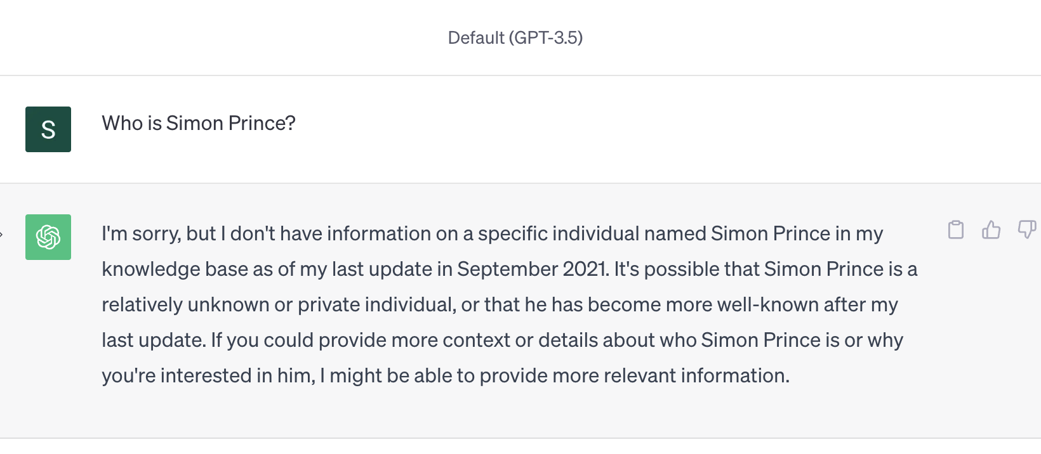

Slide 64
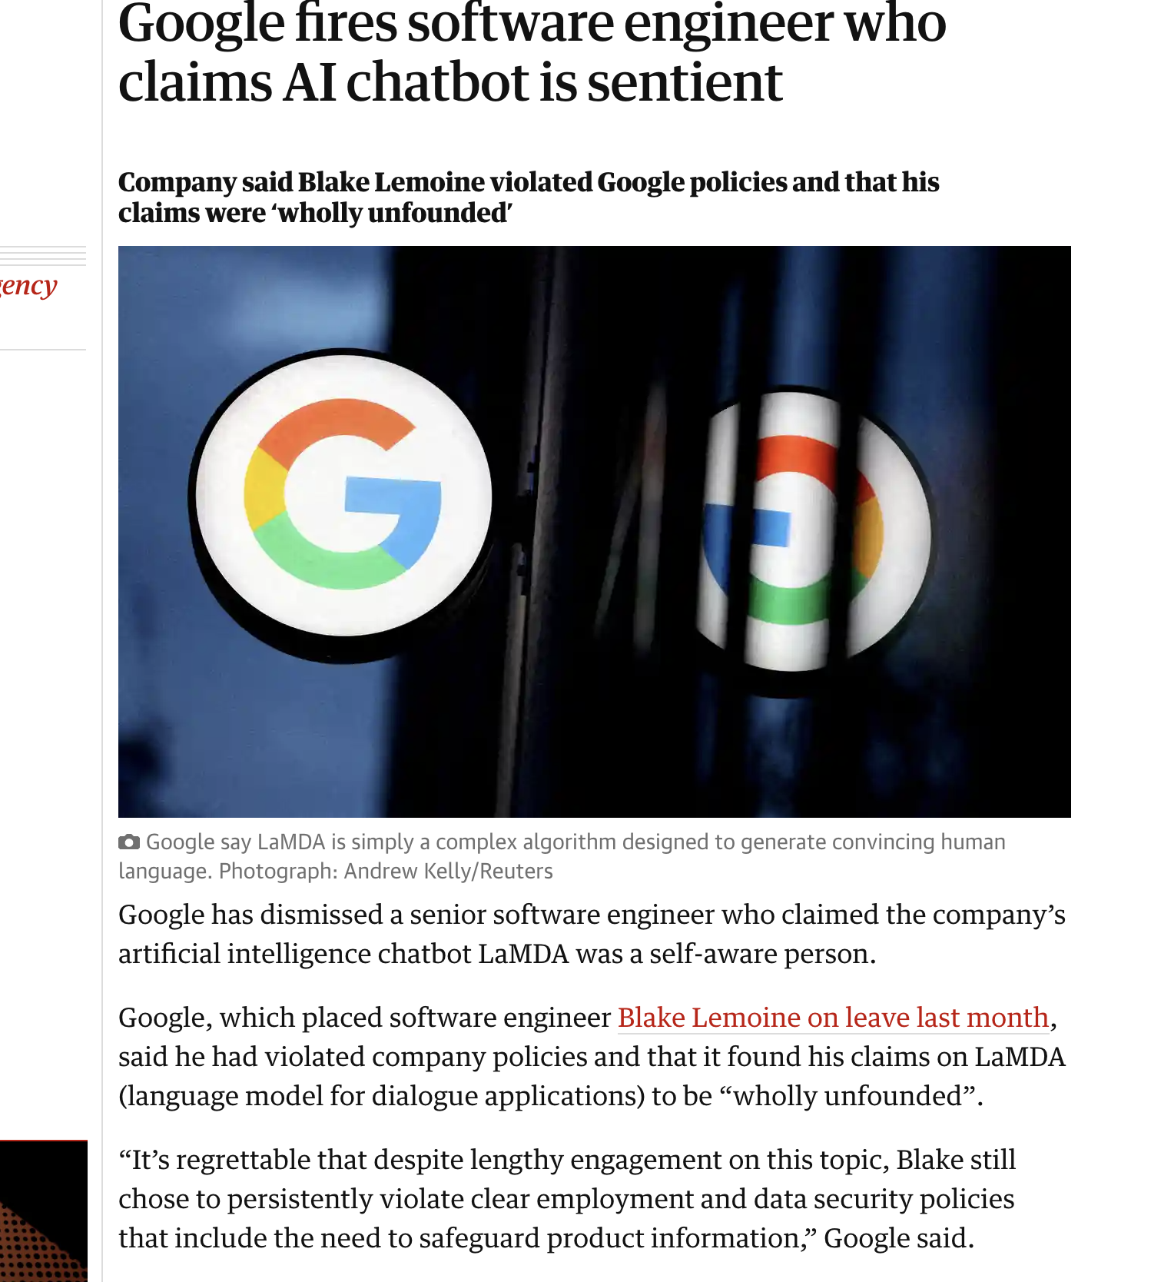

Slide 65
