Slide 1
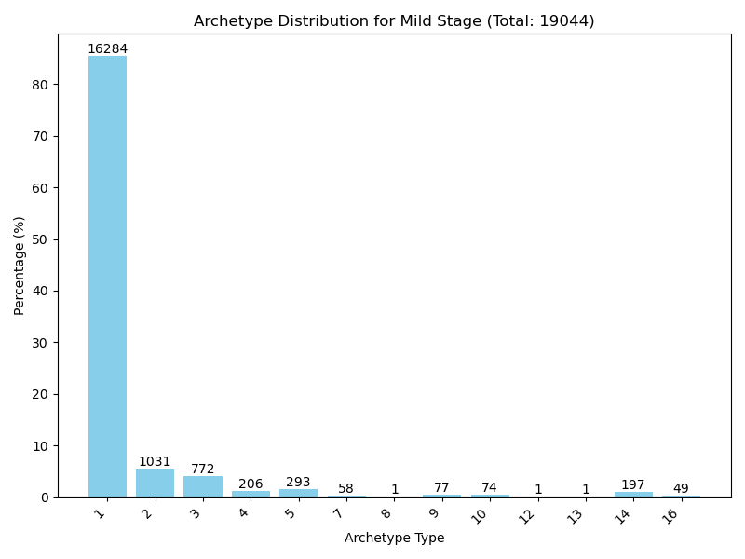
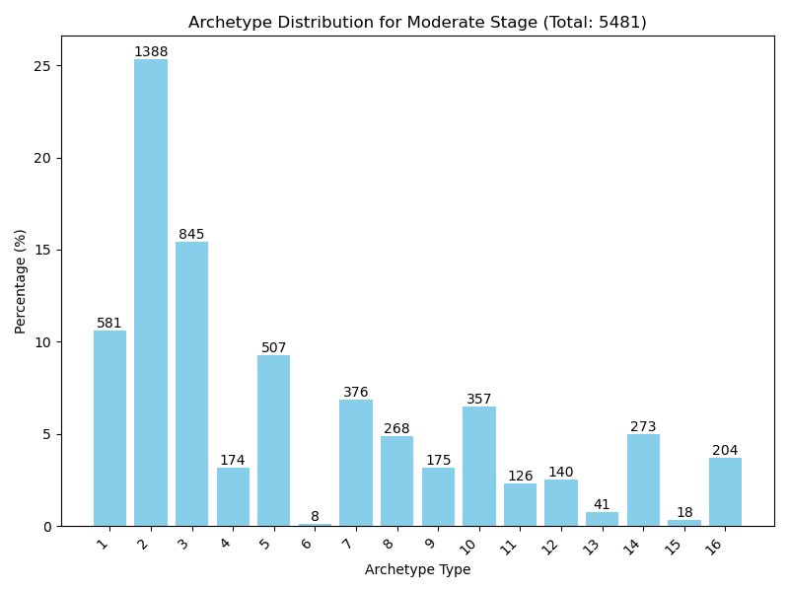
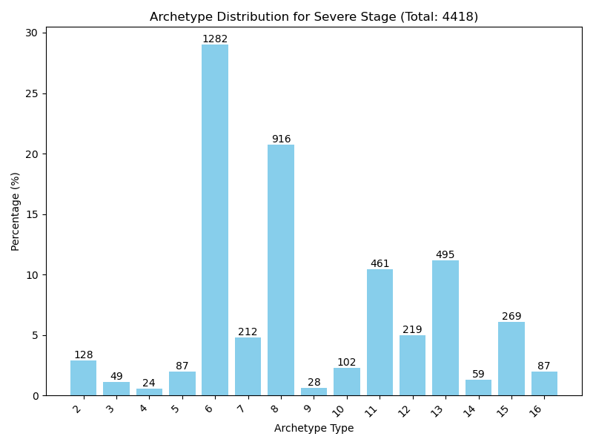
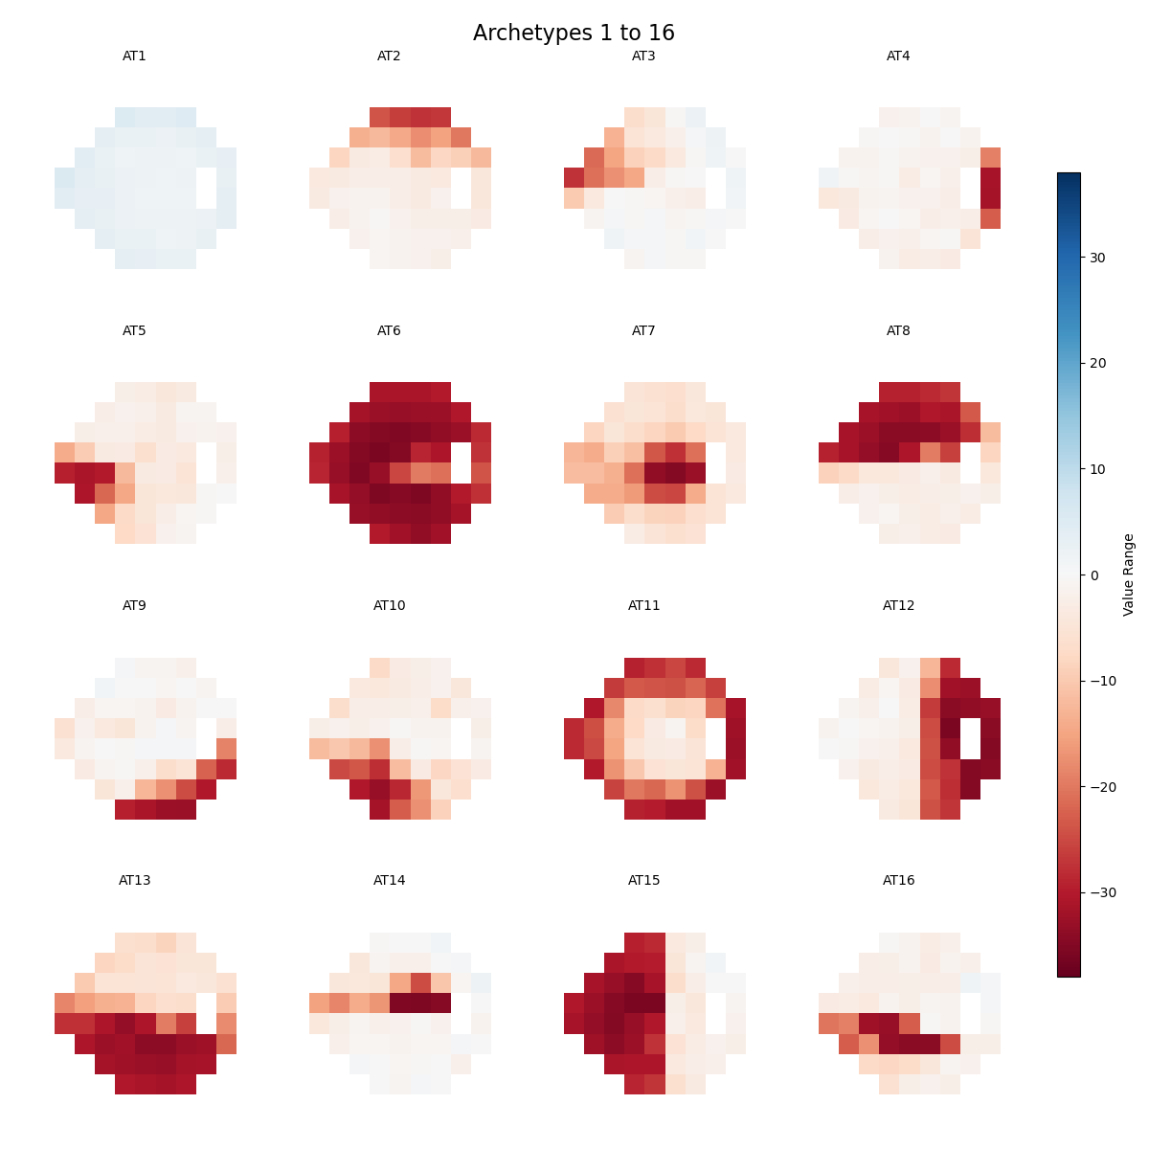
a) Archetype Distribution for Mild Stage (Total: 19044)
b) Archetype Distribution for Moderate Stage (Total: 5481)
c) Archetype Distribution for Severe Stage (Total: 4418)
d) Archetype 1 to 16

Slide 2
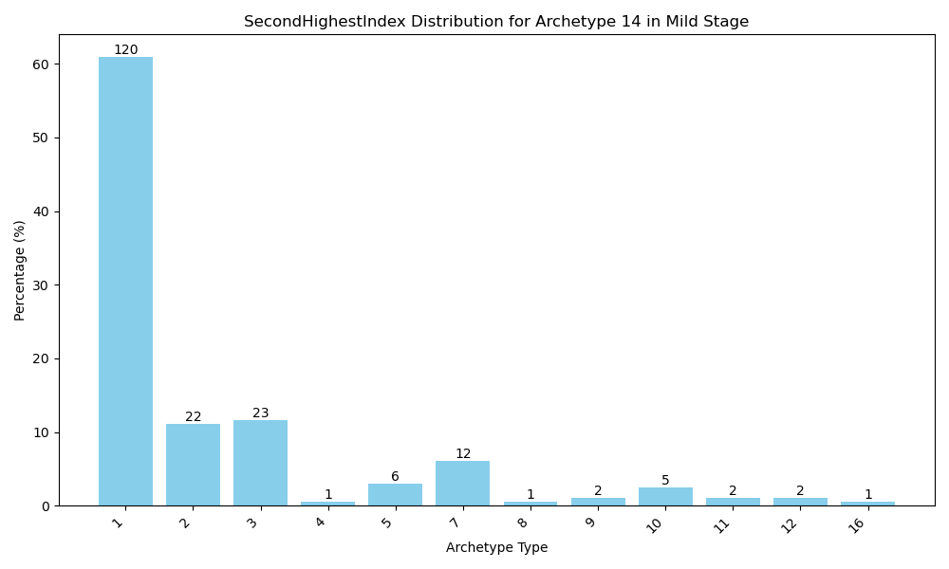
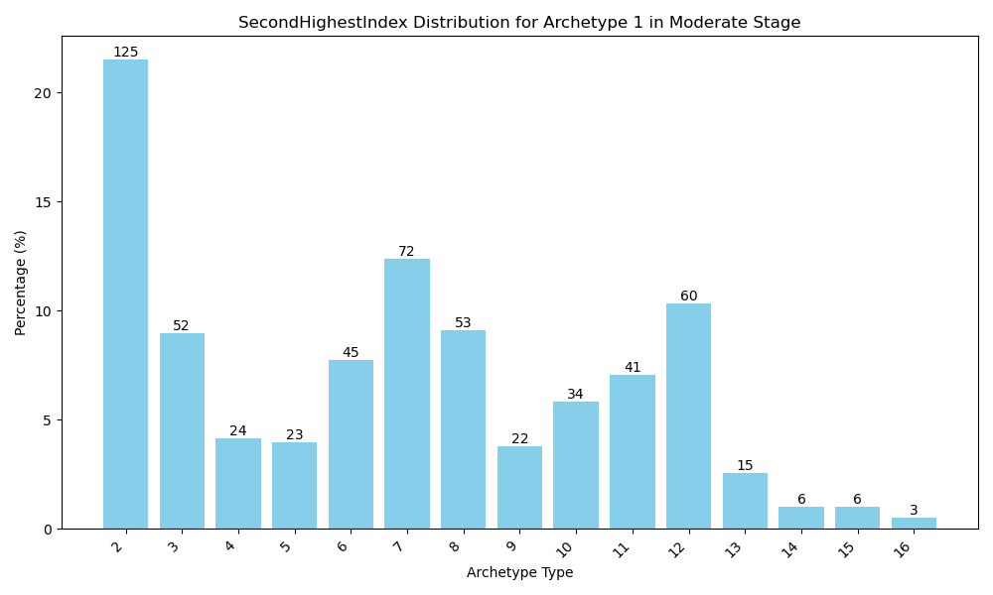
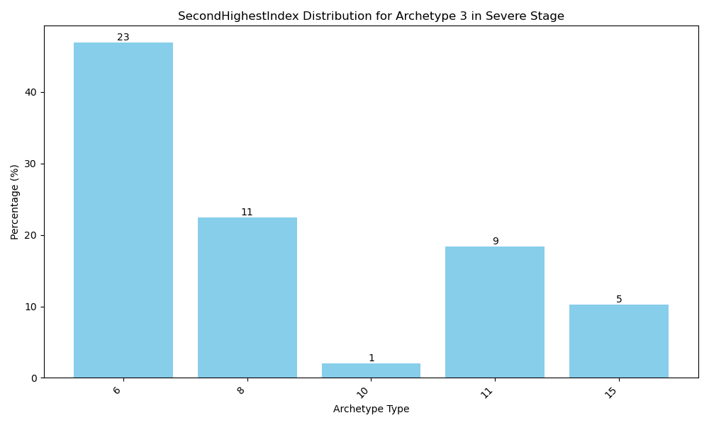
a) Secondary Archetype Distribution for AT 14 in Mild Stage
b) Secondary Archetype Distribution for AT 1 in Moderate Stage
c) Secondary Archetype Distribution for AT 3 in Severe Stage

