Slide 1
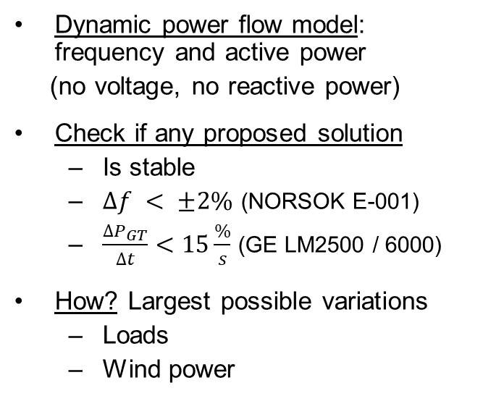
Short term analysis - Overview
Dynamic power flow model: frequency and active power
(no voltage, no reactive power)
Check if any proposed solution
Is stable
$∆f < ±2\%$ (NORSOK E-001)
$\frac{{∆P}_{GT}}{∆t}<15\frac{\%}{s}$ (GE LM2500 / 6000)
How? Largest possible variations
Loads
Wind power
More details:
https://doi.org/10.3390/en12152985
Notes:
Dynamic power flow model:
Inputs: type and amount of GT, type and amount of WT, power of electrolyzer and fuel cell, time series of wind speed and loads
Representation of the system as a rotating mass with inertia
Gas Turbine Generator: controls frequency (grid forming)
Wind Turbine Generator: inject as much power as possible (grid feeding in MPPT)
Energy Storage: follow SP from EMS (produce or consume H2) and support the grid during transients (grid supporting)
Voltage and reactive power: can be solved by AVR, on-load tap changers, energy storage converter
Largest possible variation: obtained by statistical analysis of wind speed and load time series.
If availability of 100% is required, 100% of wind power is lost + largest load connected at the same time.
If availability of 99.9% required (8 hours of downtime per year), how much load?

Slide 2

Integrated model and optimization
Scenario Generation
System Constraints
Analysis & Optimization
Gas Turbine: type, #, MinSP
Wind Turbine: type, #, MaxCurtail
Storage: Electrolizer size, Fuel Cell size
Physical: footprint, weight
Power: electrical, thermal
Operational: peak vs tail, availability
Emissions: CO₂, NO_{X}, CO
Storage: capacity
Operational: H₂ to GT, curtailed load

