Slide 1
Window Programming 10-2
GraphicsPath
FillPath
Yuan Ze University

Slide 2
FillPath
FillPath填滿形狀內部
  e.Graphics.FillPath(new SolidBrush(Color.Red), gp);
  畫刷可為SolidBrush, HatchBrush, TextureBrush
  形狀區域的預設計算方式為XOR，也就是聯集減去交集
形狀外部
形狀內部
形狀內部

Slide 3
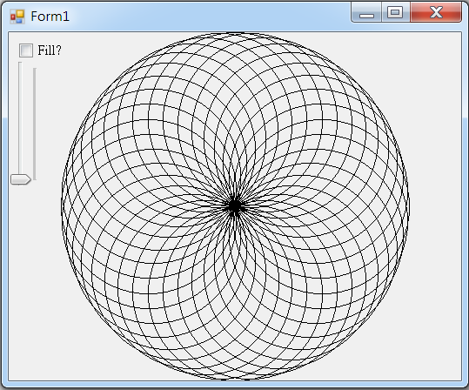
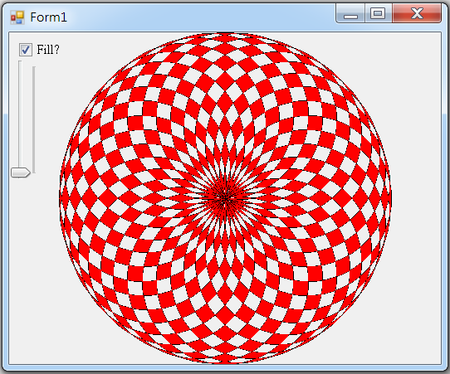
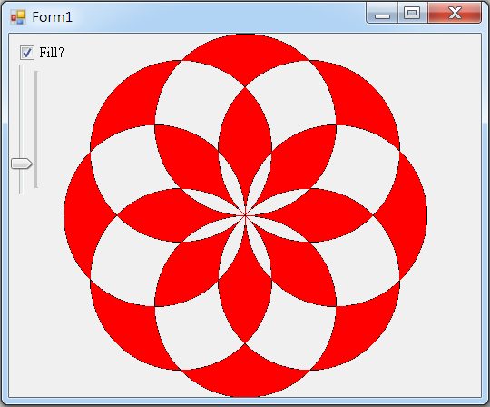
FillPath example

Slide 4
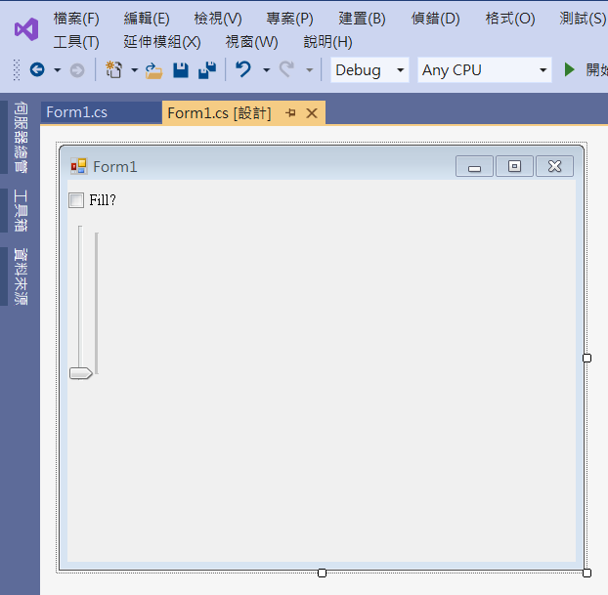
FillPath example
checkBox1
trackBar1
Maximum -> 180
Minimum -> 10
Value -> 10
Orientation -> Vertical

Slide 5
FillPath example
using System;
using System.Collections.Generic;
using System.ComponentModel;
using System.Data;
using System.Drawing;
using System.Linq;
using System.Text;
using System.Threading.Tasks;
using System.Windows.Forms;
using System.Drawing.Drawing2D;

Slide 6
FillPath example
public partial class Form1 : Form
{
int Gap = 10; // 角度間隔
public Form1()
{
InitializeComponent();
ClientSize = new Size(520, 400);
}

Slide 7
FillPath example
private void Form1_Paint(object sender, PaintEventArgs e)
{
GraphicsPath gp = new GraphicsPath(); // GraphicsPath物件
int Cx = ClientSize.Width / 2; // 視窗客戶區的正中央
int Cy = ClientSize.Height / 2;
// 圓形的半徑是取自視窗客戶區寬高最小者的四分之一
int D1 = Math.Min(ClientSize.Width, ClientSize.Height) / 4;

Slide 8
FillPath example
for (int i = 0; i < 360; i = i + Gap) // 每隔 Gap 角度 加入一個 圓形
{
int x = (int)(Cx + D1 * Math.Cos(i * Math.PI / 180));
int y = (int)(Cy + D1 * Math.Sin(i * Math.PI / 180));
gp.AddEllipse(x - D1, y - D1, 2 * D1, 2 * D1);
}
// 將 gp 內的形狀 繪出
e.Graphics.DrawPath(Pens.Black, gp); // 繪出GraphicsPath物件
if (checkBox1.Checked)
e.Graphics.FillPath(new SolidBrush(Color.Red), gp); //填色
}

Slide 9
FillPath example
private void Form1_Resize(object sender, EventArgs e)
{
Invalidate(); // 要求重畫
}
private void TrackBar1_Scroll(object sender, EventArgs e)
{
Gap = trackBar1.Value; // 更改角度間隔
Invalidate(); // 要求重畫
}
private void CheckBox1_CheckedChanged(object sender, EventArgs e)
{
Invalidate(); // 要求重畫
}

Slide 10
Exercise#10-2
仔細觀察填滿顏色處

Slide 11
內容來源
  Visual C# 2012 視窗程式設計：繪圖與遊戲專題(鄞永傳/著; 松崗)

