Slide 1
Window Programming 10-4
GraphicsPath
AddCurve, FillPath
Yuan Ze University

Slide 2
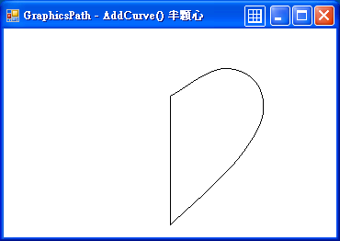
AddCurve
AddCurve加入曲線 (參數為一個點陣列以及張力值)
  private void Form1_Paint(object sender, PaintEventArgs e)
  { GraphicsPath gp = new GraphicsPath(); // GraphicsPath物件
  int Cx = ClientSize.Width / 2; // 視窗客戶區的中心點
  int Cy = ClientSize.Height / 2;
  int D = 30; // 每格 寬
  int x = Cx; // 心形的起始點
  int y = Cy - 2 * D;
  //心形右邊的曲線 由上往下
  PointF[] pt = new PointF[]{
  new PointF(x, y),
  new PointF(x+3*D, y - 1.5f*D),
  new PointF(x+5*D, y),
  new PointF(x+4*D, y+3*D),
  new PointF(x, y+ 7 *D),
  };
  gp.AddCurve(pt, 0.6f); // 加入曲線
  e.Graphics.DrawPath(Pens.Black, gp); // 繪出曲線軌跡
  }
心型設定
張力 0.0~1.0, 0.0為直線

Slide 3
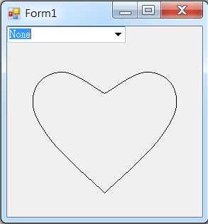
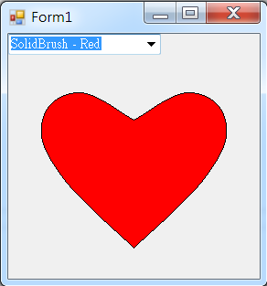
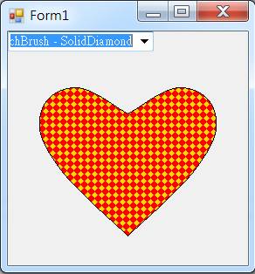
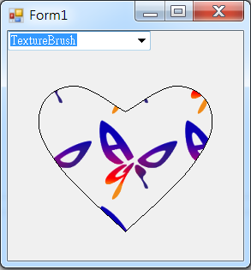
AddCurve example

Slide 4
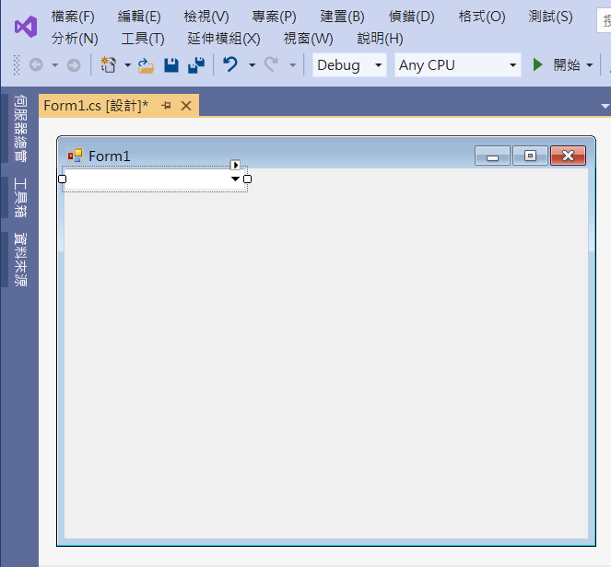
AddCurve example
comboBox1

Slide 5
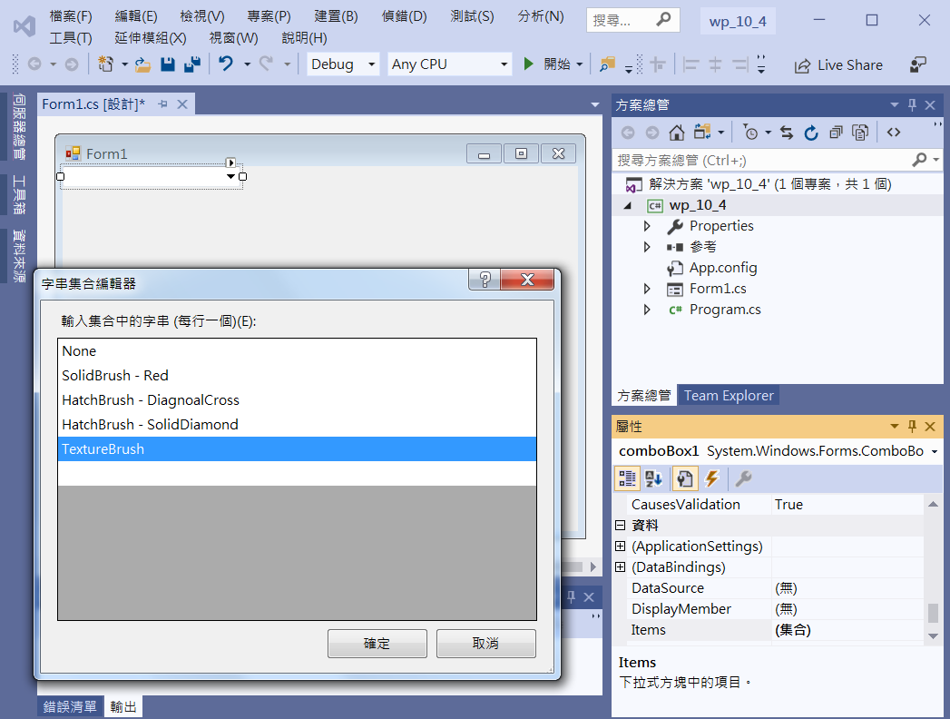
AddCurve example
1. Click comboBox1
3. Add items to
comboBox1
4. Click OK
2. Click Items

Slide 6
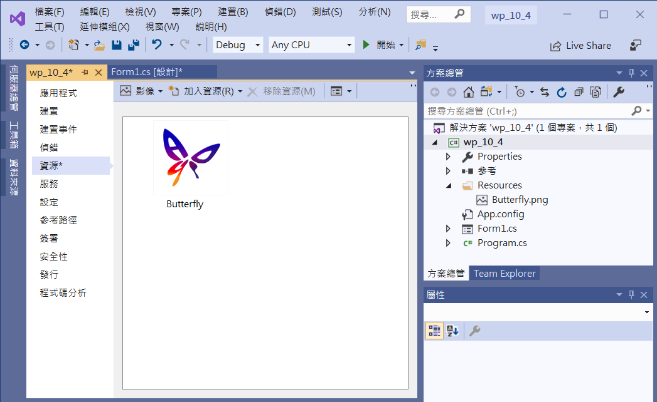
AddCurve example
Add image to
resource

Slide 7
AddCurve example
using System;
using System.Collections.Generic;
using System.ComponentModel;
using System.Data;
using System.Drawing;
using System.Linq;
using System.Text;
using System.Threading.Tasks;
using System.Windows.Forms;
using System.Drawing.Drawing2D;

Slide 8
AddCurve example
public partial class Form1 : Form
{
public Form1()
{
InitializeComponent();
ClientSize = new Size(500, 400);
comboBox1.SelectedIndex = 0;
}

Slide 9
AddCurve example
private void ComboBox1_SelectedIndexChanged(object sender, EventArgs e)
{
Invalidate();
}
private void Form1_Resize(object sender, EventArgs e)
{
Invalidate();
}

Slide 10
AddCurve example
private void Form1_Paint(object sender, PaintEventArgs e)
{
GraphicsPath gp = new GraphicsPath();
int Cx = ClientSize.Width / 2; // 視窗客戶區的中心點
int Cy = ClientSize.Height / 2;
int D = 20; // 每格 寬
int x = Cx; // 心臟的起始點
int y = Cy - 2 * D;

Slide 11
AddCurve example
//心臟右邊的曲線 由上往下
PointF[] pt = new PointF[]{
new PointF(x, y),
new PointF(x+3*D, y - 1.5f*D),
new PointF(x+5*D, y),
new PointF(x+4*D, y+3*D),
new PointF(x, y+ 7 *D),
};
gp.AddCurve(pt, 0.6f);

Slide 12
AddCurve example
//心臟左邊的曲線 順時鐘方向 由下往上 定義點的座標
PointF[] pt2 = new PointF[]{
new PointF(x, y+ 7 *D),
new PointF(x-4*D, y+3*D),
new PointF(x-5*D, y),
new PointF(x-3*D, y - 1.5f*D),
new PointF(x, y),
};
gp.AddCurve(pt2, 0.6f);

Slide 13
AddCurve example
if (comboBox1.SelectedIndex == 1) // 單色塗刷
e.Graphics.FillPath(Brushes.Red, gp); // 填滿形狀區域
else if (comboBox1.SelectedIndex == 2) // 樣式塗刷一
{
HatchBrush myBrush1 = new HatchBrush(HatchStyle.DiagonalCross, Color.Gold, Color.Red);
e.Graphics.FillPath(myBrush1, gp); //填滿形狀區域
}

Slide 14
AddCurve example
else if (comboBox1.SelectedIndex == 3) // 樣式塗刷二
{
HatchBrush myBrush2 = new HatchBrush(HatchStyle.SolidDiamond, Color.Gold, Color.Red);
e.Graphics.FillPath(myBrush2, gp); //填滿形狀區域
}
else if (comboBox1.SelectedIndex == 4) // 使用圖形塗刷
{
Bitmap bm = new Bitmap(Properties.Resources.Butterfly);
TextureBrush myBrush3 = new TextureBrush(bm); // 圖形塗刷
e.Graphics.FillPath(myBrush3, gp); //填滿形狀區域
}
e.Graphics.DrawPath(Pens.Black, gp); //繪出圖形軌跡
}

Slide 15
Exercise#10-4

Slide 16
內容來源
  Visual C# 2012 視窗程式設計：繪圖與遊戲專題(鄞永傳/著; 松崗)

