Slide 1
Window Programming 10-8
Heart-shaped Magnifier
Yuan Ze University

Slide 2
Heart-shaped magnifier example
因DrawImage只能繪矩形
故以GraphicsPath繪出心形
產生一張放大兩倍的圖做為TextureBrush畫刷
TranslateTransform座標轉換將畫刷對齊滑鼠位置
用FillPath達到心形放大鏡效果

Slide 3
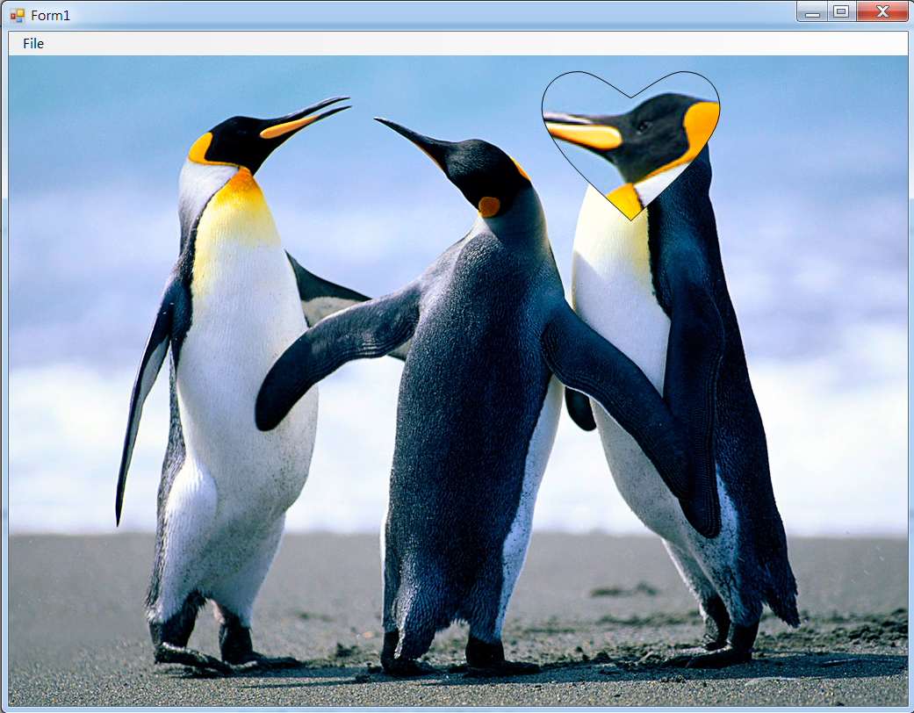
Heart-shaped magnifier example

Slide 4
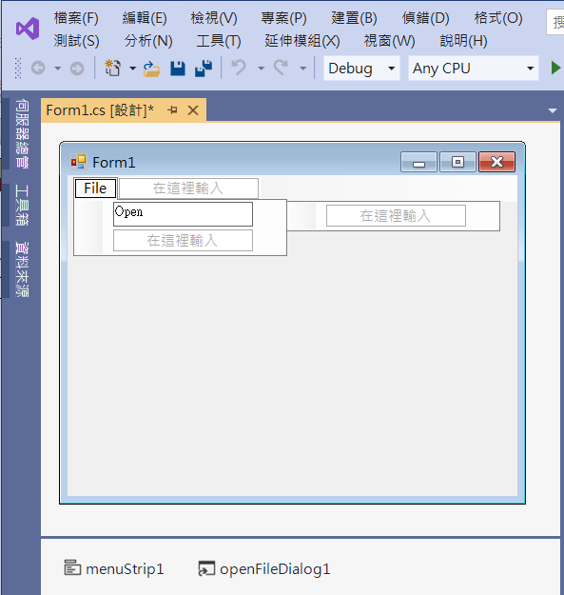
Heart-shaped magnifier example
2. Edit menuStrip1
1. Add menuStrip1
3. Add openFileDialog1

Slide 5
Heart-shaped magnifier example
using System;
using System.Collections.Generic;
using System.ComponentModel;
using System.Data;
using System.Drawing;
using System.Linq;
using System.Text;
using System.Threading.Tasks;
using System.Windows.Forms;
using System.Drawing.Drawing2D;

Slide 6
Heart-shaped magnifier example
public partial class Form1 : Form
{
Image img; // 影像
Point mousePos; // 滑鼠位置
Image imgDouble; // 兩倍影像的點陣圖物件
TextureBrush texBrush; // 兩倍影像的塗刷
public Form1()
{
InitializeComponent();
DoubleBuffered = true;
}

Slide 7
Heart-shaped magnifier example
private void OpenToolStripMenuItem_Click(object sender, EventArgs e)
{
if (openFileDialog1.ShowDialog() == DialogResult.OK) // 開啟影像檔
{
String input = openFileDialog1.FileName;
img = Image.FromFile(input); // 產生一個Image物件
if ((ClientSize.Width < img.Width) || (ClientSize.Height < img.Height))
ClientSize = new Size(img.Width, img.Height);
imgDouble = new Bitmap(img.Width * 2, img.Height * 2); // 新增點陣圖物件

Slide 8
Heart-shaped magnifier example
Graphics G = Graphics.FromImage(imgDouble); // 由點陣圖物件產生畫布
Rectangle rectDest = new Rectangle(0, 0, imgDouble.Width, imgDouble.Height);
Rectangle rectSrc = new Rectangle(0, 0, img.Width, img.Height);
G.DrawImage(img, rectDest, rectSrc, GraphicsUnit.Pixel); // 放大兩倍
texBrush = new TextureBrush(imgDouble); // 兩倍影像的塗刷
Invalidate(); // 要求重畫
}
}

Slide 9
Heart-shaped magnifier example
private void Form1_Paint(object sender, PaintEventArgs e)
{
if (img != null)
{
e.Graphics.SmoothingMode = System.Drawing.Drawing2D.SmoothingMode.AntiAlias;
e.Graphics.DrawImage(img, 0, 00, img.Width, img.Height); // 呈現原圖
texBrush.ResetTransform(); // 塗刷的轉換矩陣 = 單位矩陣
texBrush.TranslateTransform(-mousePos.X, -mousePos.Y); // 塗刷對齊 滑鼠位置

Slide 10
Heart-shaped magnifier example
GraphicsPath gp = new GraphicsPath(); // GraphicsPath圖形軌跡物件
PointF[] pt1 = new PointF[5]; //心形右邊的曲線
PointF[] pt2 = new PointF[5]; //心形左邊的曲線
GetPointF(mousePos.X-20, mousePos.Y, 20, pt1, pt2); //計算心形左右邊的曲線
gp.AddCurve(pt1, 0.6f); // 心形曲線 的外框
gp.AddCurve(pt2, 0.6f);
e.Graphics.FillPath(texBrush, gp); //填滿形狀區域 使用影像塗刷 繪出心形
e.Graphics.DrawPath(Pens.Black, gp); // 放大鏡外框
}
}

Slide 11
Heart-shaped magnifier example
void GetPointF(int x, int y, int D, PointF[] pt1, PointF[] pt2)
{
//心形右邊的曲線 由上往下
pt1[0] = new PointF(x, y);
pt1[1] = new PointF(x + 3 * D, y - 1.5f * D);
pt1[2] = new PointF(x + 5 * D, y);
pt1[3] = new PointF(x + 4 * D, y + 3 * D);
pt1[4] = new PointF(x, y + 7 * D);

Slide 12
Heart-shaped magnifier example
//心形左邊的曲線 順時間方向 由下往上 定義點的座標
pt2[0] = new PointF(x, y + 7 * D);
pt2[1] = new PointF(x - 4 * D, y + 3 * D);
pt2[2] = new PointF(x - 5 * D, y);
pt2[3] = new PointF(x - 3 * D, y - 1.5f * D);
pt2[4] = new PointF(x, y);
}

Slide 13
Heart-shaped magnifier example
private void Form1_MouseMove(object sender, MouseEventArgs e)
{
mousePos = e.Location; // 記錄 滑鼠位置
Invalidate(); // 要求更新表單
}

Slide 14
Exercise#10-8

Slide 15
內容來源
  Visual C# 2012 視窗程式設計：繪圖與遊戲專題(鄞永傳/著; 松崗)

