Slide 1
Window Programming 11-2
Bitmap Image
SetColorMatrix 色彩調整矩陣
Yuan Ze University

Slide 2
SetColorMatrix
調整紅色, 例 0.8f
using System.Drawing.Imaging;
float[][] cmArray =
{
new float[] {1, 0, 0, 0, 0},
new float[] {0, 1, 0, 0, 0},
new float[] {0, 0, 1, 0, 0},
new float[] {0, 0, 0, 0.5f, 0}, //
new float[] {0, 0, 0, 0, 1}
}; // 5 x 5 的矩陣
ColorMatrix cm = new ColorMatrix(cmArray); // 色彩調整矩陣
ImageAttributes ia = new ImageAttributes(); // 影像屬性
ia.SetColorMatrix(cm, ColorMatrixFlag.Default,
ColorAdjustType.Bitmap); //設定影像屬性的色彩調整矩陣
調整綠色, 例 0.8f
調整藍色, 例 0.8f
調整透明度,例 0.5f

Slide 3
SetColorMatrix
// 繪出透明的影像
e.Graphics.DrawImage(img2,
new Rectangle(MousePos.X - img2.Width / 2,
MousePos.Y - img2.Height/2,
img2.Width, img2.Height),
0, 0, img2.Width, img2.Height,
GraphicsUnit.Pixel, ia); // 使用 影像屬性 繪製

Slide 4
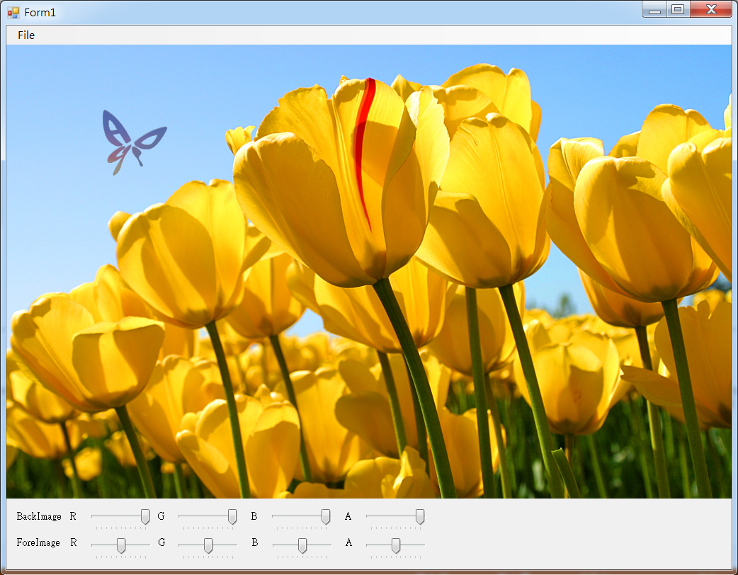
SetColorMatrix example

Slide 5
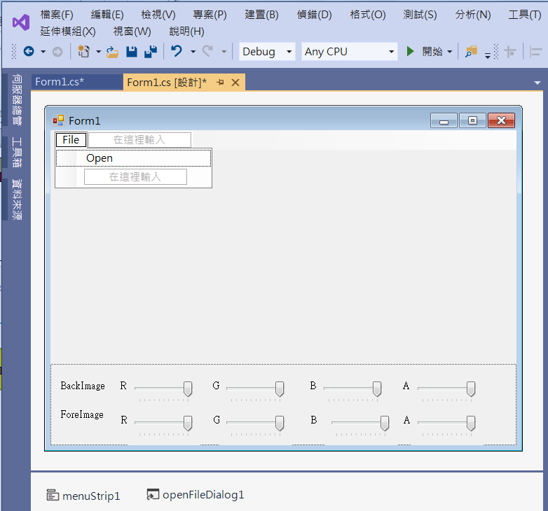
SetColorMatrix example
4. trackBar1
Minimum -> 0
Maximum -> 10
Value -> 10
5. trackBar2
1. panel1
Dock -> bottom
3. label2
2. label1
6. menuStrip1
7. openFileDialog1

Slide 6
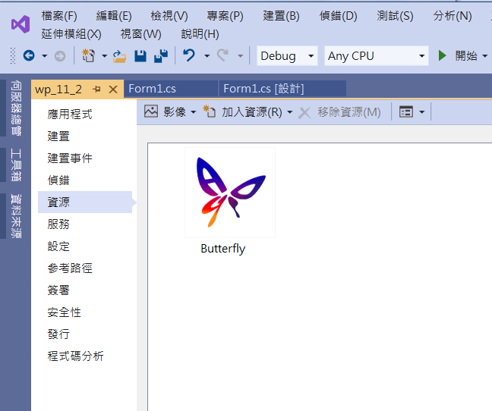
SetColorMatrix example
Add image resource

Slide 7
SetColorMatrix example
using System;
using System.Collections.Generic;
using System.ComponentModel;
using System.Data;
using System.Drawing;
using System.Linq;
using System.Text;
using System.Threading.Tasks;
using System.Windows.Forms;
using System.Drawing.Imaging;

Slide 8
SetColorMatrix example
public partial class Form1 : Form
{
Image img; // 影像
Image img2; // 透明的影像
Point MousePos;
float r1, g1, b1, a1, r2, g2, b2, a2;

Slide 9
SetColorMatrix example
public Form1()
{
InitializeComponent();
img2 = Properties.Resources.Butterfly;
DoubleBuffered = true;
r1 = g1 = b1 = a1 = 1;
r2 = g2 = b2 = a2 = 0.5f;
trackBar1.Value = trackBar2.Value=trackBar3.Value=trackBar4.Value=10;
trackBar5.Value = trackBar6.Value = trackBar7.Value = trackBar8.Value = 5;
}

Slide 10
SetColorMatrix example
private void OpenToolStripMenuItem_Click(object sender, EventArgs e)
{
if (openFileDialog1.ShowDialog() == DialogResult.OK) // 開啟影像檔
{
String input = openFileDialog1.FileName;
img = Image.FromFile(input); // 產生一個Image物件
if ((ClientSize.Width < img.Width) || (ClientSize.Height < img.Height))
ClientSize = new Size(img.Width, img.Height);
Invalidate(); // 要求重畫
}
}

Slide 11
SetColorMatrix example
private void Form1_Paint(object sender, PaintEventArgs e)
{
if (img != null)
{
// 色彩調整矩陣
float[][] cmArray1 =
{
new float[] {r1, 0, 0, 0, 0},
new float[] {0, g1, 0, 0, 0},
new float[] {0, 0, b1, 0, 0},
new float[] {0, 0, 0, a1, 0},
new float[] {0, 0, 0, 0, 1}
};

Slide 12
SetColorMatrix example
ColorMatrix cm1 = new ColorMatrix(cmArray1);
ImageAttributes ia1 = new ImageAttributes();
ia1.SetColorMatrix(cm1,
ColorMatrixFlag.Default,
ColorAdjustType.Bitmap);
// 繪出透明的背景影像
Rectangle rectDest = new Rectangle(0, 0, img.Width, img.Height);
e.Graphics.DrawImage(img,
rectDest,
0, 0, img.Width, img.Height,
GraphicsUnit.Pixel, ia1);
}

Slide 13
SetColorMatrix example
// 色彩調整矩陣
float[][] cmArray2 =
{
new float[] {r2, 0, 0, 0, 0},
new float[] {0, g2, 0, 0, 0},
new float[] {0, 0, b2, 0, 0},
new float[] {0, 0, 0, a2, 0},
new float[] {0, 0, 0, 0, 1}
};

Slide 14
SetColorMatrix example
ColorMatrix cm2 = new ColorMatrix(cmArray2);
ImageAttributes ia2 = new ImageAttributes();
ia2.SetColorMatrix(cm2,
ColorMatrixFlag.Default,
ColorAdjustType.Bitmap);
// 繪出透明的前景影像
e.Graphics.DrawImage(img2,
new Rectangle(MousePos.X - img2.Width / 2, MousePos.Y - img2.Height / 2, img2.Width, img2.Height),
0, 0, img2.Width, img2.Height,
GraphicsUnit.Pixel, ia2);
}

Slide 15
SetColorMatrix example
private void Form1_MouseMove(object sender, MouseEventArgs e)
{
MousePos = e.Location;
Invalidate();
}
private void TrackBar1_Scroll(object sender, EventArgs e)
{
r1 = (float)trackBar1.Value / 10;
Invalidate();
}

Slide 16
SetColorMatrix example
private void TrackBar2_Scroll(object sender, EventArgs e)
{
g1 = (float)trackBar2.Value / 10;
Invalidate();
}
private void TrackBar3_Scroll(object sender, EventArgs e)
{
b1 = (float)trackBar3.Value / 10;
Invalidate();
}

Slide 17
SetColorMatrix example
private void TrackBar4_Scroll(object sender, EventArgs e)
{
a1 = (float)trackBar4.Value / 10;
Invalidate();
}
private void TrackBar5_Scroll(object sender, EventArgs e)
{
r2 = (float)trackBar5.Value / 10;
Invalidate();
}

Slide 18
SetColorMatrix example
private void TrackBar6_Scroll(object sender, EventArgs e)
{
g2 = (float)trackBar6.Value / 10;
Invalidate();
}
private void TrackBar7_Scroll(object sender, EventArgs e)
{
b2 = (float)trackBar7.Value / 10;
Invalidate();
}

Slide 19
SetColorMatrix example
private void TrackBar8_Scroll(object sender, EventArgs e)
{
a2 = (float)trackBar8.Value / 10;
Invalidate();
}

Slide 20
Exercise#11-2

Slide 21
內容來源
  Visual C# 2012 視窗程式設計：繪圖與遊戲專題(鄞永傳/著; 松崗)

