Slide 1
Window Programming 11-4
Bitmap Image
SetPixel example 2
Yuan Ze University

Slide 2
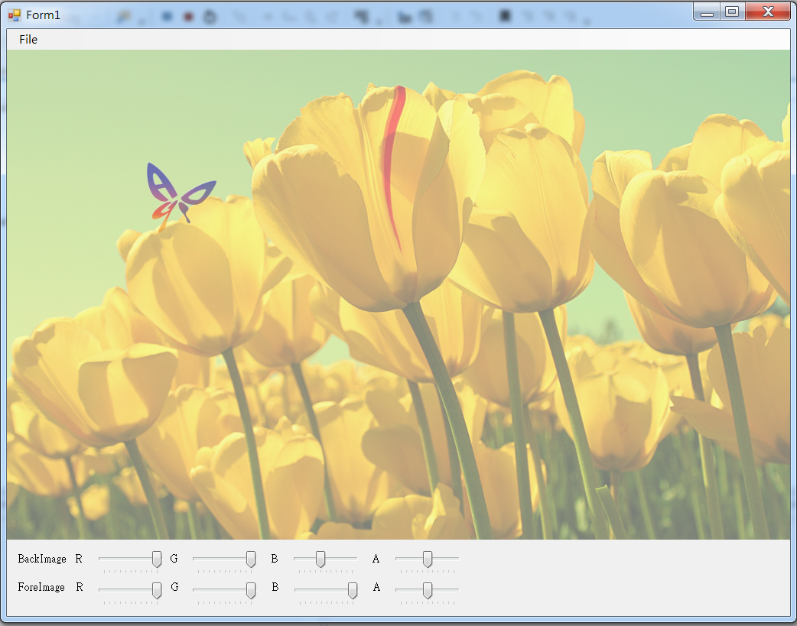
SetPixel example 2

Slide 3
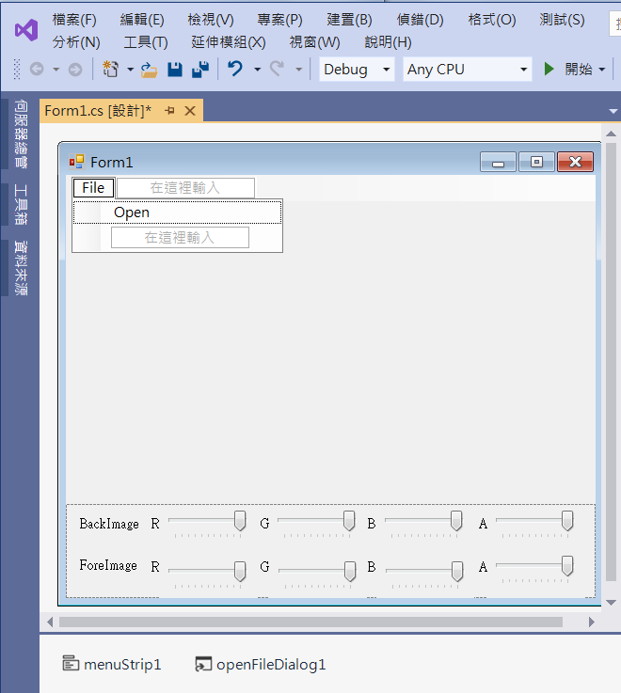
SetPixel example 2
4. trackBar1
Minimum -> 0
Maximum -> 10
Value -> 10
5. trackBar2
1. panel1
Dock -> bottom
3. label2
2. label1
6. menuStrip1
7. openFileDialog1

Slide 4
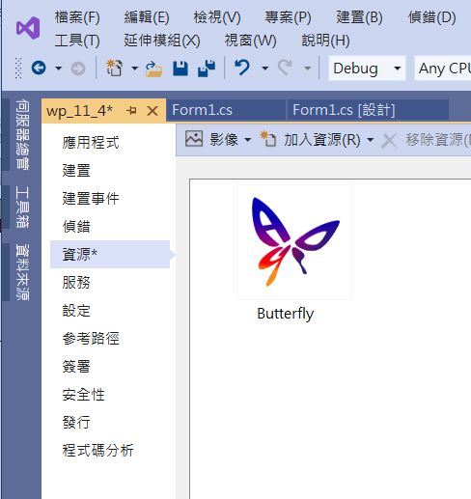
SetPixel example 2
Add image resource

Slide 5
SetPixel example 2
public partial class Form1 : Form
{
Bitmap img, imgClone; // 影像
Bitmap img2, img2Clone; // 透明的影像
Point MousePos;
float r1, g1, b1, a1, r2, g2, b2, a2;

Slide 6
SetPixel example 2
public Form1()
{
InitializeComponent();
img2 = Properties.Resources.Butterfly;
DoubleBuffered = true;
r1 = g1 = b1 = a1 = 1;
r2 = g2 = b2 = a2 = 0.5f;
trackBar1.Value = trackBar2.Value=trackBar3.Value=trackBar4.Value=10;
trackBar5.Value = trackBar6.Value = trackBar7.Value = trackBar8.Value = 5;
foreImageClone();
}

Slide 7
SetPixel example 2
private void OpenToolStripMenuItem_Click(object sender, EventArgs e)
{
if (openFileDialog1.ShowDialog() == DialogResult.OK) // 開啟影像檔
{
String input = openFileDialog1.FileName;
img = (Bitmap)Image.FromFile(input); // 產生一個Bitmap物件
if ((ClientSize.Width < img.Width) || (ClientSize.Height < img.Height))
ClientSize = new Size(img.Width, img.Height);
backImageClone();
Invalidate(); // 要求重畫
}
}

Slide 8
SetPixel example 2
void backImageClone()
{
imgClone = (Bitmap)img.Clone();
int x, y;
// 重設 img 的 圖素
for (x = 0; x < imgClone.Width; x++)
{
for (y = 0; y < imgClone.Height; y++)
{
Color pixelColor = imgClone.GetPixel(x, y); // 得到圖素
Color newColor = pixelColor;
newColor = Color.FromArgb(pixelColor.A * trackBar4.Value / 10, pixelColor.R * trackBar1.Value / 10, pixelColor.G * trackBar2.Value / 10, pixelColor.B * trackBar3.Value / 10);
imgClone.SetPixel(x, y, newColor); // 設定圖素
}
}
}

Slide 9
SetPixel example 2
void foreImageClone()
{
img2Clone = (Bitmap)img2.Clone();
int x1, y1;
// 重設 img 的 圖素
for (x1 = 0; x1 < img2Clone.Width; x1++)
{
for (y1 = 0; y1 < img2Clone.Height; y1++)
{
Color pixelColor = img2Clone.GetPixel(x1, y1); // 得到圖素
Color newColor = pixelColor;
newColor = Color.FromArgb(pixelColor.A * trackBar8.Value / 10, pixelColor.R * trackBar5.Value / 10, pixelColor.G * trackBar6.Value / 10, pixelColor.B * trackBar7.Value / 10);
img2Clone.SetPixel(x1, y1, newColor); // 設定圖素
}
}
}

Slide 10
SetPixel example 2
private void Form1_Paint(object sender, PaintEventArgs e)
{
if (img != null)
{
Rectangle rectDest1 = new Rectangle(0, 0, imgClone.Width, imgClone.Height);
e.Graphics.DrawImage(imgClone, rectDest1);
}
Rectangle rectDest2 = new Rectangle(MousePos.X - img2Clone.Width / 2, MousePos.Y - img2Clone.Height / 2, img2Clone.Width, img2Clone.Height);
e.Graphics.DrawImage(img2Clone, rectDest2);
}

Slide 11
SetPixel example 2
private void Form1_MouseMove(object sender, MouseEventArgs e)
{
MousePos = e.Location;
Invalidate();
}
private void TrackBar1_Scroll(object sender, EventArgs e)
{
r1 = (float)trackBar1.Value / 10;
backImageClone();
Invalidate();
}

Slide 12
SetPixel example 2
private void TrackBar2_Scroll(object sender, EventArgs e)
{
g1 = (float)trackBar2.Value / 10;
backImageClone();
Invalidate();
}
private void TrackBar3_Scroll(object sender, EventArgs e)
{
b1 = (float)trackBar3.Value / 10;
backImageClone();
Invalidate();
}

Slide 13
SetPixel example 2
private void TrackBar4_Scroll(object sender, EventArgs e)
{
a1 = (float)trackBar4.Value / 10;
backImageClone();
Invalidate();
}
private void TrackBar5_Scroll(object sender, EventArgs e)
{
r2 = (float)trackBar5.Value / 10;
foreImageClone();
Invalidate();
}

Slide 14
SetPixel example 2
private void TrackBar6_Scroll(object sender, EventArgs e)
{
g2 = (float)trackBar6.Value / 10;
foreImageClone();
Invalidate();
}
private void TrackBar7_Scroll(object sender, EventArgs e)
{
b2 = (float)trackBar7.Value / 10;
foreImageClone();
Invalidate();
}

Slide 15
SetPixel example 2
private void TrackBar8_Scroll(object sender, EventArgs e)
{
a2 = (float)trackBar8.Value / 10;
foreImageClone();
Invalidate();
}

Slide 16
Exercise#11-4

Slide 17
內容來源
  Visual C# 2012 視窗程式設計：繪圖與遊戲專題(鄞永傳/著; 松崗)

