Slide 1
Window Programming 12-2
陽春版小畫家範例
顏色調整(灰階、負片)
Yuan Ze University

Slide 2
Example
using System.Drawing.Imaging;
float[][] cmArray =
{
new float[] {0.33f, 0.33f, 0.33f, 0, 0},
new float[] {0.33f, 0.33f, 0.33f, 0, 0},
new float[] {0.33f, 0.33f, 0.33f, 0, 0},
new float[] {0, 0, 0, 1, 0}, //
new float[] {0, 0, 0, 0, 1}
}; // 5 x 5 的矩陣
ColorMatrix cm = new ColorMatrix(cmArray); // 色彩調整矩陣
ImageAttributes ia = new ImageAttributes(); // 影像屬性
ia.SetColorMatrix(cm, ColorMatrixFlag.Default,
ColorAdjustType.Bitmap); //設定影像屬性的色彩調整矩陣
灰階
取三色平均值成單一值

Slide 3
Example
負片
255-R, 255-G, 255-B
using System.Drawing.Imaging;
ColorMatrix cm = new ColorMatrix(
new float[][]{ new float[]{ -1f, 0, 0, 0, 0},
new float[]{ 0, -1f, 0, 0, 0},
new float[]{ 0, 0, -1f, 0, 0},
new float[]{ 0, 0, 0, 1, 0},
new float[]{ 1, 1, 1, 0, 1}}); // 色彩調整矩陣
ImageAttributes ia = new ImageAttributes(); // 影像屬性
ia.SetColorMatrix(cm, ColorMatrixFlag.Default,
ColorAdjustType.Bitmap); //設定影像屬性的色彩調整矩陣

Slide 4
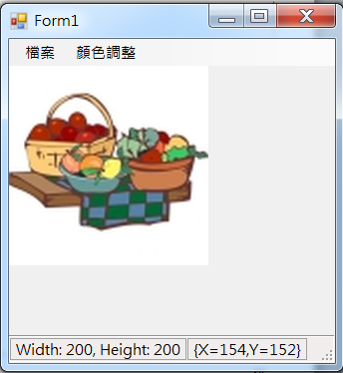
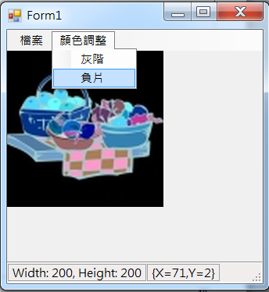
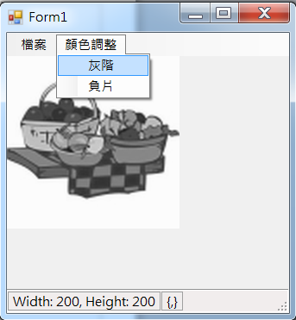
Example

Slide 5
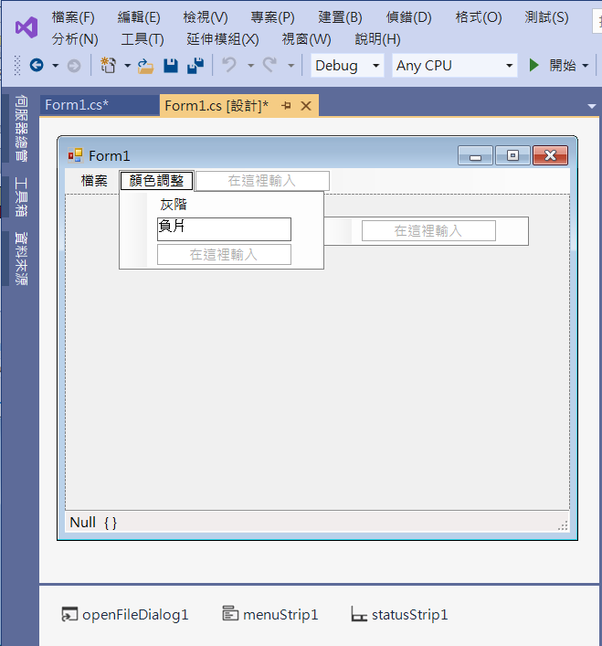
Example
Add menuItems

Slide 6
Example
using System;
using System.Collections.Generic;
using System.ComponentModel;
using System.Data;
using System.Drawing;
using System.Linq;
using System.Text;
using System.Threading.Tasks;
using System.Windows.Forms;
using System.Drawing.Imaging; // ColorMatrix

Slide 7
Example
public Bitmap ConvertCM(Image image, ColorMatrix cm)
{
Bitmap dest = new Bitmap(image.Width, image.Height);
Graphics g = Graphics.FromImage(dest); // 從點陣圖 建立 新的畫布
// cm 定義含有 RGBA 空間座標的 5 x 5 矩陣
// (R, G, B, A, 1) 乘上 此矩陣
// ImageAttributes 類別的多個方法會使用色彩矩陣來調整影像色彩
ImageAttributes ia = new ImageAttributes();
// 設定預設分類的色彩調整矩陣。
ia.SetColorMatrix(cm);
g.DrawImage(image, new Rectangle(0, 0, image.Width, image.Height), 0, 0, image.Width, image.Height, GraphicsUnit.Pixel, ia);
g.Dispose(); //清掉畫布與點陣圖變數的連結
return dest;
}

Slide 8
Example
private void 灰階ToolStripMenuItem_Click(object sender, EventArgs e)
{
if (pictureBox1.Image != null)
{
ColorMatrix cm = new ColorMatrix(
new float[][]{ new float[]{0.33f, 0.33f, 0.33f, 0, 0},
new float[]{0.33f, 0.33f, 0.33f, 0, 0},
new float[]{0.33f, 0.33f, 0.33f, 0, 0},
new float[]{ 0, 0, 0, 1, 0},
new float[]{ 0, 0, 0, 0, 1}});
pictureBox1.Image = ConvertCM(pictureBox1.Image, cm);
}
}

Slide 9
Example
private void 負片ToolStripMenuItem_Click(object sender, EventArgs e)
{
if (pictureBox1.Image != null)
{
ColorMatrix cm = new ColorMatrix(
new float[][]{ new float[]{ -1f, 0, 0, 0, 0},
new float[]{ 0, -1f, 0, 0, 0},
new float[]{ 0, 0, -1f, 0, 0},
new float[]{ 0, 0, 0, 1, 0},
new float[]{ 1, 1, 1, 0, 1}});
pictureBox1.Image = ConvertCM(pictureBox1.Image, cm);
}
}

Slide 10
Exercise#12-2

Slide 11
內容來源
  Visual C# 2012 視窗程式設計：繪圖與遊戲專題(鄞永傳/著; 松崗)
  Visual C# 2013視窗程式設計(黃聰明/著; 松崗)
  跟著範例學會Visual C# 2015(張逸中/著; 博碩)

