Slide 1
Window Programming 12-7
陽春版小畫家範例
復原與取消復原
Yuan Ze University

Slide 2
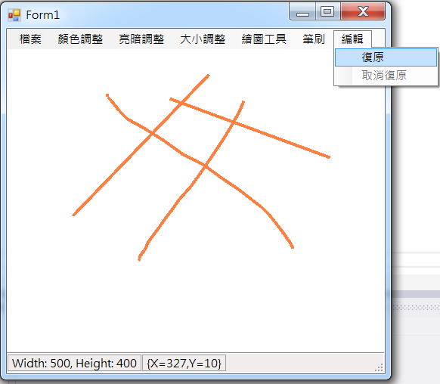
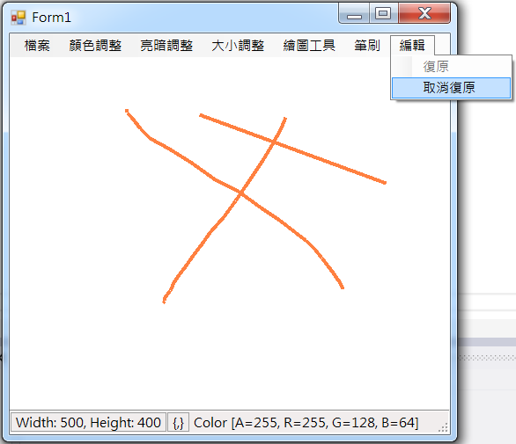
Example

Slide 3
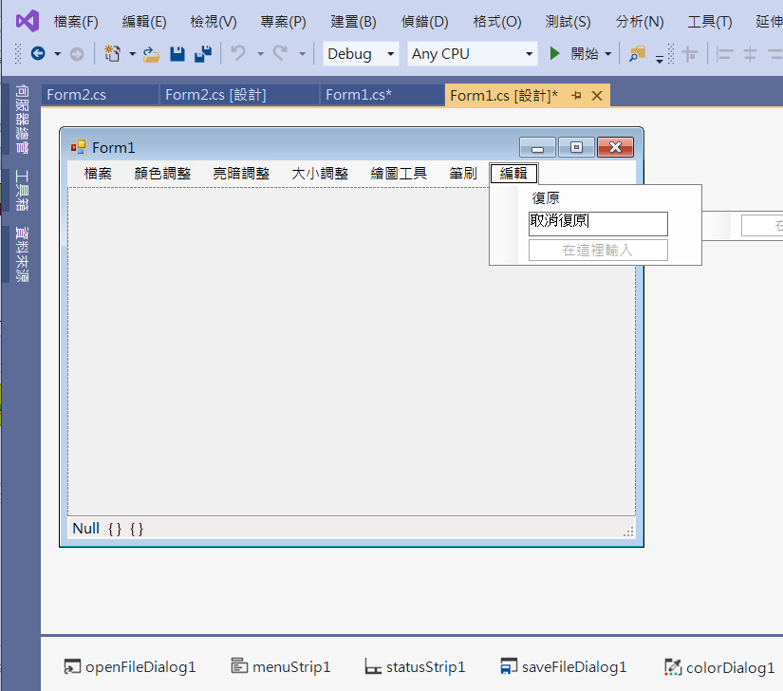
Example
Add menuItems

Slide 4
Example
public partial class Form1 : Form
{
int w, h, x0, y0, pen_width = 1;
Bitmap img1, img2, BackupImg, BackupImg2;
Pen p;
int tools = 0;
Color c = Color.Black;

Slide 5
Example
public Form1()
{
InitializeComponent();
DoubleBuffered = true;
p = new Pen(c, pen_width);
toolStripStatusLabel1.Text = "Width: " + w.ToString() + ", Height: " + h.ToString();
toolStripStatusLabel3.Text = c.ToString();
復原ToolStripMenuItem.Enabled = false;
取消復原ToolStripMenuItem.Enabled = false;
}

Slide 6
Example
public Bitmap ConvertCM(Image image, ColorMatrix cm)
{
Bitmap dest = new Bitmap(image.Width, image.Height);
Graphics g = Graphics.FromImage(dest); // 從點陣圖 建立 新的畫布
// cm 定義含有 RGBA 空間座標的 5 x 5 矩陣
// (R, G, B, A, 1) 乘上 此矩陣
// ImageAttributes 類別的多個方法會使用色彩矩陣來調整影像色彩
ImageAttributes ia = new ImageAttributes();
// 設定預設分類的色彩調整矩陣。
ia.SetColorMatrix(cm);
g.DrawImage(image, new Rectangle(0, 0, image.Width, image.Height), 0, 0, image.Width, image.Height, GraphicsUnit.Pixel, ia);
g.Dispose(); //清掉畫布與點陣圖變數的連結
BackupImg = (Bitmap)pictureBox1.Image.Clone();
復原ToolStripMenuItem.Enabled = true;
return dest;
}

Slide 7
Example
private void 一半ToolStripMenuItem_Click(object sender, EventArgs e)
{
BackupImg = (Bitmap)pictureBox1.Image.Clone();
復原ToolStripMenuItem.Enabled = true;
w = pictureBox1.Image.Width;
h = pictureBox1.Image.Height;
img1 = (Bitmap)pictureBox1.Image;
Bitmap p = new Bitmap(w / 2, h / 2);

Slide 8
Example
private void 二倍ToolStripMenuItem_Click(object sender, EventArgs e)
{
BackupImg = (Bitmap)pictureBox1.Image.Clone();
復原ToolStripMenuItem.Enabled = true;
w = pictureBox1.Image.Width;
h = pictureBox1.Image.Height;
Bitmap p = new Bitmap(w * 2, h * 2);
img1 = (Bitmap)pictureBox1.Image;

Slide 9
Example
private void PictureBox1_MouseDown(object sender, MouseEventArgs e)
{
if (pictureBox1.Image != null)
{
x0 = e.X;
y0 = e.Y;
img2 = (Bitmap)pictureBox1.Image.Clone();
BackupImg = (Bitmap)pictureBox1.Image.Clone();
}
}

Slide 10
Example
private void PictureBox1_MouseUp(object sender, MouseEventArgs e)
{
復原ToolStripMenuItem.Enabled = true;
}

Slide 11
Example
private void 復原ToolStripMenuItem_Click(object sender, EventArgs e)
{
復原ToolStripMenuItem.Enabled = false;
取消復原ToolStripMenuItem.Enabled = true;
BackupImg2 = (Bitmap)pictureBox1.Image;
pictureBox1.Image = BackupImg;
pictureBox1.Refresh();
}

Slide 12
Example
private void 取消復原ToolStripMenuItem_Click(object sender, EventArgs e)
{
復原ToolStripMenuItem.Enabled = true;
取消復原ToolStripMenuItem.Enabled = false;
pictureBox1.Image = BackupImg2;
pictureBox1.Refresh();
}

Slide 13
Exercise#12-7

Slide 14
內容來源
  Visual C# 2012 視窗程式設計：繪圖與遊戲專題(鄞永傳/著; 松崗)
  Visual C# 2013視窗程式設計(黃聰明/著; 松崗)
  跟著範例學會Visual C# 2015(張逸中/著; 博碩)

