Slide 1
Window Programming 14-1
Integrated Example: PhoneBook I
(connected to Access database)
Yuan Ze University

Slide 2
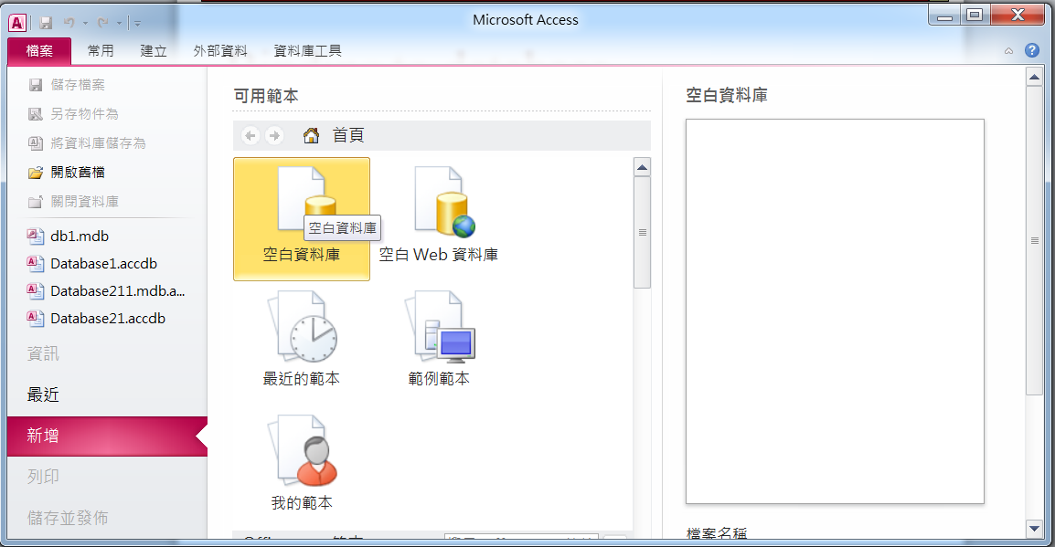
Access database
Add a database

Slide 3
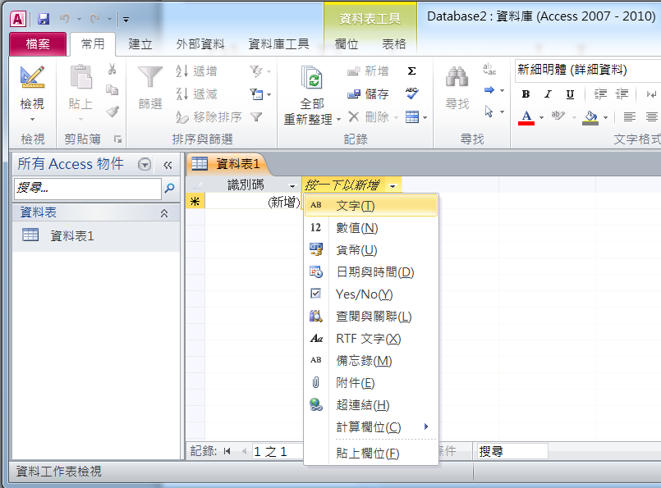
Access database
Click to choose data type

Slide 4
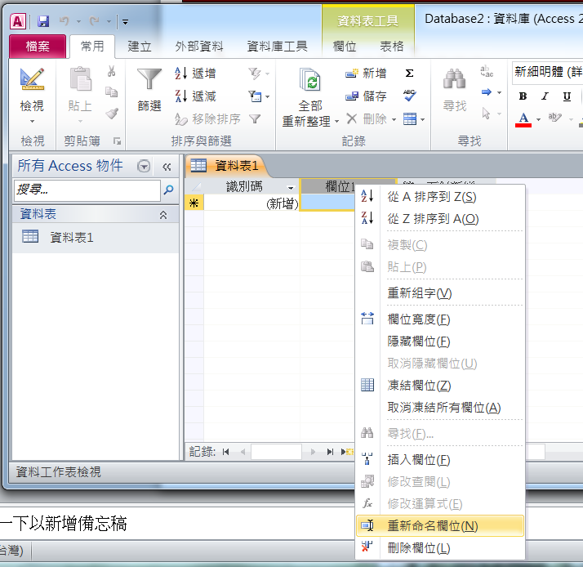
Access database
Click right button on field to rename the field

Slide 5
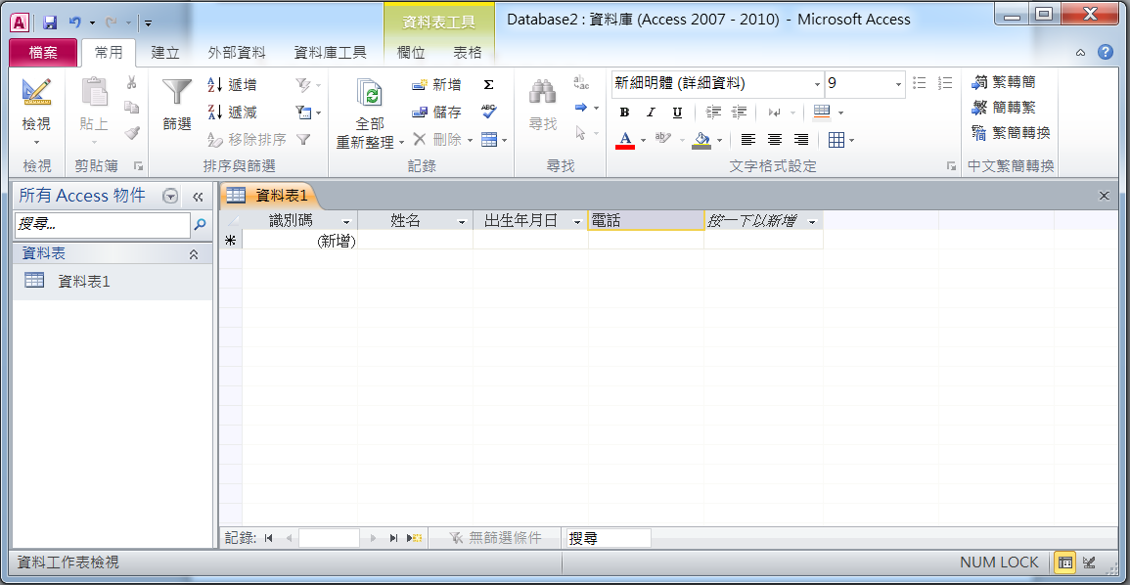
Access database
Name
文字(String)
Phone
文字(String)
Date
日期與時間(Date)

Slide 6
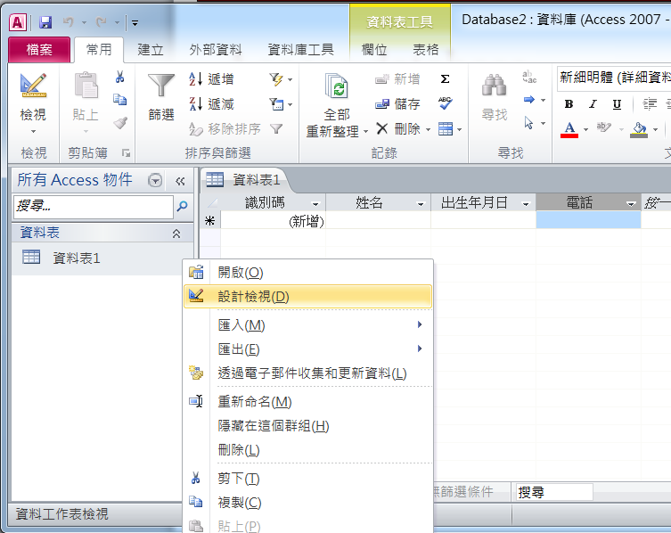
Access database
Click 設計檢視
Click right button on data table

Slide 7
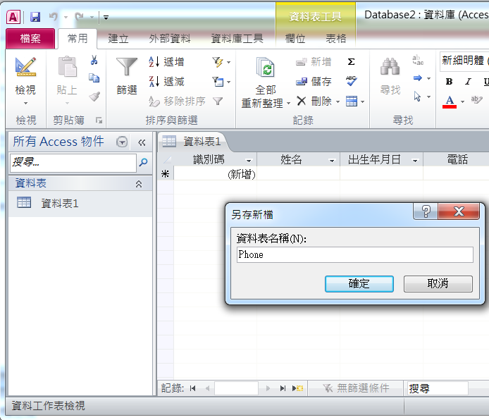
Access database
PhoneBook
Save data table

Slide 8
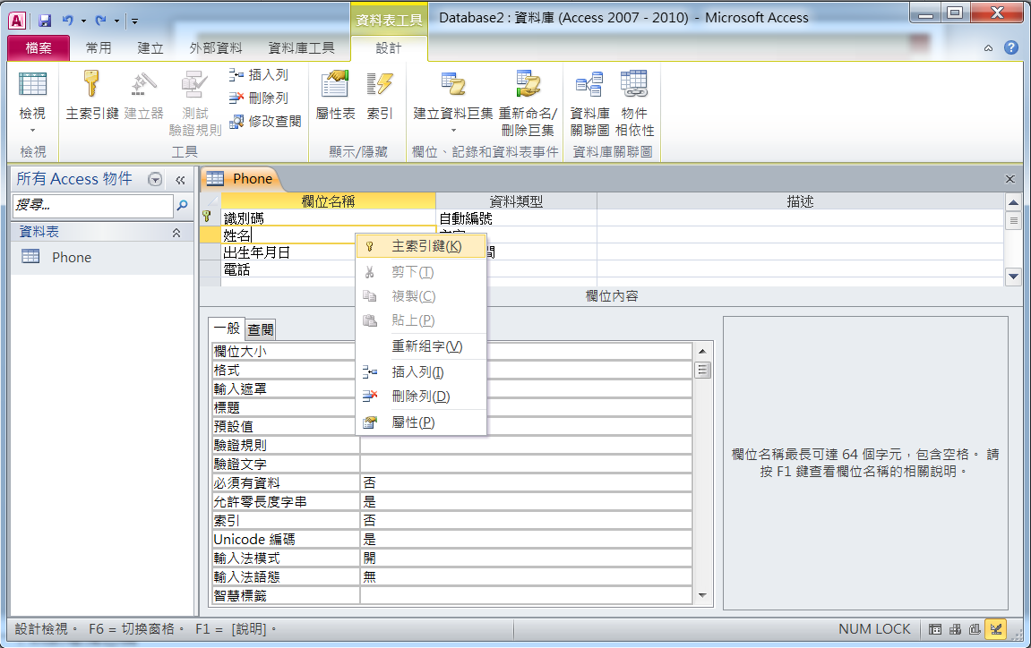
Access database
Click right button at name to change the primary key to name

Slide 9
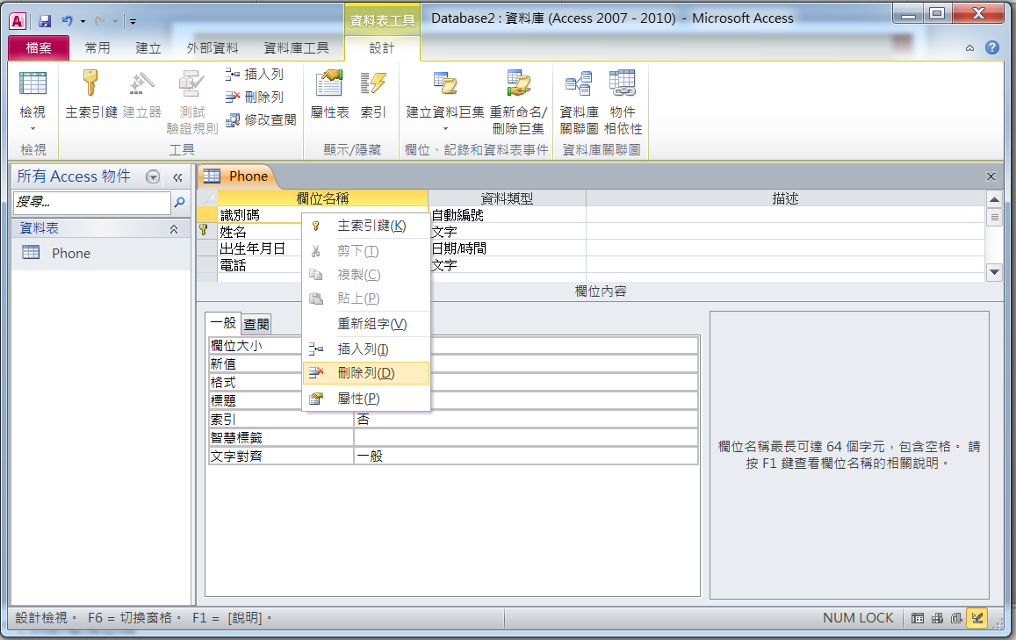
Access database
Click right button at id to delete id field

Slide 10
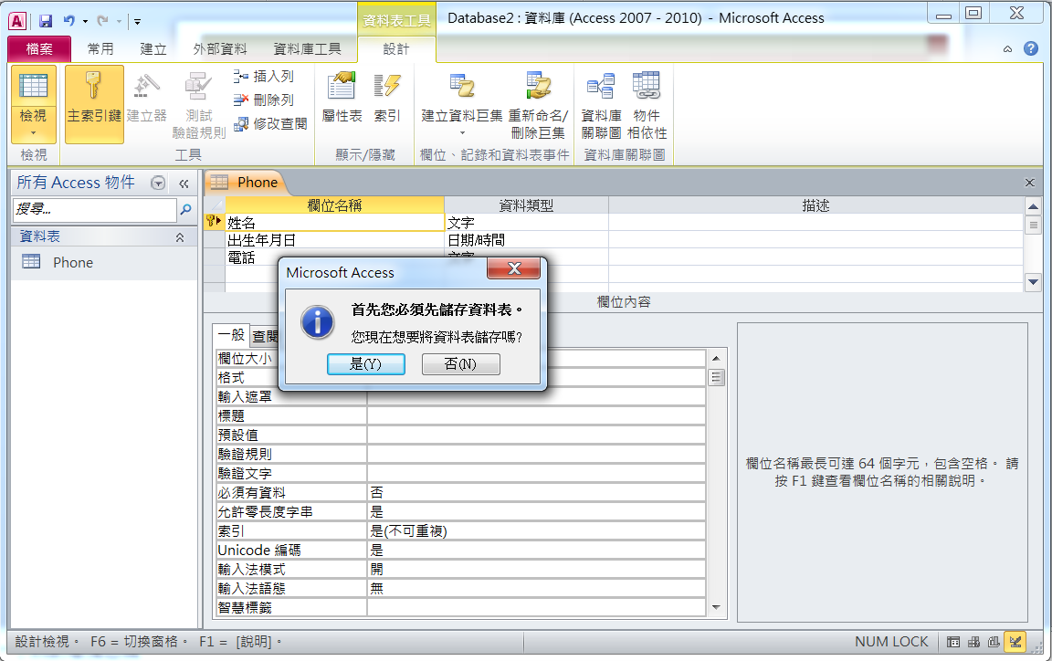
Access database
Click at view
Save data table

Slide 11
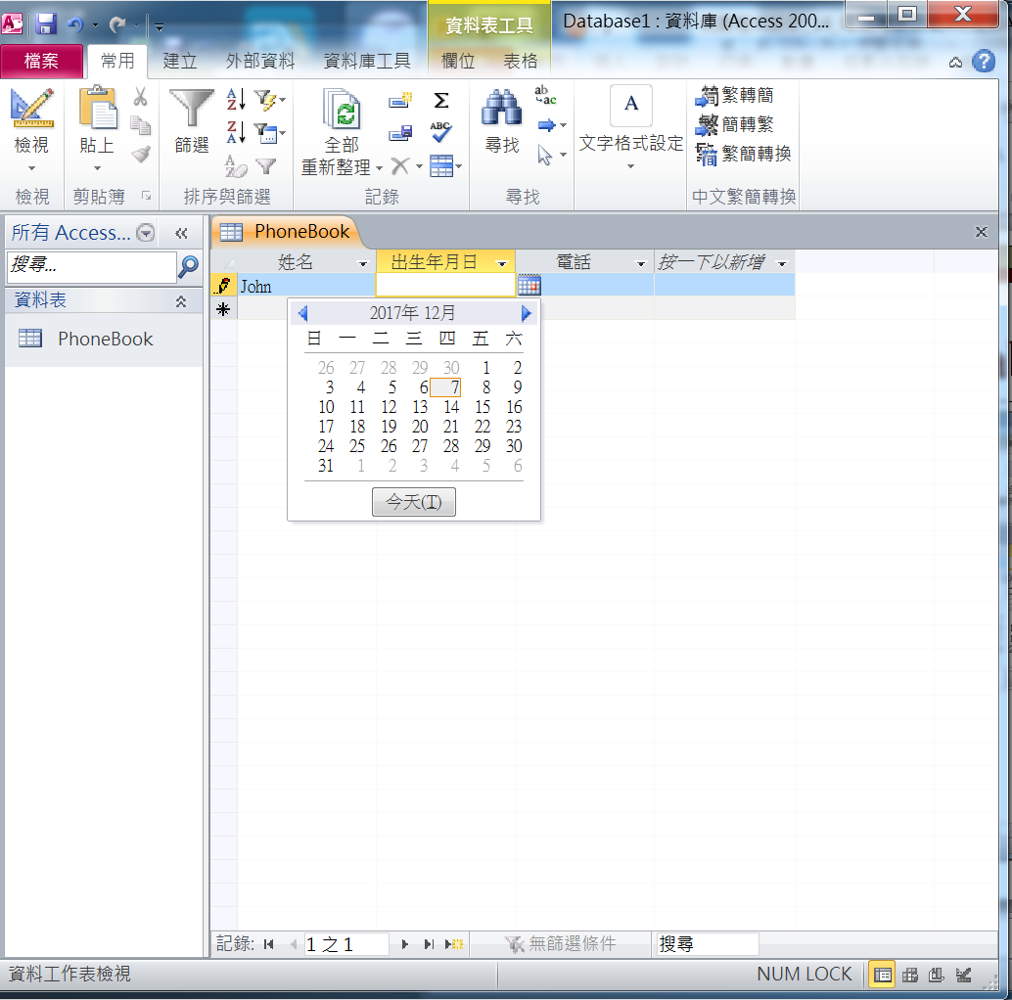
Access database
Input data

Slide 12
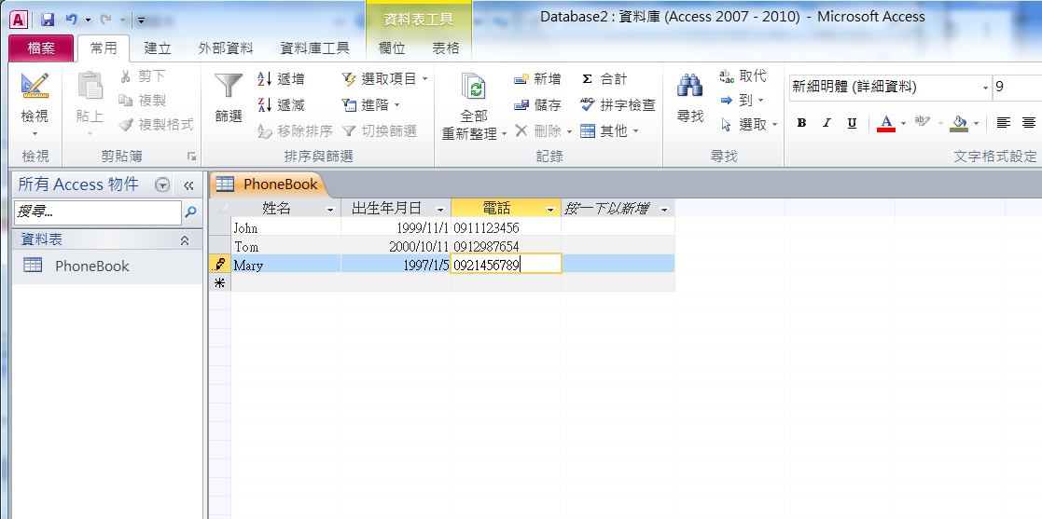
Access database
Input data

Slide 13
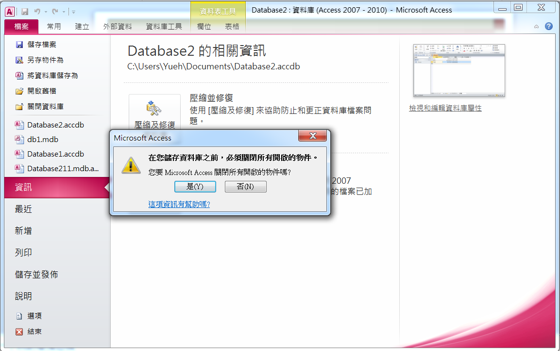
Access database
Save as
Click “yes”

Slide 14
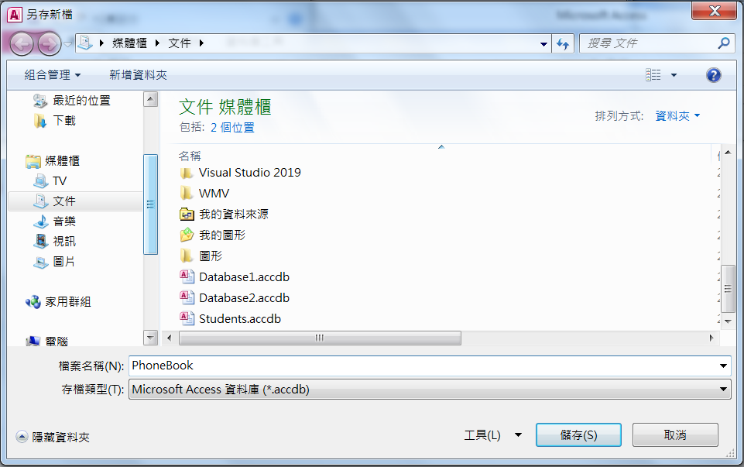
Access database
Save as PhoneBook

Slide 15
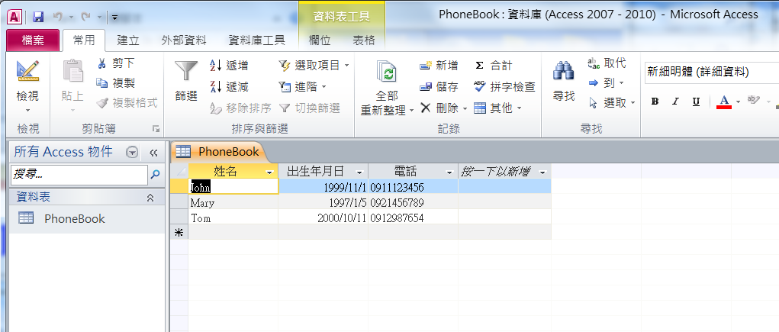
Exercise#14-1

Slide 16
內容來源
  跟著範例學會Visual C# 2015(張逸中/著; 博碩)
  Visual C# 2013視窗程式設計(黃聰明/著; 松崗)

