Slide 1
Window Programming 14-2
Integrated Example: PhoneBook I
Binding listBox
Yuan Ze University

Slide 2
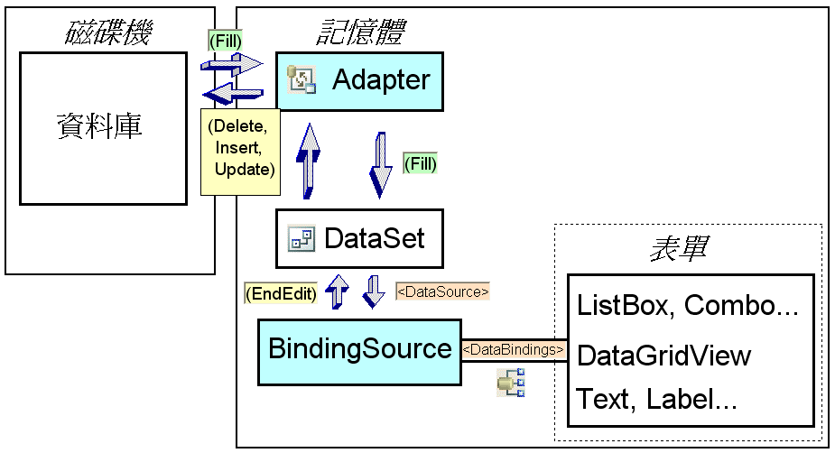
Binding to database
DataSet
TableAdapter
BindingSource

Slide 3
Components for connecting to Access database
Microsoft Office Access database engine 2007
Microsoft Access Database Engine 2010 Redistributable
https://www.microsoft.com/en-gb/download/details.aspx?id=13255

Slide 4
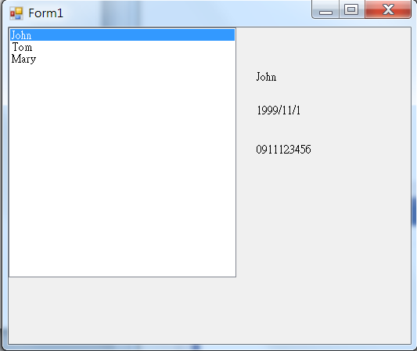
PhoneBook example I

Slide 5
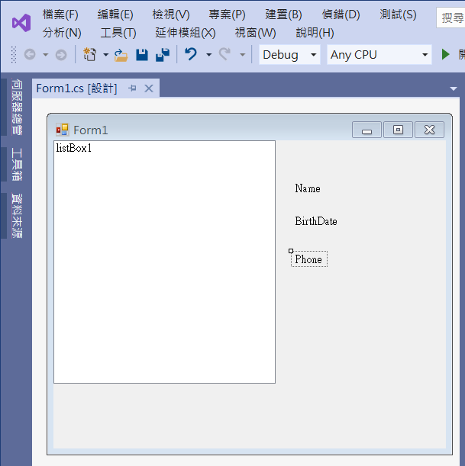
PhoneBook example I
Add listBox1
label1
label2
label3

Slide 6
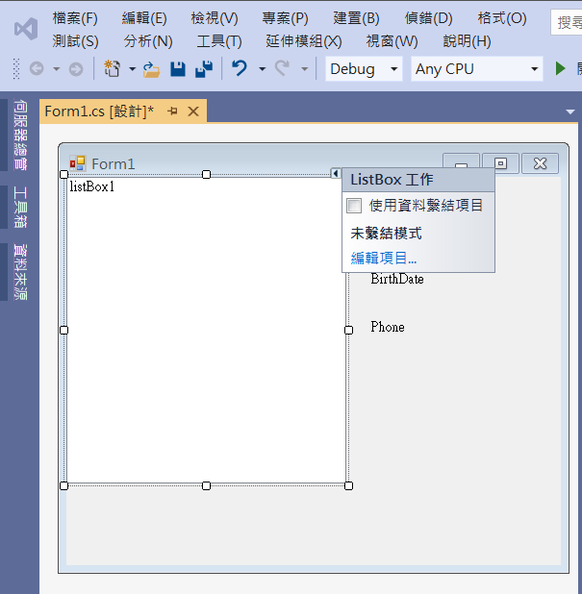
PhoneBook example I
1. Click at arrow
2. Click at data binding

Slide 7
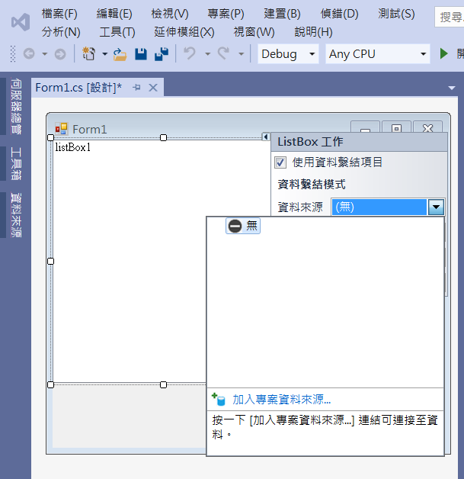
PhoneBook example I
1. Click at Data source
2. Click at Add a data source

Slide 8
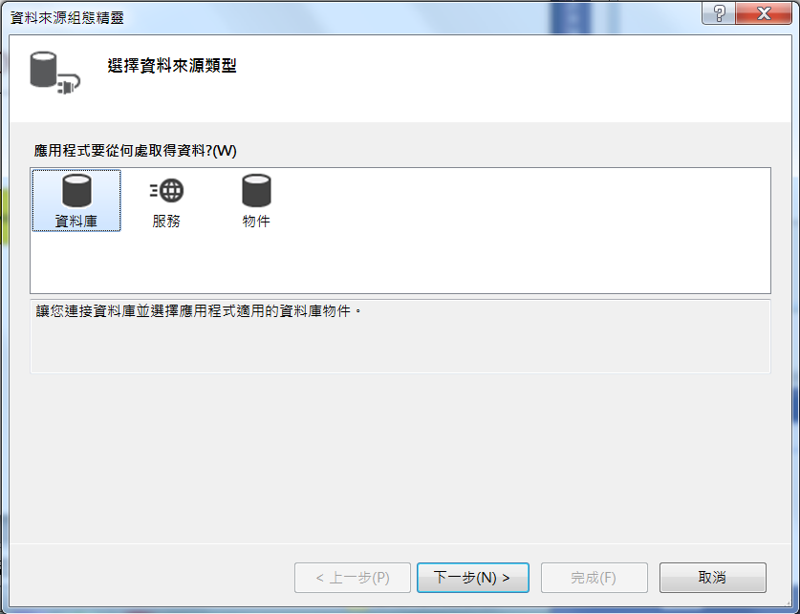
PhoneBook example I
1. Click at Database
2. Click at Next

Slide 9
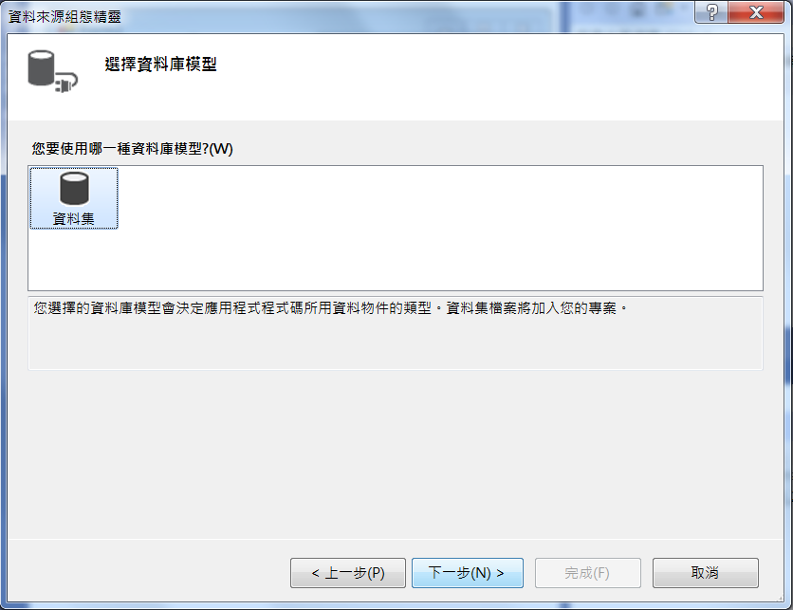
PhoneBook example I
1. Click at Database
2. Click at Next

Slide 10
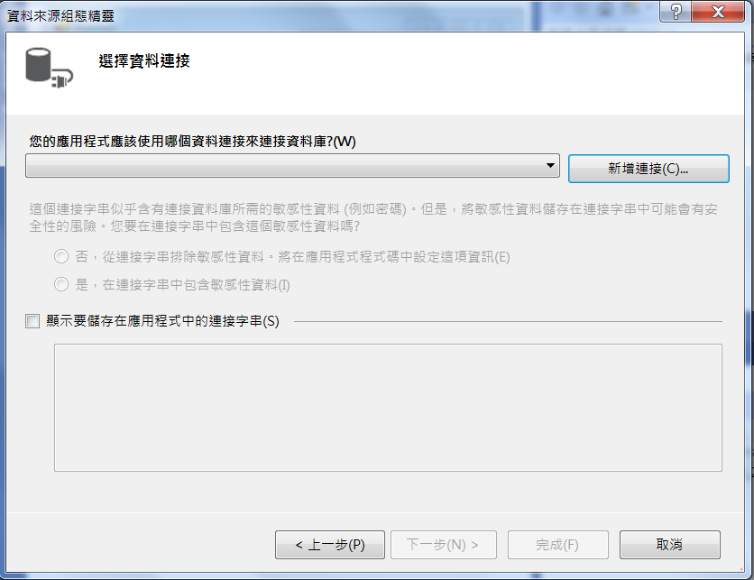
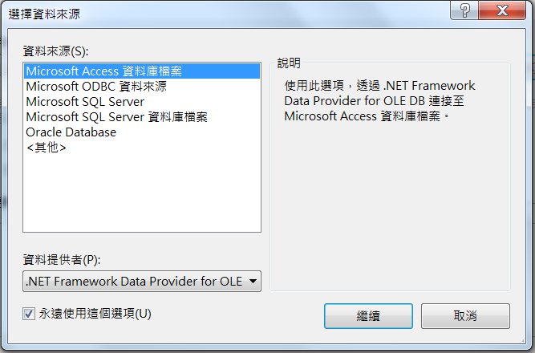
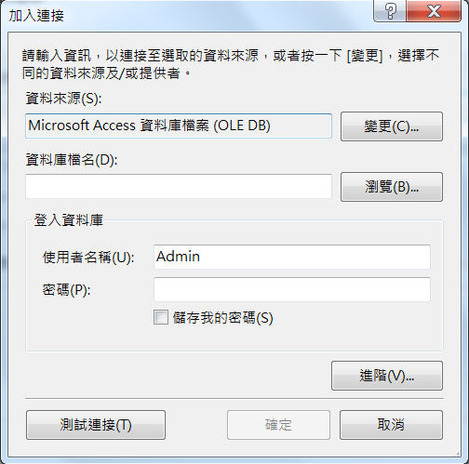
PhoneBook example I
1. Click at New
2. Click Access database
3. Click to choose database

Slide 11
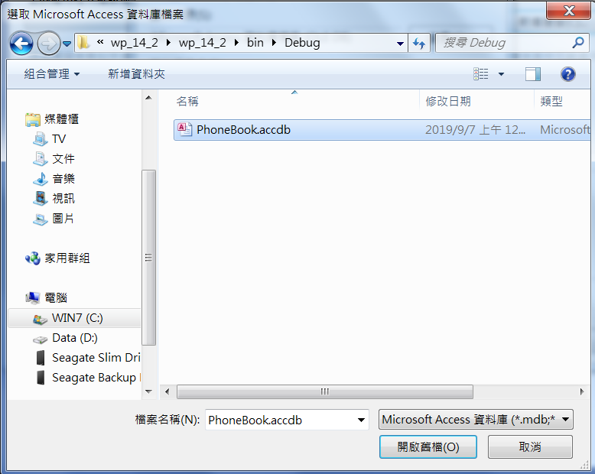
PhoneBook example I
1. Choose database file
2. Click Open

Slide 12
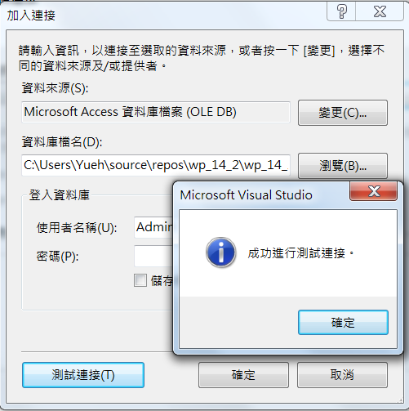
PhoneBook example I
2. Click OK
1. Click Test
3. Click OK

Slide 13
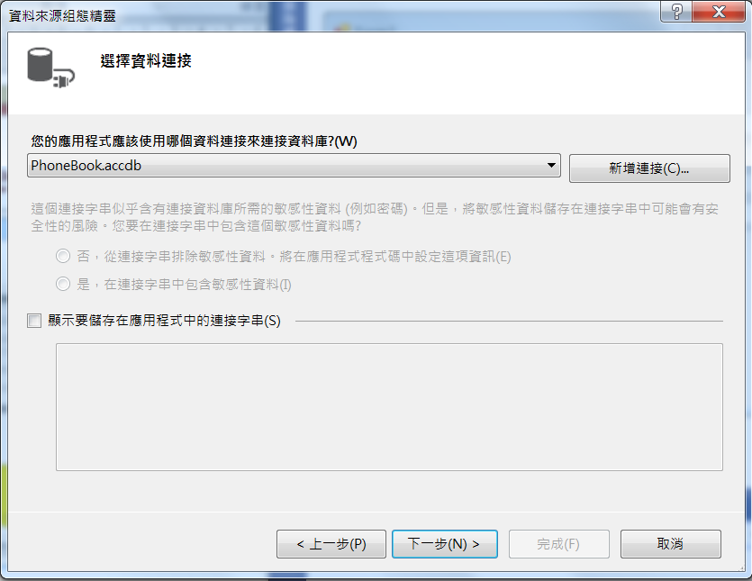
PhoneBook example I
Click Next

Slide 14
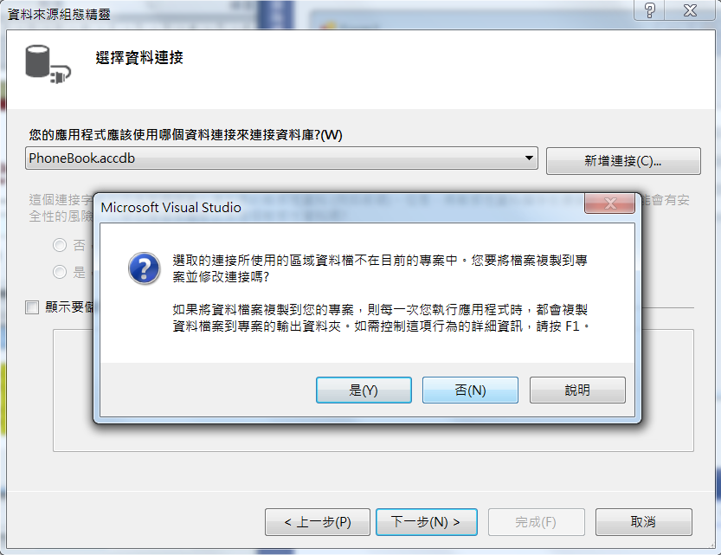
PhoneBook example I
Click No，不然每次變動都會複製出一份新的資料庫，原來的資料庫不會變動

Slide 15
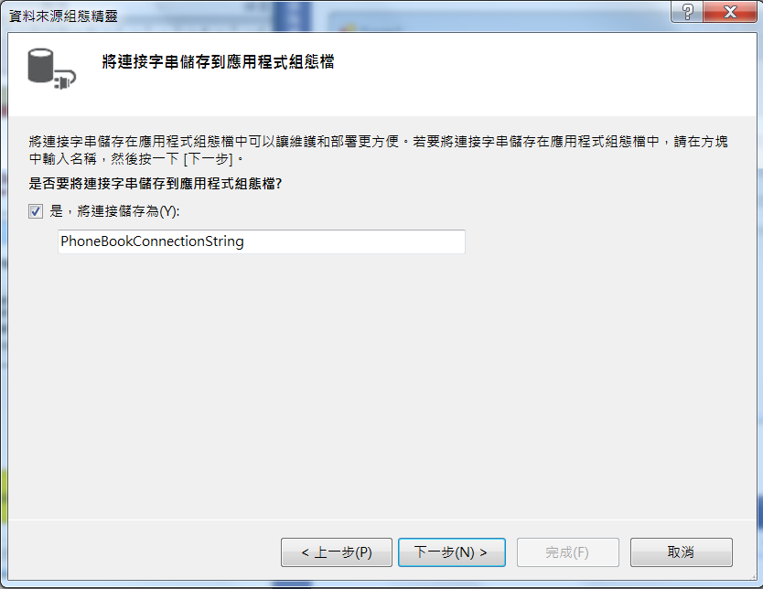
PhoneBook example I
Click Next

Slide 16
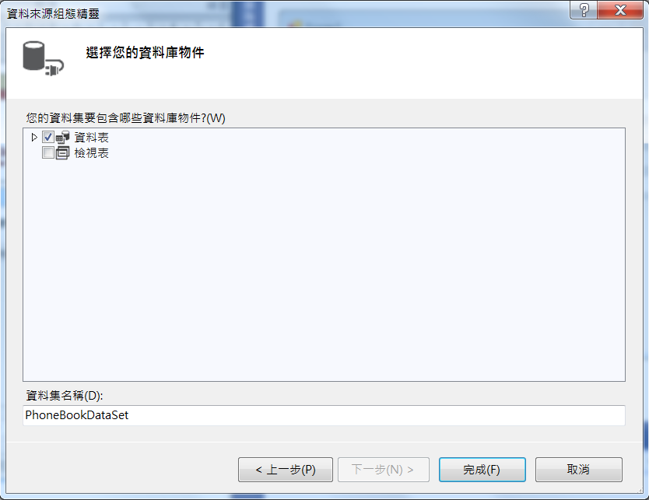
PhoneBook example I
Click to choose dataTable
Click OK

Slide 17
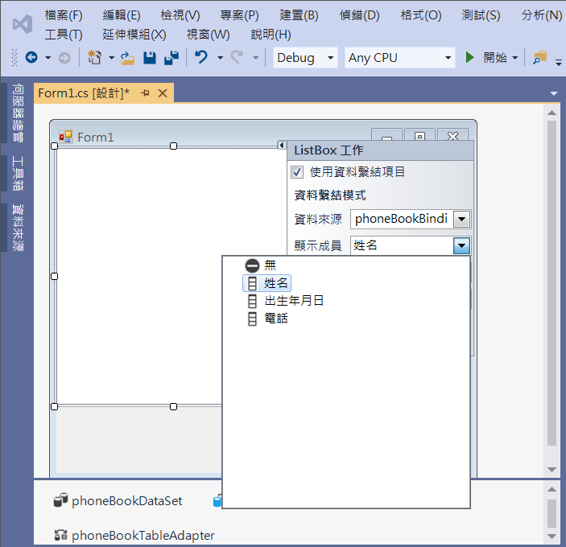
PhoneBook example I
Choose Name as Display member

Slide 18
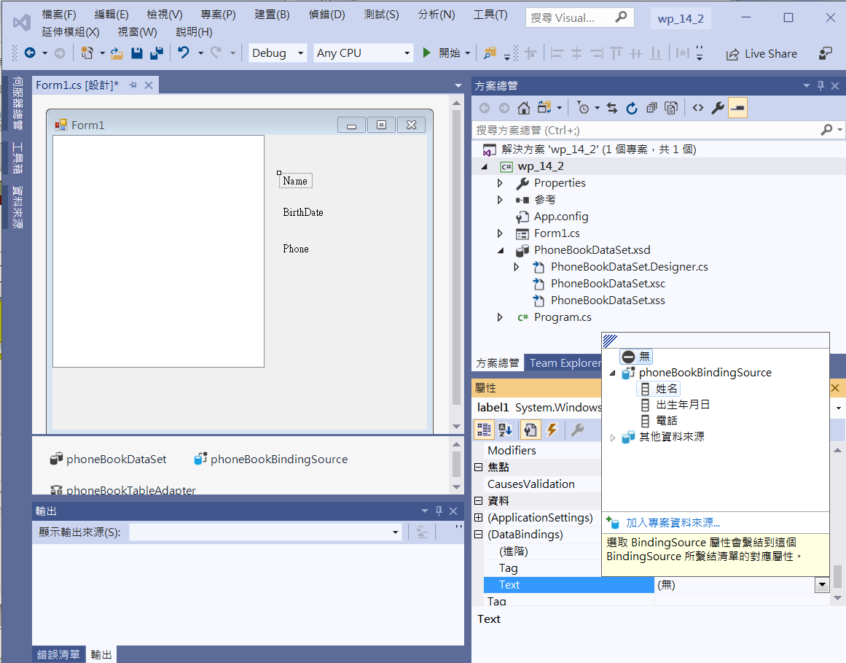
PhoneBook example I
Binding
label1 -> Name
label2 -> Data
label3 -> Phone
1. Click label1
3. Choose Name field for presentation
2. Click at DataBinding
Text

Slide 19
Connecting to Access database
連接Access資料庫時有時會連接不到，或是檔案換位置後就連不上。原因是因為Visual Studio的路徑設定。請依底下步驟放置Access資料庫以及建立連結。
1. 把Access資料庫(例如PhoneBook.accdb)放在專案的/bin/debug內。
2. 到Visual Studio專案，連結Access資料庫
3. 到Visual Studio專案，打開App.config檔案
找到底下這段路徑設定
<add name="access_test3.Properties.Settings.PhoneBookConnectionString"
connectionString="Provider=Microsoft.ACE.OLEDB.12.0;Data Source=|DataDirectory|\bin\debug\PhoneBook.accdb"
providerName="System.Data.OleDb" />
刪掉其中\bin\debug\部分(Visual Studio多加的)
變成
<add name="access_test3.Properties.Settings.PhoneBookConnectionString"
connectionString="Provider=Microsoft.ACE.OLEDB.12.0;Data Source=|DataDirectory|PhoneBook.accdb"
providerName="System.Data.OleDb" />
即可。

Slide 20
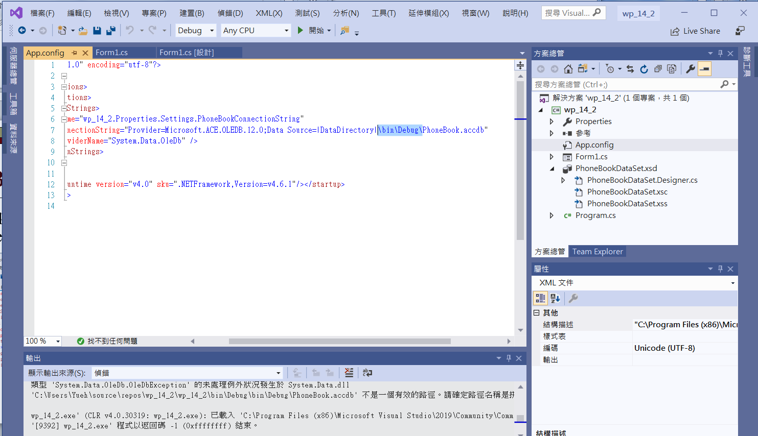
PhoneBook example I
開啟App.config檔，刪掉路徑中的\bin\Debug\
2. Delete “\bin\Debug\”
1. Double click App.config

Slide 21
PhoneBook example I
private void Form1_Load(object sender, EventArgs e)
{
// TODO: 這行程式碼會將資料載入 ‘phoneBookDataSet.Phone’ 資料表。您可以視需要進行移動或移除。
this.phoneTableAdapter.Fill(this.phoneBookDataSet.Phone);
}

Slide 22
Exercise#14-2

Slide 23
內容來源
  跟著範例學會Visual C# 2015(張逸中/著; 博碩)
  Visual C# 2013視窗程式設計(黃聰明/著; 松崗)

