Slide 1
Window Programming 14-3
Integrated Example: PhoneBook I
Modify, add, delete
Yuan Ze University

Slide 2
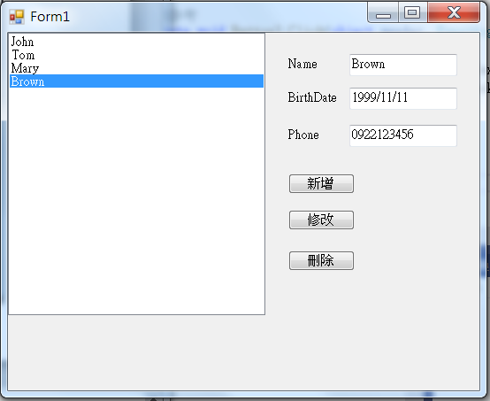
PhoneBook example I

Slide 3
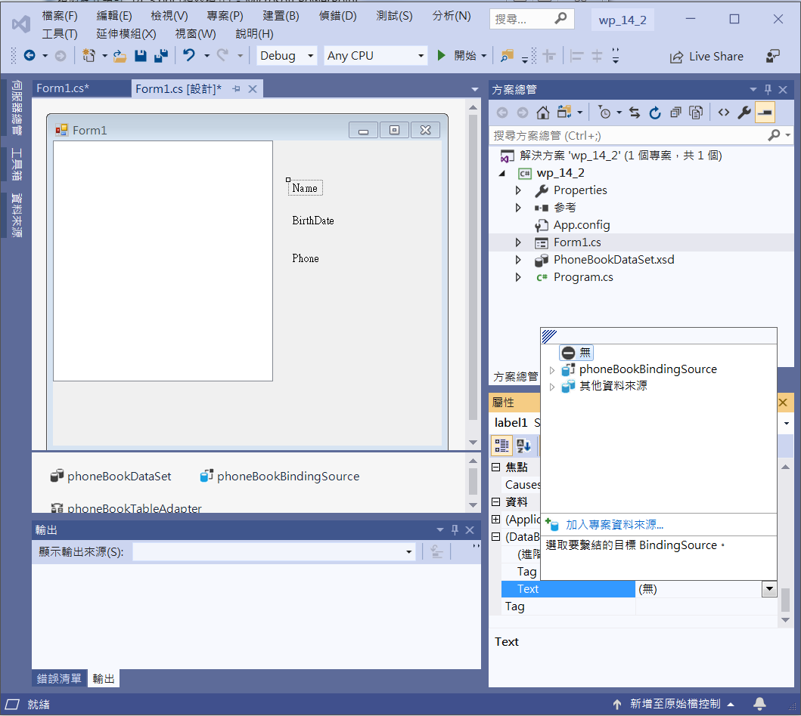
PhoneBook example I
Unbinding data
(刪掉DataBindings Text的內容)
label1
label2
label3
Unbinding label1

Slide 4
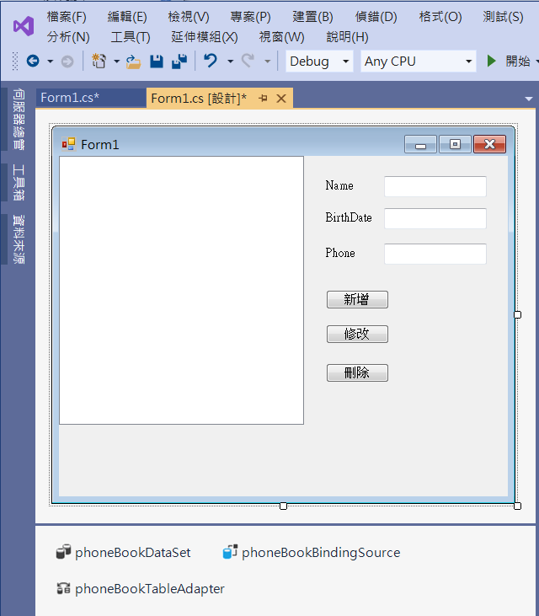
PhoneBook example I
textBox1
textBox2
textBox3
button1
button2
button3

Slide 5
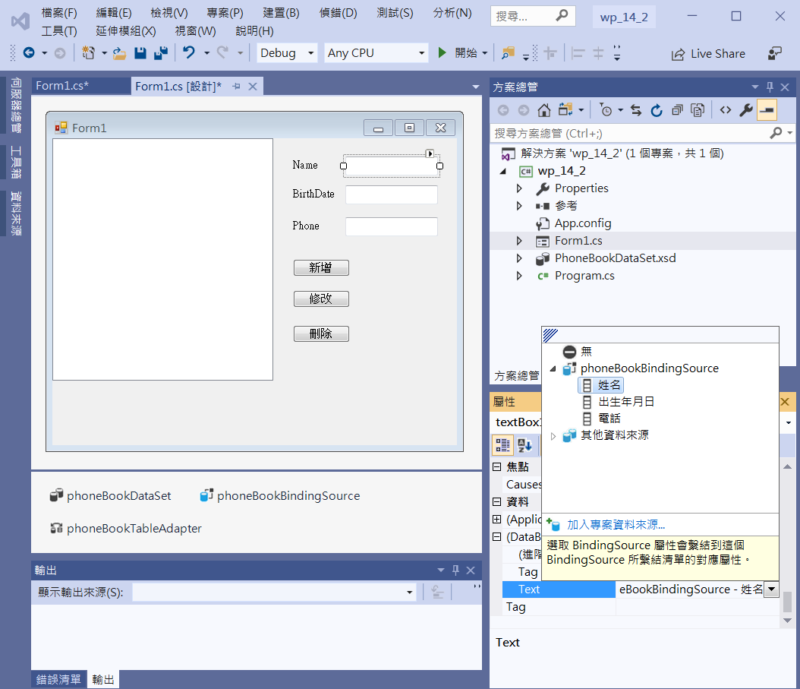
PhoneBook example I
Binding Data
textBox1-> Name
textBox2 -> BirthDate
textBox3 -> Phone
Binding name to textBox1

Slide 6
PhoneBook example I
private void Button1_Click(object sender, EventArgs e)
{
if ((this.phoneBookBindingSource.Find("姓名",textBox1.Text))!=-1)
{
MessageBox.Show("This name exists!");
}
else
{
this.phoneBookTableAdapter.Insert(textBox1.Text, DateTime.Parse(textBox2.Text), textBox3.Text);
this.phoneBookTableAdapter.Fill(this.phoneBookDataSet.PhoneBook);
}
}

Slide 7
PhoneBook example I
private void Button2_Click(object sender, EventArgs e)
{
this.phoneBookBindingSource.EndEdit();
this.phoneBookTableAdapter.Update(this.phoneBookDataSet);
}
private void Button3_Click(object sender, EventArgs e)
{
this.phoneBookTableAdapter.Delete(textBox1.Text, DateTime.Parse(textBox2.Text), textBox3.Text);
this.phoneBookTableAdapter.Fill(this.phoneBookDataSet.PhoneBook);
}

Slide 8
Exercise#14-3

Slide 9
內容來源
  跟著範例學會Visual C# 2015(張逸中/著; 博碩)
  Visual C# 2013視窗程式設計(黃聰明/著; 松崗)

