Slide 1
Window Programming 14-4
Integrated Example: PhoneBook I
MaskedTextBox, DateTimePicker
Yuan Ze University

Slide 2
MaskedTextBox
Validating the input value
Attributes
  Mask
    maskedTextBox1.Mask = "0000/90/90";
  ValidatingType
    maskedTextBox1.ValidatingType = typeof(System.DateTime);
Methods
  TypeValidationCompleted

Slide 3
DateTimePicker
Pick a DateTime
Attributes
  Value
  Format
    Long, Short, Time, Custom
Methods
  ValueChanged

Slide 4
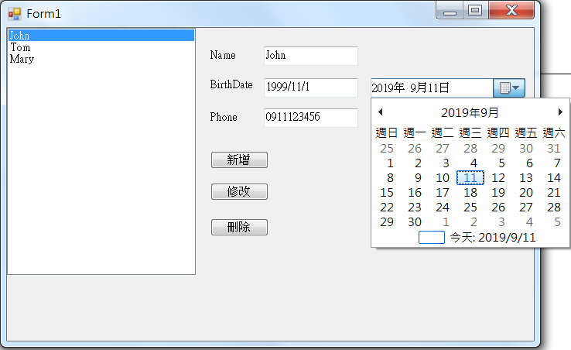
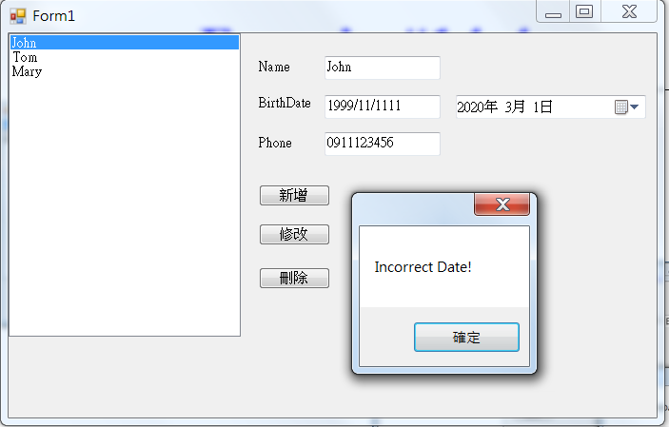
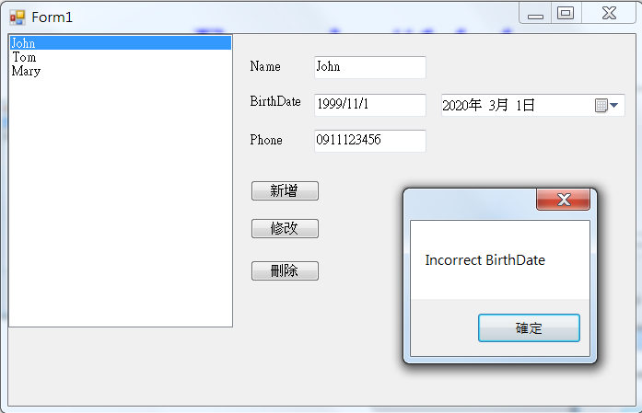
PhoneBook example I

Slide 5
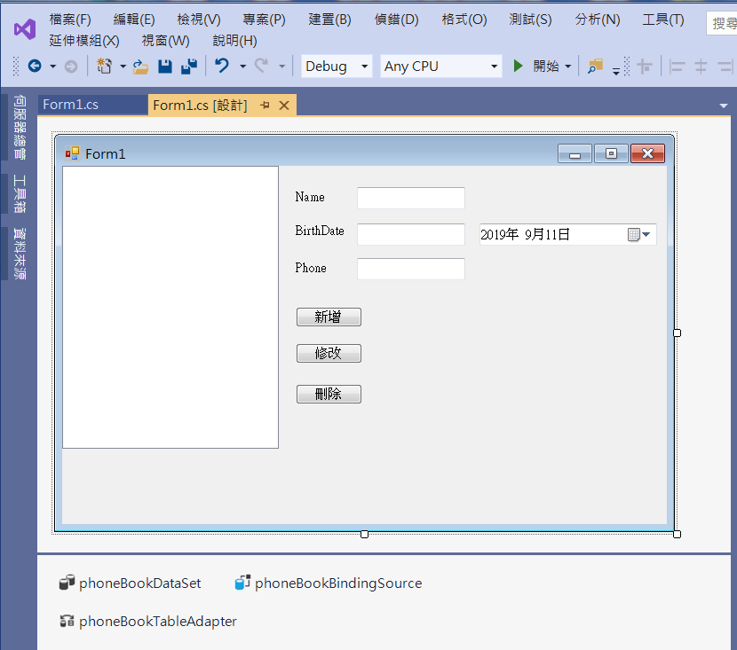
PhoneBook example I
刪掉 textBox2
新增 maskedTextBox1
dateTimePicker1

Slide 6
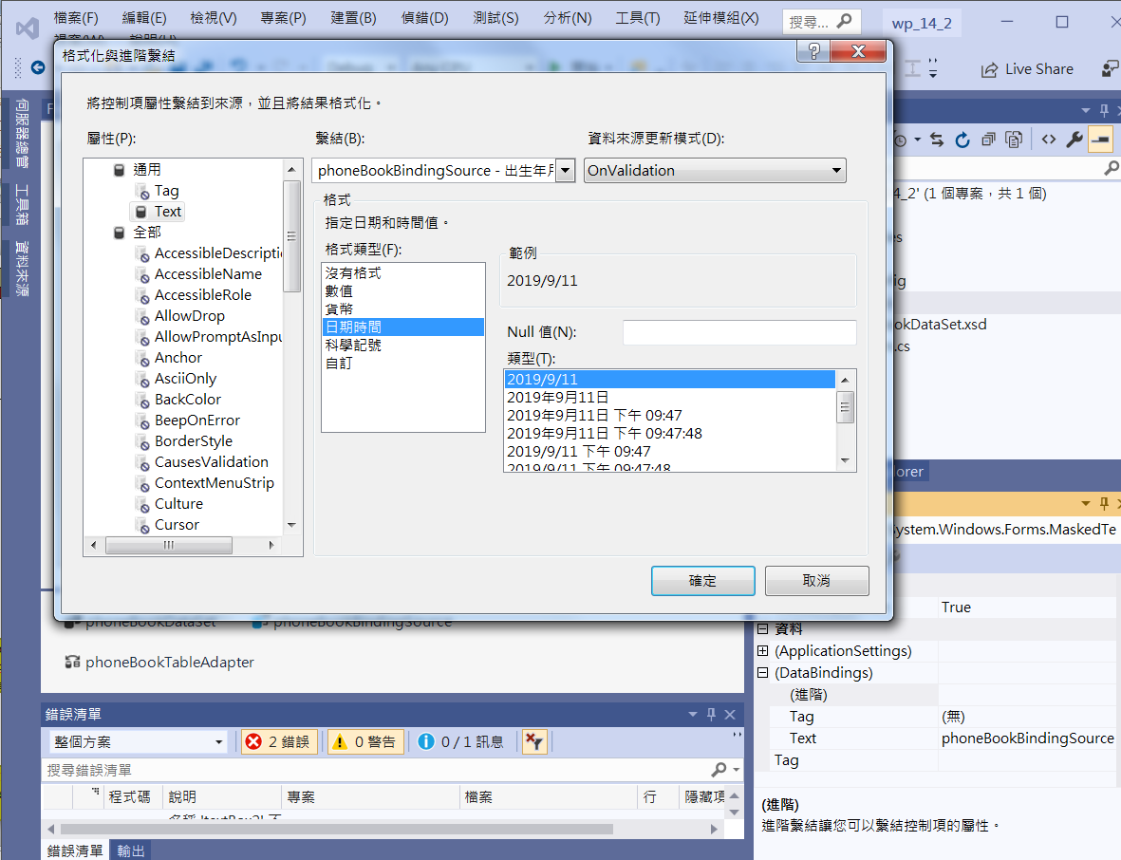
PhoneBook example I
4. Choose Datetime Format
3. Choose Datetime
2. maskedTextBox1
Click at (DataBindings)
Advanced (進階)
5. Click at OK
1. maskedTextBox1
Set DataBindings Text to BirthDate

Slide 7
PhoneBook example I
private void Form1_Load(object sender, EventArgs e)
{
// TODO: 這行程式碼會將資料載入 'phoneBookDataSet.Phone' 資料表。您可以視需要進行移動或移除。
this.phoneTableAdapter.Fill(this.phoneBookDataSet.Phone);
maskedTextBox1.ValidatingType = typeof(System.DateTime);
}

Slide 8
PhoneBook example I
private void Button1_Click(object sender, EventArgs e)
{
if ((this.phoneBindingSource.Find("姓名",textBox1.Text))!=-1)
{
MessageBox.Show("This name exists!");
}
else
{
this.phoneTableAdapter.Insert(textBox1.Text, DateTime.Parse(maskedTextBox1.Text), textBox3.Text);
this.phoneTableAdapter.Fill(this.phoneBookDataSet.Phone);
}
}

Slide 9
PhoneBook example I
private void Button3_Click(object sender, EventArgs e)
{
this.phoneTableAdapter.Delete(textBox1.Text, DateTime.Parse(maskedTextBox1.Text), textBox3.Text);
this.phoneTableAdapter.Fill(this.phoneBookDataSet.Phone);
}

Slide 10
PhoneBook example I
private void DateTimePicker1_ValueChanged(object sender, EventArgs e)
{
if (dateTimePicker1.Value.Date < DateTime.Now)
maskedTextBox1.Text = dateTimePicker1.Value.Date.ToShortDateString();
else
MessageBox.Show("Incorrect BirthDate");
}

Slide 11
PhoneBook example I
private void maskedTextBox1_TypeValidationCompleted(object sender, TypeValidationEventArgs e)
{
if (!e.IsValidInput)
{
MessageBox.Show("Incorrect Date!");
e.Cancel = true; // 不被接受的輸入，無法下個動作，
// 例如按“修改”按鈕會跳出警告MessageBox，也無法關閉視窗應用程式
}
else
{
DateTime userDate = (DateTime)e.ReturnValue;
if (userDate > DateTime.Now)
{
MessageBox.Show("Incorrect BirthDate");
e.Cancel = true; //不被接受的輸入
}
}
}

Slide 12
Exercise#14-4

Slide 13
內容來源
  跟著範例學會Visual C# 2015(張逸中/著; 博碩)
  Visual C# 2013視窗程式設計(黃聰明/著; 松崗)

