Slide 1
Window Programming 14-5
Integrated Example: PhoneBook I
Searching
Yuan Ze University

Slide 2
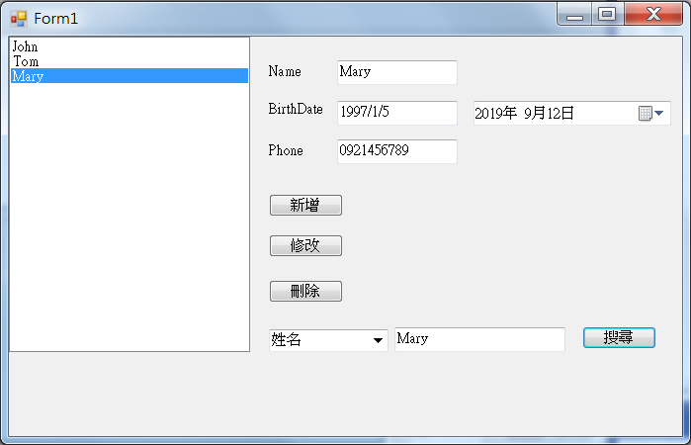
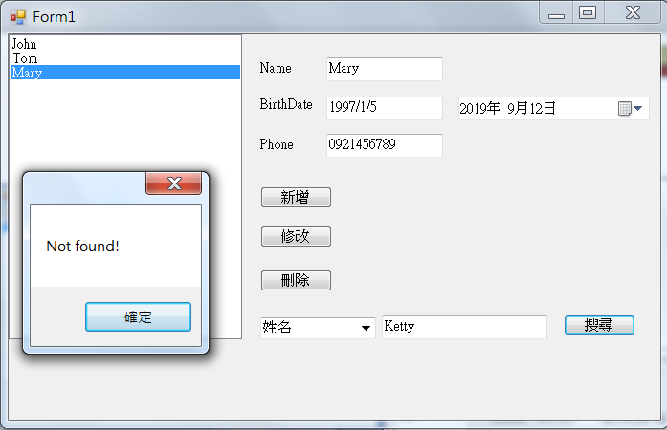
PhoneBook example I

Slide 3
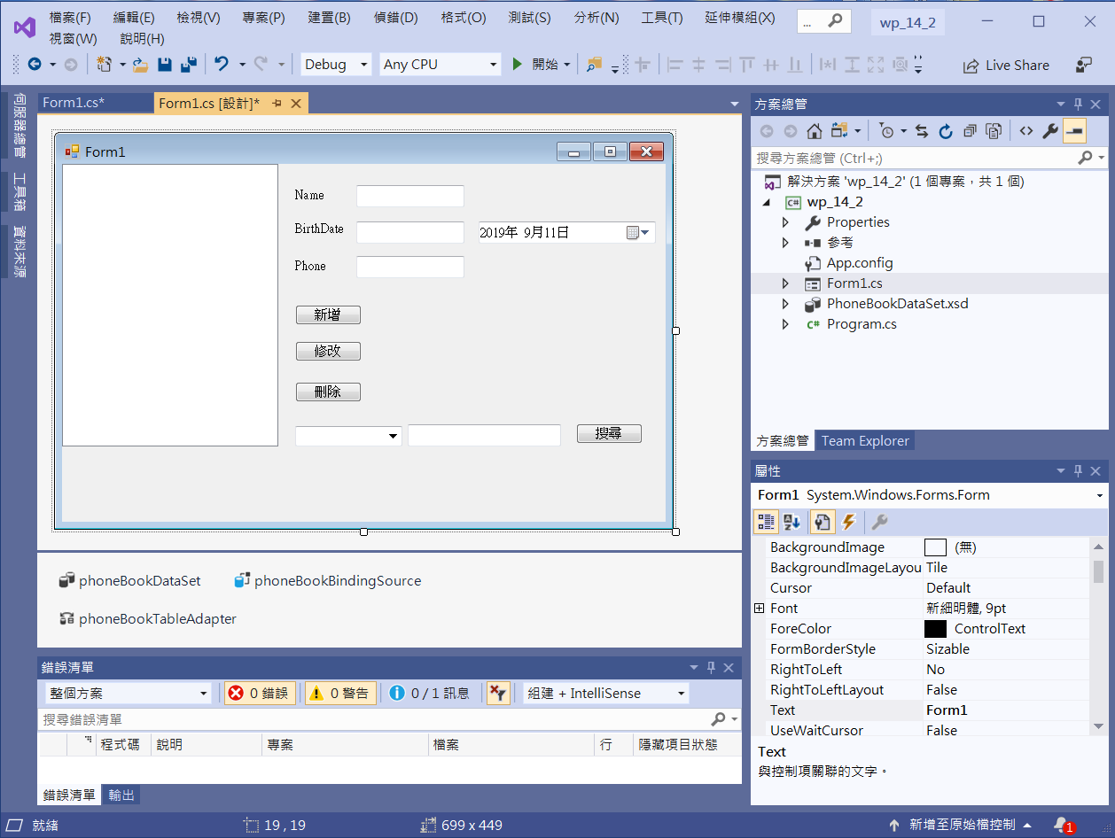
PhoneBook example I
button4
comboBox1
textBox2

Slide 4
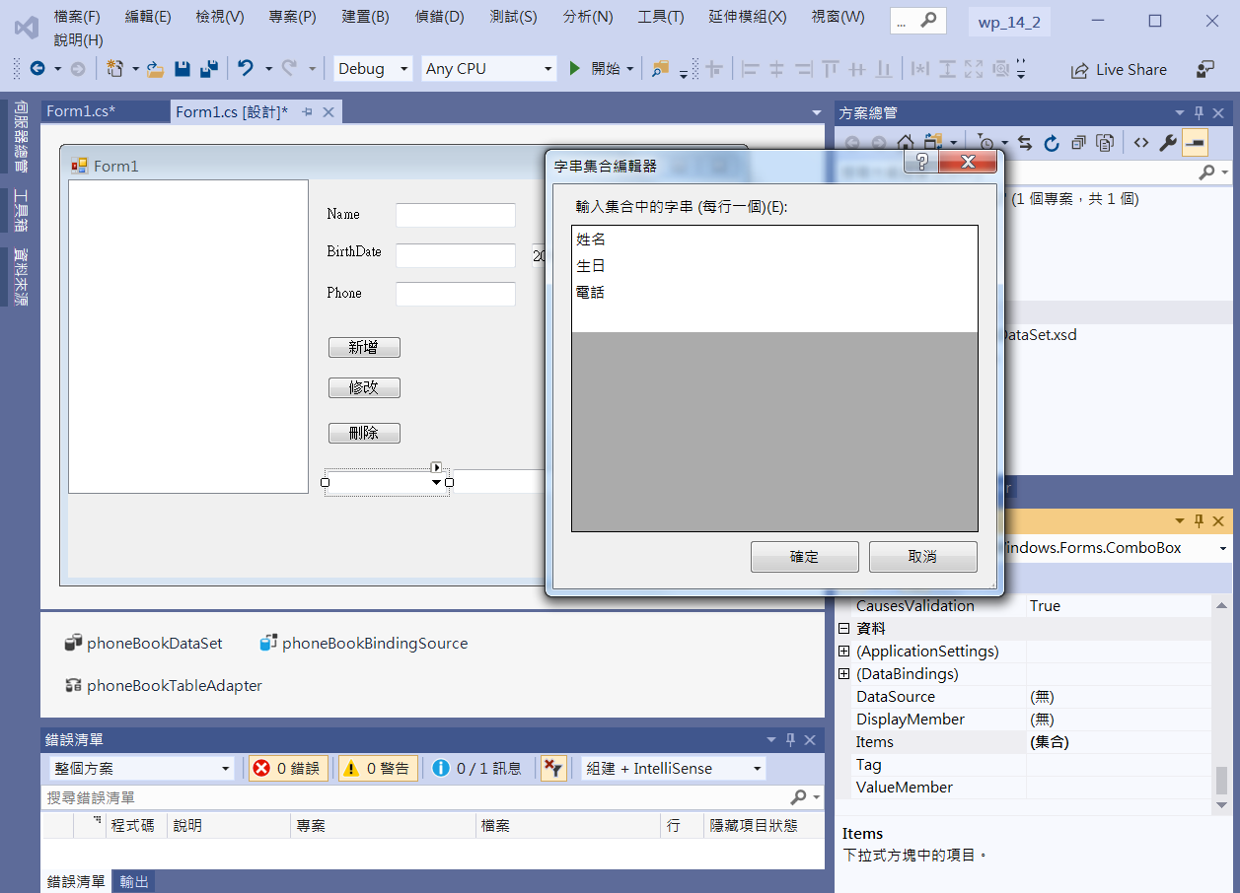
PhoneBook example I
3. Add Items
1. comboBox1
2. Click Items

Slide 5
PhoneBook example I
private void Button4_Click(object sender, EventArgs e)
{
int i = -1;
switch (comboBox1.Text)
{
case "姓名":
i= this.phoneBookBindingSource.Find("姓名", textBox2.Text);
break;
case "電話":
i = this.phoneBookBindingSource.Find("電話", textBox2.Text);
break;

Slide 6
PhoneBook example I
case "生日":
DateTime d;
if (DateTime.TryParse(textBox2.Text, out d))
i = this.phoneBookBindingSource.Find("出生年月日",d);
break;
}
if (i != -1)
this.phoneBookBindingSource.Position = i;
else
MessageBox.Show("Not found!");
}

Slide 7
Exercise#14-5

Slide 8
內容來源
  跟著範例學會Visual C# 2015(張逸中/著; 博碩)
  Visual C# 2013視窗程式設計(黃聰明/著; 松崗)

