Slide 1
Window Programming 14-6
Integrated Example: PhoneBook II
Binding to DataGridView
Yuan Ze University

Slide 2
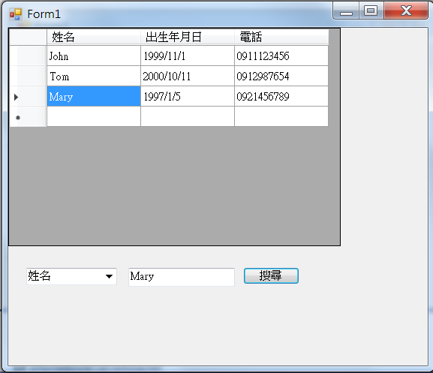
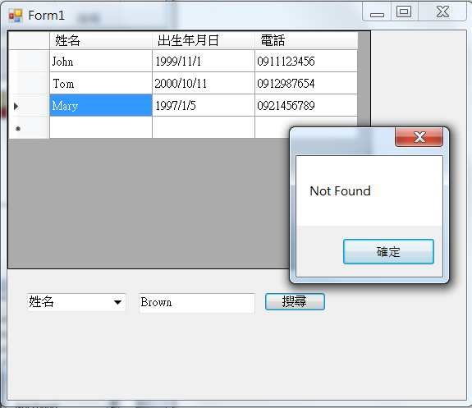
PhoneBook example II

Slide 3
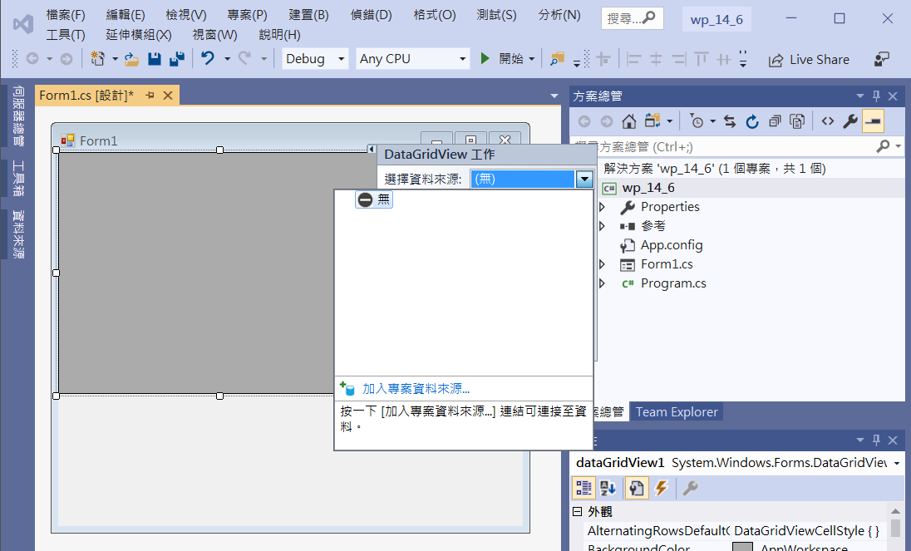
PhoneBook example II
1. Add dataGridView1
2. Click at Arrow
3. Click at Arrow
4. Add source

Slide 4
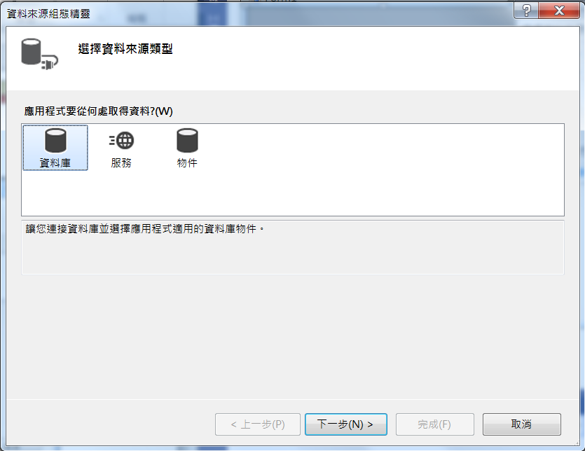
PhoneBook example II
Click next

Slide 5
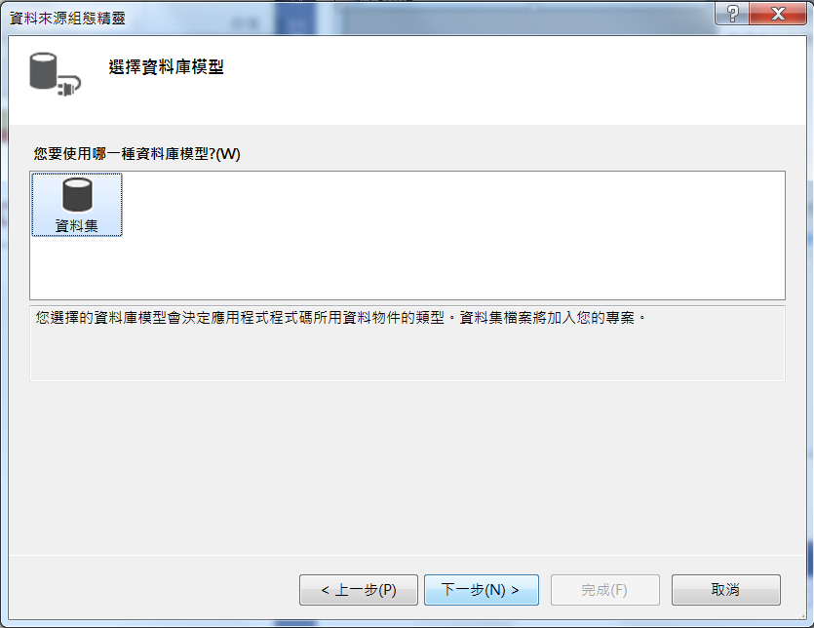
PhoneBook example II
Click next

Slide 6
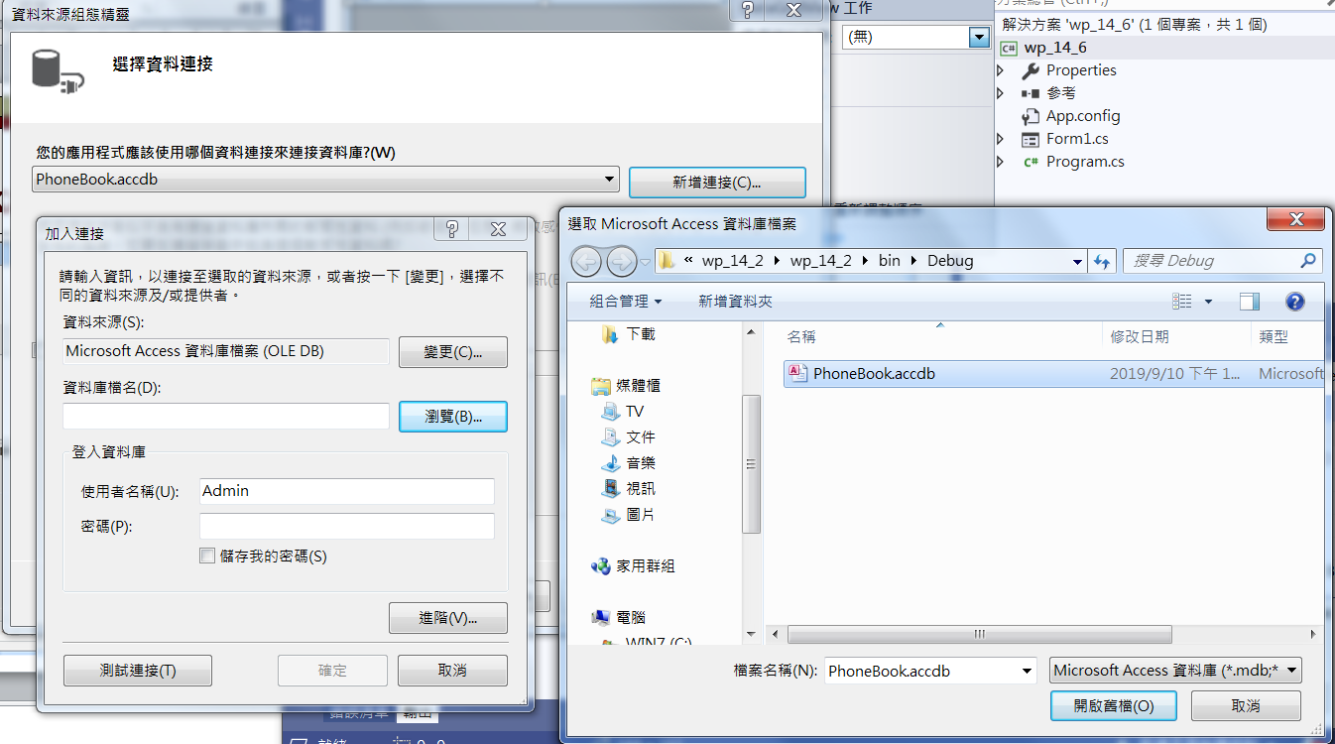
PhoneBook example II
1. Add new connection
3. Choose file
2. Choose file
4. Open file

Slide 7
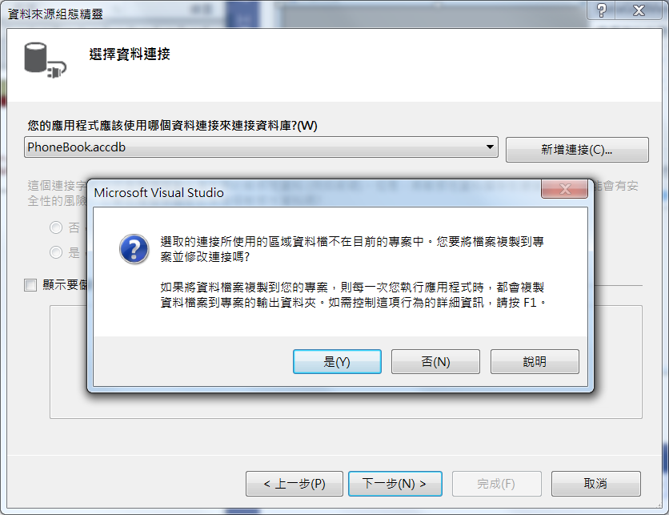
PhoneBook example II
Choose No

Slide 8
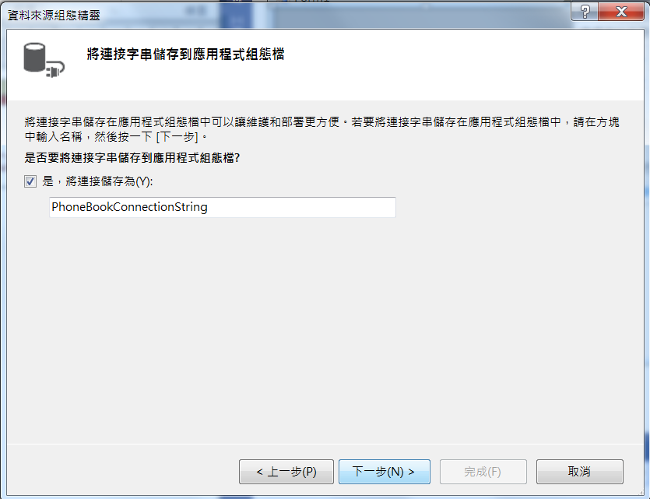
PhoneBook example II
Click next

Slide 9
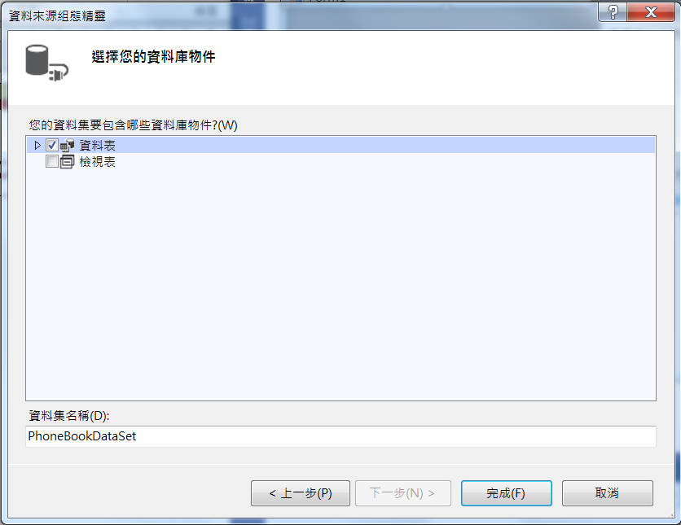
PhoneBook example II
Enable data table
Click Ok

Slide 10
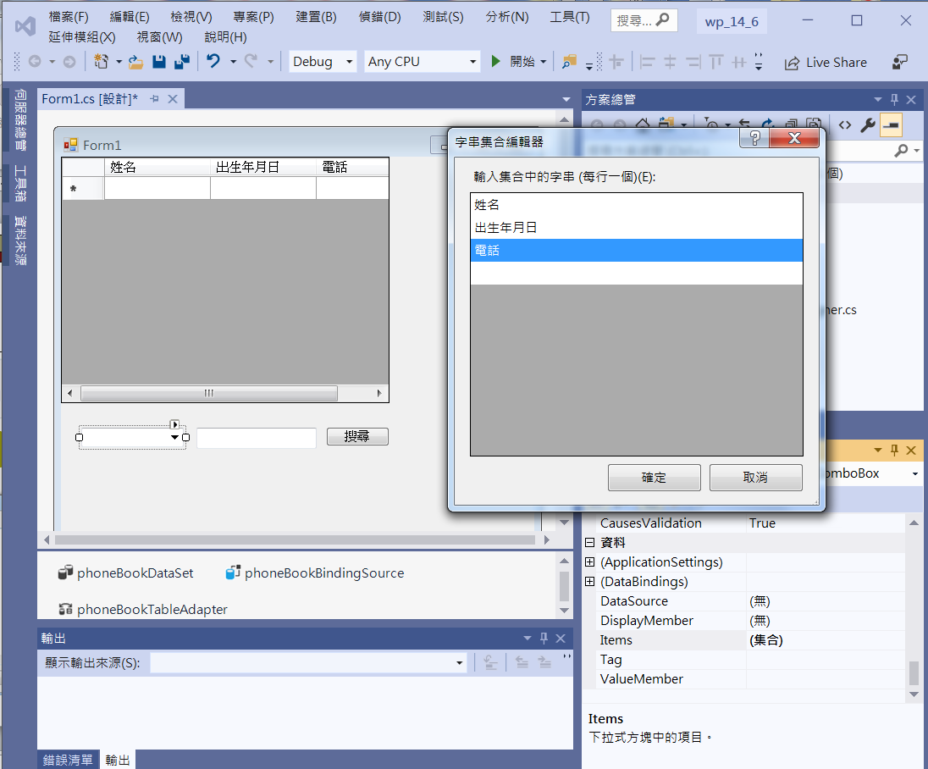
PhoneBook example II
3. Add Items into comboBox1
1. comboBox1
4. textBox1
5. button1
2. Click Items of comboBox1

Slide 11
PhoneBook example II
private void DataGridView1_CellValueChanged(object sender, DataGridViewCellEventArgs e)
{
this.phoneBookBindingSource.EndEdit();
this.phoneBookTableAdapter.Update(this.phoneBookDataSet);
}

Slide 12
PhoneBook example II
private void Button1_Click(object sender, EventArgs e)
{
bool found=false;
switch (comboBox1.Text)
{
case "姓名":
for (int i = 0; i < dataGridView1.RowCount - 1; i++)
{
if (dataGridView1[0, i].Value.ToString().IndexOf(textBox1.Text) >= 0)
{
this.phoneBookBindingSource.Position = i;
found = true;
}
}
if (found != true)
MessageBox.Show("Not Found");
break;

Slide 13
PhoneBook example II
case "出生年月日":
DateTime d;
if (DateTime.TryParse(textBox1.Text, out d))
{
for (int i = 0; i < dataGridView1.RowCount - 1; i++)
{
if (dataGridView1[1, i].Value.ToString().IndexOf(textBox1.Text) >= 0)
{
this.phoneBookBindingSource.Position = i;
found = true;
}
}
if (found != true)
MessageBox.Show("Not Found");
}
else MessageBox.Show("Unvalid Date");
break;

Slide 14
PhoneBook example II
case "電話":
for (int i = 0; i < dataGridView1.RowCount - 1; i++)
{
if (dataGridView1[2, i].Value.ToString().IndexOf(textBox1.Text) >= 0)
{
this.phoneBookBindingSource.Position = i;
found = true;
}
}
if (found != true)
MessageBox.Show("Not Found");
break;
}
}

Slide 15
Exercise#14-6

Slide 16
內容來源
  跟著範例學會Visual C# 2015(張逸中/著; 博碩)
  Visual C# 2013視窗程式設計(黃聰明/著; 松崗)

