Slide 1
Window Programming 14-7
Integrated Example: PhoneBook II
BindingNavigator
Yuan Ze University

Slide 2
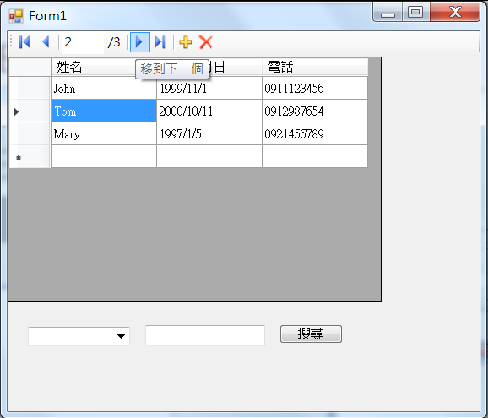
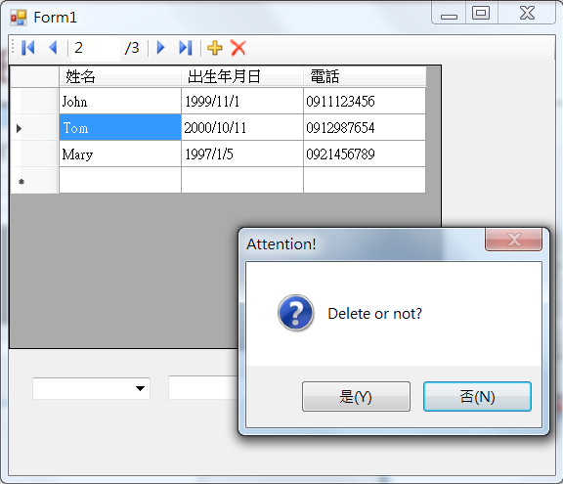
PhoneBook example II

Slide 3
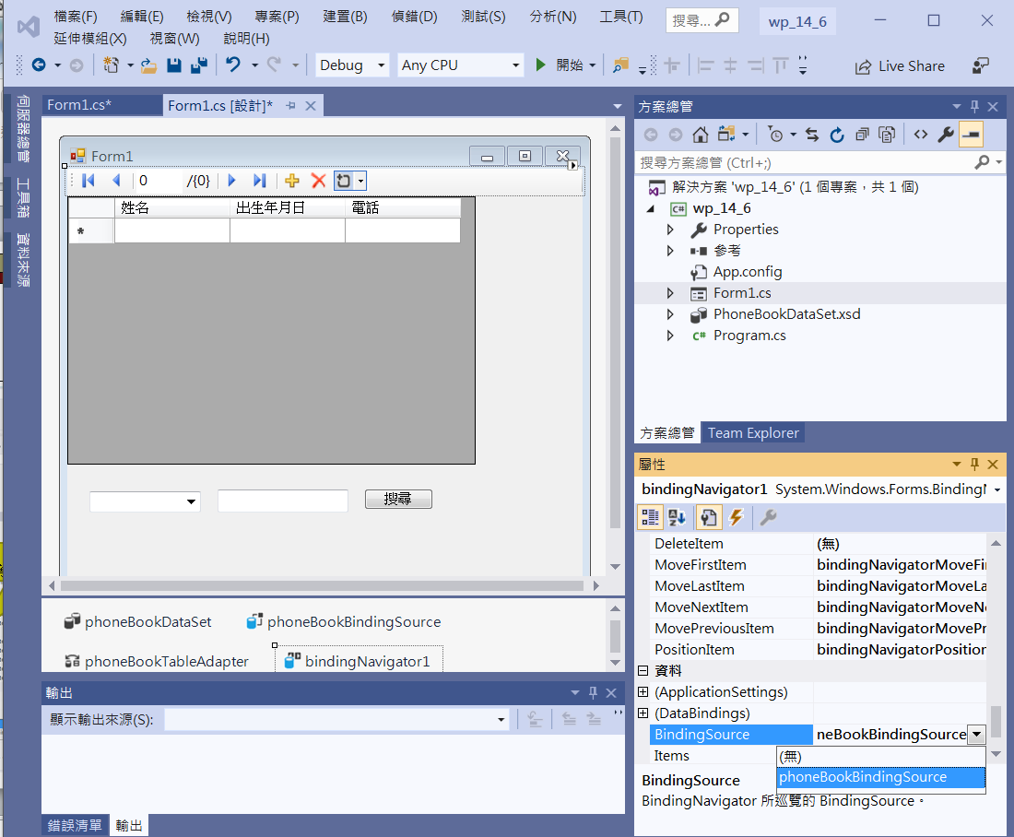
PhoneBook example II
1.Add bindingNavigator1
2. Add BindingSource

Slide 4
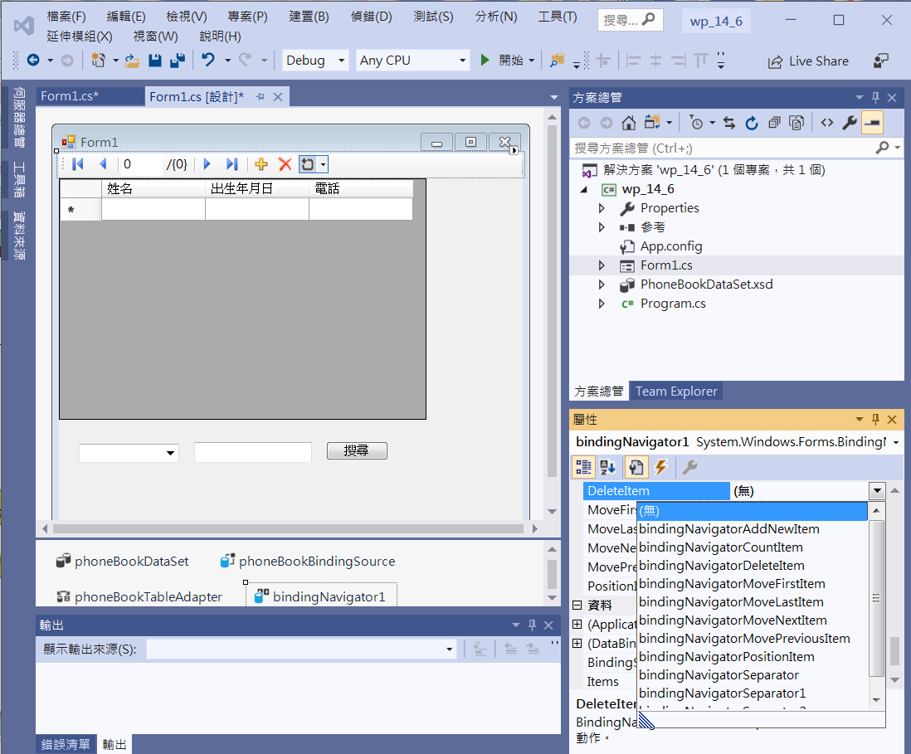
PhoneBook example II
DeleteItem Chooses “無”
等下寫自己的回應函數

Slide 5
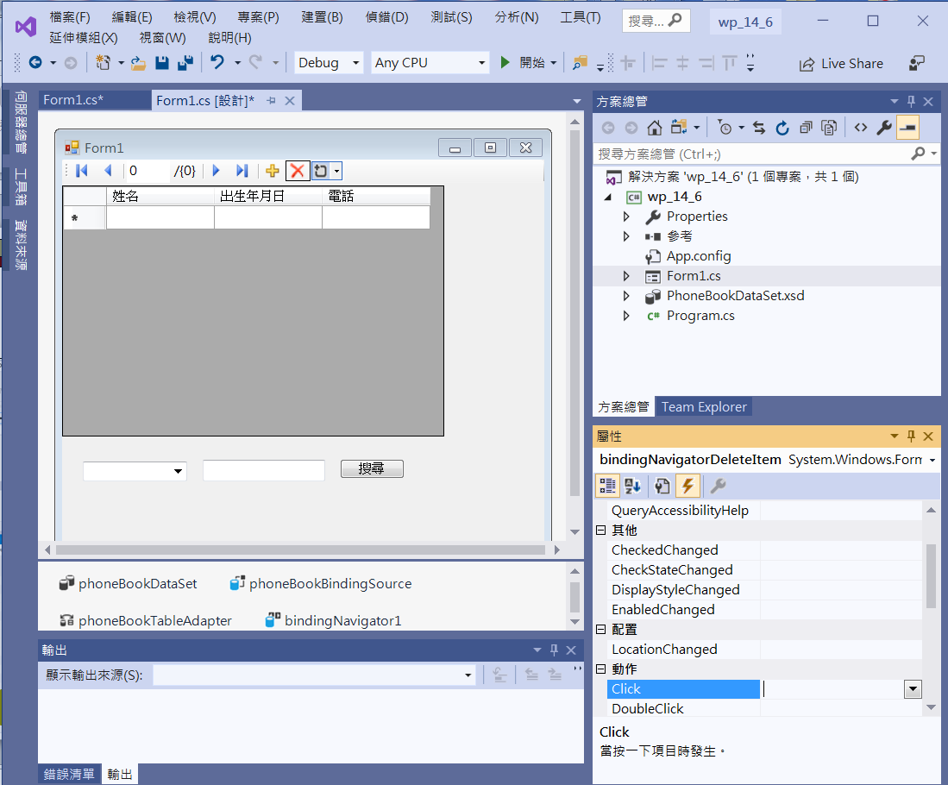
PhoneBook example II
1. Click at DeleteItem
2. Add Click event_function

Slide 6
PhoneBook example II
private void BindingNavigatorDeleteItem_Click(object sender, EventArgs e)
{
//另外寫的DeleteItem回應函數，增加MessageBox提醒
if (MessageBox.Show("Delete or not?", "Attention!", MessageBoxButtons.YesNo, MessageBoxIcon.Question, MessageBoxDefaultButton.Button2) == DialogResult.Yes)
{
phoneBookBindingSource.RemoveCurrent();
this.phoneBookTableAdapter.Update(this.phoneBookDataSet);
}
}

Slide 7
Exercise#14-7

Slide 8
內容來源
  跟著範例學會Visual C# 2015(張逸中/著; 博碩)
  Visual C# 2013視窗程式設計(黃聰明/著; 松崗)

