Slide 1
Window Programming 14-1
Integrated Example: MyNote
TextBox記事本範例
讀檔、存檔、另存新檔
Yuan Ze University

Slide 2
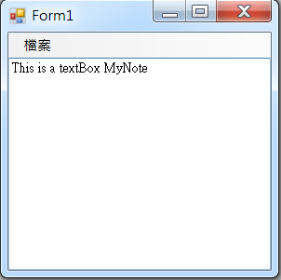
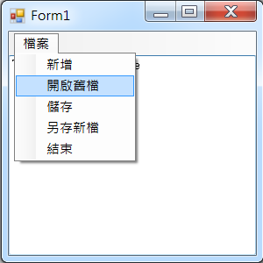
TextBox記事本範例

Slide 3
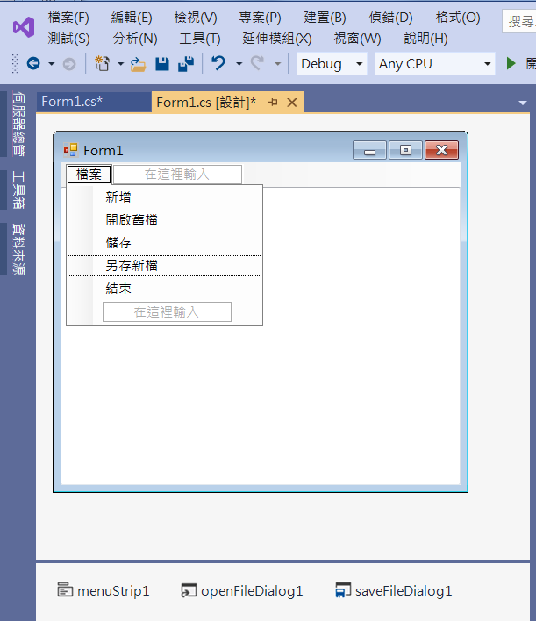
TextBox記事本範例
Add menuItems
textBox1
Dock -> Fill
Multiline -> true
savefileDialog1
openFileDialog1
menuStrip1

Slide 4
TextBox記事本範例
using System;
using System.Collections.Generic;
using System.ComponentModel;
using System.Data;
using System.Drawing;
using System.Linq;
using System.Text;
using System.Threading.Tasks;
using System.Windows.Forms;
using System.IO; //File

Slide 5
TextBox記事本範例
private void 新增ToolStripMenuItem_Click(object sender, EventArgs e)
{
openFileDialog1.FileName = "";
textBox1.Clear(); //清除
}
private void 開啟舊檔ToolStripMenuItem_Click(object sender, EventArgs e)
{
if (openFileDialog1.ShowDialog() == DialogResult.OK)
{
textBox1.Text = File.ReadAllText(openFileDialog1.FileName, Encoding.Default);
}
}

Slide 6
TextBox記事本範例
private void 儲存ToolStripMenuItem_Click(object sender, EventArgs e)
{
if (openFileDialog1.FileName == "")
{
if (saveFileDialog1.ShowDialog() == DialogResult.OK)
{
File.WriteAllText(saveFileDialog1.FileName, textBox1.Text, Encoding.Default);
openFileDialog1.FileName = saveFileDialog1.FileName;
}
}
else
{
File.WriteAllText(openFileDialog1.FileName, textBox1.Text, Encoding.Default);
}
}

Slide 7
TextBox記事本範例
private void 另存新檔ToolStripMenuItem_Click(object sender, EventArgs e)
{
if (saveFileDialog1.ShowDialog() == DialogResult.OK)
{
File.WriteAllText(saveFileDialog1.FileName, textBox1.Text, Encoding.Default);
openFileDialog1.FileName = saveFileDialog1.FileName;
}
}
private void 結束ToolStripMenuItem_Click(object sender, EventArgs e)
{
Application.Exit();
}

Slide 8
TextBox記事本範例
private void Form1_Load(object sender, EventArgs e)
{
openFileDialog1.FileName = "";
openFileDialog1.Filter = "純文字檔案|*.txt";
saveFileDialog1.Filter = "純文字檔案|*.txt";
}

Slide 9
Exercise#14-1

Slide 10
內容來源
  跟著範例學會Visual C# 2015(張逸中/著; 博碩)
  Visual C# 2013視窗程式設計(黃聰明/著; 松崗)

