Slide 1
Window Programming 14-7
RichTextBox記事本範例
搜尋
Yuan Ze University

Slide 2
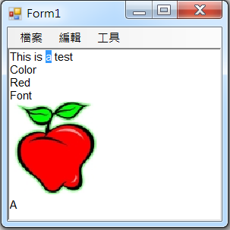
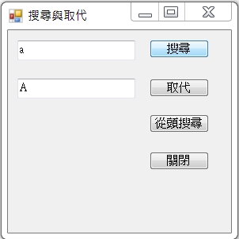
RichTextBox記事本範例

Slide 3
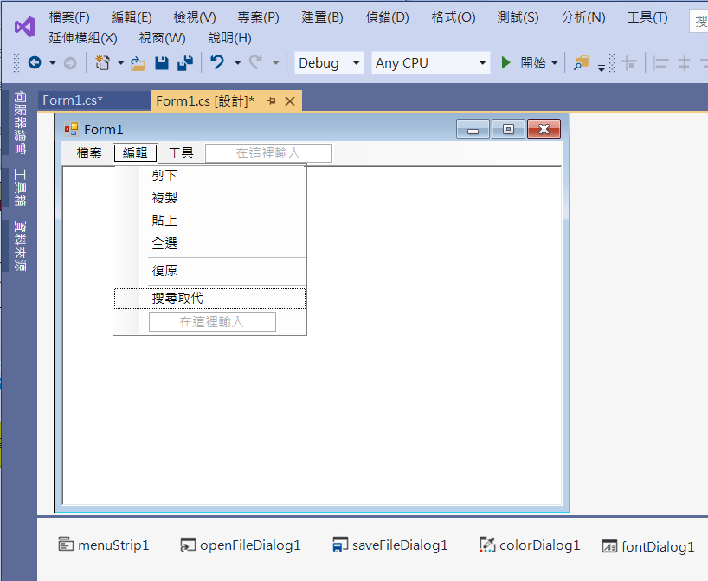
RichTextBox記事本範例
新增“搜尋取代"選項

Slide 4
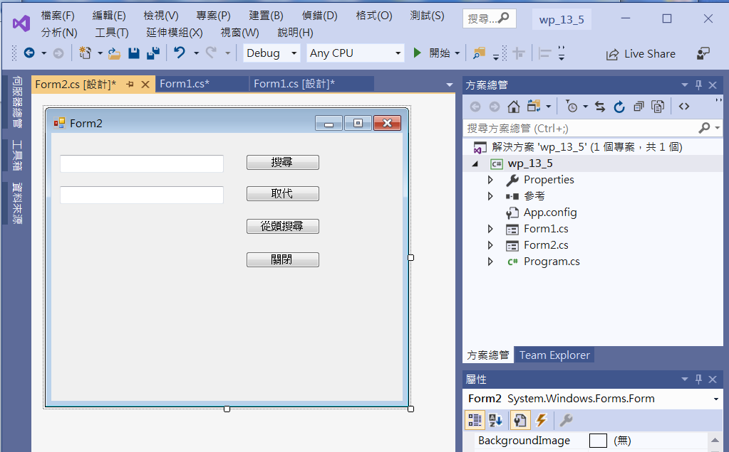
RichTextBox記事本範例
1. Add Form2
2. Add textBox1
4. Add button1
3. Add textBox2
5. Add button2

Slide 5
RichTextBox記事本範例
//class Form1 內
public RichTextBox RichTextBox1
{
get
{
return richTextBox1;
}
}

Slide 6
RichTextBox記事本範例
//Form1
private void 搜尋取代ToolStripMenuItem_Click(object sender, EventArgs e)
{
richTextBox1.SelectionLength = 0;
richTextBox1.SelectionStart = 0;
Form2 x = new Form2(this);
x.TopMost = true;
x.Text = "搜尋與取代";
x.Show();
}

Slide 7
RichTextBox記事本範例
//Form2
public partial class Form2 : Form
{
Form1 Form1_Ref = null;
public Form2(Form1 temp)
{
InitializeComponent();
Form1_Ref = temp;
}

Slide 8
RichTextBox記事本範例
private void Button1_Click(object sender, EventArgs e)
{
int P;
if (Form1_Ref.RichTextBox1.SelectionLength > 0)
{//已有目標被搜到時
P = Form1_Ref.RichTextBox1.Text.IndexOf(textBox1.Text, Form1_Ref.RichTextBox1.SelectionStart + 1);
}
else
{//尚無目標被搜到時
P = Form1_Ref.RichTextBox1.Text.IndexOf(textBox1.Text, Form1_Ref.RichTextBox1.SelectionStart);
}

Slide 9
RichTextBox記事本範例
if (P < 0)
{//找不到目標時
MessageBox.Show("未發現搜尋字串！");
}
else
{//找到目標時，選取被找到的目標
Form1_Ref.RichTextBox1.SelectionStart = P;
Form1_Ref.RichTextBox1.SelectionLength = textBox1.TextLength;
Form1_Ref.RichTextBox1.Select();
Form1_Ref.TopMost = true;
}
}

Slide 10
RichTextBox記事本範例
private void Button2_Click(object sender, EventArgs e)
{
if (Form1_Ref.RichTextBox1.SelectionLength > 0)
Form1_Ref.RichTextBox1.SelectedText = textBox2.Text;
Form1_Ref.RichTextBox1.SelectionLength = 0;
}

Slide 11
RichTextBox記事本範例
private void Button3_Click(object sender, EventArgs e)
{
int P;
P = Form1_Ref.RichTextBox1.Text.IndexOf(textBox1.Text);
if (P < 0)
{//找不到目標時
MessageBox.Show("未發現搜尋字串！");
}
else
{//找到目標時，選取被找到的目標
Form1_Ref.RichTextBox1.SelectionStart = P;
Form1_Ref.RichTextBox1.SelectionLength = textBox1.TextLength;
Form1_Ref.RichTextBox1.Select();
Form1_Ref.TopMost = true;
}
}

Slide 12
RichTextBox記事本範例
private void Button4_Click(object sender, EventArgs e)
{
Close();
}

Slide 13
Exercise#14-7

Slide 14
內容來源
  跟著範例學會Visual C# 2015(張逸中/著; 博碩)
  Visual C# 2013視窗程式設計(黃聰明/著; 松崗)

