Slide 1
Window Programming 15-3
ScreenSaver I
Yuan Ze University

Slide 2

ScreenSaver I

Slide 3
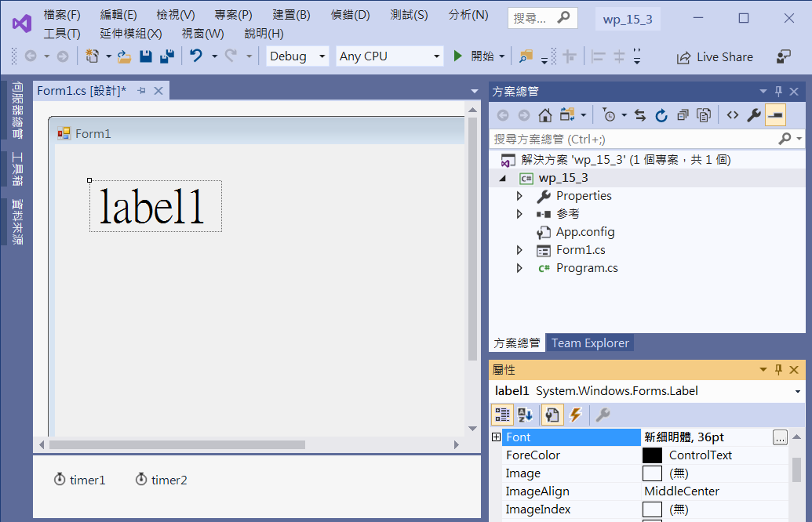
ScreenSaver I
label1
Font -> 36 pt
timer1
Interval -> 300
timer2
Interval -> 5000

Slide 4
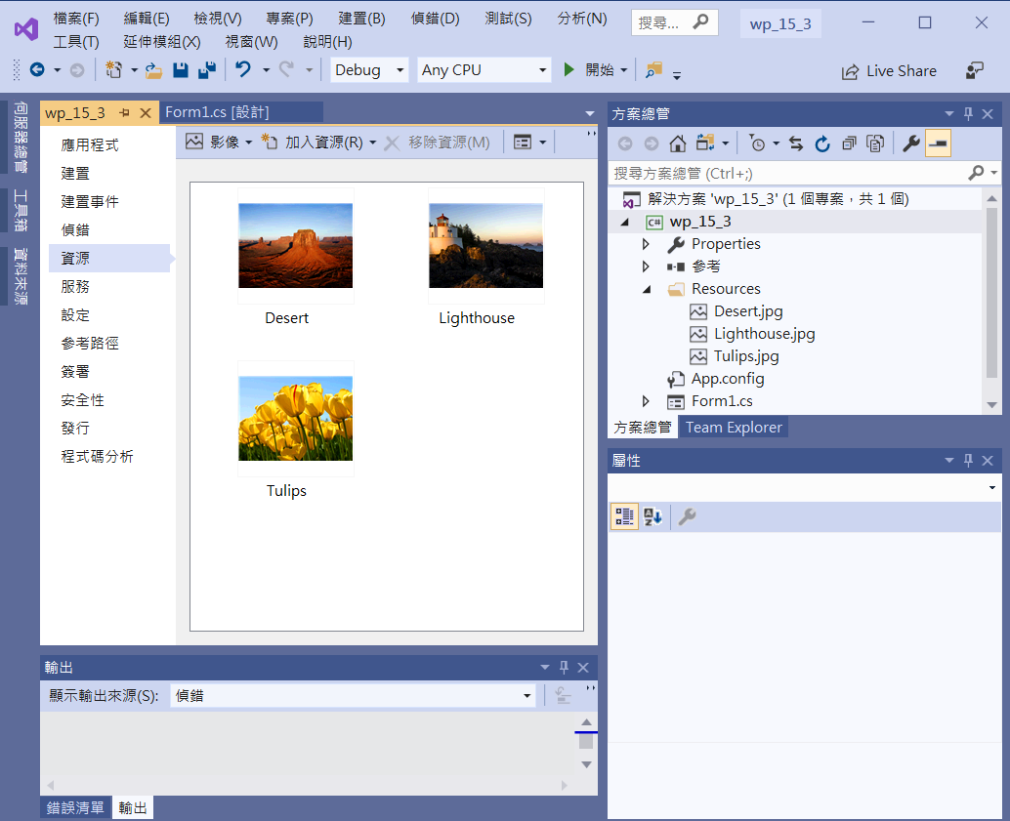
ScreenSaver I
Add three image resources

Slide 5
ScreenSaver I
private void Form1_Click(object sender, EventArgs e)
{
Application.Exit(); //結束螢幕保護程式
}

Slide 6
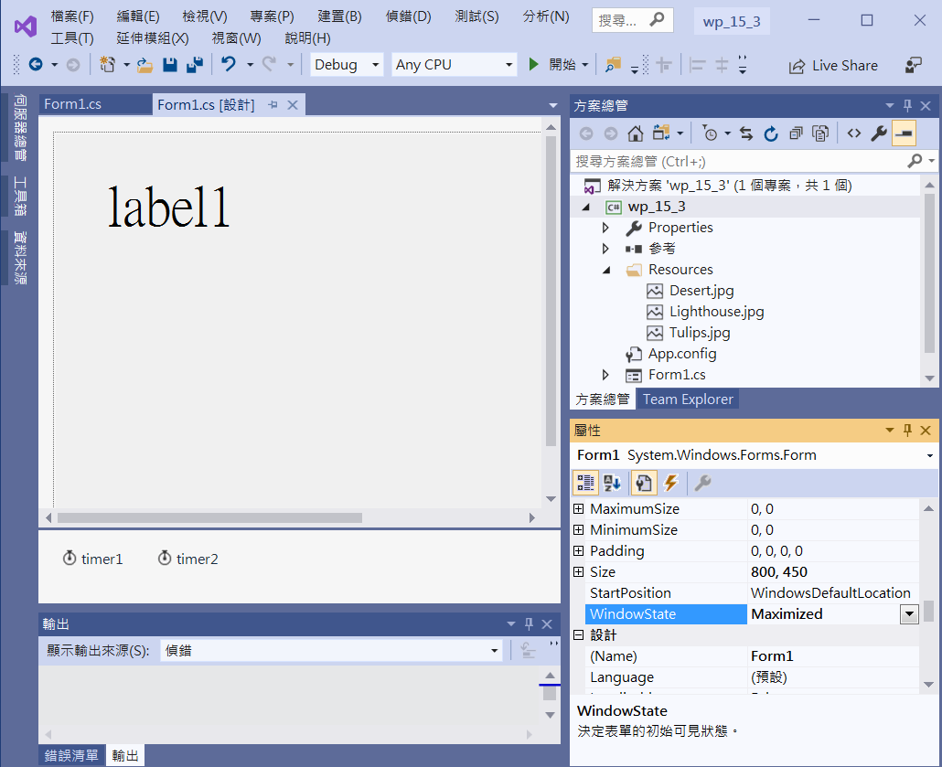
ScreenSaver I
Form1
WindowState -> Maximized
FormBorderStyle -> None
占滿整個螢幕

Slide 7
ScreenSaver I
public partial class Form1 : Form
{
int img = 0;
Random r = new Random(DateTime.Now.Second);
public Form1()
{
InitializeComponent();
DoubleBuffered = true;
timer1.Start();
timer2.Start();
randomBG();
}

Slide 8
ScreenSaver I
void randomBG()
{
img = r.Next(3);
switch (img)
{
case 0:
BackgroundImage = Properties.Resources.Desert;
break;
case 1:
BackgroundImage = Properties.Resources.Lighthouse;
break;
case 2:
BackgroundImage = Properties.Resources.Tulips;
break;
}
}

Slide 9
ScreenSaver I
private void Form1_Load(object sender, EventArgs e)
{
label1.Text = DateTime.Now.ToString();
BackgroundImageLayout = ImageLayout.Stretch;
}
private void Timer2_Tick(object sender, EventArgs e)
{
randomBG();
}

Slide 10
ScreenSaver I
private void Timer1_Tick(object sender, EventArgs e)
{
label1.Text = DateTime.Now.ToString();
label1.Left -= 5;
if (label1.Right < 0)
{
label1.Left = ClientSize.Width;
label1.Top = r.Next(Height - label1.Height);
}
}

Slide 11
Exercise#3

Slide 12
內容來源
  Visual C# 2012 視窗程式設計：繪圖與遊戲專題(鄞永傳/著; 松崗)
  跟著範例學會Visual C# 2015(張逸中/著; 博碩)
  Visual C# 2013視窗程式設計(黃聰明/著; 松崗)

