Slide 1
Window Programming 3-2
Drawing I
DrawLines & DrawPolygon
Yuan Ze University

Slide 2
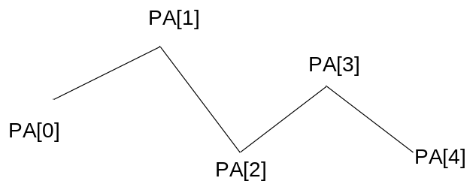
DrawLines()
Point[] PA = new Point[5]; // 5 個點
...
e.Graphics.DrawLines(Pens.Black, PA); // 畫出一連串的線條

Slide 3
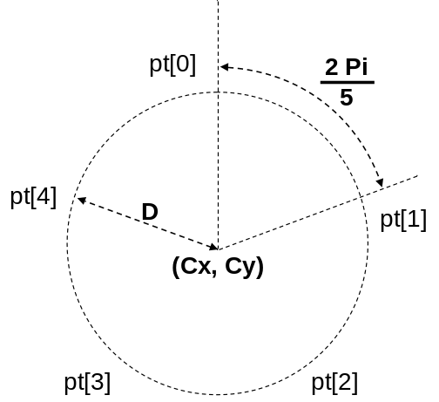
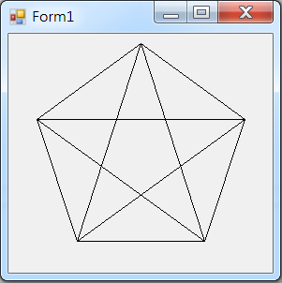
DrawLines
private void Form1_Paint(object sender, PaintEventArgs e)
{ Point[] pt1 = new Point[6]; // 6個點,起點=終點
Point[] pt2 = new Point[6];
int Cx = this.ClientSize.Width / 2; // 中心點
int Cy = this.ClientSize.Height / 2;
int D = (int)(Math.Min(this.ClientSize.Width, this.ClientSize.Height) / 2) - 10; // 半徑
double Theta1 = -Math.PI / 2.0; // 初始角度 正上方
double Theta2 = -Math.PI / 2.0; // 初始角度 正上方
for (int i = 0; i < 5; i++)
{
pt1[i].X = Cx + (int)(D * Math.Cos(Theta1));
pt1[i].Y = Cy + (int)(D * Math.Sin(Theta1));
pt2[i].X = Cx + (int)(D * Math.Cos(Theta2));
pt2[i].Y = Cy + (int)(D * Math.Sin(Theta2));
Theta1 += Math.PI * 2.0 / 5.0; // 五邊形
Theta2 += 2 * Math.PI * 2.0 / 5.0; // 五角星星
}

Slide 4
DrawLines
pt1[5] = pt1[0];// 起點=終點
pt2[5] = pt2[0];
e.Graphics.DrawLines(Pens.Black, pt1); // 繪出多條線段,五邊形
e.Graphics.DrawLines(Pens.Black, pt2); // 繪出多條線段,五角星星
}
private void Form1_Resize(object sender, EventArgs e)
{
Invalidate();
}

Slide 5
DrawPolygon()
private void Form1_Paint(object sender, PaintEventArgs e)
{
Point[] pt1 = new Point[5]; // 5個點
Point[] pt2 = new Point[5];
int Cx = this.ClientSize.Width / 2; // 中心點
int Cy = this.ClientSize.Height / 2;
int D = (int)(Math.Min(this.ClientSize.Width, this.ClientSize.Height) / 2) - 10; // 半徑
double Theta1 = -Math.PI / 2.0; // 角度
double Theta2 = -Math.PI / 2.0; // 角度
for (int i = 0; i < 5; i++)
{
pt1[i].X = Cx + (int)(D * Math.Cos(Theta1));
pt1[i].Y = Cy + (int)(D * Math.Sin(Theta1));
pt2[i].X = Cx + (int)(D * Math.Cos(Theta2));
pt2[i].Y = Cy + (int)(D * Math.Sin(Theta2));
Theta1 += Math.PI * 2.0 / 5.0; // 五邊形
Theta2 += 2 * Math.PI * 2.0 / 5.0; // 五角星星
}

Slide 6
DrawPolygon()
e.Graphics.DrawPolygon(Pens.Black, pt1); // 繪出五邊形
e.Graphics.DrawPolygon(Pens.Black, pt2); // 繪出五角星星
}
private void Form1_Resize(object sender, EventArgs e)
{
Invalidate();
}

Slide 7
Exercise#3-2

Slide 8
內容來源
  Visual C# 2012 視窗程式設計：繪圖與遊戲專題(鄞永傳/著; 松崗)
  Visual C# 2013視窗程式設計(黃聰明/著; 松崗)
  跟著範例學會Visual C# 2015(張逸中/著; 博碩)

