Slide 1
Window Programming 3-4
Drawing I
DrawEllipse & DrawArc
Yuan Ze University

Slide 2
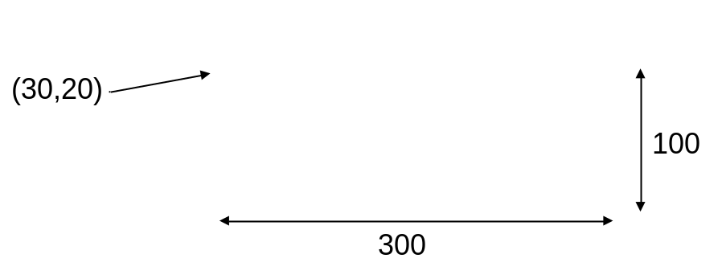
DrawEllipse()
e.Graphics.DrawEllipse(Pens.Black, 30, 20, 300, 100);
Rectangle rect = new Rectangle(20, 10, 300, 100);
e.Graphics.DrawEllipse(Pens.Black, rect);

Slide 3
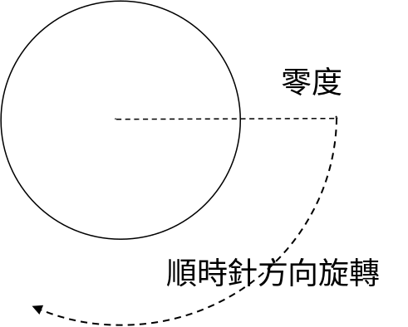
DrawArc()
int Cx=200, Cy=200; // 圓心
int D = 100; // 半徑
e.Graphics.DrawArc(Pens.Black, Cx - D, Cy - D, 2 * D, 2 * D, 0, 180);

Slide 4
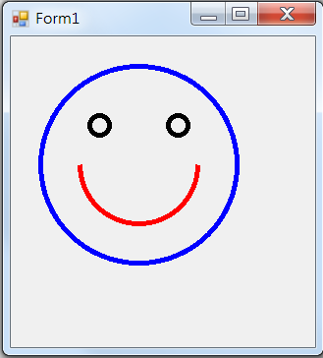
Exercise#3-4

Slide 5
Exercise#3-4
private void Form1_Paint(object sender, PaintEventArgs e)
{
Pen p1=new Pen(Color.Blue,5);
e.Graphics.DrawEllipse(p1, 30, 30, 200, 200);
Pen p2 = new Pen(Color.Black, 5);
e.Graphics.DrawEllipse(p2, 80, 80, 20, 20);
e.Graphics.DrawEllipse(p2, 160, 80, 20, 20);
Pen p3 = new Pen(Color.Red, 5);
e.Graphics.DrawArc(p3, 70, 70, 120, 120, 0, 180);
}

Slide 6
內容來源
  Visual C# 2012 視窗程式設計：繪圖與遊戲專題(鄞永傳/著; 松崗)
  Visual C# 2013視窗程式設計(黃聰明/著; 松崗)
  跟著範例學會Visual C# 2015(張逸中/著; 博碩)

