Slide 1
Window Programming 3-6
Drawing I
Brush & Fill
Yuan Ze University

Slide 2
Brush
Brush myBrush = new SolidBrush(Color.Red); // 紅色的單色塗刷
SolidBrush myBrush = new SolidBrush(Color.Red); // 紅色的單色塗刷
SolidBrush 是Brush的子類別

Slide 3
Fill
Method | 說明 | 相關的筆畫方法
FillEllipse() | 填滿橢圓形內部 | DrawEllipse()
FillPie() | 填滿派形區段的內部 | DrawPie()
FillPolygon() | 填滿多邊形內部 | DrawPolygon()
FillRectangle() | 填滿矩形內部 | DrawRectangle()

Slide 4
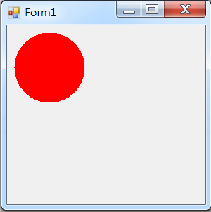
Brush & FillEllipse
private void Form1_Paint(object sender, PaintEventArgs e)
{
Brush myBrush = new SolidBrush(Color.Red); // 紅色的單色塗刷
e.Graphics.FillEllipse(myBrush, 10, 10, 100, 100); // 填滿一個橢圓形
}
private void Form1_Paint(object sender, PaintEventArgs e)
{
SolidBrush myBrush = new SolidBrush(Color.Red); // 紅色的單色塗刷
e.Graphics.FillEllipse(myBrush, 10, 10, 100, 100); // 填滿一個橢圓形
}

Slide 5
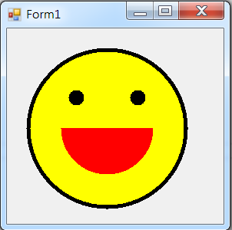
Exercise#3-6

Slide 6
Exercise#3-6
private void Form1_Paint(object sender, PaintEventArgs e)
{
Pen p1 = new Pen(Color.Black, 10);
e.Graphics.DrawEllipse(p1, 30, 30, 200, 200);
Brush b1 = new SolidBrush(Color.Yellow);
e.Graphics.FillEllipse(b1, 30, 30, 200, 200);
Brush b2 = new SolidBrush(Color.Black);
e.Graphics.FillEllipse(b2, 80, 80, 20, 20);
e.Graphics.FillEllipse(b2, 160, 80, 20, 20);
Brush b3 = new SolidBrush(Color.Red);
e.Graphics.FillPie(b3, 70, 70, 120, 120, 0, 180);
}

Slide 7
內容來源
  Visual C# 2012 視窗程式設計：繪圖與遊戲專題(鄞永傳/著; 松崗)
  Visual C# 2013視窗程式設計(黃聰明/著; 松崗)
  跟著範例學會Visual C# 2015(張逸中/著; 博碩)

