Slide 1
Window Programming 3-8
Drawing I
Integrated Example 2
Yuan Ze University

Slide 2
Integrated Example 2
private void Form1_MouseDown(object sender, MouseEventArgs e)
{ int x, y, r, g, b;
Random rd = new Random(); //使用亂數類別
Brush b1;
Graphics g1 = this.CreateGraphics();
//g1.Clear(Color.White); //以白色塗滿
for (int i = 0; i < 10; i++)
{
x = 10 + rd.Next(260); //產生 (10+0 ~ 10+259)的亂數
y = 10 + rd.Next(260);
r = rd.Next(256); //產生0~255的亂數
g = rd.Next(256);
b = rd.Next(256);
b1 = new SolidBrush(Color.FromArgb(r, g, b)); //產生亂數顏色畫刷
g1.FillEllipse(b1, x - 5, y - 5, 10, 10); //畫圓
}
}

Slide 3
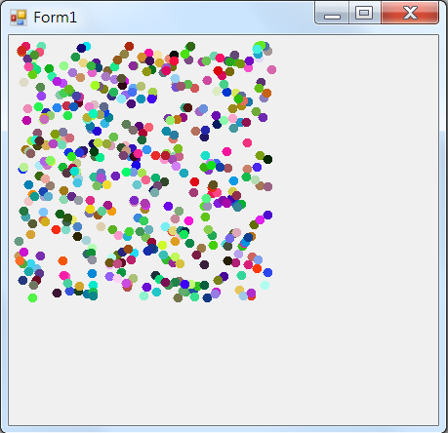
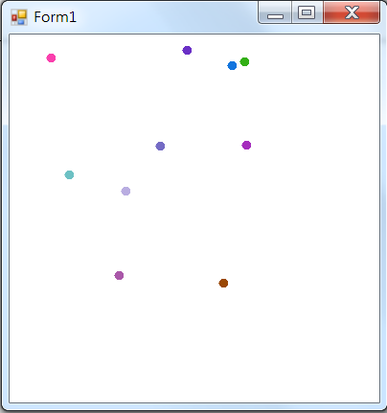
Exercise#3-8

Slide 4
內容來源
  Visual C# 2012 視窗程式設計：繪圖與遊戲專題(鄞永傳/著; 松崗)
  Visual C# 2013視窗程式設計(黃聰明/著; 松崗)
  跟著範例學會Visual C# 2015(張逸中/著; 博碩)

