Slide 1
Window Programming 4-1
ComboBox
Yuan Ze University

Slide 2
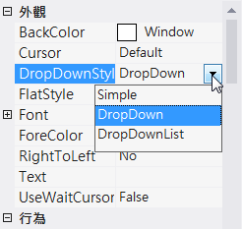








ComboBox
DropDownStyle
  Simple: 文字部分為可編輯的，而清單部分是永遠可見的
  DropDown: 文字部分為可編輯的。使用者必須按一下箭頭按鈕以顯示清單部分，點選後，選項會出現在文字方塊內
  DropDownList: 使用者不能直接編輯文字部分。使用者必須按一下箭頭按鈕以顯示清單部分

Slide 3
ComboBox
Attribute
  SelectedIndex
    First item: 0
    Second item: 1
    …
Event
  SelectedIndexChanged

Slide 4
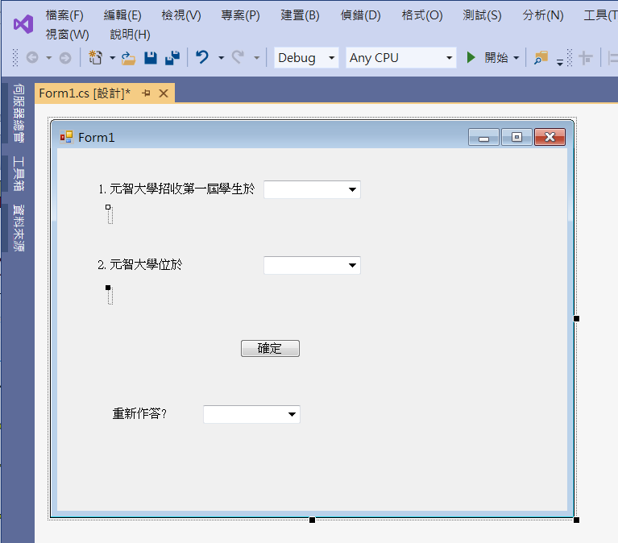
An example of ComboBox
comboBox1
label1
label2
comboBox2
label3
button1
label4
label5
comboBox3

Slide 5
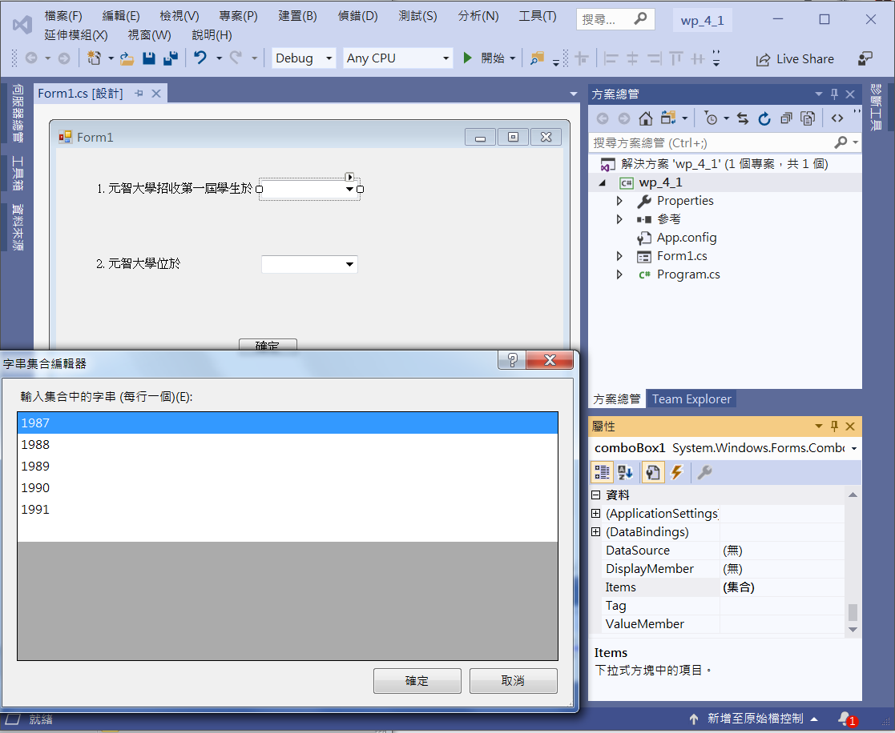
An example of ComboBox
1. Click comboBox1
3. Edit Items
2. Click Items

Slide 6
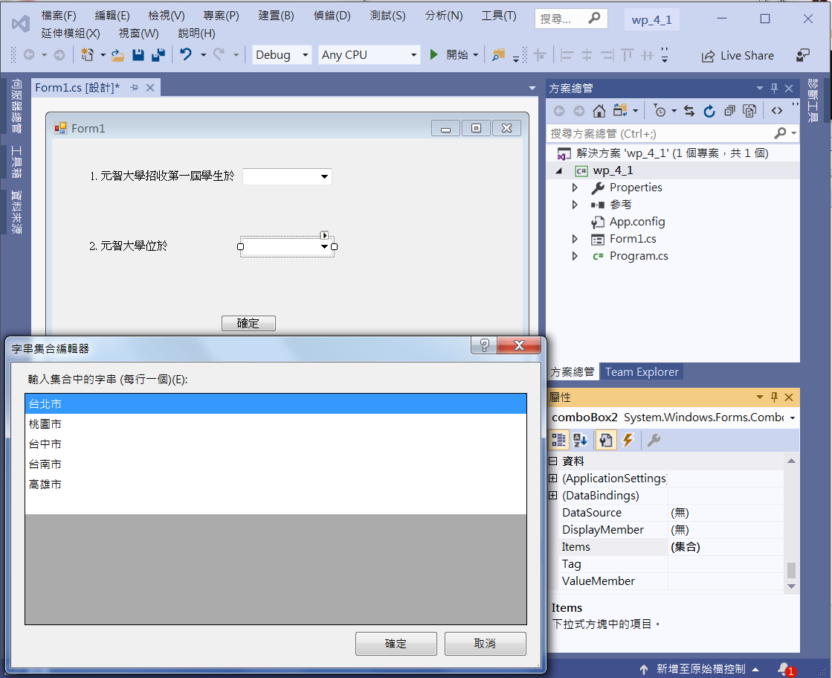
An example of ComboBox
1. Click comboBox2
3. Edit Items
2. Click Items

Slide 7
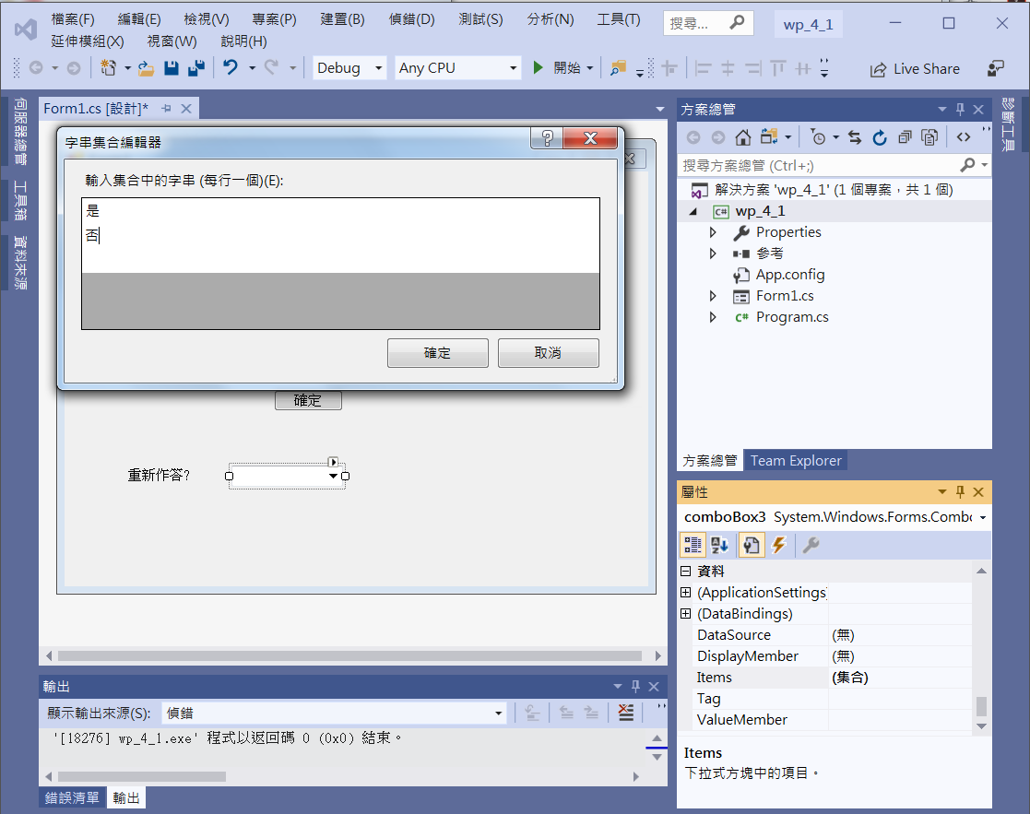
An example of ComboBox
3. Edit Items
1. Click comboBox3
2. Click Items

Slide 8
An example of ComboBox
private void Button1_Click(object sender, EventArgs e)
{
if (comboBox1.SelectedIndex == 2)
label2.Text = "答對了";
else
label2.Text = "答錯了，元智大學於1989年招收第一屆學生";
if (comboBox2.SelectedIndex == 1)
label4.Text = "答對了";
else
label4.Text = "答錯了，元智大學位於桃園市";
}

Slide 9
An example of ComboBox
private void ComboBox3_SelectedIndexChanged(object sender, EventArgs e)
{
if (comboBox3.SelectedIndex == 0)
{
label2.Text = "";
label4.Text = "";
comboBox1.SelectedIndex = -1;
comboBox2.SelectedIndex = -1;
comboBox3.SelectedIndex = -1;
}
}

Slide 10
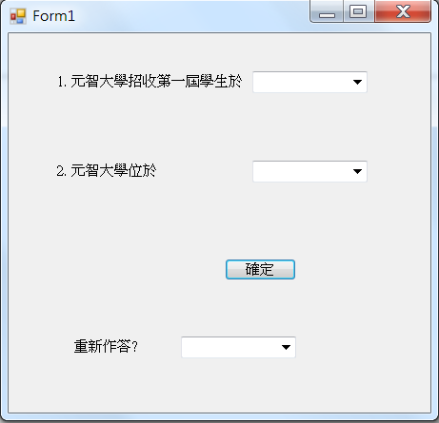
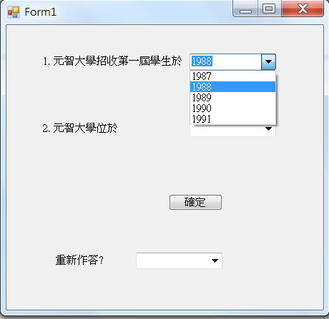
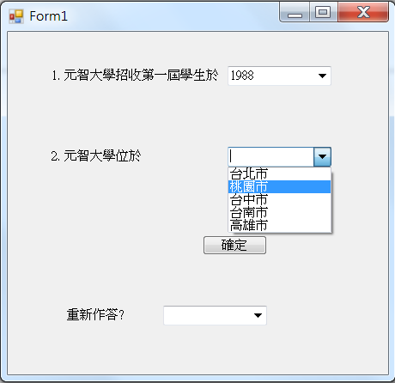
Exercise#4-1

Slide 11
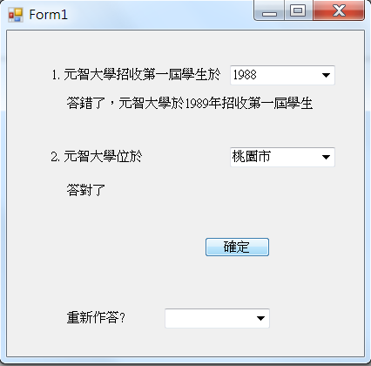
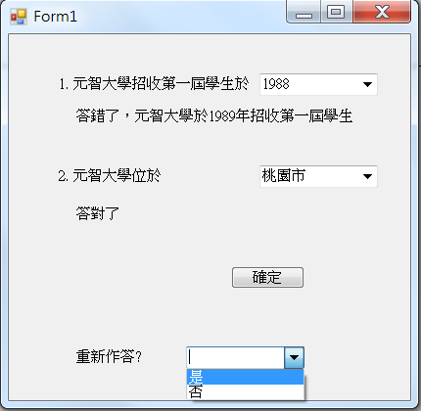
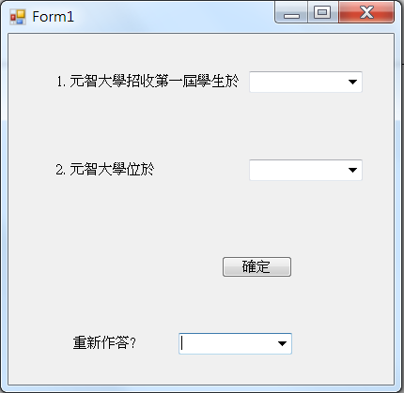
Exercise#4-1

Slide 12
內容來源
  Visual C# 2012 視窗程式設計：繪圖與遊戲專題(鄞永傳/著; 松崗)
  Visual C# 2013視窗程式設計(黃聰明/著; 松崗)
  跟著範例學會Visual C# 2015(張逸中/著; 博碩)

