Slide 1
Window Programming 4-2
RadioButton, GroupBox
Yuan Ze University

Slide 2
RadioButton (選項按鈕)
  Single choice among different RadioButtons
  Attribute
    Checked
      radioButton1.Checked=true;
      if (radioButton2.Checked == true)
  Event
    CheckedChanged

Slide 3
GroupBox
A container to contain several components
Grouping RadioButtons

Slide 4
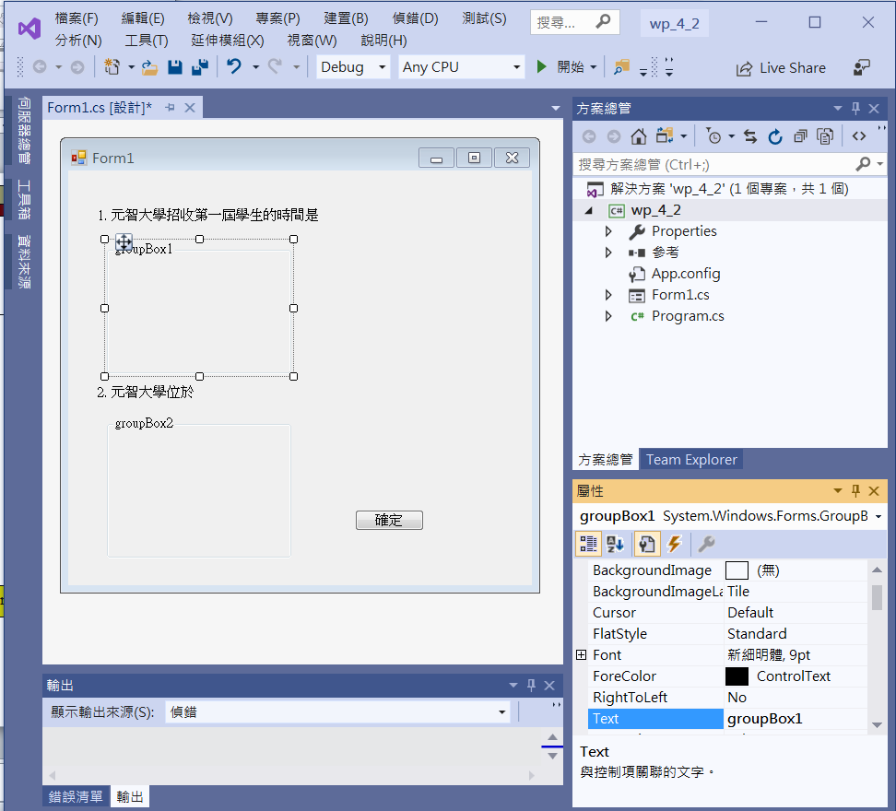
An example of RadioButton
label1
label3
groupBox1
label2
label4
button1
groupBox2
groupBox1, groupBox2
set Text empty

Slide 5
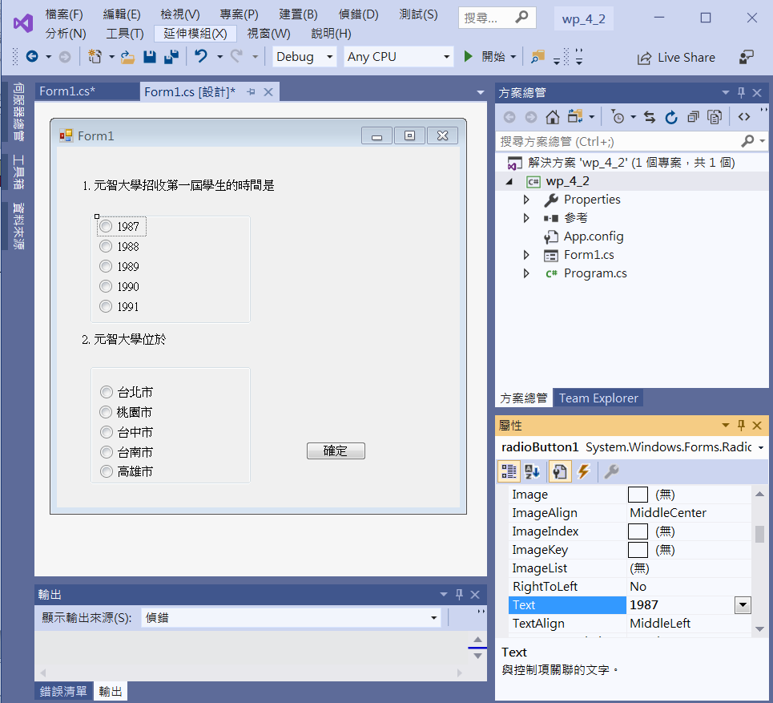
An example of RadioButton
radioButton1
|
radioButton5
radioButton6
|
radioButton10
Modify Text
of each radioButton

Slide 6
An example of RadioButton
private void Button1_Click(object sender, EventArgs e)
{
if (radioButton3.Checked == true)
label3.Text = "答對了";
else
label3.Text = "答錯了，元智大學於1989年招收第一屆學生";
if (radioButton7.Checked==true)
label4.Text = "答對了";
else
label4.Text = "答錯了，元智大學位於桃園市";
}

Slide 7
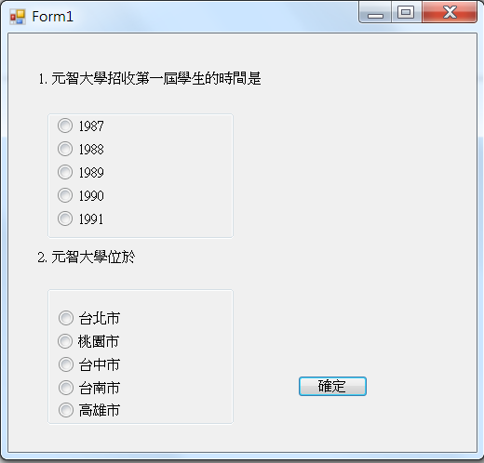
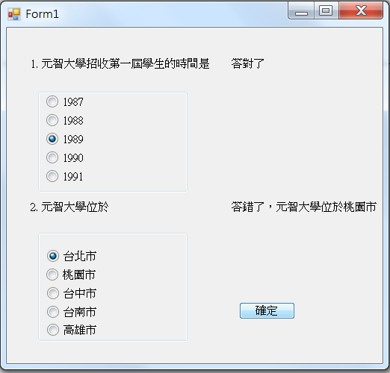
Exercise#4-2

Slide 8
內容來源
  Visual C# 2012 視窗程式設計：繪圖與遊戲專題(鄞永傳/著; 松崗)
  Visual C# 2013視窗程式設計(黃聰明/著; 松崗)
  跟著範例學會Visual C# 2015(張逸中/著; 博碩)

