Slide 1
Window Programming 4-3
CheckBox
Yuan Ze University

Slide 2
CheckBox (核取方塊)
Multiple choices among different CheckBoxs
  Attribute
    Checked
      checkBox1.Checked=true;
      if (checkBox2.Checked == true)
  Event
    CheckedChanged

Slide 3
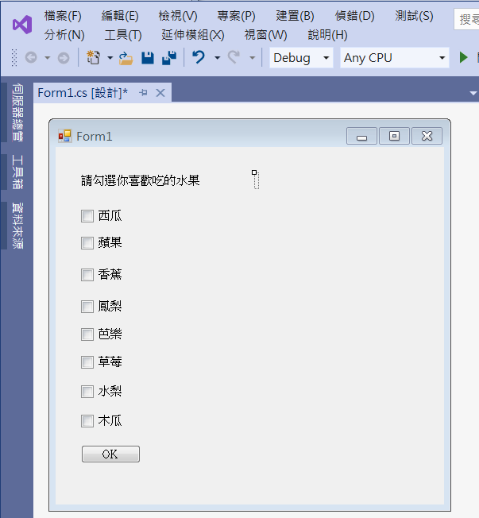
An example of CheckBox
label1
label2
checkBox1
checkBox2
checkBox8
button1

Slide 4
An example of CheckBox
private void Button1_Click(object sender, EventArgs e)
{
label2.Text = "你喜歡的水果有\n";
if (checkBox1.Checked==true)
label2.Text += "西瓜\n";
if (checkBox2.Checked == true)
label2.Text += "蘋果\n";
if (checkBox3.Checked == true)
label2.Text += "香蕉\n";
if (checkBox4.Checked == true)
label2.Text += "鳳梨\n";
if (checkBox5.Checked == true)
label2.Text += "芭樂\n";
if (checkBox6.Checked == true)
label2.Text += "草莓\n";
if (checkBox7.Checked == true)
label2.Text += "水梨\n";
if (checkBox8.Checked == true)
label2.Text += "木瓜\n";
}

Slide 5
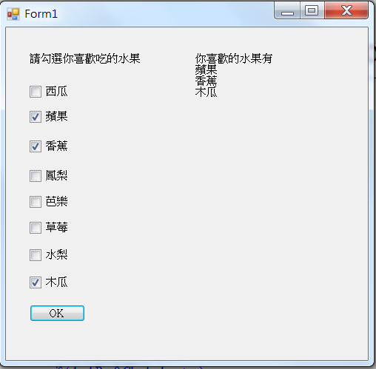
Exercise#4-3

Slide 6
內容來源
  Visual C# 2012 視窗程式設計：繪圖與遊戲專題(鄞永傳/著; 松崗)
  Visual C# 2013視窗程式設計(黃聰明/著; 松崗)
  跟著範例學會Visual C# 2015(張逸中/著; 博碩)

