Slide 1
Window Programming 5-6
An Example of Draw Lines
Yuan Ze University

Slide 2
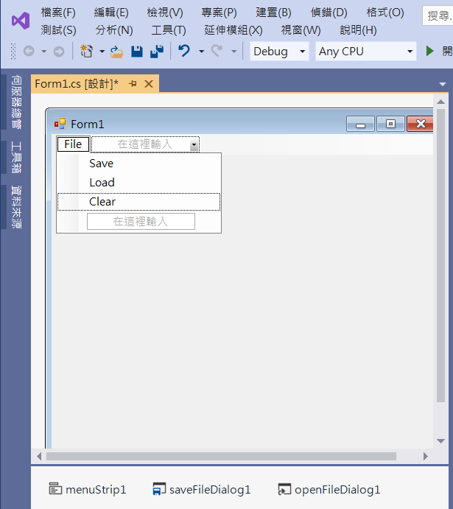
An Example of Draw Lines
Edit
Menu
menuStrip1
saveFileDialog1
openFileDialog1

Slide 3
An Example of Draw Lines
using System;
using System.Collections.Generic;
using System.ComponentModel;
using System.Data;
using System.Drawing;
using System.Linq;
using System.Text;
using System.Threading.Tasks;
using System.Windows.Forms;
using System.IO;

Slide 4
An Example of Draw Lines
namespace wp_5_6
{
public partial class Form1 : Form
{
List<Point> startPt = new List<Point>();
List<Point> endPt = new List<Point>();
Point p1;
public Form1()
{
InitializeComponent();
}

Slide 5
An Example of Draw Lines
private void Form1_MouseDown(object sender, MouseEventArgs e)
{
p1=e.Location;
}
private void Form1_MouseUp(object sender, MouseEventArgs e)
{
startPt.Add(p1);
endPt.Add(e.Location);
Invalidate();
}

Slide 6
An Example of Draw Lines
private void Form1_Paint(object sender, PaintEventArgs e)
{
Pen pen1 = new Pen(Color.Black, 1);
for (int i=0;i < endPt.Count(); i++)
{
e.Graphics.DrawLine(pen1,startPt[i].X,startPt[i].Y,endPt[i].X,endPt[i].Y);
}
}
private void Form1_Load(object sender, EventArgs e)
{
openFileDialog1.Filter = "線段檔(*.pnt)|*.pnt";
saveFileDialog1.Filter = "線段檔(*.pnt)|*.pnt";
}

Slide 7
An Example of Draw Lines
private void SaveToolStripMenuItem_Click(object sender, EventArgs e)
{
if (saveFileDialog1.ShowDialog()== DialogResult.OK)
{
String s = saveFileDialog1.FileName;
BinaryWriter outFile = new BinaryWriter(File.Open(s, FileMode.Create));
outFile.Write(endPt.Count());
for (int i=0; i< endPt.Count(); i++)
{
outFile.Write(startPt[i].X);
outFile.Write(startPt[i].Y);
outFile.Write(endPt[i].X);
outFile.Write(endPt[i].Y);
}
outFile.Close();
}
}

Slide 8
An Example of Draw Lines
private void LoadToolStripMenuItem_Click(object sender, EventArgs e)
{
if (openFileDialog1.ShowDialog() == DialogResult.OK)
{
String s = openFileDialog1.FileName;
if (!File.Exists(s)) return;
BinaryReader inFile = new BinaryReader(File.Open(s, FileMode.Open));
startPt.Clear();
endPt.Clear();
int n = inFile.ReadInt32();
for (int i = 0; i < n; i++)
{
startPt.Add(new Point(inFile.ReadInt32(),inFile.ReadInt32()));
endPt.Add(new Point(inFile.ReadInt32(),inFile.ReadInt32()));
}
Invalidate();
inFile.Close();
}
}

Slide 9
An Example of Draw Lines
private void ClearToolStripMenuItem_Click(object sender, EventArgs e)
{
startPt.Clear();
endPt.Clear();
Invalidate();
}

Slide 10

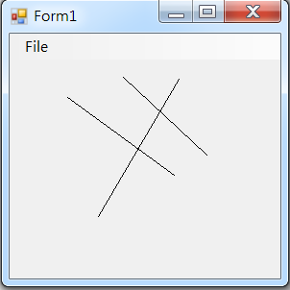
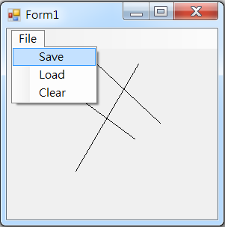
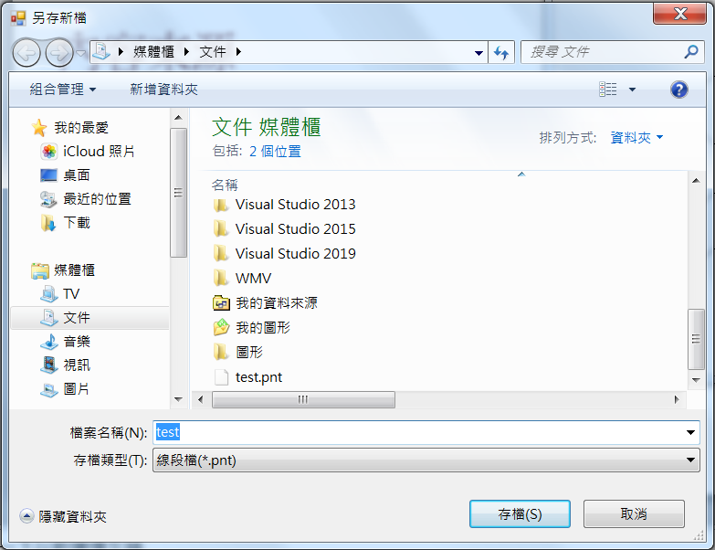
Exercise#5-6

Slide 11
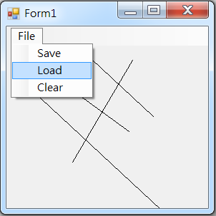
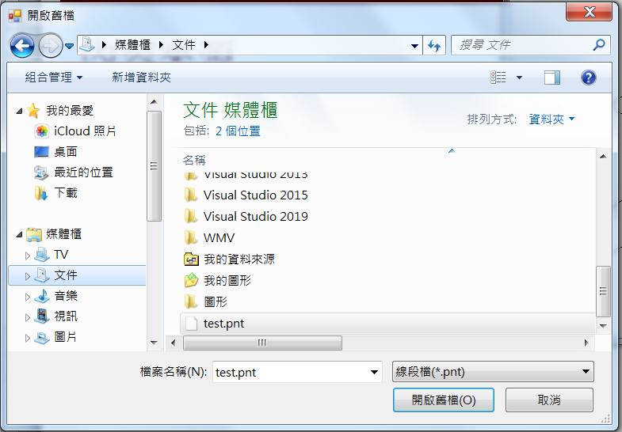
Exercise#5-6

Slide 12
內容來源
  Visual C# 2012 視窗程式設計：繪圖與遊戲專題(鄞永傳/著; 松崗)
  Visual C# 2013視窗程式設計(黃聰明/著; 松崗)
  跟著範例學會Visual C# 2015(張逸中/著; 博碩)

