Slide 1
Window Programming 7-6
TranslateTransform
Yuan Ze University

Slide 2
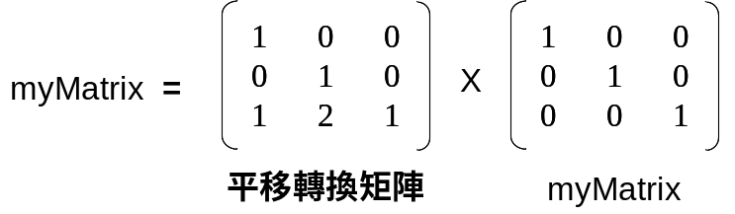
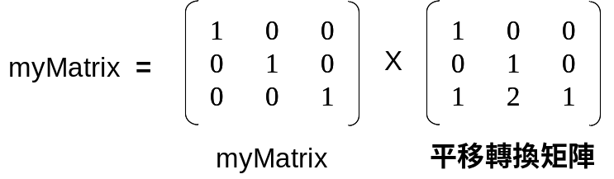
Translate
Matrix矩陣的平移
Matrix myMatrix = new Matrix();
myMatrix.Translate(1, 2); // X軸平移 1個單位、Y軸平移 2個單位
Matrix myMatrix = new Matrix();
myMatrix.Translate(1, 2, MatrixOrder.Append); // X軸Y軸平移 (1, 2) 個單位

Slide 3

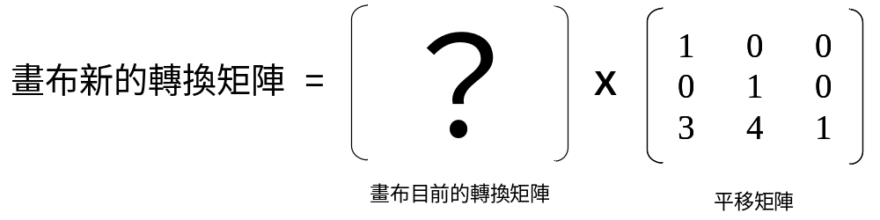
TranslateTransform
畫布轉換矩陣的平移
e.Graphics.TranslateTransform(3, 4);
// X軸平移 3個單位、Y軸平移 4個單位
e.Graphics.TranslateTransform(3, 4, MatrixOrder.Append);

Slide 4
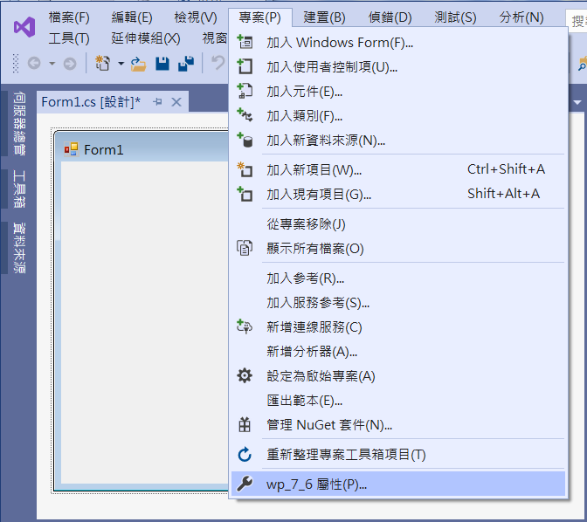
An example of TranslateTransform
1. Click project
2. Click Property

Slide 5
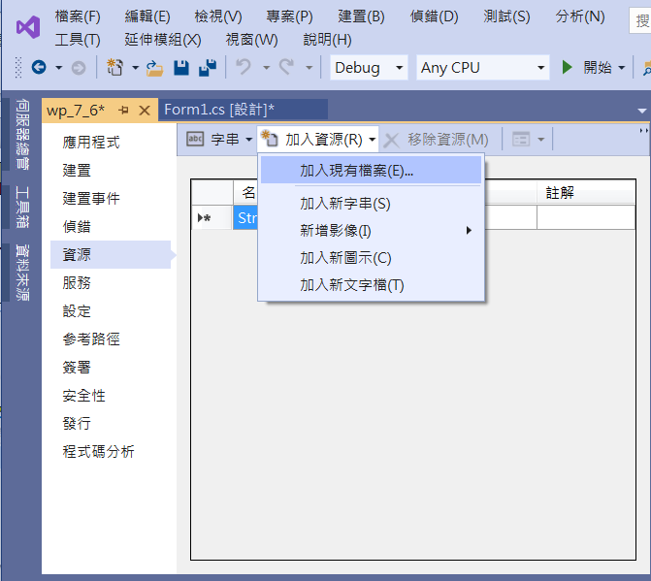
An example of TranslateTransform
2. Click
Add a File
1. Click resource

Slide 6
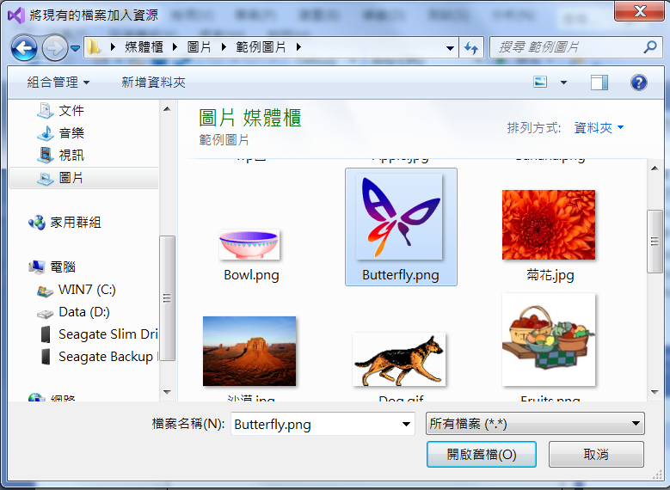
An example of TranslateTransform
1. Click a file
2. Click
open the File

Slide 7
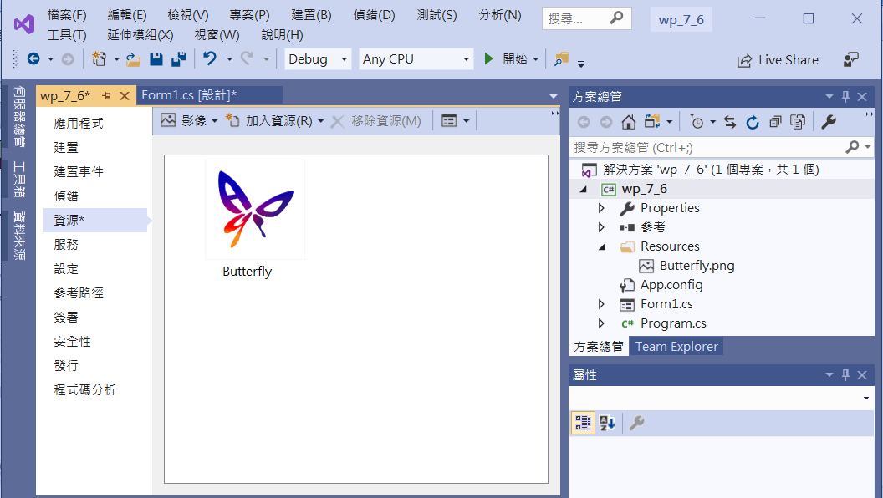
An example of TranslateTransform

Slide 8
An example of TranslateTransform
public partial class Form1 : Form
{
Bitmap bm = new Bitmap(Properties.Resources.Butterfly);
Point pos = new Point(); // 圖形的位置
public Form1()
{
InitializeComponent();
}

Slide 9
An example of TranslateTransform
private void Form1_Paint(object sender, PaintEventArgs e)
{
e.Graphics.TranslateTransform(pos.X, pos.Y);
TextureBrush tb= new TextureBrush(bm);
e.Graphics.FillRectangle(tb, 0, 0, 100,100); // 繪出圖形
}

Slide 10
An example of TranslateTransform
private void Form1_KeyDown(object sender, KeyEventArgs e)
{
if (e.KeyData == Keys.Up) // 上
pos = new Point(pos.X, pos.Y - 10);
else if (e.KeyData == Keys.Down) // 下
pos = new Point(pos.X, pos.Y + 10);
else if (e.KeyData == Keys.Left) // 左
pos = new Point(pos.X - 10, pos.Y);
else if (e.KeyData == Keys.Right) // 右
pos = new Point(pos.X + 10, pos.Y);
Invalidate();
}

Slide 11
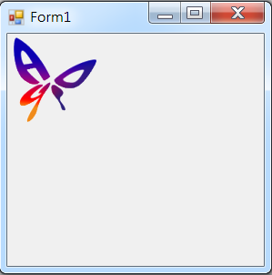
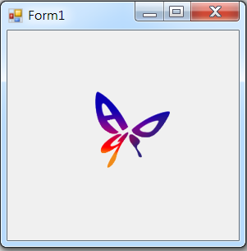
Exercise#7-6

Slide 12
內容來源
  Visual C# 2012 視窗程式設計：繪圖與遊戲專題(鄞永傳/著; 松崗)
  Visual C# 2013視窗程式設計(黃聰明/著; 松崗)
  跟著範例學會Visual C# 2015(張逸中/著; 博碩)

