Slide 1
Window Programming 8-2
Drawing III
RotateTransform Example (公轉+座標軸)
Yuan Ze University

Slide 2
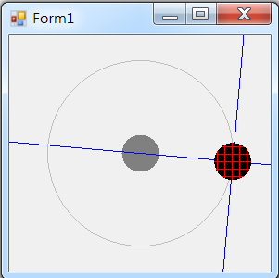
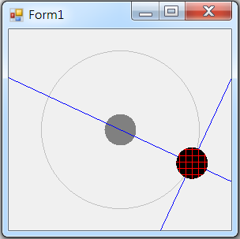
RotateTransform example (公轉+座標軸)

Slide 3
RotateTransform example (公轉+座標軸)
using System;
using System.Collections.Generic;
using System.ComponentModel;
using System.Data;
using System.Drawing;
using System.Linq;
using System.Text;
using System.Threading.Tasks;
using System.Windows.Forms;
using System.Drawing.Drawing2D;

Slide 4
RotateTransform example (公轉)
public partial class Form1 : Form
{
HatchBrush myBrush1 = new HatchBrush(HatchStyle.Cross, Color.Red);
float theta = 0; // 旋轉角度
int i = 0; //座標轉換次數
public Form1()
{
InitializeComponent();
}

Slide 5
RotateTransform example (公轉+座標軸)
private void Form1_Paint(object sender, PaintEventArgs e)
{
int Cx = this.ClientSize.Width / 2; // 視窗客戶區正中心點
int Cy = this.ClientSize.Height / 2;//
int D = 20; // 球本身的半徑
int D2 = 100; // 球旋轉的半徑
e.Graphics.ResetTransform(); // 畫布的矩陣 = 單位矩陣
e.Graphics.FillEllipse(Brushes.Gray, Cx - D, Cy - D, 2 * D, 2 * D); //畫出正中心圓點
e.Graphics.DrawEllipse(Pens.Silver, Cx - D2, Cy - D2, 2 * D2, 2 * D2); //畫出軌道

Slide 6
RotateTransform example (公轉+座標軸)
if (i == 0)
{
e.Graphics.DrawLine(Pens.Blue, -2 * Cx, 0, 2 * Cx, 0);
e.Graphics.DrawLine(Pens.Blue, 0, -2 * Cy, 0, 2 * Cy);
e.Graphics.FillEllipse(myBrush1, 0 - D, 0 - D, 2 * D, 2 * D); //畫出旋轉的圓點
}
e.Graphics.TranslateTransform(D2, 0, MatrixOrder.Append); // 先平移到 旋轉的半徑邊緣
if (i == 1)
{
e.Graphics.DrawLine(Pens.Blue, -2 * Cx, 0, 2 * Cx, 0);
e.Graphics.DrawLine(Pens.Blue, 0, -2 * Cy, 0, 2 * Cy);
e.Graphics.FillEllipse(myBrush1, 0 - D, 0 - D, 2 * D, 2 * D); //畫出旋轉的圓點
}

Slide 7
RotateTransform example (公轉+座標軸)
e.Graphics.RotateTransform(theta, MatrixOrder.Append); // 乘上 旋轉矩陣
if (i == 2)
{
e.Graphics.DrawLine(Pens.Blue, -2 * Cx, 0, 2 * Cx, 0);
e.Graphics.DrawLine(Pens.Blue, 0, -2 * Cy, 0, 2 * Cy);
e.Graphics.FillEllipse(myBrush1, 0 - D, 0 - D, 2 * D, 2 * D); //畫出旋轉的圓點
}
e.Graphics.TranslateTransform(Cx, Cy, MatrixOrder.Append); // 再位移到軌道上
if (i == 3)
{
e.Graphics.DrawLine(Pens.Blue, -2 * Cx, 0, 2 * Cx, 0);
e.Graphics.DrawLine(Pens.Blue, 0, -2 * Cy, 0, 2 * Cy);
e.Graphics.FillEllipse(myBrush1, 0 - D, 0 - D, 2 * D, 2 * D); //畫出旋轉的圓點
}
}

Slide 8
RotateTransform example (公轉+座標軸)
private void Form1_MouseDown(object sender, MouseEventArgs e)
{
if (i < 3)
i++;
else
{
i = 0;
theta = theta + 5; // 旋轉角度 遞增
}
Invalidate(); // 要求表單重畫
}

Slide 9
Exercise#8-2

Slide 10
內容來源
  Visual C# 2012 視窗程式設計：繪圖與遊戲專題(鄞永傳/著; 松崗)
  Visual C# 2013視窗程式設計(黃聰明/著; 松崗)
  跟著範例學會Visual C# 2015(張逸中/著; 博碩)

