Slide 1
Window Programming 8-4
Drawing III
ScaleTransform
Yuan Ze University

Slide 2
ScaleTransform
e.Graphics. ScaleTransform(2.5f, 0.5f);
//畫布的轉換矩陣 x 縮放矩陣 (x軸縮放比率，y軸縮放比率)
e.Graphics. ScaleTransform(2.5f, 0.5f, MatrixOrder.Append);
// 縮放矩陣x畫布的轉換矩陣

Slide 3
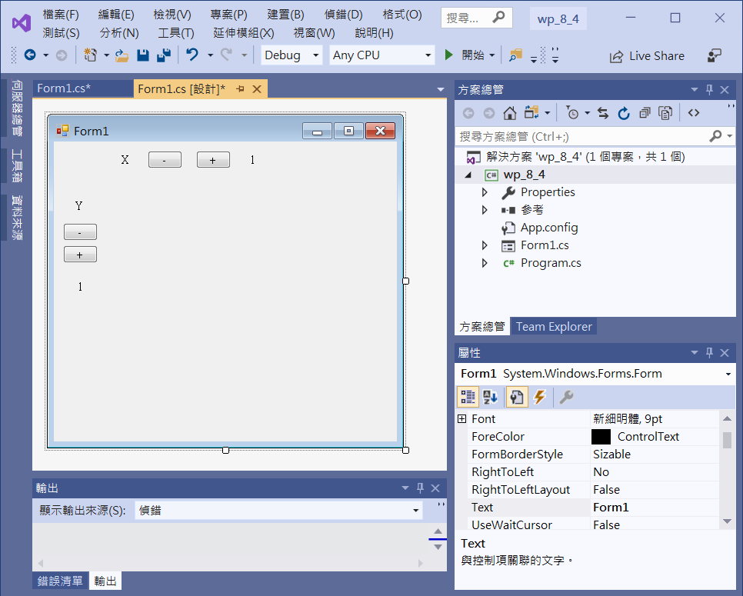
ScaleTransform example
button1
button2
label1
label3
label2
button3
button4
label4

Slide 4
ScaleTransform example
using System;
using System.Collections.Generic;
using System.ComponentModel;
using System.Data;
using System.Drawing;
using System.Linq;
using System.Text;
using System.Threading.Tasks;
using System.Windows.Forms;
using System.Drawing.Drawing2D;

Slide 5
ScaleTransform example
public partial class Form1 : Form
{
double xScale = 1; // X 軸縮放倍數
double yScale = 1; // Y 軸縮放倍數
public Form1()
{
InitializeComponent();
ClientSize=new Size(450,450);
};

Slide 6
ScaleTransform example
private void Form1_Paint(object sender, PaintEventArgs e)
{
int Cx = this.ClientSize.Width / 2; // 視窗客戶區正中心點
int Cy = this.ClientSize.Height / 2;//
int D = 100; // 球本身的半徑
e.Graphics.ResetTransform(); // 畫布的矩陣 = 單位矩陣
e.Graphics.DrawEllipse(Pens.Silver, Cx - D, Cy - D, 2 * D, 2 * D); //畫出開始的圓
e.Graphics.ScaleTransform((float)xScale, (float)yScale, MatrixOrder.Append); // 乘上 縮放矩陣
e.Graphics.TranslateTransform(Cx, Cy, MatrixOrder.Append); // 再搬到視窗客戶區正中心點
e.Graphics.DrawEllipse(Pens.Red, 0 - D, 0 - D, 2 * D, 2 * D); //畫出縮放後的圓
}

Slide 7
ScaleTransform example
private void Button1_Click(object sender, EventArgs e)
{
xScale = xScale - 0.1;
if (xScale <= 0.1) xScale = 0.1;
label3.Text = xScale.ToString();
Invalidate();
}
private void Button2_Click(object sender, EventArgs e)
{
xScale = xScale + 0.1;
label3.Text = xScale.ToString();
Invalidate();
}

Slide 8
ScaleTransform example
private void Button3_Click(object sender, EventArgs e)
{
yScale = yScale - 0.1;
if (yScale <= 0.1) yScale = 0.1;
label4.Text = yScale.ToString();
Invalidate();
}
private void Button4_Click(object sender, EventArgs e)
{
yScale = yScale + 0.1;
label4.Text = yScale.ToString();
Invalidate();
}

Slide 9
ScaleTransform example
private void Form1_Resize(object sender, EventArgs e)
{
Invalidate();
}

Slide 10
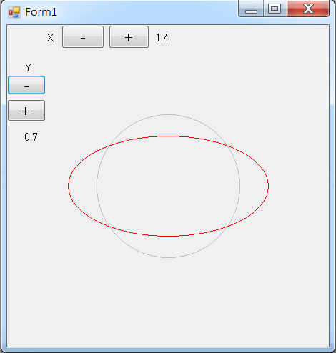
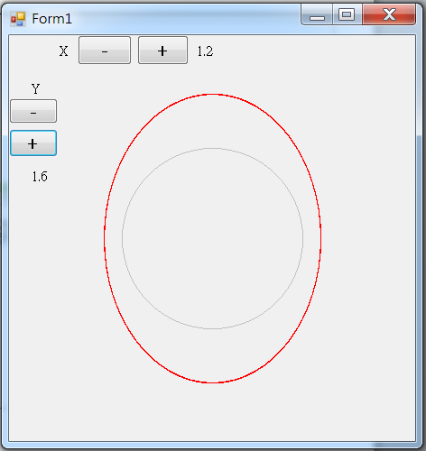
Exercise#8-4

Slide 11
內容來源
  Visual C# 2012 視窗程式設計：繪圖與遊戲專題(鄞永傳/著; 松崗)
  Visual C# 2013視窗程式設計(黃聰明/著; 松崗)
  跟著範例學會Visual C# 2015(張逸中/著; 博碩)

