Slide 1
Window Programming 9-4
DrawImage
Scale & partial image
Yuan Ze University

Slide 2
DrawImage
Image img;
…
Rectangle rectDest = new Rectangle(0, 0, img.Width, img.Height); //目的地的區域
Rectangle rectSrc = new Rectangle(0, 0, img.Width, img.Height); //來源的區域
e.Graphics.DrawImage(img, rectDest, rectSrc, GraphicsUnit.Pixel); // 呈現原圖
rectDest = new Rectangle(0, 0, img.Width / 2, img.Height / 2);
e.Graphics.DrawImage(img, rectDest); // 呈現原圖1/2倍

Slide 3
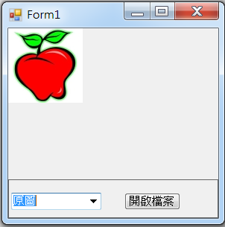
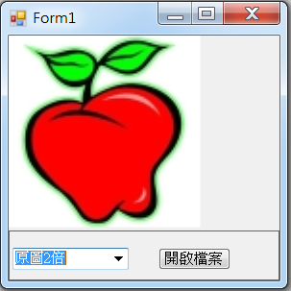
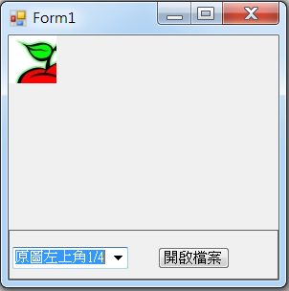
DrawImage example

Slide 4
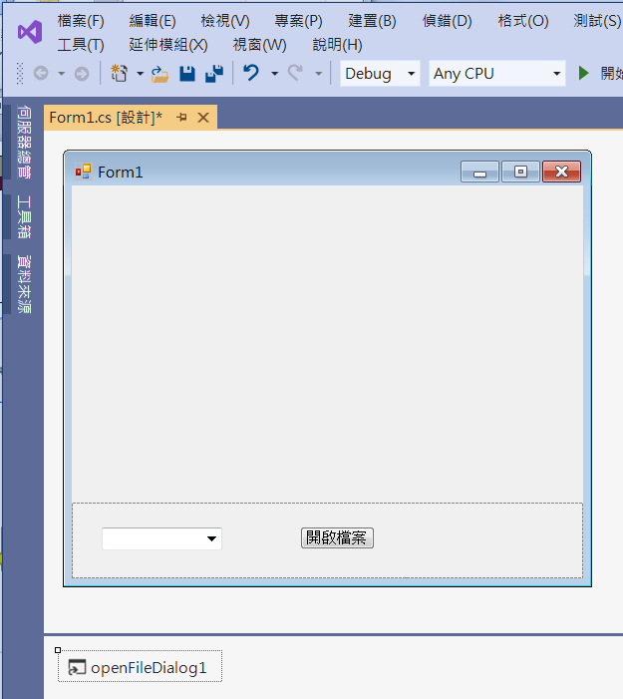
DrawImage example
1. panel1
Dock -> bottom
2. comboBox1
3. button1
4. openFileDialog1

Slide 5
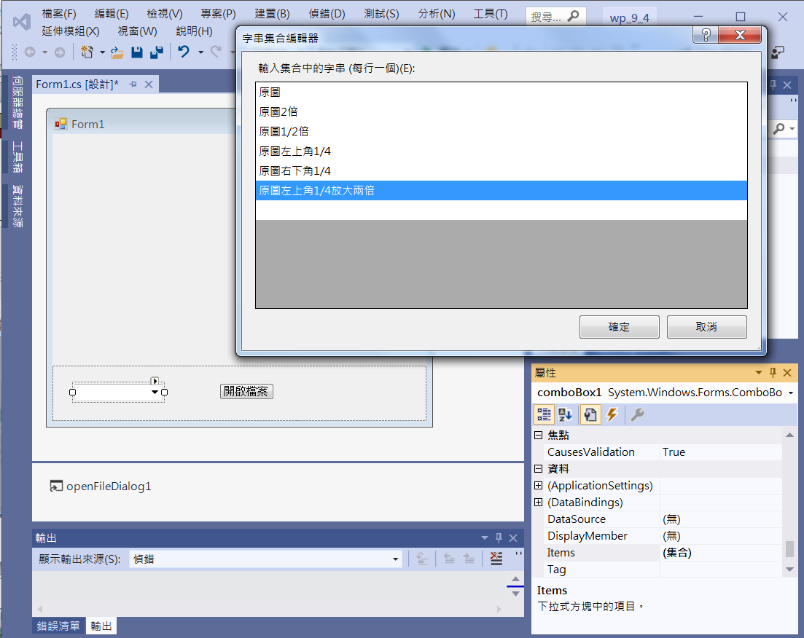
DrawImage example
3. Edit Items (集合)
1. Click comboBox1
2. Click Items

Slide 6
DrawImage example
public partial class Form1 : Form
{
Image img; // Bitmap 影像
public Form1()
{
InitializeComponent();
}

Slide 7
DrawImage example
private void Button1_Click(object sender, EventArgs e)
{
if (openFileDialog1.ShowDialog() == DialogResult.OK) // 開啟影像檔
{
String input = openFileDialog1.FileName;
img = Image.FromFile(input); // 產生一個Image物件
Invalidate();
}
}

Slide 8
DrawImage example
private void Form1_Paint(object sender, PaintEventArgs e)
{
if (img!=null)
{
if (comboBox1.SelectedIndex == 0)
{
Rectangle rectDest = new Rectangle(0, 0, img.Width, img.Height);
Rectangle rectSrc = new Rectangle(0, 0, img.Width, img.Height);
e.Graphics.DrawImage(img, rectDest, rectSrc, GraphicsUnit.Pixel); // 呈現原圖
}

Slide 9
DrawImage example
else if (comboBox1.SelectedIndex == 1)
{
Rectangle rectDest = new Rectangle(0, 0, img.Width * 2, img.Height * 2);
e.Graphics.DrawImage(img, rectDest); // 呈現原圖2倍
}
else if (comboBox1.SelectedIndex == 2)
{
Rectangle rectDest = new Rectangle(0, 0, img.Width / 2, img.Height / 2);
e.Graphics.DrawImage(img, rectDest); // 呈現原圖1/2倍
}

Slide 10
DrawImage example
else if (comboBox1.SelectedIndex == 3)
{
Rectangle rectDest = new Rectangle(0, 0, img.Width / 2, img.Height / 2);
Rectangle rectSrc = new Rectangle(0, 0, img.Width / 2, img.Height / 2);
e.Graphics.DrawImage(img, rectDest, rectSrc, GraphicsUnit.Pixel); // 呈現原圖左上角1/4
}

Slide 11
DrawImage example
else if (comboBox1.SelectedIndex == 4)
{
Rectangle rectDest = new Rectangle(0, 0, img.Width / 2, img.Height / 2);
Rectangle rectSrc = new Rectangle(img.Width / 2, img.Height / 2, img.Width / 2, img.Height / 2);
e.Graphics.DrawImage(img, rectDest, rectSrc, GraphicsUnit.Pixel); // 呈現原圖右下角1/4
}

Slide 12
DrawImage example
else if (comboBox1.SelectedIndex == 5)
{
Rectangle rectDest = new Rectangle(0, 0, img.Width, img.Height);
Rectangle rectSrc = new Rectangle(0, 0, img.Width / 2, img.Height / 2);
e.Graphics.DrawImage(img, rectDest, rectSrc, GraphicsUnit.Pixel); // 呈現原圖左上角1/4以兩倍呈現
}
}
}
private void comboBox1_SelectedIndexChanged(object sender, EventArgs e)
{
Invalidate();
}

Slide 13
DrawImage example
private void Form1_Load(object sender, EventArgs e)
{
comboBox1.SelectedIndex = 0; // 預設選項為原圖;
}

Slide 14
Exercise#9-4

Slide 15
內容來源
  Visual C# 2012 視窗程式設計：繪圖與遊戲專題(鄞永傳/著; 松崗)
  跟著範例學會Visual C# 2015(張逸中/著; 博碩)

