Slide 1
Window Programming 9-5
DrawImage
Flip
Yuan Ze University

Slide 2
DrawImage flip example
e.Graphics.DrawImage(img, Cx, Cy, -img.Width, img.Height);
  水平翻轉
e.Graphics.DrawImage(img, Cx, Cy, img.Width, -img.Height);
  垂直翻轉
e.Graphics.DrawImage(img, Cx, Cy, -img.Width, -img.Height);
  水平翻轉+垂直翻轉

Slide 3
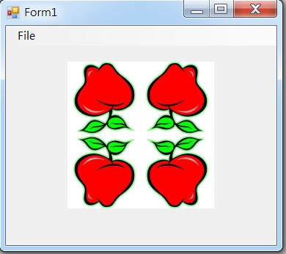
DrawImage flip example

Slide 4
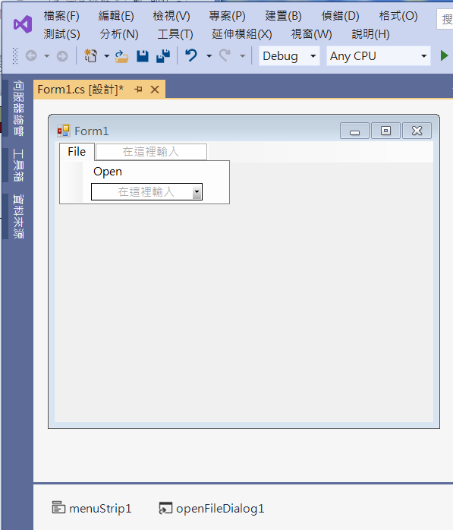
DrawImage flip example
2. Edit menuStrip1
3. Add openFileDialog1
1. Add menuStrip1

Slide 5
DrawImage flip example
public partial class Form1 : Form
{
Image img;
public Form1()
{
InitializeComponent();
}

Slide 6
DrawImage flip example
private void OpenToolStripMenuItem_Click(object sender, EventArgs e)
{
if (openFileDialog1.ShowDialog() == DialogResult.OK) // 開啟影像檔
{
String input = openFileDialog1.FileName;
img = Image.FromFile(input); // 產生一個Image物件
ClientSize = new Size(img.Width*2, img.Height*2+50);
// + 50 預留選單的高度
Invalidate(); // 要求重畫
}
}

Slide 7
DrawImage flip example
private void Form1_Paint(object sender, PaintEventArgs e)
{
int Cx = this.ClientSize.Width / 2; // 視窗客戶區 正中心
int Cy = this.ClientSize.Height / 2;
if (img != null)
{
e.Graphics.DrawImage(img, Cx, Cy, img.Width, img.Height);
e.Graphics.DrawImage(img, Cx, Cy, -img.Width, img.Height);
e.Graphics.DrawImage(img, Cx, Cy, img.Width, -img.Height);
e.Graphics.DrawImage(img, Cx, Cy, -img.Width, -img.Height);
}
}

Slide 8
DrawImage flip example
private void Form1_Resize(object sender, EventArgs e)
{
Invalidate();
}

Slide 9
Exercise#9-5

Slide 10
內容來源
  Visual C# 2012 視窗程式設計：繪圖與遊戲專題(鄞永傳/著; 松崗)
  跟著範例學會Visual C# 2015(張逸中/著; 博碩)

