Slide 1
視窗程式設計
Homework #2: Tic-tac-toe
作業二：井字遊戲
元智資工

Slide 2
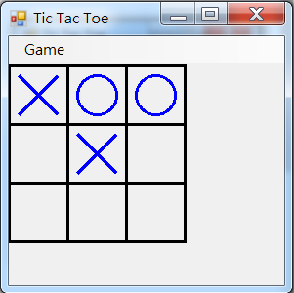
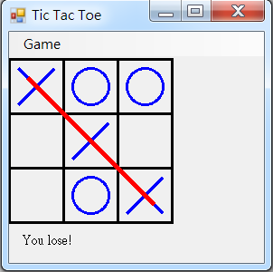
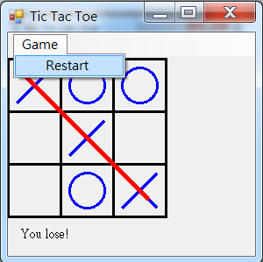
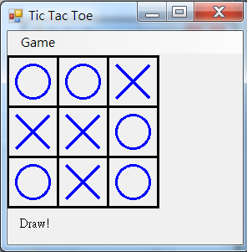
Homework #2: Tic-tac-toe
Draw a tic-tac-toe board with 9 spaces in a 3 × 3 grid. The width and length of each space are 60 pixels.
The system is a opponent to against the user. The user first moves.
The user clicks a blank space to mark the space.
The system will check whether a player wins or draw.
The system has a menu for playing again

Slide 3
作業二:井字遊戲
繪製一長寬各60像素的九官格矩形作為井字遊戲的棋盤。
電腦會和玩家對下，由玩家先下。
玩家以滑鼠點選某一個空白矩形來下棋子。
電腦會判斷是否已有勝負或平手。
具備選單可以重玩。

