Slide 1
6426 Data Structures & Algorithms
Learning session 1

Slide 2
Lecturer Information
Dr Bede Amarasekara
Doctor of Philosophy (Software Engineering) at Massey University, New Zealand
Google Scholar: https://scholar.google.com/citations?user=H182IPgAAAAJ&hl=en
ResearchGate: https://www.researchgate.net/profile/Bede-Amarasekara
My research interests:
  Online tracking
  Online Traffic generation within e-commerce platforms
  Online Privacy management
Email: bamarasekara@unitec.ac.nz
Notes:
Ask students to introduce themselves, where they are from, where they are living now? Overseas/Locally, Bachelors or Graduate Diploma,
Ethnicity Maori/Pacific

Slide 3
In This session…
Course information, schedule, marking scheme & assignments
Our Learning Environment
Familiarizing with VS IDE
Textbooks & Software

Slide 4
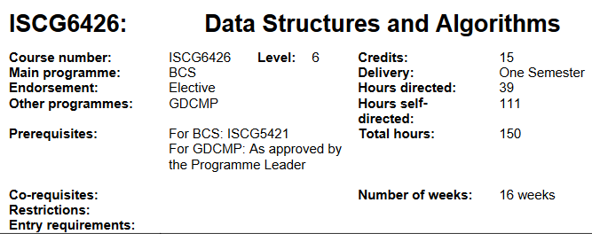
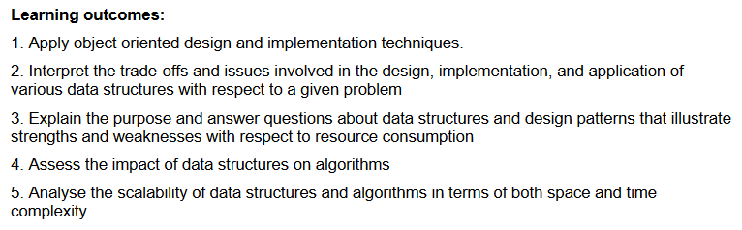
Learning Outcomes
Moodle => Course Information => Course Information

Slide 5
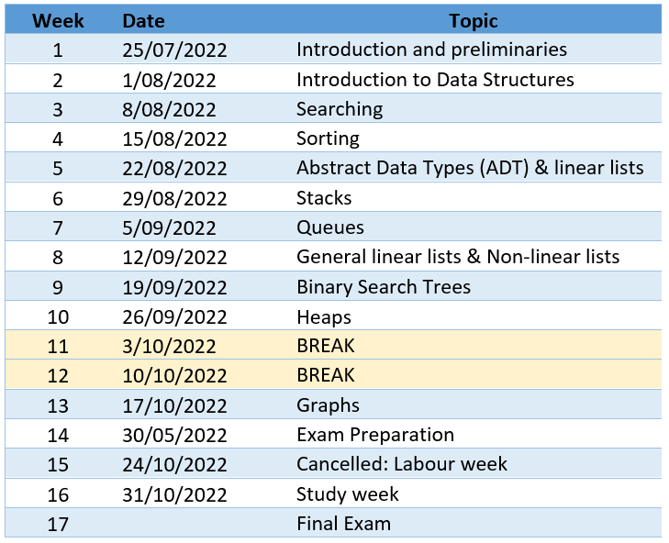
Course Schedule
Available on Moodle: https://moodle.unitec.ac.nz/

Slide 6
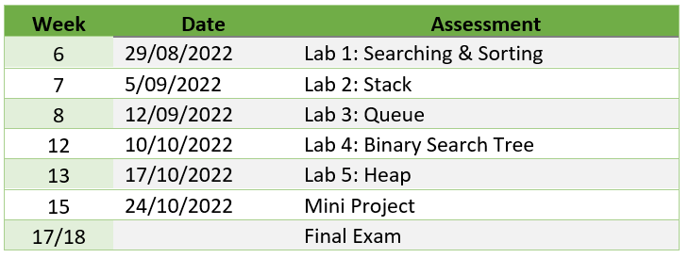
Assignment & Assessment schedule

Slide 7
Marking scheme & Assignments
Lab Exercises (30%)
  Completed individually. You can study in small groups Based on classroom topics and implementation
Mini-Project (40%)
  A multimedia project related to implementing and using a data structure, and (or) an algorithm in a real-world situation
Final Exam (30%)
  11 Questions (8 short-answer & 3 coding questions), close-book, 3 hours.

Slide 8
Recommended Textbooks & Software
  C# Data Structures and Algorithms
    Principles of data structures using C and C++, by Vinu Das, publisher: New Age International
    Available online via Unitec Library
    C# Data Structures and Algorithms by Marcin Jamro
    https://www.packtpub.com/product/c-data-structures-and-algorithms/9781788833738
  Improving your C# Skills
    Ovais Mehboob Ahmed Khan, et al
    https://www.packtpub.com/product/improving-your-c-skills/9781838558383
  Professional C#
    Simon Robinson, et al
    Available online via Unitec Library

Slide 9
Learning happens in learning communities
Form a group of 3
Teaching is the best way to learn
Mutual respect, recognition, acceptance, not being discriminated
Four processes of learning
  Knowledge construction
  Knowledge retention
  Knowledge retrieval
  Knowledge consolidation
Every activity we undertake is with these goals in mind

Slide 10
Tertiary Adult Learning context
Face-to-face classroom delivery
  I will introduce concepts
  We will do some interactive learning
Online asynchronous mode
  Self-directed learning to explore the concept further and construct your own knowledge
  Collaboration and interaction with others
Online synchronous mode (if it becomes necessary)
  Summarize previous lecture, discuss any issues
  I will introduce concepts

Slide 11
Creating a friendly and inclusive learning Environment
We are all learners, including me.
We will collaborate to learn from each other
School education is teacher-centric. University education is learner-centric.
In First year, we introduced you how to become independent learners
In Second year, we help you to master self-directed learning & evolve as researchers
By Third year we want to see researchers ready to create new knowledge

Slide 12
Creating a friendly and inclusive learning Environment (Contd)
Do not be afraid to ask questions
There are no dumb questions, every question opens a door to challenge one’s own knowledge and leads to a deeper understanding of the subject
Your questions give me pointers how the learning is progressing, am I on the right path, or what should I do different. Without questions I am in the dark
Questions and interactions keep all of us awake, during 3-hour learning sessions

Slide 13

Individual work vs
Collaborative work vs
Being a leech

Slide 14
Our learning context

Slide 15
Course Prescription
Hours directed: | Hours Self-directed: | Total Learning Hours:
39 | 111 | 150

Slide 16
Each Week Time Allocation ( in Hours)
Hours directed: | Independent work | Project
3 | >1 | >0
 | = 8.5

Slide 17

Textbooks & Software
Software
Visual Studio 2017, 2019, 2022
Visual Studio Code
Git: Github, GitLab, BitBucket
Cloud: Onedrive (Unitec)
Physical copy: SSD, USB
Reference site
C# Documentation
Storage & Backup

Slide 18
Need a break?
Data Structures overview

Slide 19
Software setup
We use Microsoft Visual Studio Integrated Development Environment (IDE)
How many of you have installed Visual Studio on your local machines?
Has anybody not being able to install VS IDE?
Who has not used C# before?
Notes:
How many are used to this IDE?

Slide 20
Getting started with C#
Open Visual Studio 2019/2017
  If not-yet installed, follow the instructions on Moodle to download and setup
Before we do any coding, a quick break
  15 minutes

Slide 21
References
Das, V. V. (2006). Principles of data structures using C and C++. New Age International.

