Slide 1
Searching & Sorting
Learning session 3
6426 Data Structures & Algorithms

Slide 2
In This session…
Revision of previous Learning session
Introduction to Searching algorithms.
Hands-on coding revision from last session
Coding exercise

Slide 3
Last week we learned
What are data structures?
Structures created in computer’s memory to store individual or collections of data, so that application programmes can use, manipulate and process the data in an efficient and organized manner.
Why do we need them?
Arrays that are the basic and fundamental collection type, though very fast and efficient, have their limitations.
Fixed size, can’t grow or shrink
Size has to be pre-determined, hence can be wasteful of memory
We can create data structures that can extend capabilities suitable for our requirements. Dynamically growing, faster search and sort algorithms, key/value pairs for accessing data

Slide 4
Data structures
We looked at some data structures
Array
Linked-List
Queue
Stack
Key/Value pairs (Dictionary)
Data structures are often designed around searching quickly.

Slide 5
Arrays
Int[] A = new int[5];
A[0] | A[1] | A[2] | A[3] | A[4]
A[1] = 10; A[4]= 25; A[0] = 80;
Any element in the array can be accessed directly using its subscript, e.g., A[1], A[2]…. A[100] etc. If there were 100 elements, to access A[99], we do not have to traverse from A[0], A[1]…A[99].

Slide 6
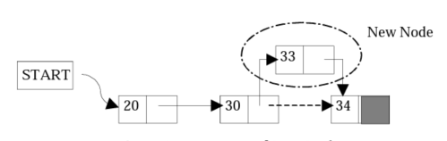
Linked lists
Insertion or deletion of a node at any arbitrary point is easy (Das,2006).

Slide 7
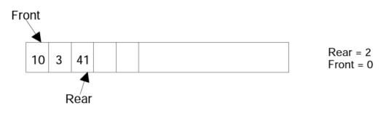
Queue
First in-First out (FIFO)
enqueue() to add an element and dequeue() to remove the element in the front.
C# implementation details at:
https://docs.microsoft.com/en-us/dotnet/api/system.collections.queue?view=net-6.0

Slide 8
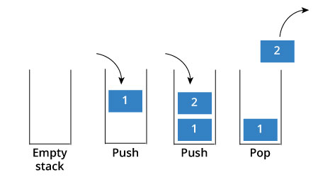
Stack
Last-in-First-out (LIFO)
push() to add elements
pop() to remover elements
Static Stacks implemented using Arrays
Dynamic Stacks use Linked Lists

Slide 9
Brute Force – Linear Search
Going through all values in a collection without any additional knowledge about the data order is called a Linear search
Trying to guess a password
  If you know “roughly” what it was, you can limit your guesses to something close
  If you don’t know at all, how many attempts will it take to get it?

Slide 10
Searching
1 | 3 | 10 | 12 | 14
. . . . . . . . . . .
255 | 280
1 2 3 4 5 . . . . . . . . . . 99 100
If we want to find value 75 within this collection, we can start traversing from 1-100 until we find 75.
Is there a better way to do that ?

Slide 11
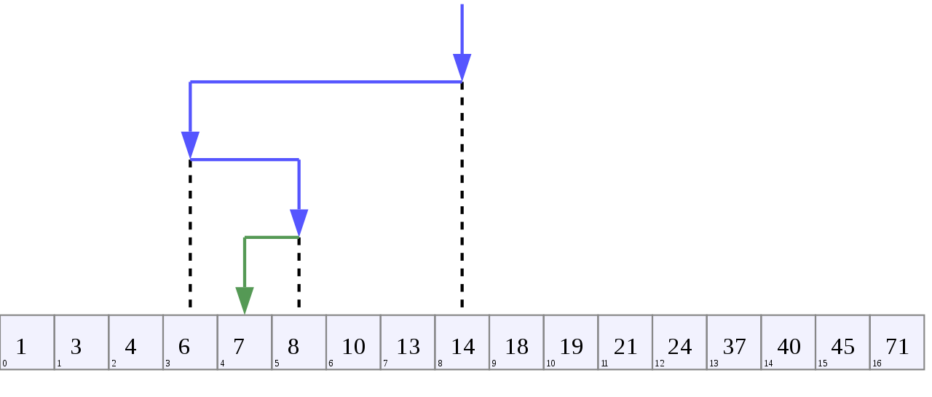
Binary Search (Divide & Conquer)

Slide 12
Big O (Order): Worst-case scenario (upper bound)
Big Θ (Theta): Average-case (derived from O and Omega)
Big Ω (Omega): Best-case (lower bound)
Big O Notation: system for describing the rate of growth of an algorithm
Notes:
N square is not what we want
Log N would be great O(Log2N)

Slide 13
Linear Search
Example:
int[ ] myArray = new int[100]; (filled with ints)
int findMe = 75;
Worst case: 75 is at myArray[99] or not found
Best case : 75 is at myArray[0]
Average case: 75 is at myArray[49-50]

Slide 14
Linear Search
Worst case: 100 loops
  O ( n )
Best case: 1 loop
  Ω ( 1 )
Average case: 50 loops
  Θ ( n ÷ 2 ) -> Simplified to Θ ( n )
    Remove constants

Slide 15
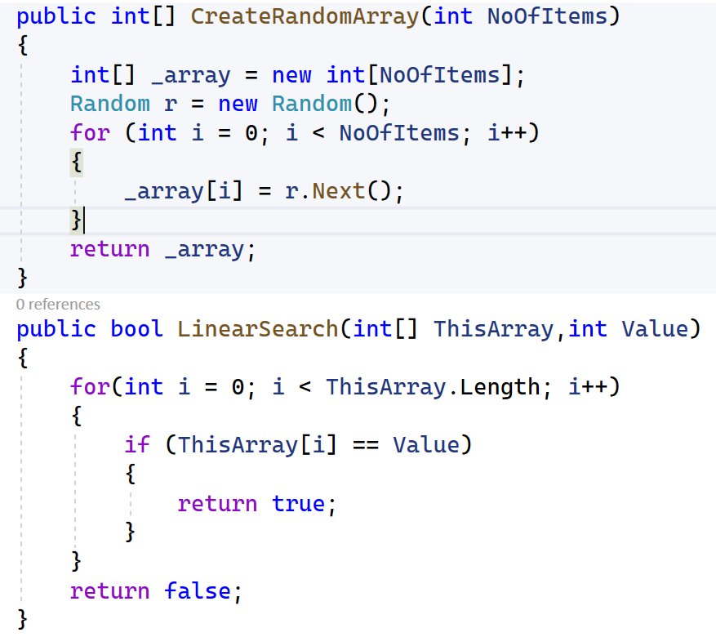
Sample Code

Slide 16
Binary Search
Example:
int[ ] myArray = new int[100]; (filled with ints, Asc)
int findMe = 17;
  Worst case: 17 is found after 6 halving actions
  Best case : 17 is at the middle (first check)
  Average case: 17 is found after 3 halving actions
Important:
Binary Search works only if the array is sorted. Linear search works on sorted or unsorted.

Slide 17
Binary Search
Worst case: 100 loops
  O ( log(n) )
Best case: 1 loop
  Ω ( 1 )
Average case: 50 loops
  Θ ( log(n) / 2) -> Simplified to Θ ( log(n) )
  Remove constants
Notes:
Logarithm = inverse of exponent

Slide 18

Questions

Slide 19
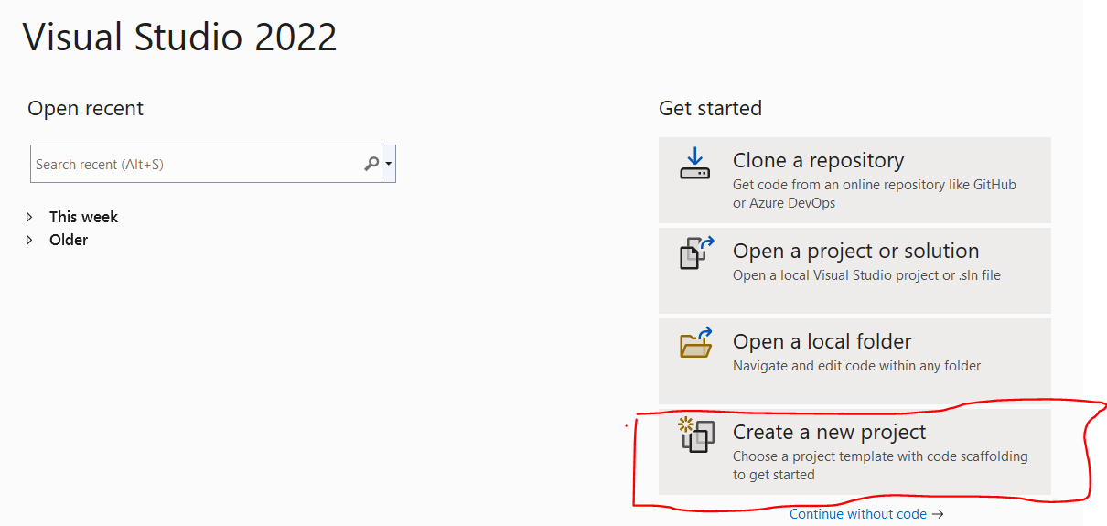
Let’s get our hands dirty
Open your Visual Studio IDE.
Watch my shared screen, when you want to double-check, what you are doing is right.
Let’s create a new Console project

Slide 20
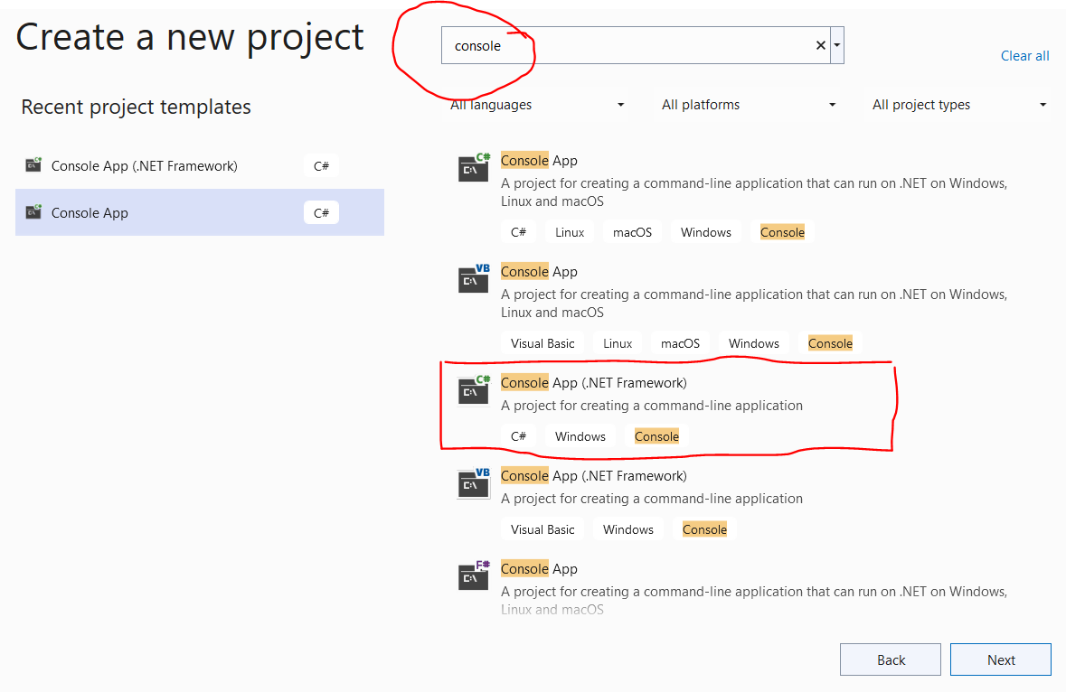
Create a New Project
Make sure you type “Console” in the search box to narrow down the options
Chose “Console App (.NET framework) and “C#” not “Visual Basic”

Slide 21
Searching – Beyond Linear, Binary
Recursive
  A function that calls itself
  Doesn’t require a loop – it is a loop
  Very easy to make infinite loops – careful

Slide 22
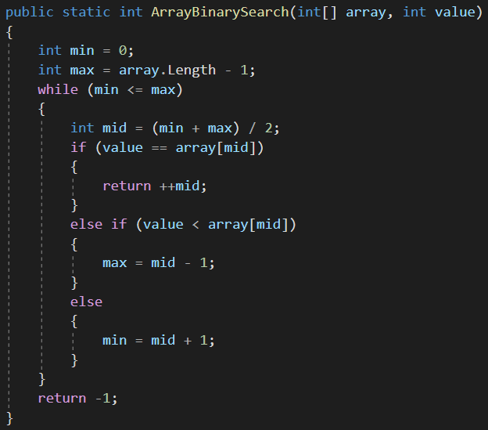
Binary Search

Slide 23
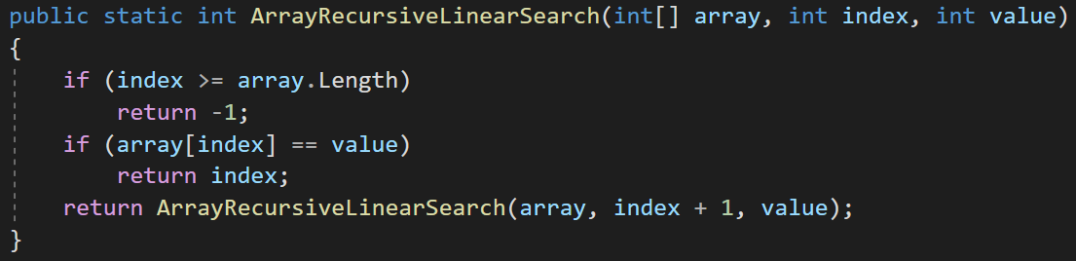
Recursive Linear Search

Slide 24
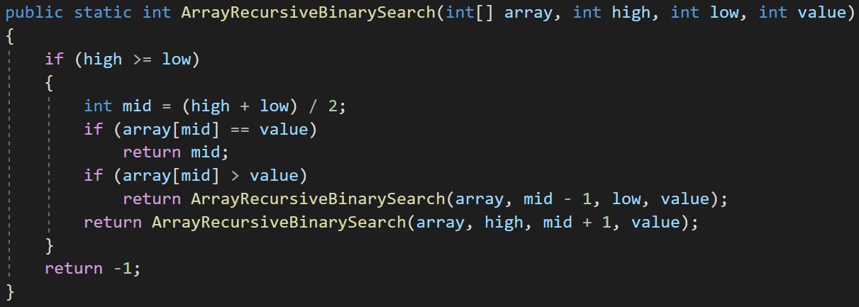
Recursive Binary Search

Slide 25
Activity – Implement the searches
Open your solution, create new Week3 project
1
Define a class called FlexiArray
2
Implement dynamic growth using Add()
3
Create a LinearSearch method for arrays
4
Create a BinarySearch method for arrays
5
Create a Recursive method for each of the above
6

