Slide 1

PinPoint
CSC1118 – Project Proposal
Student Name | Student Number
Michael Beirne-Ponomarev | 21493754
Robert Maloney | 21357483
Supervisor | Contact
Sahraoui Dhelim | sahraoui.dhelim@dcu.ie

Slide 2

Project Summary
Social Media Platform – Organising events with friends.
Upload photos to the event group chat – chat about the event.
Events disappear after a period of time.
Saves the need for switching between apps.
Save the amount of unused group chats.

Slide 3
Market Rationale
Target Market Size
Customer Segment
Value Proposition
Our target market is
substantial.
Billions use mobile social
media applications.
High smartphone usage in
North American and
European regions, who also
seek to plan events and
social gatherings.
Young Adults (18-24)
- Most likely to attend social
events.
Marketing Management
- Engaging individuals who
focus on driving attraction.
Building one platform to
create events seamlessly
without using other
applications.
Aiming to enhance the
organisation of events by
offering user-friendly
features.

Slide 4
Primary and Secondary Research
Competitor Analysis
Planned Market Validation
Social Media Platforms that offer group chats – Facebook, Messenger, Snapchat.
Event Applications – Eventbrite.
Interviews:
Meeting with people in groups and ask about how they organised the event – Finding interest.
Alpha/Beta Testing:
Let potential users test the app and responding to any feedback that is given.
Social Trends
Seeing how people use location-based features currently. Identify how other applications utilise it.

Slide 5
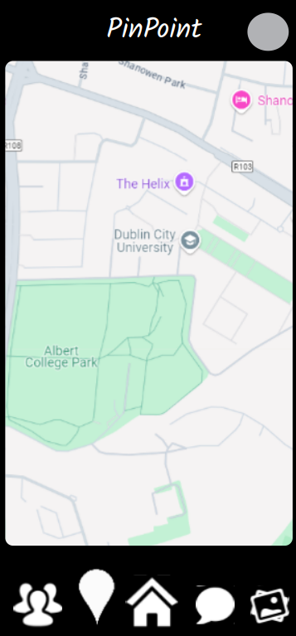
Expected Technical Delivery
Complete a Pen-Pot Model of what the final app will appear to look like.
Being able to see and use a Google Maps or OpenStreetMaps API.
A Functional Application using either Flutter or React Native along with a Django and Firebase backend.
Potential Prototype using an Android emulator such as BlueStacks or Android Studio.
Notes:
Pen pot is an open source design tool used for interface design and prototyping.

Slide 6
Project timeline
Project Idea + Finding Suitable Supervisor
Baseline for Project
Initial Draft of Application
Creating the Logic for Application
Converting Logic into Mobile Application
Design Features + Bug Fixes
User Feedback / External Reviews for Locations
Testing + Bug Fixes

Slide 7
Thank you!

