Slide 1
Real or Not? NLP with Disaster Tweets
Drăghici Marius-Robert

Slide 2
Milestone 1 experiments
Finetuned pretrained transformer models (BERT, DistilBert, Albert, XLNet) on both clean and unclean data.
For most of the experiments, I used a learning rate of 5e-05 with 1 cycle policy as learning rate schedule for 4 or 5 epochs.
Preprocessing steps: change all text to lowercase except for pronouns, remove stopwords, punctuation and urls.

Slide 3
Results milestone 1
 | BERT | DistilBERT | Albert | XLNet
Unclean data | 0.82310 | 0.81390 | 0.77811 | 0.80061
Clean data | 0.82208 | 0.79856 | - | -

Slide 4
Data exploration and preprocessing after milestone 1
Analyzed the tweets to see what can be removed without losing too much information.
Redundant punctuation and characters:
Expanded constructions such as “I’m” to “I am”.
Removed numbers and redundant spaces.

Slide 5
Milestone 2 experiments
Finetuned pretrained transformer models (RoBERTa, ELECTRA, DeepPavlov/bert-base-cased-conversational) on both clean and unclean data using the simple transformers and ktrain libraries.
For most of the experiments, I used the default settings such as batch size 8 and learning rate 4e-5. Models were trained for different number of epochs ranging from 2 to 15.

Slide 6
Results milestone 2
 | Cleaned data | Uncleaned data
Deep Pavlov | 0.82106/0.80572 | 0.80163
Electra small generator | 0.82413 | 0.78016
Electra small discriminator | 0.81901 | 0.76073
Distil Roberta base | 0.80777 | 0.81901
Roberta base | 0.80981 | 0.81901
BERT | - | 0.83435

Slide 7
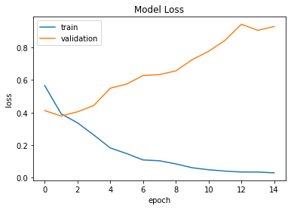
Discussions

Slide 8
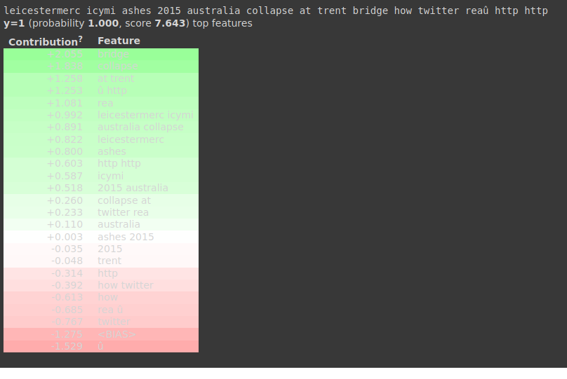

Slide 9
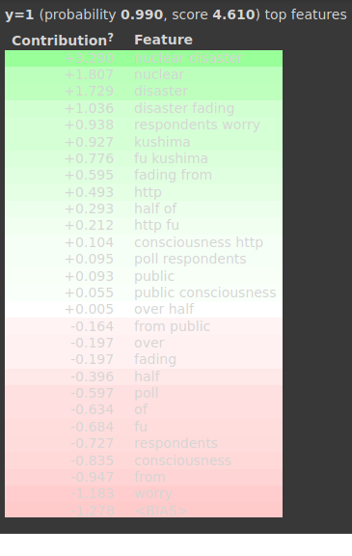
over half of poll respondents worry nuclear disaster fading from public consciousness http fu ##kushima

Slide 10
References and inspiration for milestone 1
Kaggle Kernels
Start From Here : Disaster Tweets EDA+Basic model
Disaster tweets analysis for beginners WIP
Text Classification with Hugging Face Transformers in TensorFlow 2 (Without Tears) – Medium article
Tutorials and documentation provided in the ktrain Github repository https://github.com/amaiya/ktrain

Slide 11
References and inspiration for milestone 1
Kaggle Kernels
tweet-predict1
Nlp with disaster tweets – eda, cleaning and bert.
Simple transformers — introducing the easiest way to use bert, roberta, xl-net, and xlm – Towards data science article
Tutorials and documentation provided in the simple transformers Github repository https://github.com/ThilinaRajapakse/simpletransformers

Slide 12
Thank you for your attention!

