Slide 1
Rain, timing or home advantage? What influences goals and victories in the 1. Bundsliga
Group 15: Hauke Busch, Jakob Erichsen, Alexander Liebler, Robert Ousch

Slide 2
Week 1: Topic brainstorming
Three different topics
Public transport
Crime rates
Football in Germany
Issue: Finding optimal APIs to answer all of our questions

Slide 3
Week 2: Answering the research questions
Used the data sources to answer three of our research questions
Issue: Football API does not provide as much historic data
Not enough to answer following questions:
4. How many goals are scored on average before a player is transferred to another team?
5. What is the correlation between the win rate of a coach`s team and the coach`s time at the team?
→ Were replaced

Slide 4
Week 3: Basic website
Used the data sources to answer the remaining five research questions, including the two new questions
Built a basic website, some static visualizations
Issues:
Problems with graphs using multiple interactive elements
Gunicorn start command changed
Wait times per deploy were quite long and made testing difficult

Slide 5
Week 4: Final website and poster
At least one dynamic visualization per research question
Eight different graph types
Six of our research questions on our scientific poster

Slide 6
Data sources
api.openligadb.de
Main source
Historic data of matches, teams and goals
v3.football.api-sports.io – venue capacity
geocoding-api.open-meteo.com – rainfall and precipitation
https://hi-artemii.medium.com/vertical-lollipop-chart-in-plotly-python-minimal-code-example-1e1bca0b1261 – Lollipop plot

Slide 7
Website

Slide 8
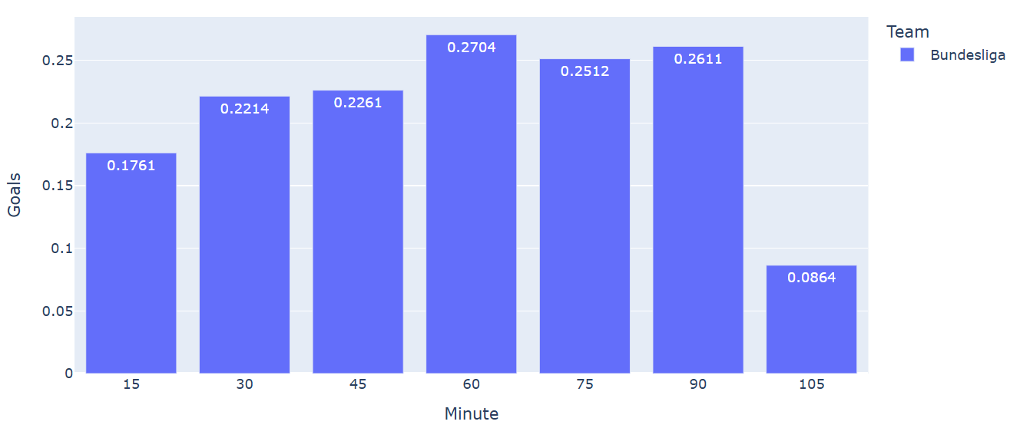
Inspecting 15 minute intervalls, when during the last 15 years were the most goals scored?
Dropdown menu: Bundesliga or different teams
Radio buttons: Goals/ Percentage

Slide 9
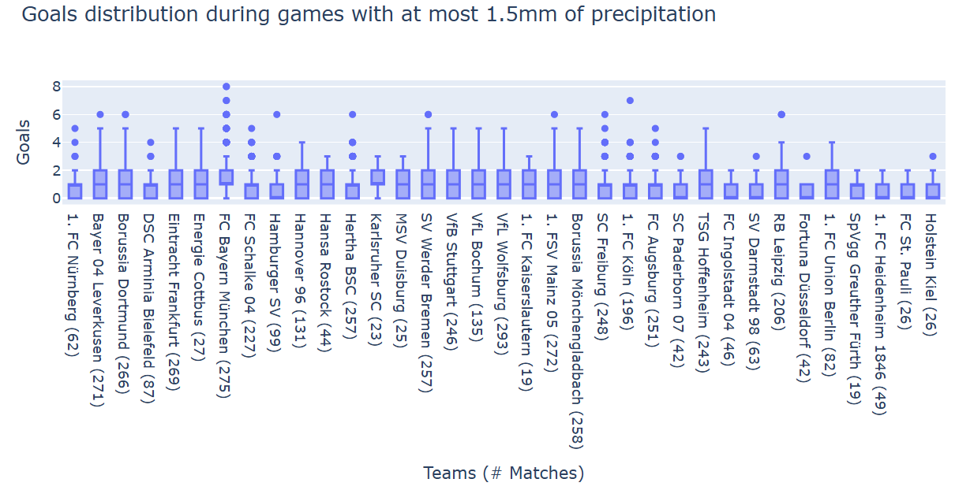
How does high rainfall during a match influence the performance of certain German teams?
Slider: Precipitation threshold (mm)
Dropdown: Teams

Slide 10
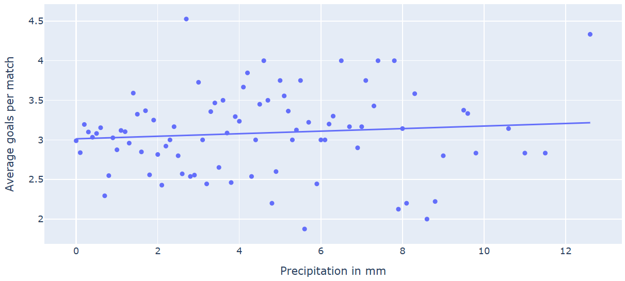
How does high precipitation during a match influence the total number of goals scored?
Radio buttons: Rain/ Precipitation

Slide 11
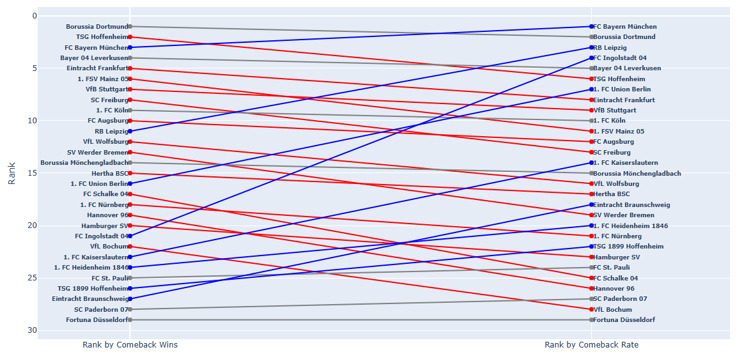
Which teams are the best at staging comebacks after trailing at half time?
Radio buttons: Comeback wins/ Comeback rate

Slide 12
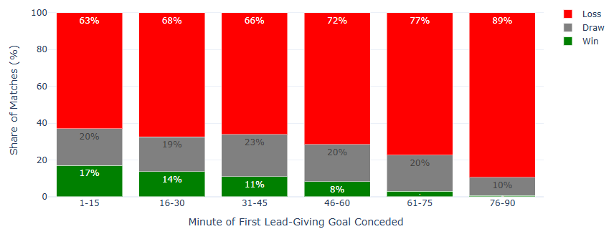
How does the timing of the first conceded lead-giving goal affect the match outcome?
Radio buttons: Win/ draw/ loss

Slide 13
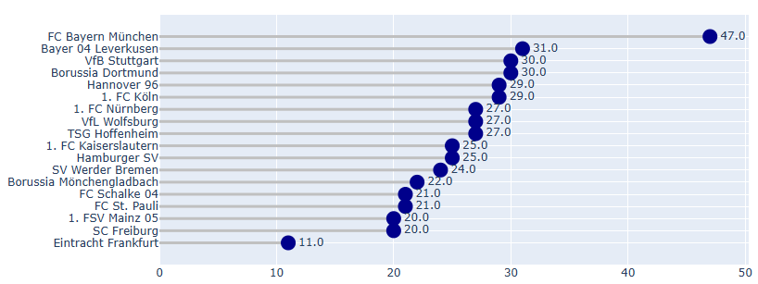
Which teams scored goals at home turf most often?
Slider: Season

Slide 14
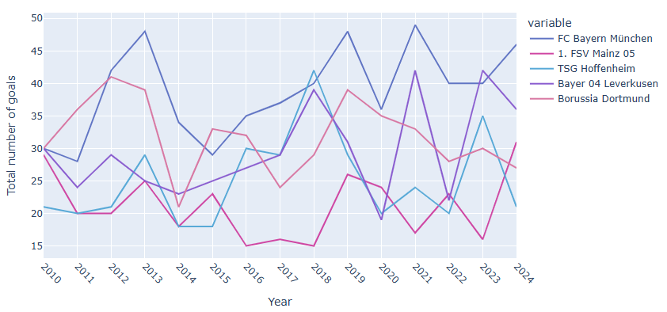
During the last 15 years, when did each team score goals most often in their opponent`s city?
Dropdown: Teams

Slide 15
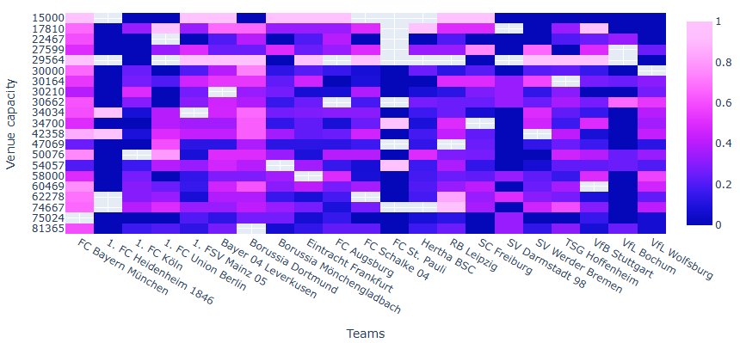
How does the venue capacity influence the win rate of the away team?
Dropdown: Teams

Slide 16
This project is created as part of the Data Science Project of the winter semester 2025/26 from Cristian-Albrechts-University in Kiel.
Our group is number 15 and the team members are Hauke Busch, Jakob Erichsen, Alexander Liebler and Robert Ousch.

