Slide 1
The technology-Value Stream
Robert sharp

Slide 2
What is it?
The technology-value stream is a comparison of effort versus reward.
Gene Kim defines it as, “the process required to convert a business hypothesis into a technology-enabled service that delivers value to the customer.”
Developers have the burden to determine what the technology value stream will look like for each product.

Slide 3
Lead time vs processing time
Lead Time and Processing Time is always an important concern during the Technology-Value Stream
Gene Kim writes, “This value stream begins when any engineer in our value stream…checks a change in to version control and ends when that change is successfully running in production, providing value to the customer and generating useful feedback and telemetry.”
We’ll hit each stage in detail next

Slide 4
Lead time vs processing time
First I’ll cover Lead time
Lead time is key to a more effective development experience
Gene Kim defines lead time as, “the lead time clock starts when the request is made and ends when it is fulfilled”
It is very important to reduce lead time so the customer isn’t subjected to an egregious wait for their request to start to be fulfilled

Slide 5
Lead time vs processing time
Next I’ll be covering processing time
Processing time is simply when the work on a project begins, and goes until completion
Process time is usually the shorter between the two
Development teams should focus on reducing lead time to be as close to processing time as possible

Slide 6
The common scenario
What it is:
Deployment Lead Times Requiring Months
This scenario is most common in larger companies where the applications are large and monolithic, infrequent testing chances, lots of manual testing, and multiple necessary accesses
Next we’ll cover the ideal scenario

Slide 7
DevOps Ideal
The DevOps ideal is as follows:
Deployment Lead Times of Minutes
In the DevOps ideal, the extremely short lead time is accomplished by nearly instant customer feedback
All of the changes in this ideal are minimal and easily implemented in order to fill the customer’s request

Slide 8
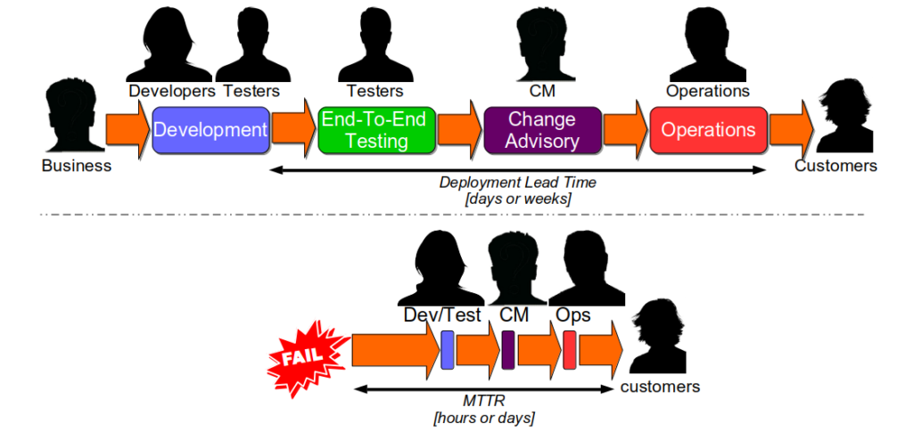
DevOps ideal

Slide 9
Devops ideal
In the previous example you can see how the process of accepting a request and implementing it into development may only take several hours
This ideal would work for new requests or a breakdown of existing function
This ideal also serves as the example of continuous delivery
In continuous delivery the application is at a stage of reliability where it can handle frequent updates with very minimal downtime

Slide 10
references
Kim, Gene et al. The Devops Handbook: How To Create World-Class Agility, Reliability, & Security In Technology Organizations. 1st ed., IT Revolution Press, LLC, 2016.
Smith, Steve. "Resilience As A Continuous Delivery Enabler – Continuous Delivery Consulting". Continuousdeliveryconsulting.Com, https://www.continuousdeliveryconsulting.com/blog/resilience-as-a-continuous-delivery-enabler/. Accessed 16 July 2018.

