Slide 1
The two-pizza team rule
Robert sharp

Slide 2
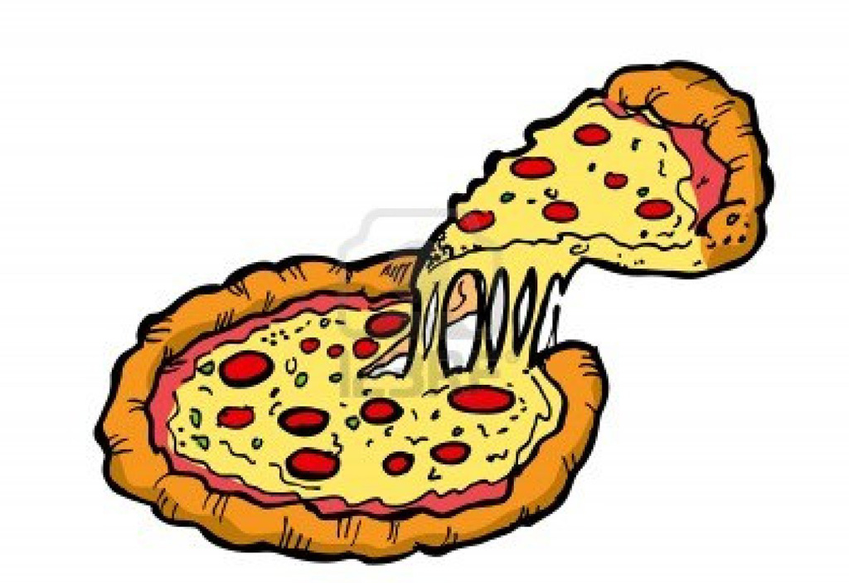
What is it?
The two pizza rule is a simple rule to keep in mind to pare down the size of development teams.
The phrase was coined by Amazon’s CEO Jeff Bezos
“The two pizza rule: Never have a meeting where two pizzas couldn’t feed the entire group.”
This Photo by Unknown Author is licensed under CC BY-NC-ND

Slide 3
Keep things small
Dr. Melvin Conway’s Law is another rule to keep in mind
“The larger an organizations is, the less flexibility it has and the more pronounced the phenomenon.”
A more famous version was written by Eric S. Raymond
“The organization of the software and the organization of the software team will be congruent; commonly stated as ‘if you have four groups working on a compiler, you’ll get a 4-pass compiler.’”

Slide 4
Why keep things small?
Jeff Bezos has several beliefs about why too large of a group is a very bad thing.
More people = less productivity
Specifically, Bezos believes that most people in a large group will start agreeing with others instead of having their own thoughts ideas be heard
Jeff Bezos also believes that small groups should only communicate when absolutely necessary

Slide 5
4 Important group size effects
#1
Everyone on the same page
Larger groups require a considerable amount of additional communication to ensure all members understand the goal

Slide 6
4 Important group size effects
#2
Limited growth rate
An amount of groups that are structured with a relatively equal amount of members will facilitate equal growth of the application as a whole
Additionally, the groups will be have an up-to-date understanding the system as a whole

Slide 7
4 Important group size effects
#3
Enabled autonomy
Like a pyramid, the group leads take the direction of the team from executives, but that’s it
The autonomous groups are empowered to act on their own to best fulfill the design function they’ve been given

Slide 8
4 Important group size effects
#4
Low risk while gaining leadership experience
The members of the small teams will have to take on some responsibility
However, if something should go wrong, a small team has the ability to fix the problem quickly
This would never be the case for a large team, or while using a monolithic application

Slide 9
Summary
Larry Dignan of Baseline wrote in 2005 that, “Small teams are fast…Each group assignment to a particular business is completely responsible for it…designs it, builds it, implements it and monitors its ongoing use.”
The use of effective two-pizza teams enables companies to employ only the right amount of the right people for the right job.

Slide 10
References
Kim, Gene et al. The Devops Handbook: How To Create World-Class Agility, Reliability, & Security In Technology Organizations. 1st ed., IT Revolution Press, LLC, 2016.
Giang, Vivian. "The 'Two Pizza Rule' Is Jeff Bezos' Secret To Productive Meetings". Business Insider, 2013, http://www.businessinsider.com/jeff-bezos-two-pizza-rule-for-productive-meetings-2013-10. Accessed 22 July 2018.

