Slide 1
JSON
Representational State Transfer

Slide 2
Josn topics
Questions that will be answered:
What a JSON API is
How they differ from SOAP APIs
What the JSON Request Header is
What the JSON Request Body is
What the JSON Response Body is

Slide 3
What is a JSON API?
First, we’ll cover the differences between SOAP and JSON APIs
Remember that SOAP APIs are XML based:
The biggest difference is that JSON is easily parsed with standard JavaScript
XML needs a specific parser
This means that JSON itself faster, and you save time with less extra work
Additionally, there’s no XML end tag, JSON requests are within curly brackets - { }

Slide 4
Now, What is a json api?
JSON is another method by which an API can be structured apart from REST, SOAP, etc.
Like REST, JSON APIs utilize HTTP methods (GET, POST, PUT, DELETE)
Part of the development of JSON APIs is to streamline these HTTP methods
The user and server send these requests in packaged JSON formats
The messages includes handling metadata, resource data and more
Every JSON API document is required to have a specific header

Slide 5
JSON headers
A JSON API header serves the same purpose that a SOAP/XML header does
That purpose is to provide some handling information, like authentication
The only difference, is that with JSON, it’s much easier to write and cleaner to read
Appropriate JSON HTTP headers:
Content-Type: application/json
Accept: application/json

Slide 6
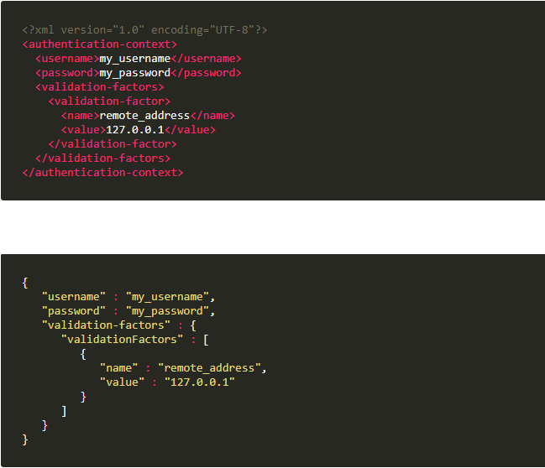
Json header comparison example
Retrieved from
https://developer.atlassian.com/server/crowd/json-requests-and-responses/

Slide 7
Json request bodies
Below the header in a JSON request is the body
Bodies are present in both requests and responses
In a request, the body contains the information that you were requesting to see
As you’d expect, the body in the response contains the information you initially requested
This is the case, unless an error occurred during the transaction

Slide 8
The json process
The package is created inside of a JSON request in curly brackets
The header is formed for authentication/login/handling
The body contains the data being requested/posted
The request is sent off and processed by the server
Then the response is returned in the same fashion that the initial request was made
Any errors that occur will also be returned

Slide 9
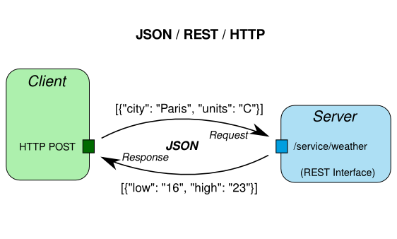
Json process
Infographic from: http://linkeddataorchestration.com/2014/01/28/data-modeling-for-apis-part-2-rest-and-json/

Slide 10
references
Doerrfeld, B. (2017). The Benefits of Using JSON API. [online] Nordic APIs. Available at: https://nordicapis.com/the-benefits-of-using-json-api/ [Accessed 22 May 2018].
W3schools.com. (n.d.). JSON vs XML. [online] Available at: https://www.w3schools.com/js/js_json_xml.asp [Accessed 22 May 2018].
Developer.atlassian.com. (n.d.). JSON requests and responses. [online] Available at: https://developer.atlassian.com/server/crowd/json-requests-and-responses/ [Accessed 22 May 2018].

Slide 11
References
Crockford, D. (2006). JSONRequest. [online] Json.org. Available at: http://www.json.org/JSONRequest.html [Accessed 22 May 2018].

