Slide 1
OAUTH
Robert Sharp

Slide 2
What is oauth?
From https://oauth.net :
OAuth is “An open protocol to allow secure authorization in a simple and standard method from web, mobile and desktop applications.”
OAuth is a tool that asks for your authorization when a service want to use your data as part of something else you’re using
An example of this is when you choose to link your Instagram account with your Facebook

Slide 3
How Oauth works
“So is OAuth handing out my passwords?”
No, it isn’t.
When you authenticate that you’re giving permission for your data to be used via another application, OAuth provides a code to the service
This method protects your privacy
While you’re protected, the service gets the benefit of more user interaction

Slide 4
Oauth 1.0
Here’s how the OAuth 1.0 authentication process would work
OAuth will assign temporary credentials for initial requests
The user provides a consumer key in the request
The server checks it, and checks the callback key present against whats permitted by the account data being accessed
Once these checks pass, temporary credentials are assigned

Slide 5
Oauth 1.0 cont.
After the initial connection, user authorization occurs
This is what would be a message asking you to enter your login information for a third party account’s access
This can also be denied
The last step is assigning new long life tokens
Token codes are assigned that allow the client to access the data you’ve approved in the last step

Slide 6
Oauth 2.0
How is Oauth 2.0 different?
Oauth 1.0 is a little limited and confusing to use
Oauth 2.0 only supports HTTPS for better security
Oauth 2.0 is more flexible for more types of devices (non desktop computers)
Oauth 2.0 also scales easier and has more extensive protocols for better future proofing

Slide 7
Why oauth is popular
Oauth has been around for a long time
Version 1.0 was released in 2006
The software had been improved as time went on
This was fine until more and more people used other devices more regularly
Now that Oauth 2.0 is out, everyone that was familiar with Oauth 1.0 can take advantage of a more simplified product with improved capabilities

Slide 8
Dataflow in an oauth api
Here is the process for how a request is made in an API that uses Oauth
A user uses an application that wants to request the user’s data from another service
The user says yes, and then the user is taken to the Oauth page that supplies an authorization code, later exchanged for a token
Now the application can access the API and retrieve data from the user’s account with the other service

Slide 9
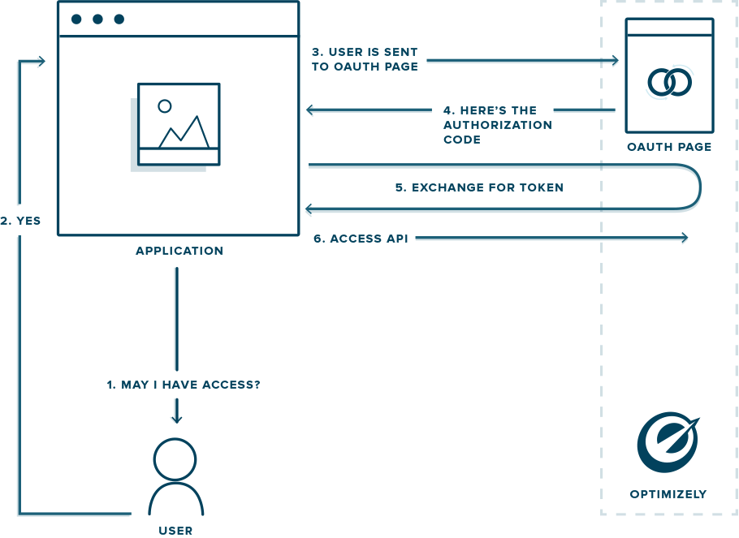
Dataflow in an oauth api cont.
Here is a graph of the dataflow from https://developers.optimizely.com/classic/oauth/

Slide 10
References
https://aaronparecki.com/oauth-2-simplified/#differences
https://oauth1.wp-api.org/docs/basics/Auth-Flow.html
https://oauth.net/2/
https://developers.optimizely.com/classic/oauth/

