Slide 1
microservices
Robert sharp

Slide 2
What are microservices?
Microservices are segmented functions of an application
Very independent
Performs functions relating to a single task
Typically developed and maintained by a very small team
Organized with interconnected containers
Increases testability and speed of making repairs

Slide 3
What is an Api Gateway?
An API Gateway is like the front door to your application
Users utilize the API gateway from the outside internet browser
Your API gateway serves to check their credentials, and in addition, these credentials are checked and verified when accessing any service managed via your microservices
Now they have access to the data contained within your application

Slide 4
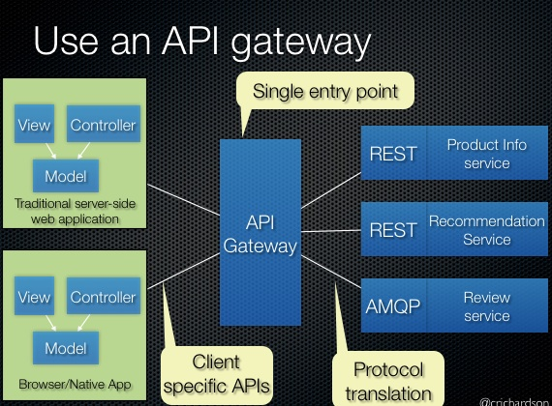
API Gateway example

Slide 5
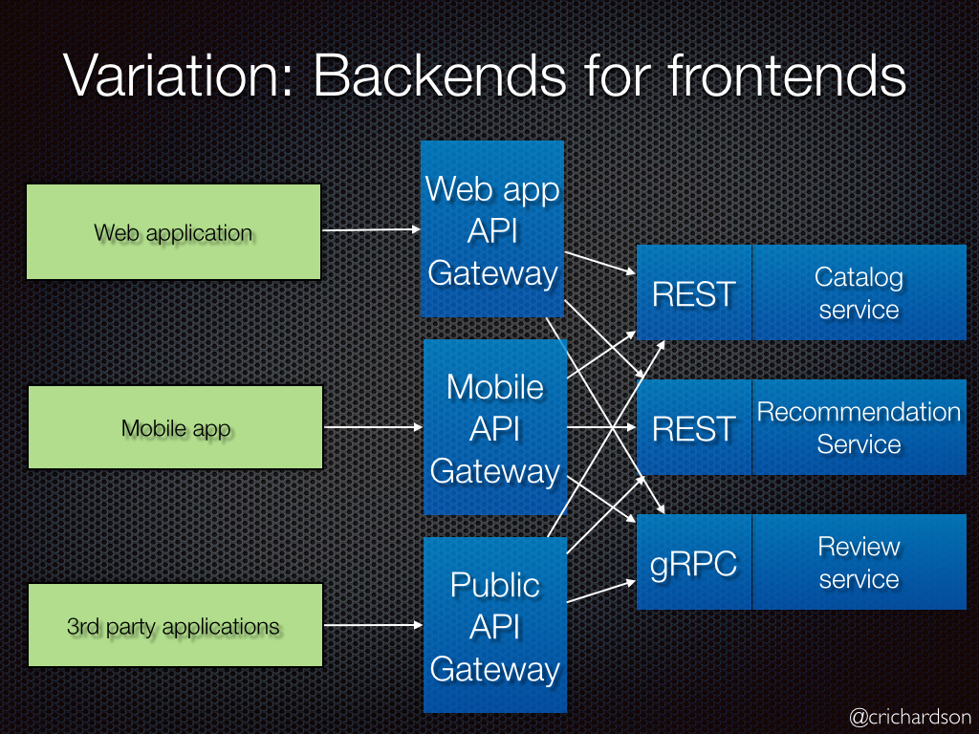
API Gateway example 2

Slide 6
Microservice advantages
Small teams leads to efficient designing and building
Microservices are tailored to best fit the customers’ needs
Relations between microservices can be easily defined to only what is necessary
Microservices can be more efficient by distributing data stores, rather than having centralized database locations
Credential checks between microservices increase security

Slide 7
Microservice disadvantages
Increasing amount of decentralization increases complexity overall
Increased labor maintaining each microservice and associated data stores
Each service requires individual testing
A massive increase of inter-team coordination is required
Securing each microservice takes more time
Disclaimer: Most of these can be solved via automation

Slide 8
Microservice production
In a monolithic application, every development team would have to create their application with the ability to handle higher data and computation loads, and then the application would be redeployed at once.
Using microservices, this reinvents the process
Each team has the ability to recreate their service and deploy it when its ready.
This method allows teams to scale their microservice independently and efficiently

Slide 9
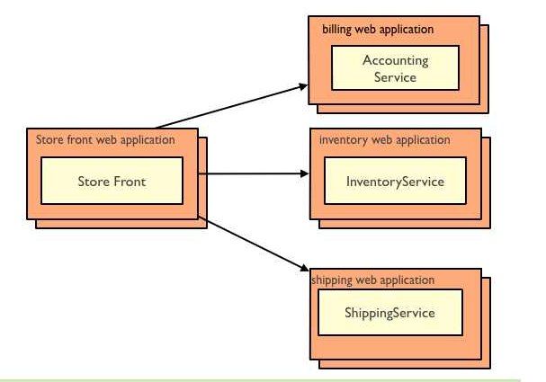
Microservice scaling example
Each application can have copies created and added almost like a deck of cards

Slide 10
References
https://www.mulesoft.com/resources/api/microservices-security
http://microservices.io/patterns/apigateway.html
https://content.bellevue.edu/cst/WEB/WEB420/Week%208/Microservices.pdf
https://cloudacademy.com/blog/microservices-architecture-challenge-advantage-drawback/

