Slide 1
Soap in apis
Robert Sharp

Slide 2
What is an soap? What is an api?
Starting off, we’ll look at what an API is
Application Program Interface
These allow communication for different applications to talk with each other, and to share data
Communication can be accomplished with SOAP:
Simple Object Access Protocol
XML based

Slide 3
Why use soap?
SOAP can be less complex to use than REST, mainly when maintaining complex content
SOAP uses standardized HTTP and requires little modifications
SOAP is extensible to other programs like WS-Security, WS-Coordination and more
One of the most important benefits of SOAP is that it’s highly ACID compliant

Slide 4
Alright, what is ACID?
ACID is an important method for testing web applications
A – Atomicity: this means that all aspects of the action will either pass or fail
C – Consistency: transforming the representation of resources reliably
I – Isolation: Ensuring changes made at the same time do not override each other
D – Durability: Changes and transactions are not reverted if there were to be some sort of failure

Slide 5
More about SOAP
SOAP is made up of 3 parts:
The Envelope
The Body
The response package
We’ll go over the envelope next
After that will be Faults and Fault codes

Slide 6
SOAP envelopes
The envelope acts a lot like a physical envelope does
A SOAP envelope has two requirements: a header and a body
Header: contains handling information like authenticators
Body: contains the encoded request (call) or response
An important point to emphasize is that all SOAP transactions must be constructed using the envelope model

Slide 7
Faults and Fault codes
Many people like SOAP because it has built in error handling capabilities
Fault elements inform you of SOAP message failures; there are 4 of them
<faultcode>: code that id’s the fault
<faultstring>: string value of the error for human readability
<faultactor>: literally, the actor in the code that caused the error
<detail>: app-specific, body-specific error information

Slide 8
Fault Codes
Now we’ll address the specific fault codes
The 4 fault codes must be used within the faultcode element
VersionMismatch: invalid envelope namespace
MustUnderstand: some of the handling info in the header was not understood
Client: the message was formed incorrectly
Server: there was some kind of problem on the server side of things; return to sender

Slide 9
End-to-end Soap message
You want to check on local dogs for sale at the humane society
Your request is put into an envelope in XML
The header has your handling info, and the body says you want to see the dogs
The closed up envelope is sent off
Your message is received
Now, the server you requested data from replies to you, but in the body of that envelope is the page of dogs you wanted to se

Slide 10
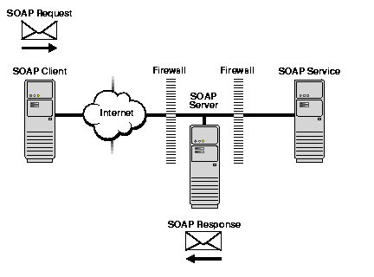
Detailed infographic
Here is a graphical representation of the process retrieved from: https://docs.oracle.com/cd/A97335_02/integrate.102/a90297/overview.htm

Slide 11
references
Stackify. (2017, March 17). SOAP vs. REST: The Differences and Benefits Between the Two Widely-Used Web Service Communication Protocols. Retrieved from https://stackify.com/soap-vs-rest/
Leinecker, R. (2002, December 13). Automatic Web Service Transactions. Retrieved May 20, 2018, from http://www.informit.com/articles/article.aspx?p=30231&seqNum=2
Docs.oracle.com. (2001). Simple Object Access Protocol Overview. [online] Available at: https://docs.oracle.com/cd/A97335_02/integrate.102/a90297/overview.htm [Accessed 20 May 2018].
Quaine, N. (2001). SOAP Basics 3 : SOAP Messages. [online] Soapuser.com. Available at: http://www.soapuser.com/basics3.html [Accessed 20 May 2018].

Slide 12
References cont.
Soapui.org. (n.d.). SOAP vs REST APIs: Which Is Right For You? | SoapUI. [online] Available at: https://www.soapui.org/learn/api/soap-vs-rest-api.html [Accessed 21 May 2018].
W3schools.com. (n.d.). XML Soap. [online] Available at: https://www.w3schools.com/xml/xml_soap.asp [Accessed 20 May 2018].

