Slide 1

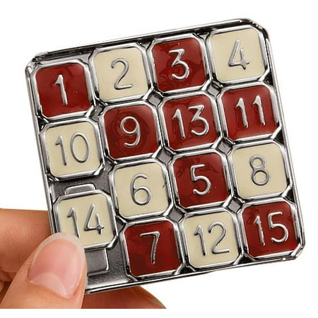
Iterative Deepening A* for the 15-Puzzle
Robert Ward II Graduate Student

Slide 2
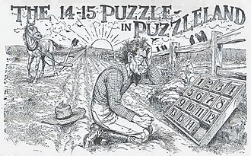
What is the 15 Puzzle?
A sliding puzzle game invented in the 1870s
15 numbered or otherwise ordered tiles on a 4x4 grid
One “free space” that can swap places with adjacent tiles to move the tiles around
Objective: arrange the tiles in order
Is one instance of a larger set of problems called n-puzzle where n is dimensions of the board
Some configurations are unsolvable (parity proof)
Can be solved with Iterative Deepening A star
advertisement from 1914` offering a 1000$ reward for anyone that can solve a (impossible) configuration

Slide 3
What is IDA*and How is it different from A*
Similarities
Differences
Goal-directed Informed search
Always optimal (with admissible heuristic)
Uses heuristics
Has a cost function:f(x) = g(x) + h(x)
f(x): total cost
g(x): path cost
h(x): cost of current node (heuristic)
Expands nodes
Memory usage (A* uses a lot, IDA* not so much)
Search type: A* is best first, IDA* combo of DFS with iterative deepening (expands nodes by increasing depth limit)
Data Structures
A*:Priority Queue
IDA*: Basic Stack
Expands nodes
A*: Selects nodes with lowest cost
IDA*: expands nodes deeper until solution is reached or bound is exceeded,pruning branches of the tree that exceed the current bound

Slide 4
What is an Inversion and how do we know a 15-puzzle is solvable
9 8 10 11 12 14 1 2 3 4 7 6 5 0 13 15
Flatten 2D array into 1D array
Then for any two pairs of numbers (a,b)
If a > b and a comes before b that is said to be and inversion

Slide 5
Checking for solvability (parity proof)
Steps to check solubility of 4x4 or 15-Puzzle
Flatten 2D grid into a 1D array
Check blank tile row index parity
Count inversions
Check inversions parity
In general for an n x n grid:
if (parity(n) == odd && parity(inversion count)== even) then solvable
if parity(n)==even
if parity(row index) == even && parity(inversion count) == odd
then solvable
elif parity(row index) ==odd && parity(inversion count) == even
then solvable
else parity(n) == odd && parity(inversion count) ==even
not solvable
(Woosley1879)
 | Row parity odd | Row parity even
Inversion count even | Solvable | Not Solvable
Inversion count odd | Not Solvable | Solvable

Slide 6
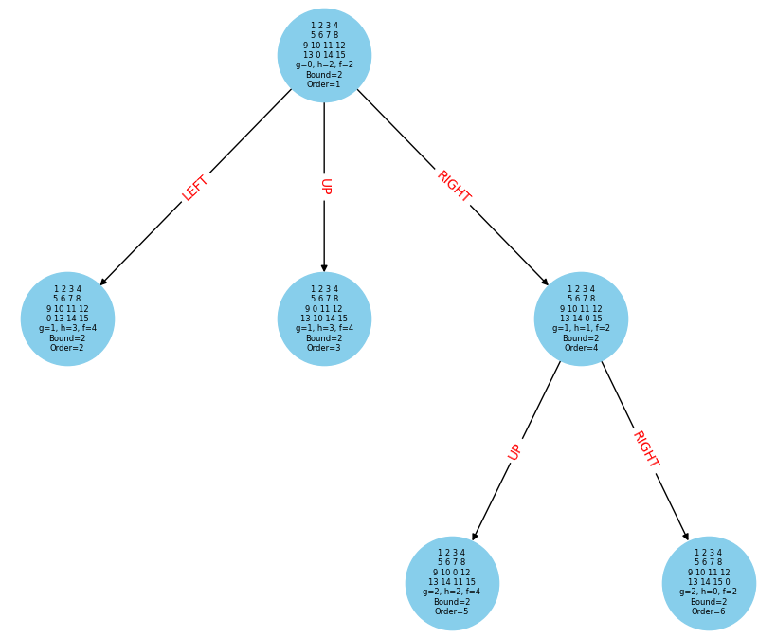

Modeling the 15-puzzle for IDA*
Simple string of numbers to represent flattened 2D array
Represented as array of integers in code
Defined heuristic function, successor function, solution check function

Slide 7
Heuristic function tested:
Manhattan Distance
Manhattan Distance + Linear Conflict
Sum of tiles’ grid displacements
Considers conflicting tiles on rows/columns
Admissible
Consistent
Augments Manhattan distance
Still consistent
Still admissible
Generally better heuristic

Slide 8
Experiment:
Python script to generate 500 random strings of numbers 0 to 15
Checks for solvability before hand
Run C++ implementation of IDA* on each puzzle and records search depth, time taken, and the solution steps, using two different heuristics: manhattan distance (control) manhattan distance + Linear conflict (should improve if only marginally)
Some are really hard and take up to an hour to solve (small chance could be my implementation)
Also could be that it just takes that long for really deep solutions
Time complexity: b/(b-1)* Time Complexity of previous iteration (Korf2001)

Slide 9
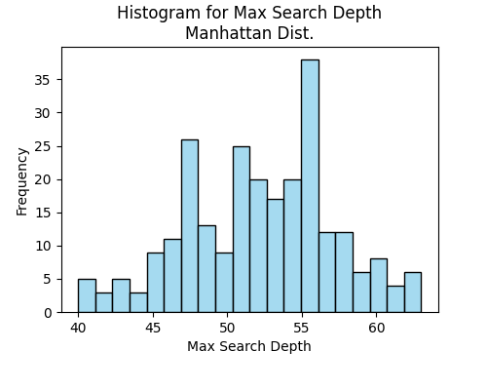
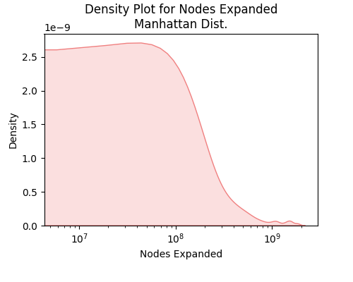
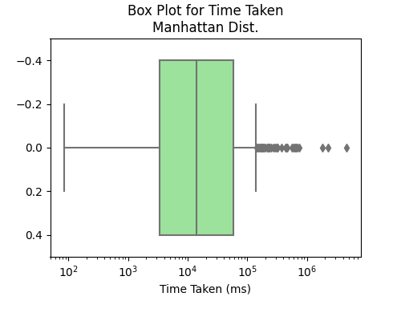
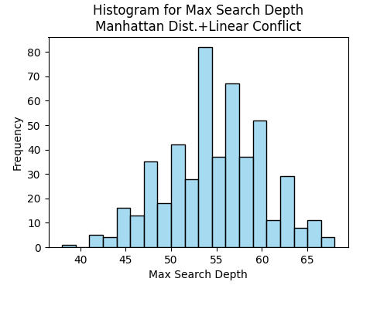
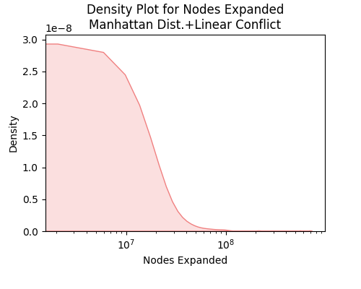
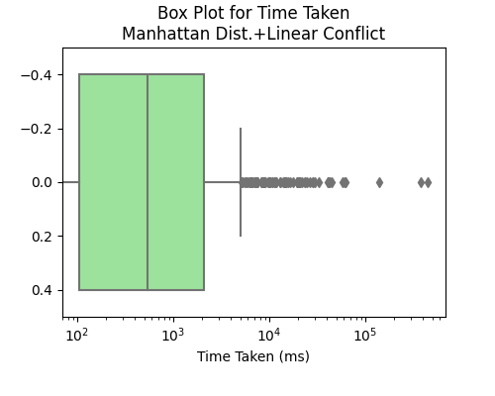
Analysis and results

Slide 10
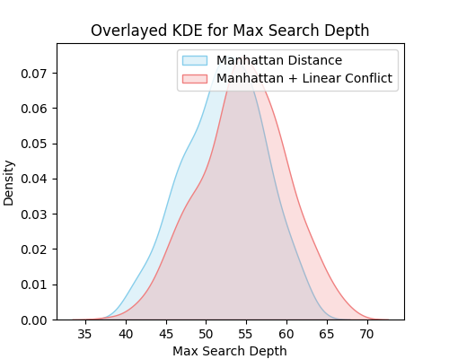
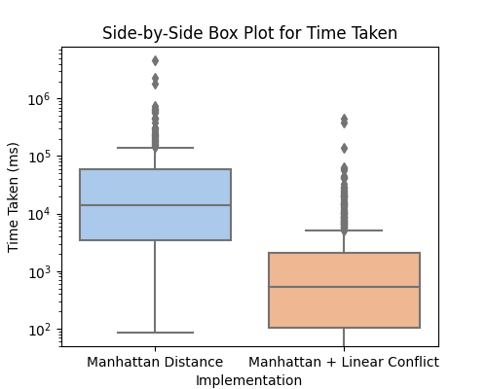
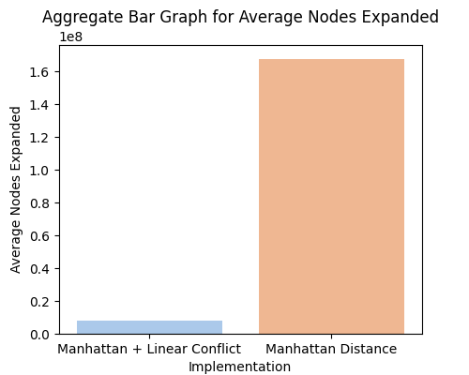
Analysis and results: More charts

Slide 11
References
[1] Wm. Woolsey Johnson and William E. Story.
Notes on the ”15” puzzle.American Journal of Mathematics, 2:397, 12 1879.
[2] Richard E. Korf.Depth-first iterative-deepening:An optimal admissible tree search.Artificial Intelligence, 27:97–109, 9 1985.
[3] Richard E. Korf, Michael Reid, and Stefan Edelkamp. Time complexity of iterative-deepening-a*.Artificial Intelligence, 129:199–218, 6 2001.1
[4] "15 Puzzle." (2023, September 26). Available: https://15puzzle.netlify.app/
[5] Numberphile. Why is this 15-Puzzle Impossible?. (Apr. 21, 2020). Accessed: Sept. 26, 2023. [Online Video]. Available: https://www.youtube.com/watch?v=YI1WqYKHi78

