Slide 1


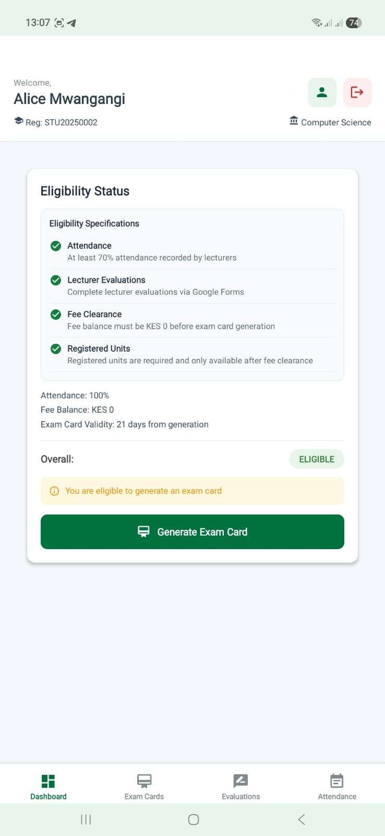
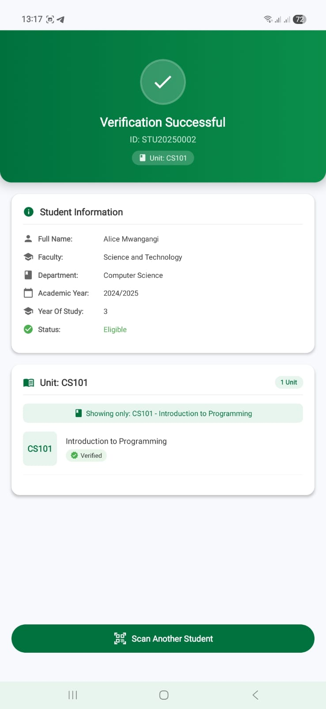
SEKU 2026
Exam Administration Verification System
Secure Digital Exam Card Generation and Real-Time Exam Attendance Verification Platform
Robert Muendo | Daniel Nzioka School of Science and Computing
Supervisor: Prof. Selpher Cheloti
Innovation Challenge Prototype

Slide 2

Problem
Why This Matters
EVAS
The opening case is exam integrity, missing marks, and policy enforcement under pressure.
Current Reality
Core Problem
• Manual exam card checks create congestion at venues
• Attendance records remain paper-heavy and hard to reconcile
• Policy enforcement becomes inconsistent during high-volume sessions
The primary objective is to eliminate or significantly reduce the pervasive problem of missing marks across universities. EVAS also enforces lecturer evaluation as a mandatory eligibility criterion, closing the feedback loop for quality assurance before an exam card is issued.
The Consequence
Missing Marks
• Wasted examination time and tedious card signing process.
• Weak audit trails behind missing-marks disputes
• High post-exam reconciliation workload for staff
Congestion
Compliance Gap
Weak Traceability
SEKU Innovation Challenge 2026
02

Slide 3
Objectives
Project Objectives
EVAS
The prototype proves an end-to-end exam administration workflow, not a standalone scanner.
1
Automate eligibility verification
Unique Value Proposition
EVAS is not just a barcode scan-and-check tool. It unifies who is allowed to sit an exam, how the student proves eligibility, how the invigilator confirms access, and how the institution produces auditable records afterward.
2
Generate secure digital exam cards
3
Streamline invigilator workflow
• Mandatory lecturer evaluation completion before exam card generation
• Session-aware invigilator verification tied to the active unit
• Digital attendance evidence that reduces missing-marks disputes
4
Generate formal PDF attendance reports
SEKU Innovation Challenge 2026
03

Slide 4
Architecture
Users and System Architecture
EVAS
The platform serves students, invigilators, examinations administrators, and institutional support offices.
Students
View eligibility, complete evaluations, generate exam card
Student App
MongoDB
Invigilators
Scan and verify students, record digital attendance
Node.js + Express API
Examinations Office
Access auditable attendance and PDF reports
Invigilator App
PDF Engine + Reports
ICT Directorate
Manage deployment, security, and maintenance
Finance Office
Enforce fee-clearance rules consistently
SEKU Innovation Challenge 2026
04

Slide 5
Workflow
Student Workflow
EVAS
Exam access is earned through policy compliance before exam day arrives.
1
2
3
4
5
Login
Dashboard
Evaluations
Attendance
Exam Card
Secure student authentication
Real-time eligibility overview
Mandatory lecturer feedback per unit
Weekly class participation record
Generate secure digital card when eligible
The workflow removes manual discretion at the venue and replaces it with rule-based eligibility.
SEKU Innovation Challenge 2026
05

Slide 6
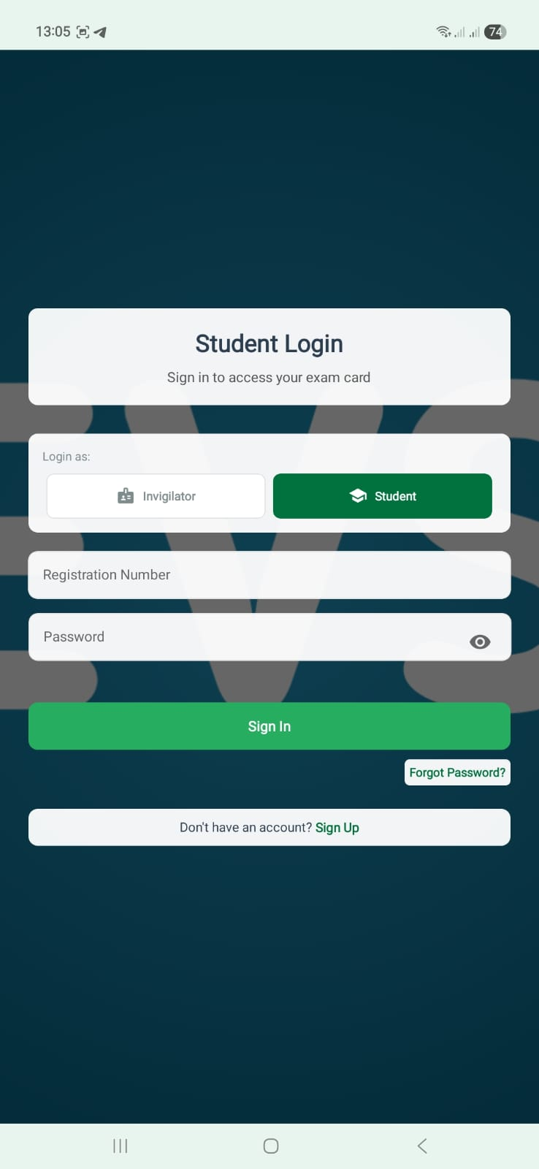
Student Module
Demo: Student Login
EVAS
Students authenticate into the academic compliance workflow from a dedicated interface.
What this slide shows
• Role separation keeps student access distinct from the invigilator interface
• Students sign in using their registered credentials before any protected action
• The login screen is the controlled entry point to eligibility, evaluations, and exam-card services
Secure authentication gates access to the rest of the student module
SEKU Innovation Challenge 2026
06

Slide 7
Student Module
Demo: Eligibility Dashboard
EVAS
The dashboard gives the student an instant explanation of whether exam-card generation is allowed.
What this slide shows
• Attendance, fee balance, evaluations, and unit registration are summarized in one place
• The interface makes it clear whether the student is eligible or which rule is still blocking them
• This reduces confusion and removes guesswork before the examination period
The dashboard becomes the student’s single source of eligibility truth
SEKU Innovation Challenge 2026
07

Slide 8
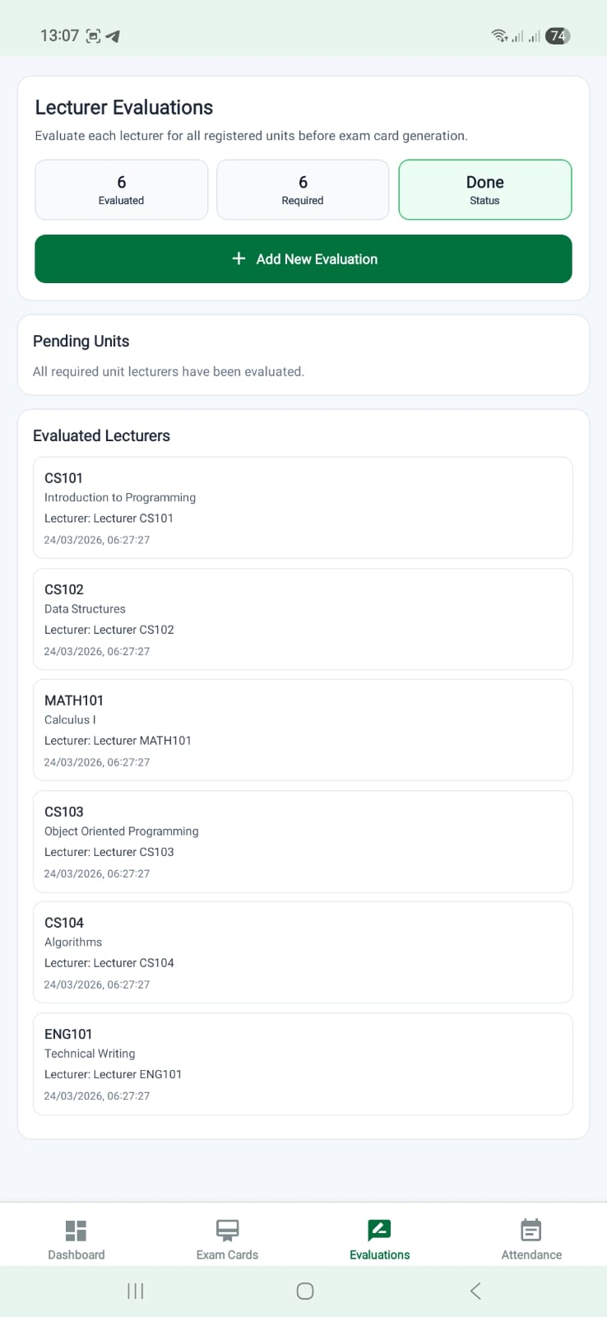
Student Module
Demo: Lecturer Evaluations Dashboard
EVAS
Evaluation tracking is tied directly to the student’s registered units.
What this slide shows
• The page shows required evaluations and completed evaluations per student
• Students can see which units still need feedback before exam-card generation becomes available
• The workflow adapts when units are not yet registered, preventing false completion states
Evaluation progress is visible before the student submits each lecturer form
SEKU Innovation Challenge 2026
08

Slide 9
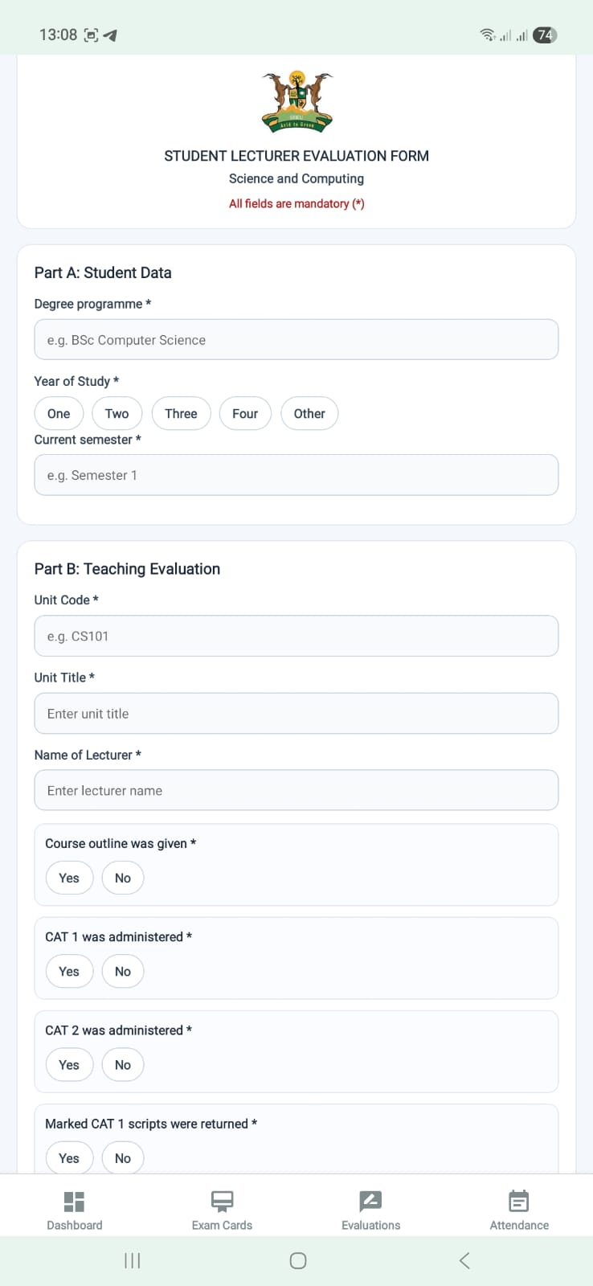
Student Module
Demo: Lecturer Evaluation Form
EVAS
Each lecturer is evaluated through a structured, mandatory form for the active unit.
What this slide shows
• Every field is required so the evaluation is complete and auditable
• The form operates one lecturer and one unit at a time to avoid mixed responses
• After submission, the state resets so the next lecturer evaluation starts cleanly
Per-unit lecturer feedback is captured in a controlled submission flow
SEKU Innovation Challenge 2026
09

Slide 10
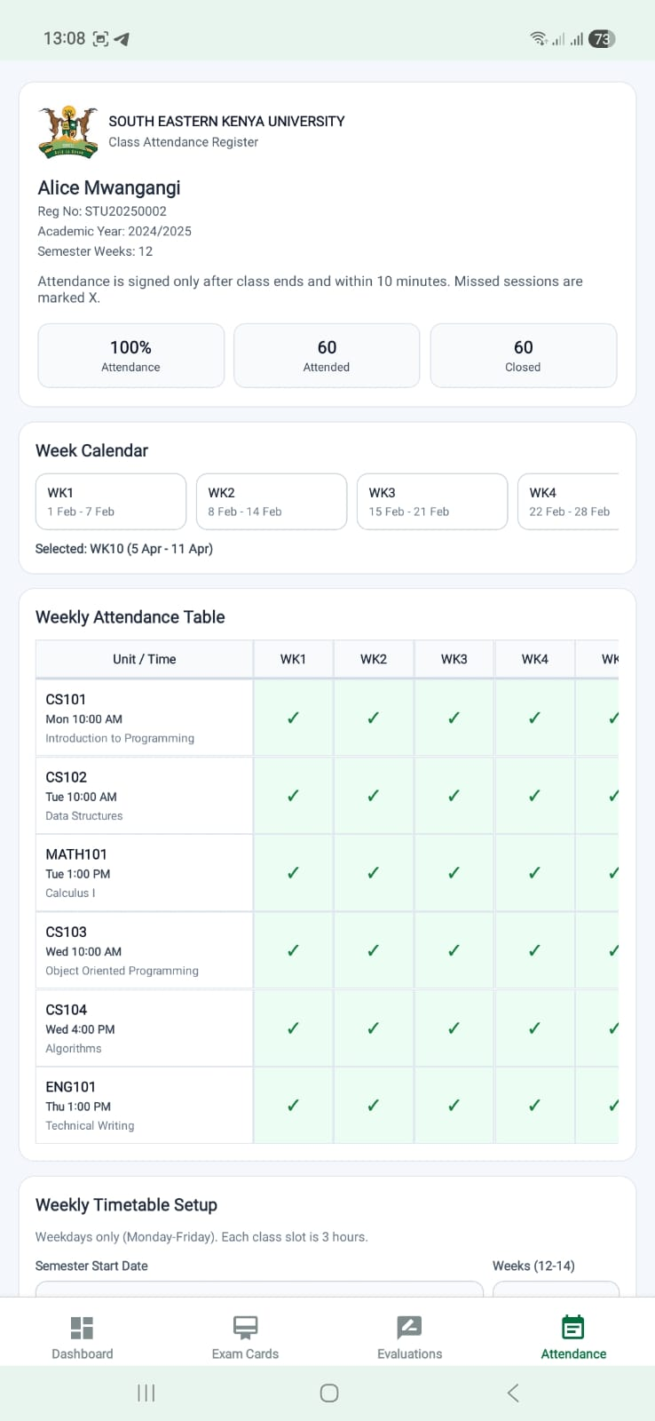
Student Module
Demo: Attendance Register
EVAS
Attendance is recorded against scheduled classes and converted into a visible weekly matrix.
What this slide shows
• Students sign only when the valid class session window has opened
• Missed sessions are marked explicitly, improving transparency for attendance percentages
• The stored record supports the 70% attendance rule used during exam-card eligibility checks
Weekly class attendance feeds directly into exam eligibility enforcement
SEKU Innovation Challenge 2026
10

Slide 11
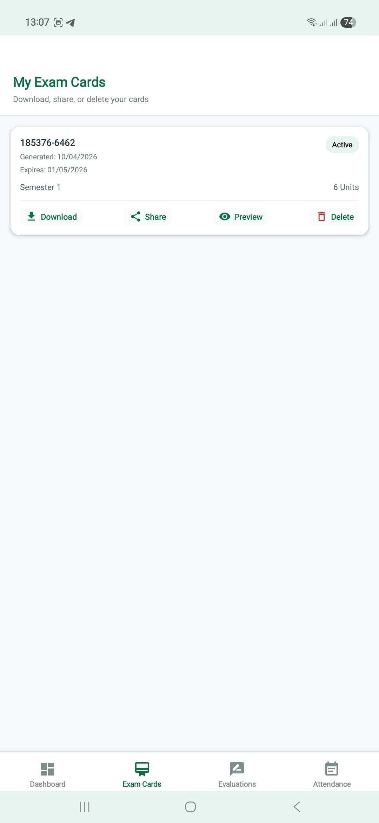
Student Module
Demo: Exam Cards List
EVAS
Generated cards are managed from a dedicated tab rather than being mixed into the main dashboard.
What this slide shows
• Students can review their active card records without leaving the app
• The page supports refresh and lifecycle actions after a card has been generated
• Keeping cards in a dedicated tab improves clarity during demonstrations and real use
Card management is isolated into a focused exam-card workspace
SEKU Innovation Challenge 2026
11

Slide 12
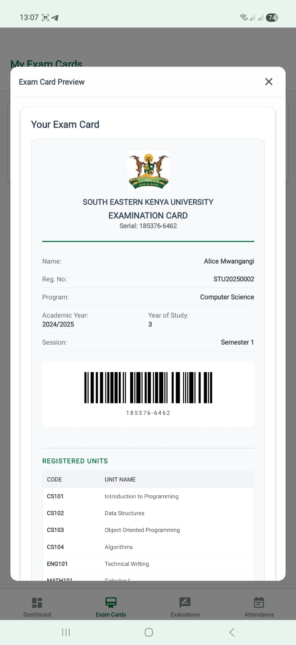
Student Module
Demo: Exam Card Preview
EVAS
Students can inspect the generated card visually before exporting or sharing it.
What this slide shows
• The preview confirms that barcode, serial number, and student identity details are correct
• It supports in-app confidence checks before the document is printed or shared externally
• This reduces mistakes during the final step of preparing for examinations
Preview reduces rework before the student distributes the exam card
SEKU Innovation Challenge 2026
12

Slide 13
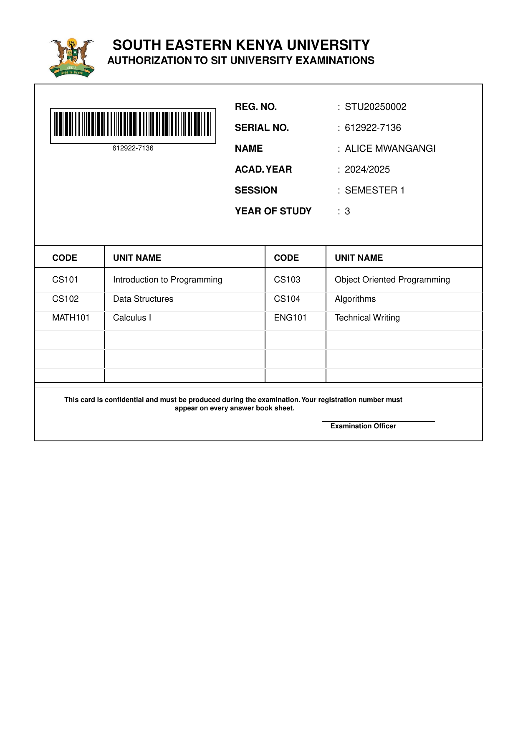
Student Module
Demo: Printable Exam Card PDF
EVAS
The final exam card output is formatted as a formal printable document for verification at the venue.
What this slide shows
• The PDF carries university branding, barcode-based verification, and student details
• Registered units are embedded directly into the printable output for exam-day reference
• The document is suitable for download, printing, and subsequent scanning by invigilators
The PDF is the formal exam-day artifact used at the venue
SEKU Innovation Challenge 2026
13

Slide 14
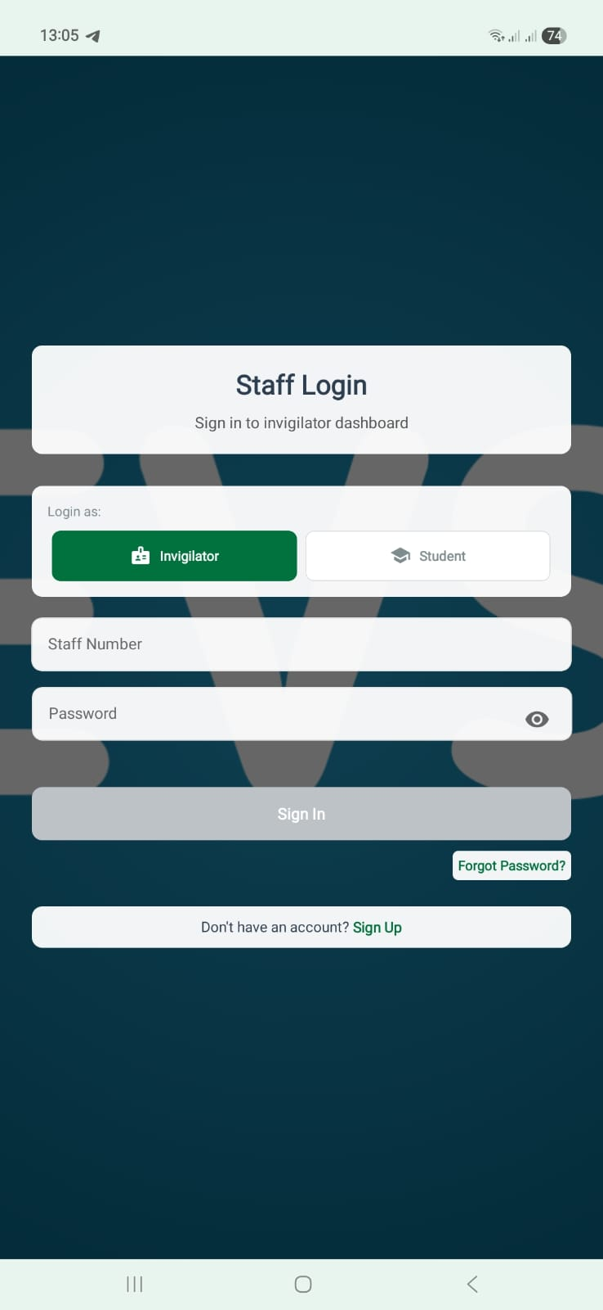
Invigilator Module
Demo: Invigilator Login
EVAS
Staff access is separated from student access to protect the verification workflow.
What this slide shows
• Invigilators authenticate into a dedicated examination interface
• The separation reduces accidental crossover into student-only actions
• It also provides a cleaner audit trail around who performed verification activities
The invigilator module starts from its own protected login flow
SEKU Innovation Challenge 2026
14

Slide 15
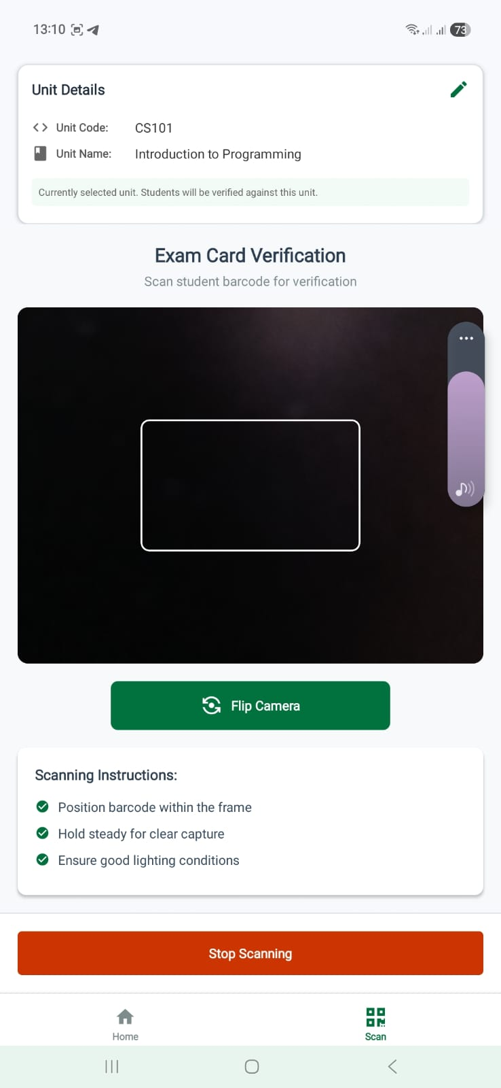
Invigilator Module
Demo: Verification Scan Screen
EVAS
Before scanning, the invigilator selects the current examination unit and then captures the student card.
What this slide shows
• Verification is session-aware because the scan is tied to the active unit
• This avoids approving a student for the wrong paper even if the card is valid generally
• The interface is optimized for fast repetitive use during exam entry
Unit-aware scanning is the core of the invigilator workflow
SEKU Innovation Challenge 2026
15

Slide 16
Invigilator Module
Demo: Verification Result
EVAS
The result screen gives an immediate decision together with the student and unit context.
What this slide shows
• The invigilator can confirm identity, eligibility status, and unit registration instantly
• Successful scans transition directly into attendance capture for that exam session
• This produces a time-stamped digital trail instead of a purely paper-based signature process
Instant verification reduces tedious exam card signing and improves confidence at the venue
SEKU Innovation Challenge 2026
16

Slide 17
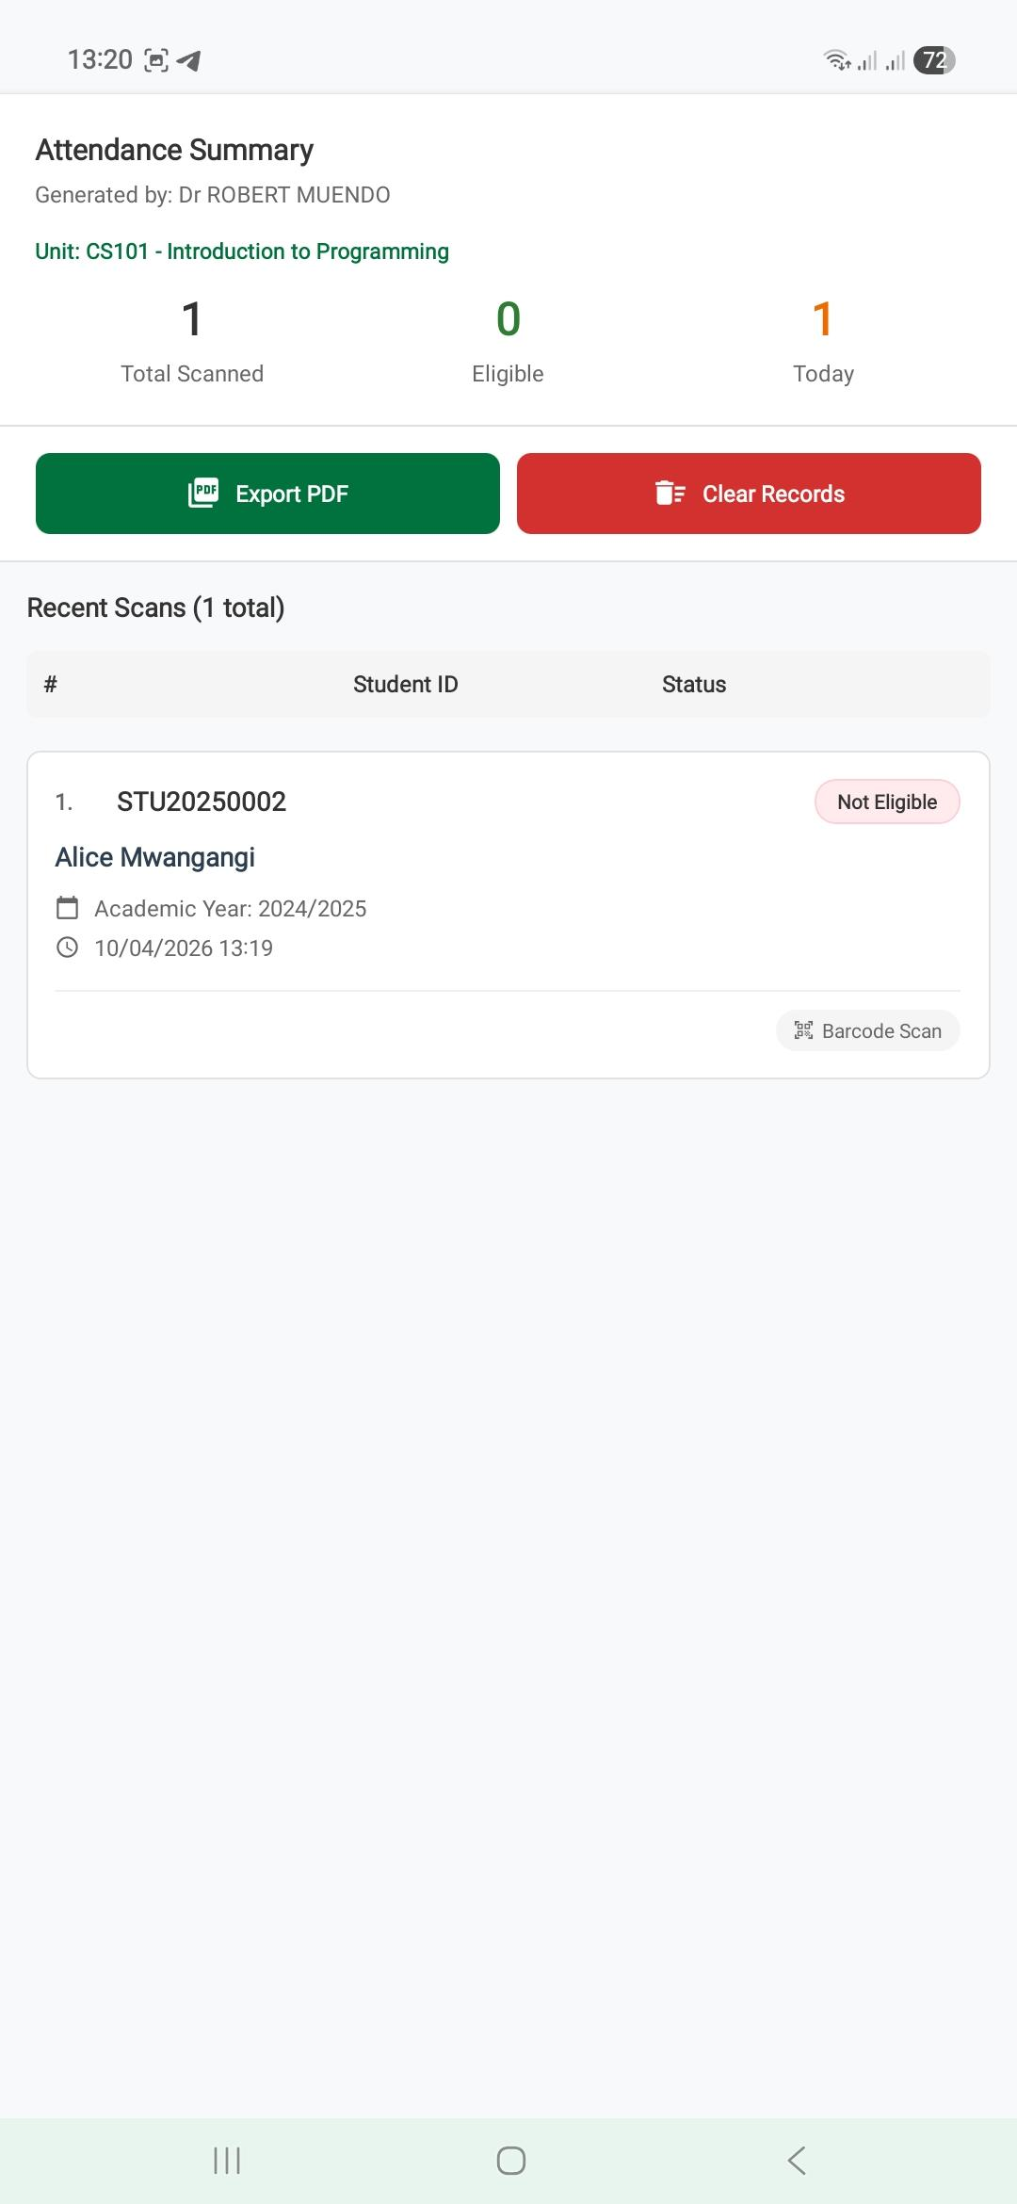
Invigilator Module
Demo: Reports Dashboard
EVAS
The reports page summarizes attendance outcomes and prepares the session for formal export.
What this slide shows
• Verified counts, eligibility outcomes, and session records are visible in one place
• The page helps invigilators confirm what happened before generating the final report
• This removes much of the manual post-exam reconciliation workload
Report preparation happens immediately after the scanning session
SEKU Innovation Challenge 2026
17

Slide 18
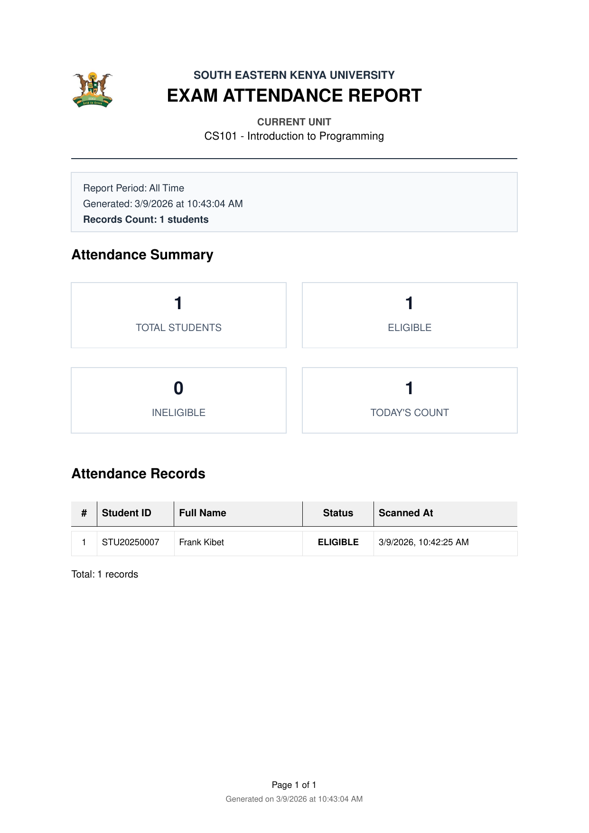
Invigilator Module
Demo: Attendance Report PDF
EVAS
Attendance evidence is exported as a formal PDF for office use and audit purposes.
What this slide shows
• The report captures institutional branding, active unit context, counts, and timestamped records
• It provides a shareable official output for the examinations office and related stakeholders
• This directly addresses weak traceability behind missing-marks disputes
The attendance PDF becomes the formal audit artifact after verification
SEKU Innovation Challenge 2026
18

Slide 19
Readiness
Security and Reliability
EVAS
The prototype includes concrete controls that make it more credible for pilot deployment.
Route Protection
Rate Limiting
Input Validation
Authenticated access for students, invigilators, and admins
Reduces brute-force attempts and abuse on sensitive endpoints
Rejects malformed payloads before business logic runs
Secure Sessions
Structured Logs
Smoke Tests
Improved token handling and refresh flows on mobile
Operational traceability for failures and verification activity
Core backend endpoints tested across auth, cards, attendance, and reports
SEKU Innovation Challenge 2026
19

Slide 20
Impact
Before vs After EVAS
EVAS
The value is operational, academic, and administrative.
Before EVAS
After EVAS
• Slow manual verification at exam venues
• Paper attendance sheets prone to disputes
• Weak enforcement of lecturer evaluations
• High reconciliation workload after exams
• Limited institutional audit trail
• Faster digital scanning and session-aware validation
• Timestamped digital attendance records
• Mandatory evaluation completion before card generation
• Instant PDF report generation for office use
• Improved traceability and missing-marks prevention
Transforming examination administration from a paper burden to a digital asset
SEKU Innovation Challenge 2026
20

Slide 21

Conclusion
EVAS unifies eligibility, secure exam cards, invigilator verification, and auditable reporting into one mobile ecosystem that can be piloted at SEKU and adapted across universities.
Thank you • Questions and discussion
EVAS printable exam card
SEKU Innovation Challenge 2026
21

