Slide 1
EVAS
Exam Administration Verification System
SEKU Innovation Challenge 2026

Slide 2
Problem
Manual verification
Congestion
Missing marks
Weak tracking

Slide 3
Solution (EVAS)
QR Exam Cards
Real-time scanning
Automated eligibility
Digital reports

Slide 4
System Architecture
React Native App
Node.js API
MongoDB
PDF Reports

Slide 5
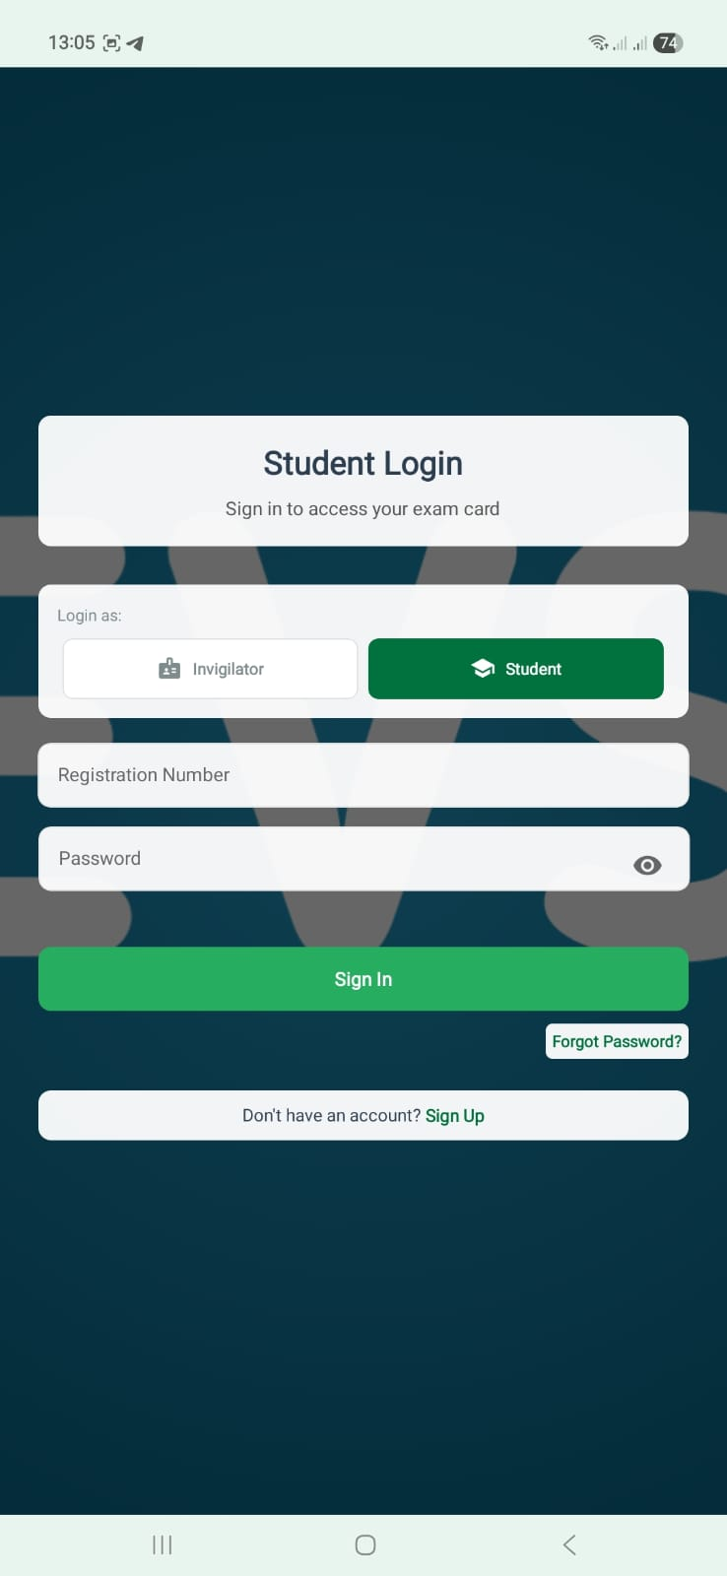
Student Login Screen

Slide 6
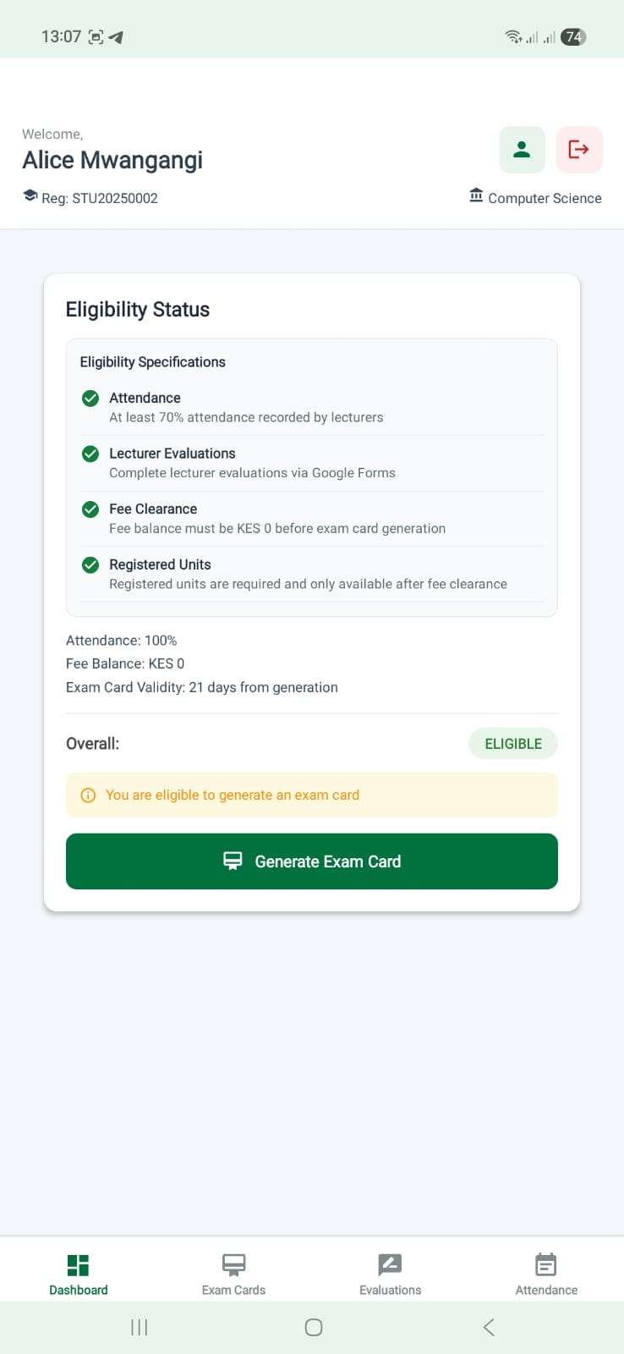
Staff Login Screen

Slide 7
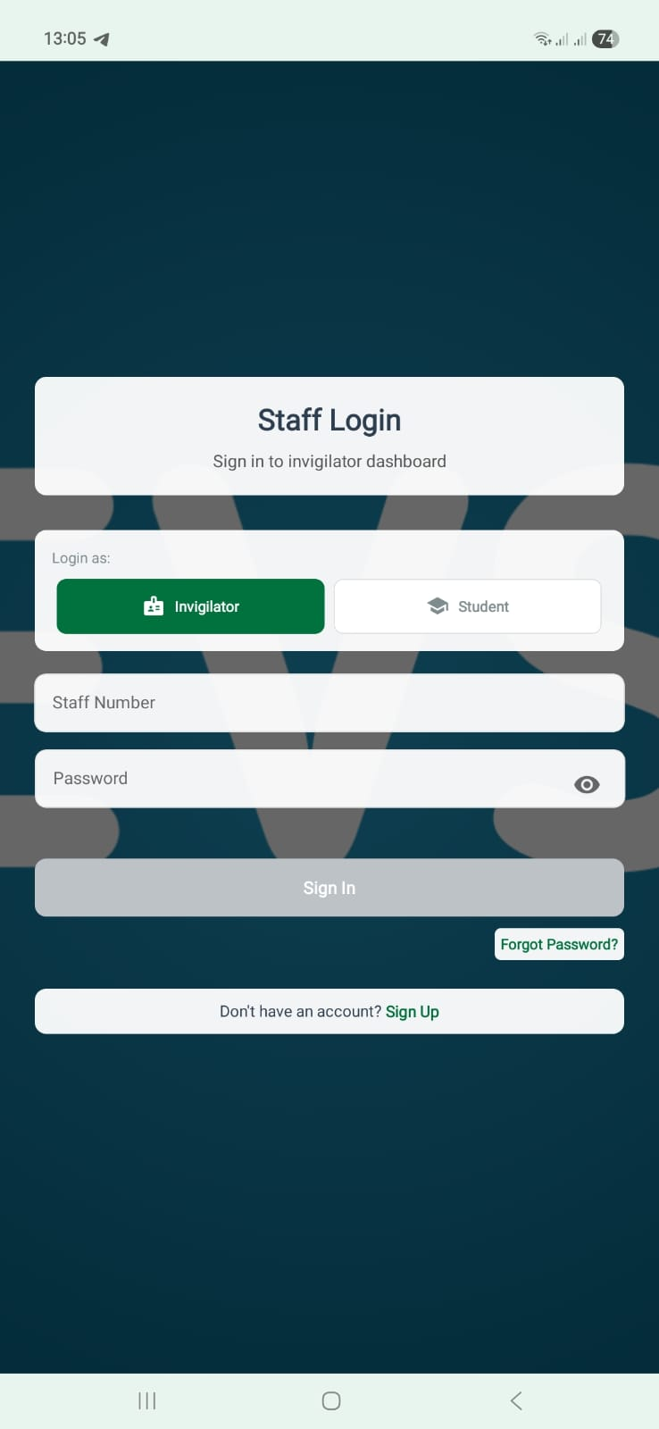
Student Dashboard & Eligibility

Slide 8
Exam Card (Placeholder)
[Insert Exam Card Screenshot Here]

Slide 9
QR Scan (Placeholder)
[Insert Scan Screen Screenshot Here]

Slide 10
Reports (Placeholder)
[Insert Report PDF Screenshot Here]

Slide 11
Impact
Faster exams
No missing marks
Better compliance
Reduced workload

