Slide 1
End-Year Project Presentation
Computer Science Department
Kenya Road Accident Analytics & Risk Prediction System
Kevin Otieno - COM/044/21
Robert Owuor - COM/025/22
Suleiman Owiyo - COM/070/22
Kipchumba Bethuel - COM/008/22
1

Slide 2
1. Problem Statement
Why the project matters
Kenyas road safety management remains largely reactive instead of predictive and evidence-driven.
NTSA collects rich accident data, but there is no integrated analytics and prediction system that turns records into actionable intelligence.
The raw dataset has quality issues such as county name variants, ambiguous victim labels, mixed formats, and unknown cause codes.
This project addresses the gap by combining database storage, data cleaning, machine learning, and dashboard reporting.
2

Slide 3
2. Aim, Objectives and Scope
Project direction
Aim:
design and implement a road accident analytics and risk prediction system for Kenya.
Objectives
1. To collect, clean, and store NTSA road accident records in a structured relational database using PostgreSQL and Python.
2. To analyze the accident data and identify patterns by county, road, time of day, cause, victim type, gender, and age group.
3. To build machine learning models that predict accident fatality and victim count using Scikit-learn.
4. To classify Kenyan counties into meaningful road risk tiers using unsupervised learning through K-Means clustering.
5. To develop an interactive Power BI dashboard that presents key road safety insights using charts, KPIs, maps, and filters.
6. To generate evidence-based recommendations for NTSA and county governments based on the findings from the data analysis and predictive models.
Scope
covered 1,119 NTSA June 2016 records across 42 counties, structured in PostgreSQL and analysed in Python. Outputs included ten EDA charts, five machine learning models, county risk clustering, and a five-page Power BI dashboard.
3

Slide 4
3. Data and System Architecture
Dataset and database foundation
Source data: 1,119 accident records from NTSA/Kenya Open Data covering June 2016.
Two-table PostgreSQL design was used: accidents_raw preserved the source while accidents_clean stored engineered fields.
Key features include county, road, cause code, victim type, age, gender, time, time of day, fatality status, and victim count.
The architecture supports traceability, reproducibility, and future extension to multi-year data.
4

Slide 5
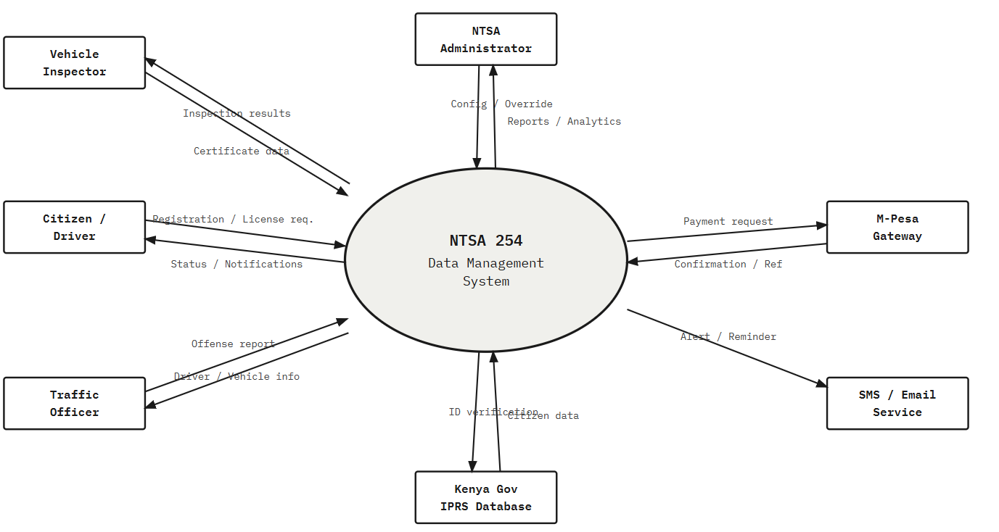
4. System Design Diagrams I
Architecture and data flow
Data Flow Diagram - Level 0
5

Slide 6
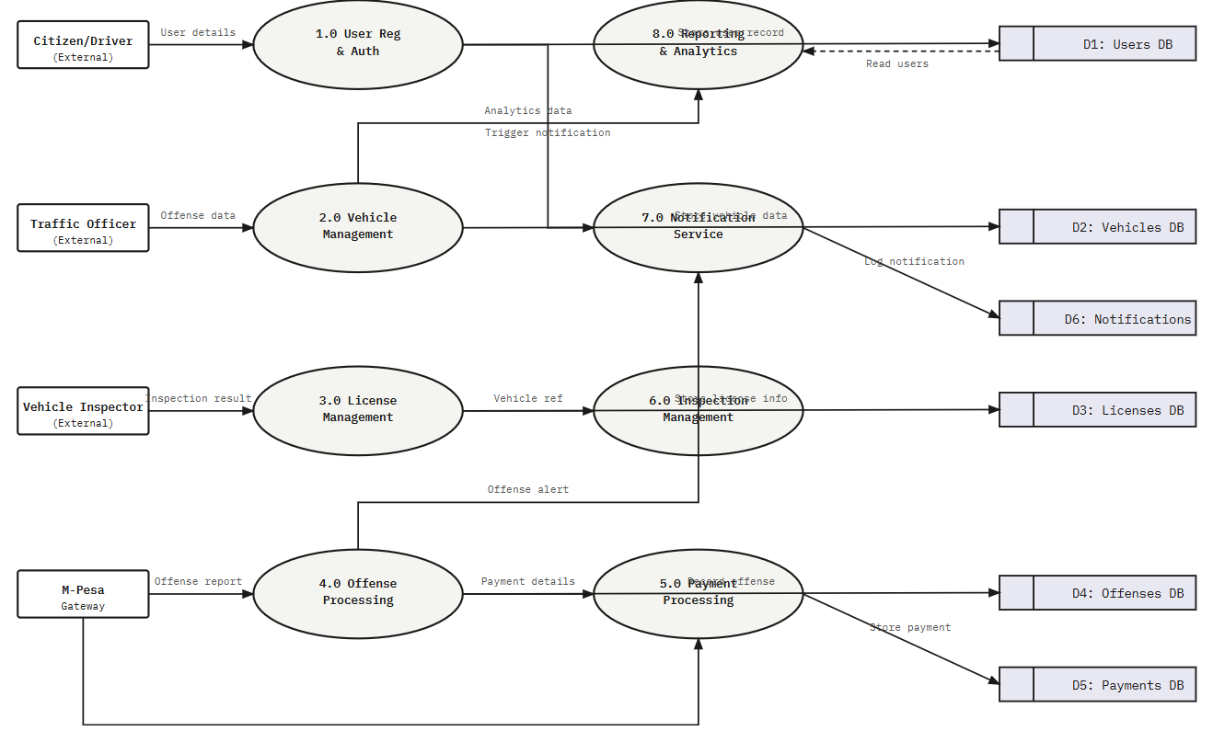
5. System Design Diagrams II
Detailed process and data model
Data Flow Diagram - Level 1
6

Slide 7
6. Methodology
Seven-phase pipeline from the report
Phase 1
Phase 2
Phase 3
Phase 4
Phase 5
Phase 6
Phase 7
Setup & Planning
Data Loading
Data Cleaning
EDA
Machine Learning
Dashboard
Reporting
The report describes a seven-phase pipeline methodology mapped to dedicated notebooks and validated deliverables.
It is iterative and data-centric: EDA findings feed back into cleaning and modelling choices are based on empirical validation.
This recreated methodology diagram is based directly on the documented process in the report.
7

Slide 8
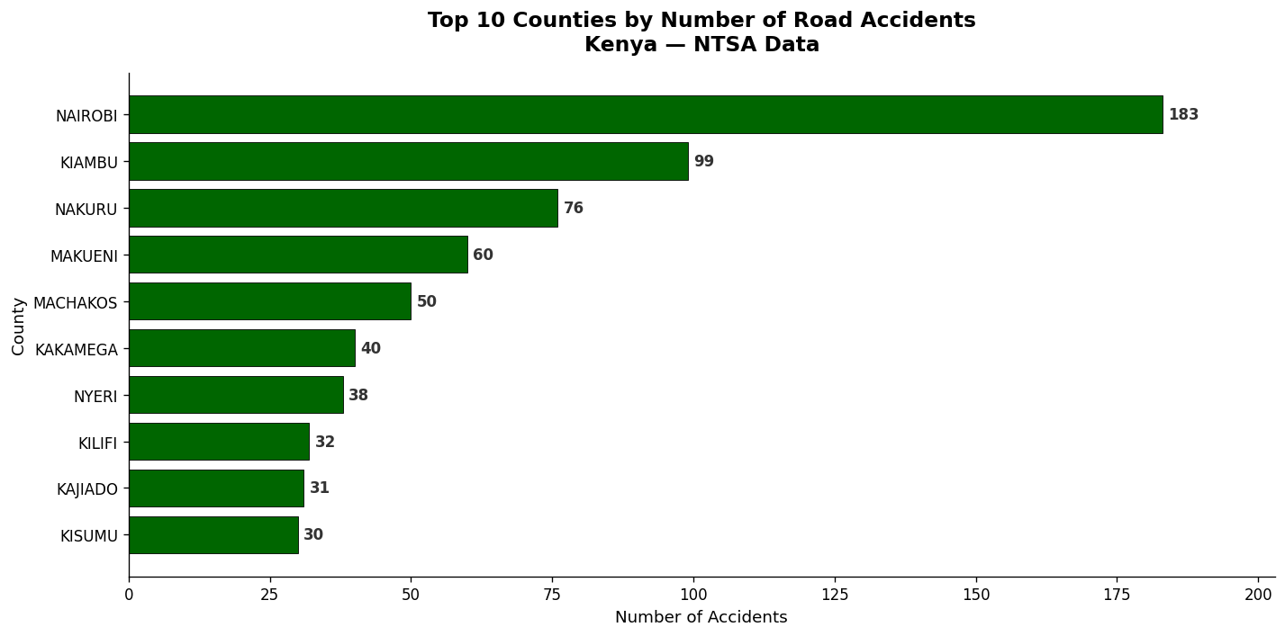
7. Key EDA Findings
Where, when, causes, and victims
Nairobi had the most accidents: 183 records (16.4% of all accidents).
The top 5 counties contributed 41.8% of all accidents.
Evening hours were the most dangerous period.
Careless driving and speeding were the leading identifiable causes, while pedestrians were the largest victim group.
8

Slide 9
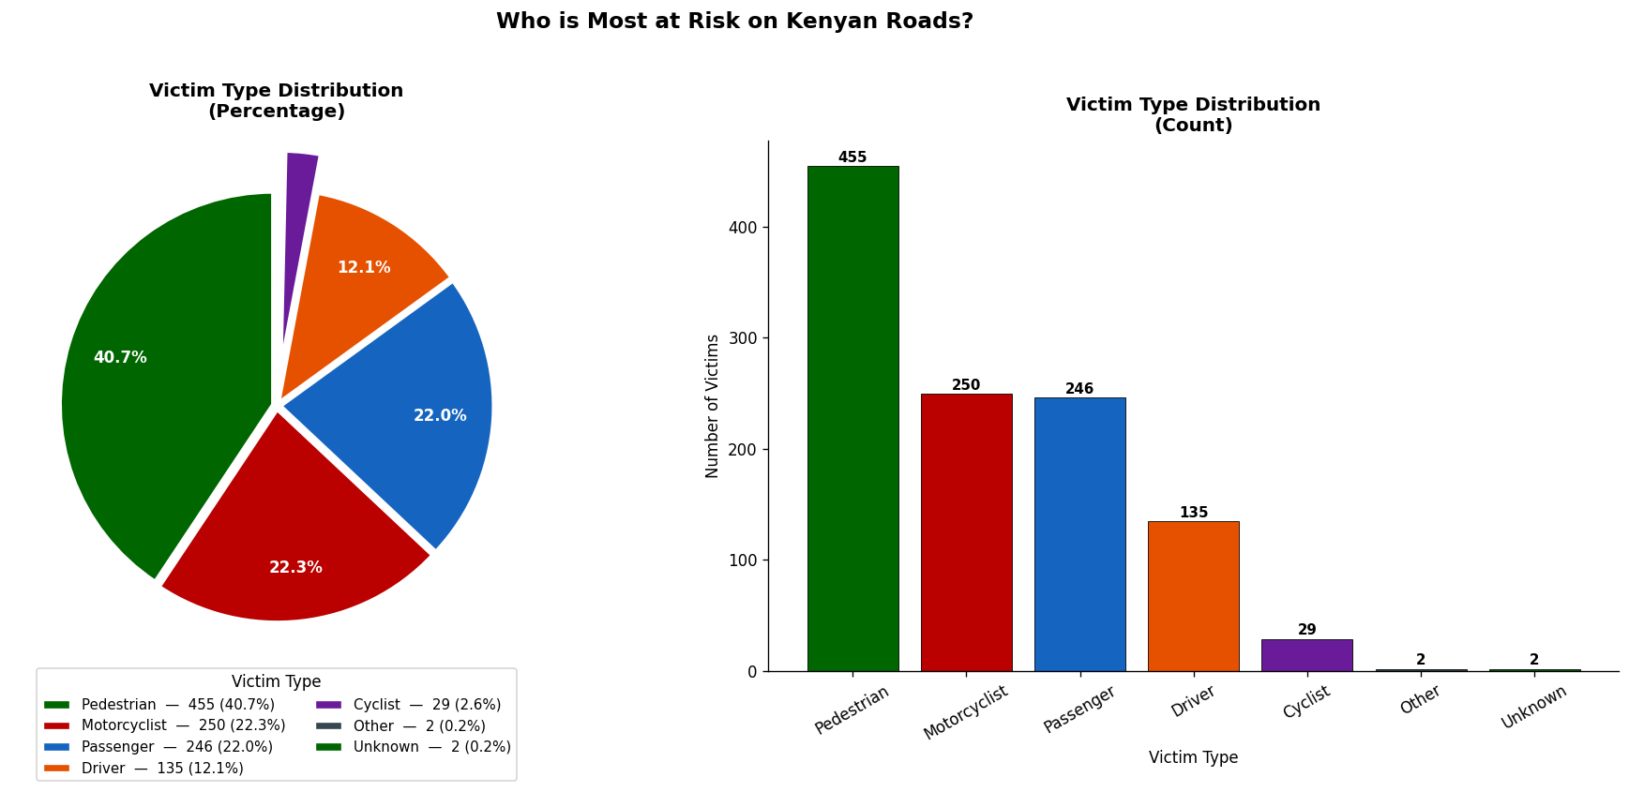

Slide 10
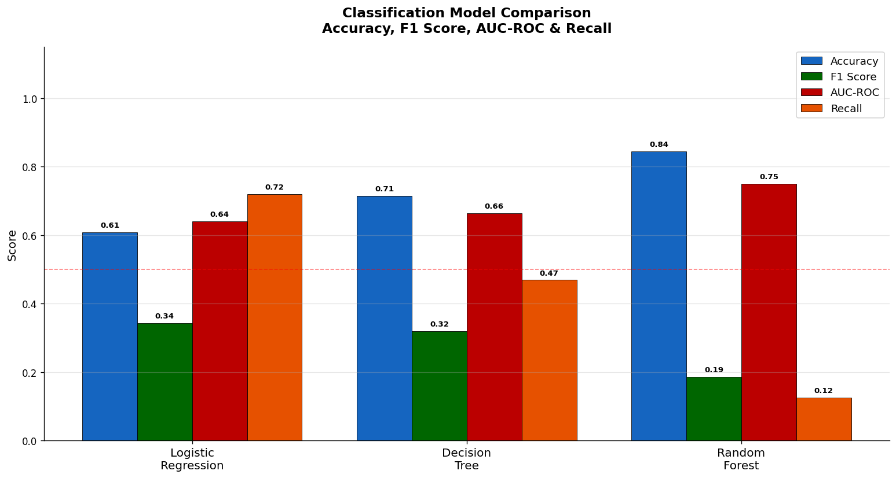
8. Machine Learning Results
Predictive modelling performance
Five models were developed: Linear Regression, Logistic Regression, Decision Tree, Random Forest, and K-Means Clustering.
Random Forest achieved the best AUC-ROC score: 0.749.
Logistic Regression achieved the highest recall: 0.719 for early warning use.
K-Means grouped counties into risk tiers for targeted interventions.
9

Slide 11
9. How the Models Were Used
Simple explanation for presentation
Linear Regression
Logistic Regression
Decision Tree
Used to predict the number of victims in an accident as a regression task.
Used as a baseline classification model to predict whether an accident would be fatal or non-fatal.
Used to classify fatality outcomes with a model that is easy to interpret and visualize.
Finding: it performed poorly because most accidents had only one victim, so there was very little variation to learn.
Finding: it produced the highest recall (0.719), meaning it identified the largest share of fatal accidents.
Finding: it captured useful rules from the data, but it was less stable and less accurate than the stronger ensemble model.
Why these 3 matter
They provided baseline regression, baseline classification, and interpretable rule-based classification.
Together they helped compare simple models before moving to the best-performing advanced models.
10

Slide 12
10. Advanced Models and Findings
Best model and clustering insight
Random Forest
K-Means Clustering
Feature insight
Used as the main ensemble classifier for predicting accident fatality from multiple features.
Used as an unsupervised model to group counties into similar risk levels based on accident patterns.
Random Forest also helped show which variables contributed most to fatality prediction.
Finding: it achieved the best AUC-ROC score of 0.749, making it the strongest overall model in the project.
Finding: it classified 42 counties into 3 tiers and identified 7 counties as High Risk.
Finding: cause code and hour of day were among the most predictive features, showing that why and when an accident happens matters a lot.
Presentation takeaway
Use Logistic Regression when recall is the priority, and Random Forest when overall classification strength is the priority.
K-Means is useful for planning because it helps authorities know where to focus limited resources.
11

Slide 13
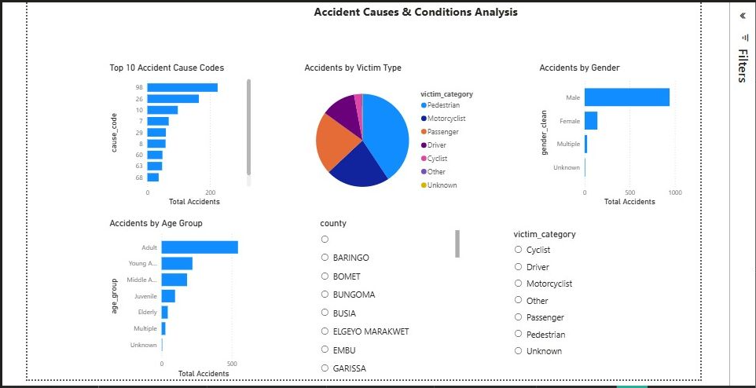
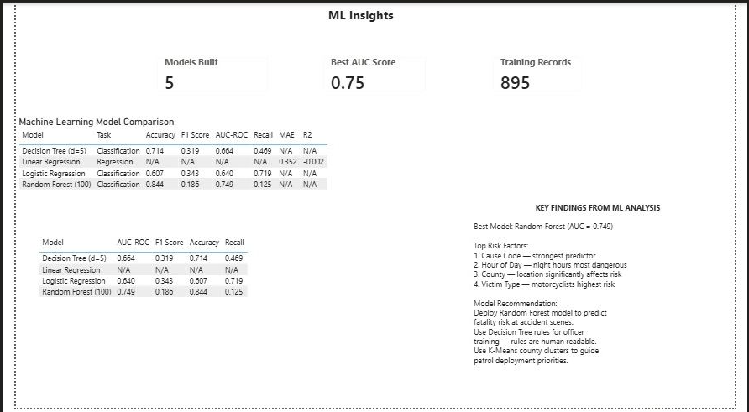
11. Dashboard and Deployment Outputs
Screens from the documented deliverables
Dashboard Page
ML Insights Page
12

Slide 14
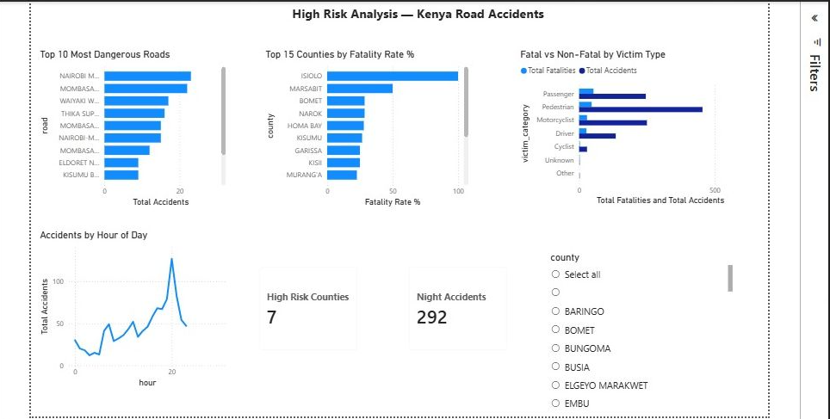
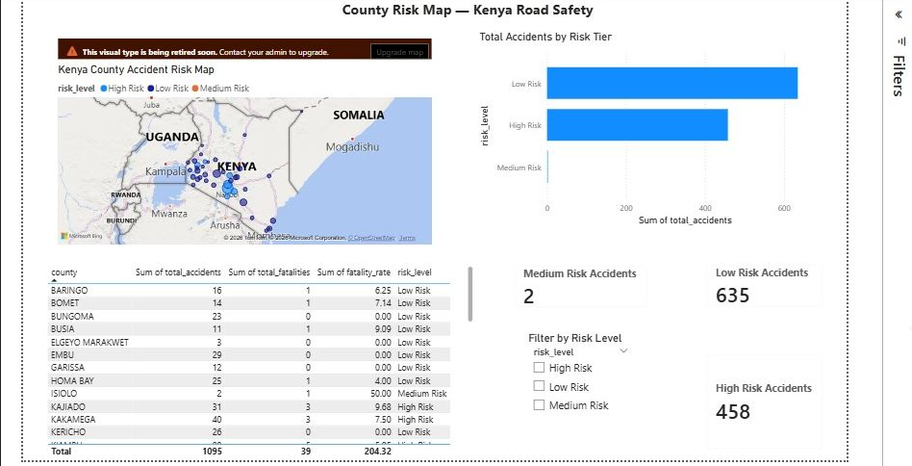
12. High Risk Analysis and County Map
Operational decision-support views
High Risk Analysis
County Risk Map
13

Slide 15
13. Recommendations and Conclusion
Evidence-based actions and final message
Recommendations
Conclusion
Deploy targeted traffic enforcement on major corridors during evening and night hours.
Prioritise careless driving and speeding enforcement because they are the largest actionable cause categories.
Improve pedestrian safety infrastructure on dangerous urban roads through crossings, walkways, and footbridges.
Use the models and dashboard to guide county-level resource allocation, especially in the seven High Risk counties.
The project transformed raw NTSA records into a complete analytics, prediction, and visualization system.
It delivered a cleaned database, EDA outputs, five ML models, county risk clustering, and a Power BI dashboard.
With larger multi-year data and richer features such as weather, speed, and GPS, the system can become even more powerful for national deployment.
14

